Slide 1
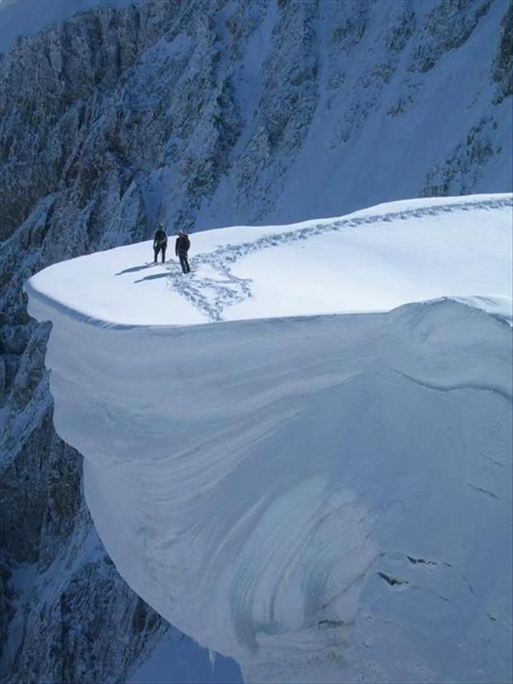
Workplace Exam
New Rule
Effective Date
October 2, 2017

Slide 2
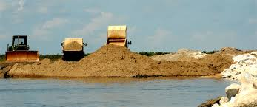
MSHA has determined that examinations of working places are an important part of an effective accident prevention strategy; they are a first line of defense because they allow operators to find and fix conditions before such conditions can adversely affect the safety or health of miners.

Slide 3
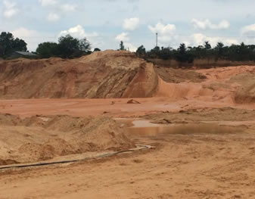
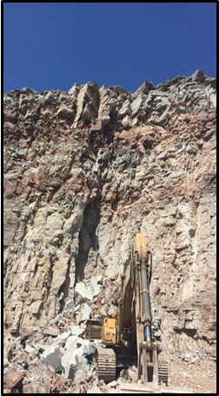
Stats
Double Fatality
Fatality
During a 5 year period (2010-2015), 122 miners were killed in 110 accidents at MNM mines.
For 16 of these, mine operators were issued citations for unwarrantable failure to comply under Section 104(d) of the Mine Act.

Slide 4
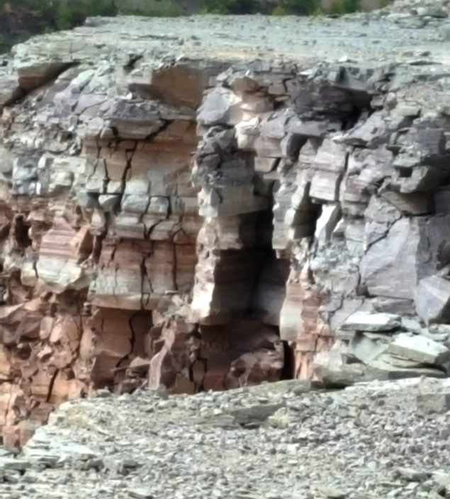
Unwarrantable failure
Unwarrantable failure violations involve serious conditions that the operator should have known about.

Slide 5
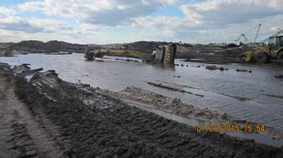
Fatality
These accidents indicate that miners would benefit from timely and rigorous work place examinations and better communication regarding hazards and other adverse conditions identified so they can be addressed before miners are injured or killed.

Slide 6
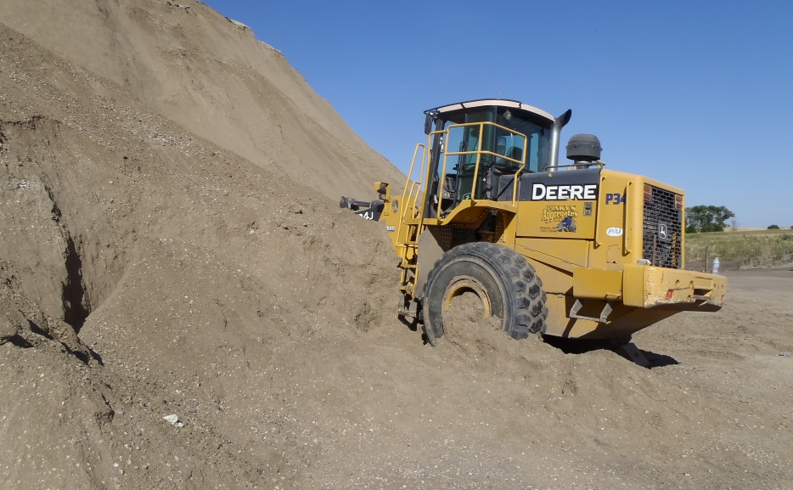
Fatality
MSHA believes that for these accidents, had the person making the examination recorded the conditions, the records of the adverse conditions would have alerted operators to take prompt corrective actions, thus preventing the accidents.

Slide 7
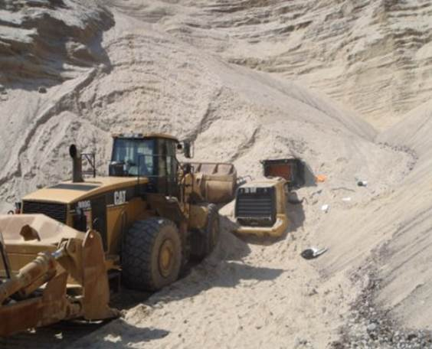
Fatality
Also, when miners are notified of these types of conditions immediately, they can be more proactive in helping to prevent injury, illness, and death.

Slide 8
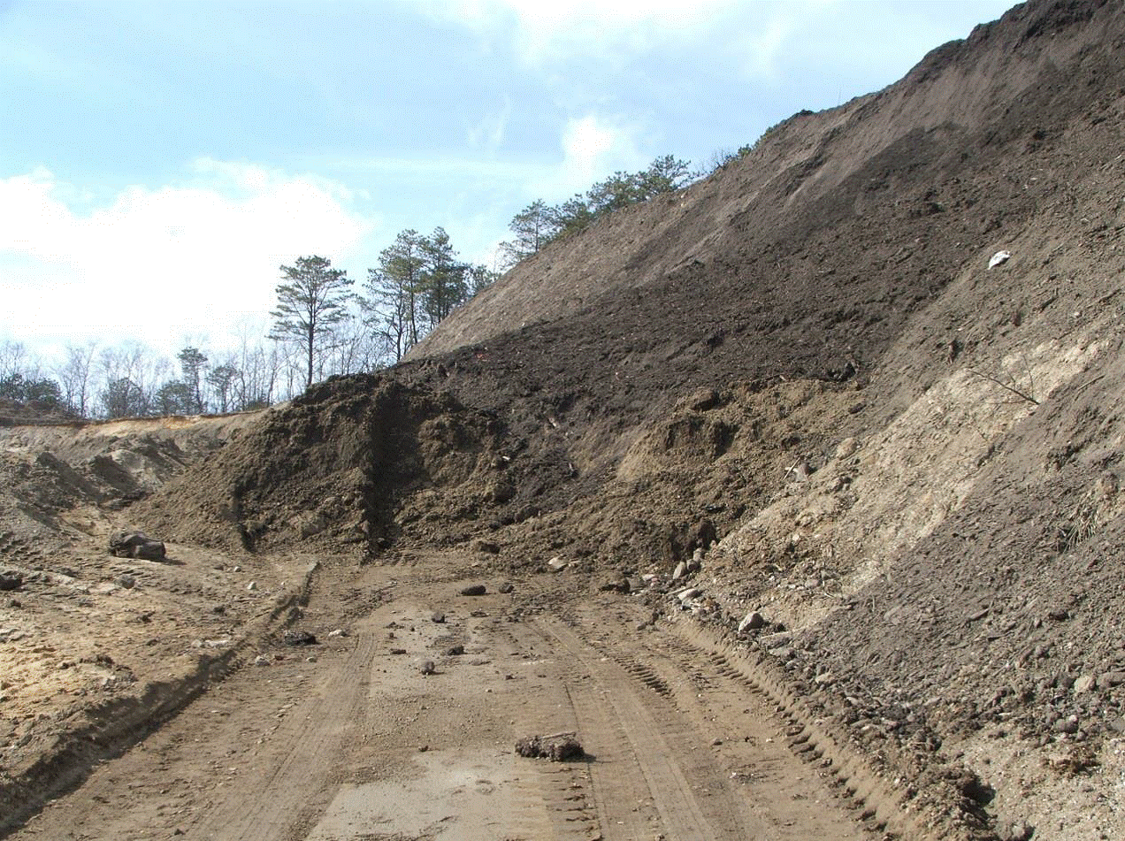
Fatality
MSHA believes that the additional required communication – making sure miners are aware of potentially hazardous conditions – will encourage prompt corrective action and help prevent fatalities and other accidents.

Slide 9
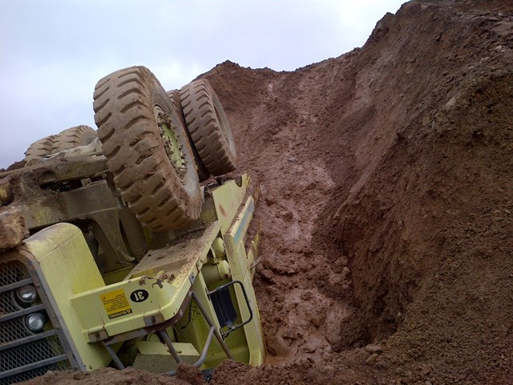
Requirements for Workplace Exams - Change to Rule
MSHA’s approach improves miners’ safety and health by requiring mine operators to: (1) conduct working place examinations to identify hazards before work begins in an area;
Fatality

Slide 10
Fell 51 feet to death
Doors opened; no elevator
(2) notify affected miners of hazardous conditions that are not corrected immediately;
Fatality

Slide 11
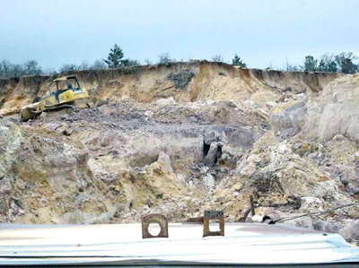
Fatality
(3) record the locations examined, the adverse conditions found, and the date of the corrective action.

Slide 12
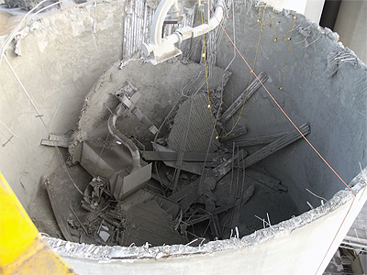
Fatality
In addition, this final rule strengthens and improves MSHA’s existing standard for MNM working place examinations by requiring that:

Slide 13
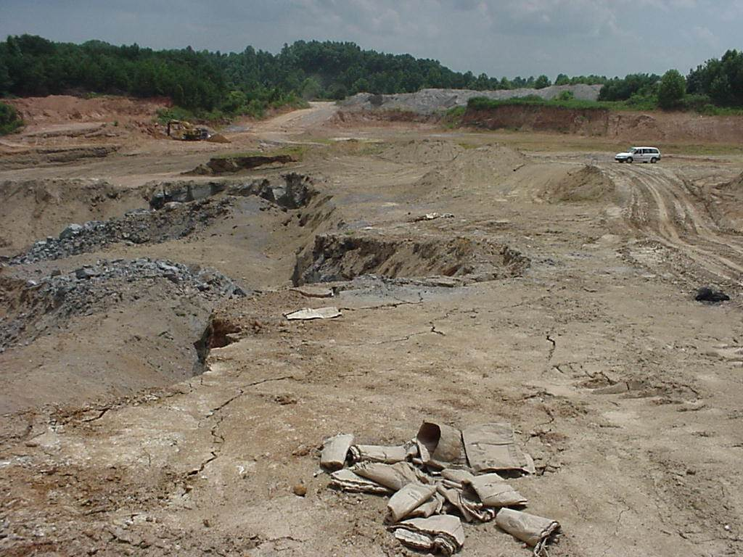
Mine operators promptly notify miners of any conditions that may adversely affect their safety or health and promptly initiate appropriate corrective action;

Slide 14
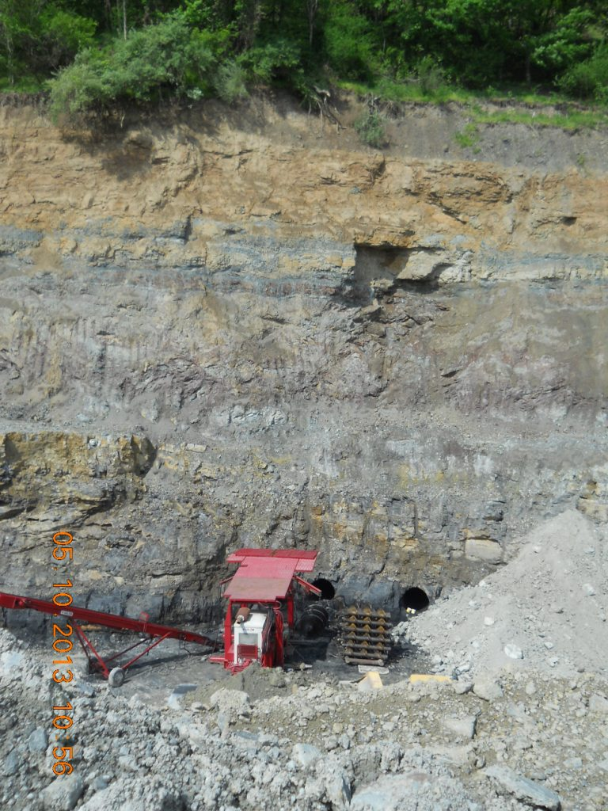
The examination record is to include the name of the person conducting the examination; date of the examination; location of all areas examined; description of each condition found that may adversely affect the safety or health of miners; the date the corrective action was made; and

Slide 15
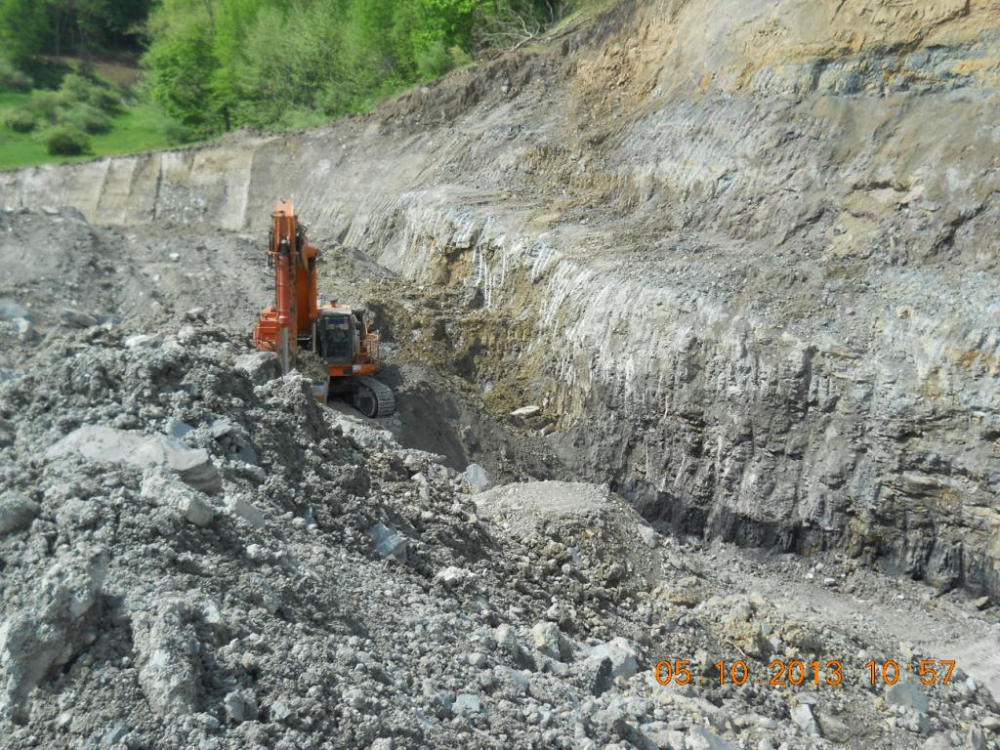
Records be made available for inspection by MSHA and miners’ representatives, and operators provide a copy of the records upon request.

Slide 16
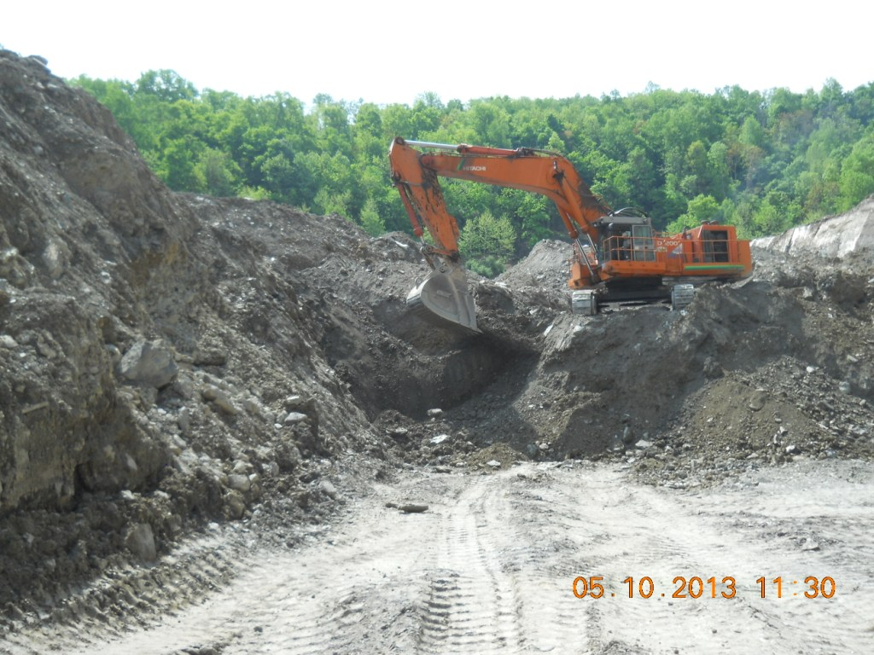
MSHA also reiterates in the preamble to the final rule that a “working place” applies to all locations at a mine where miners work in the extraction or milling processes, including roads traveled to and from a work area.

Slide 17
Not included:
A working place would not include roads not directly involved in the mining process, administrative office buildings, parking lots, lunchrooms, toilet facilities, or inactive storage areas. In addition, unless required by other standards, mine operators would be required to examine isolated, abandoned, or idle areas of mines or mills only when miners have to perform work in these areas during the shift.

Slide 18
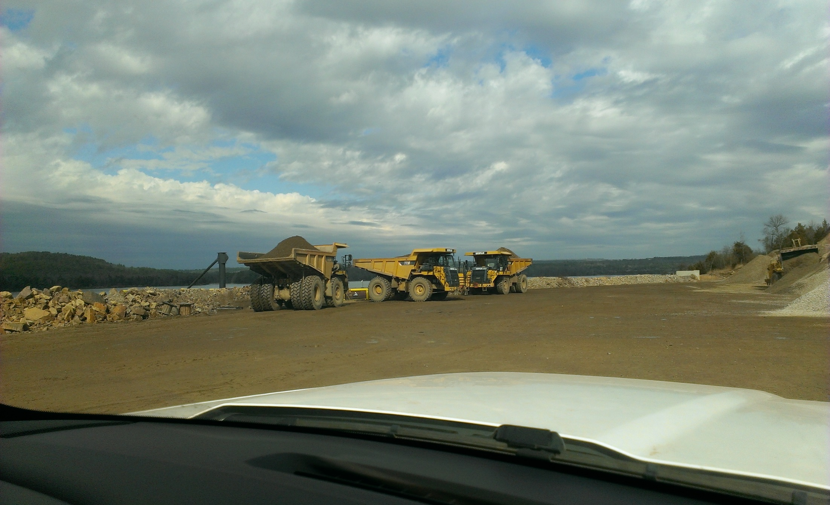
The rule takes effect on October 2, 2017

Slide 19
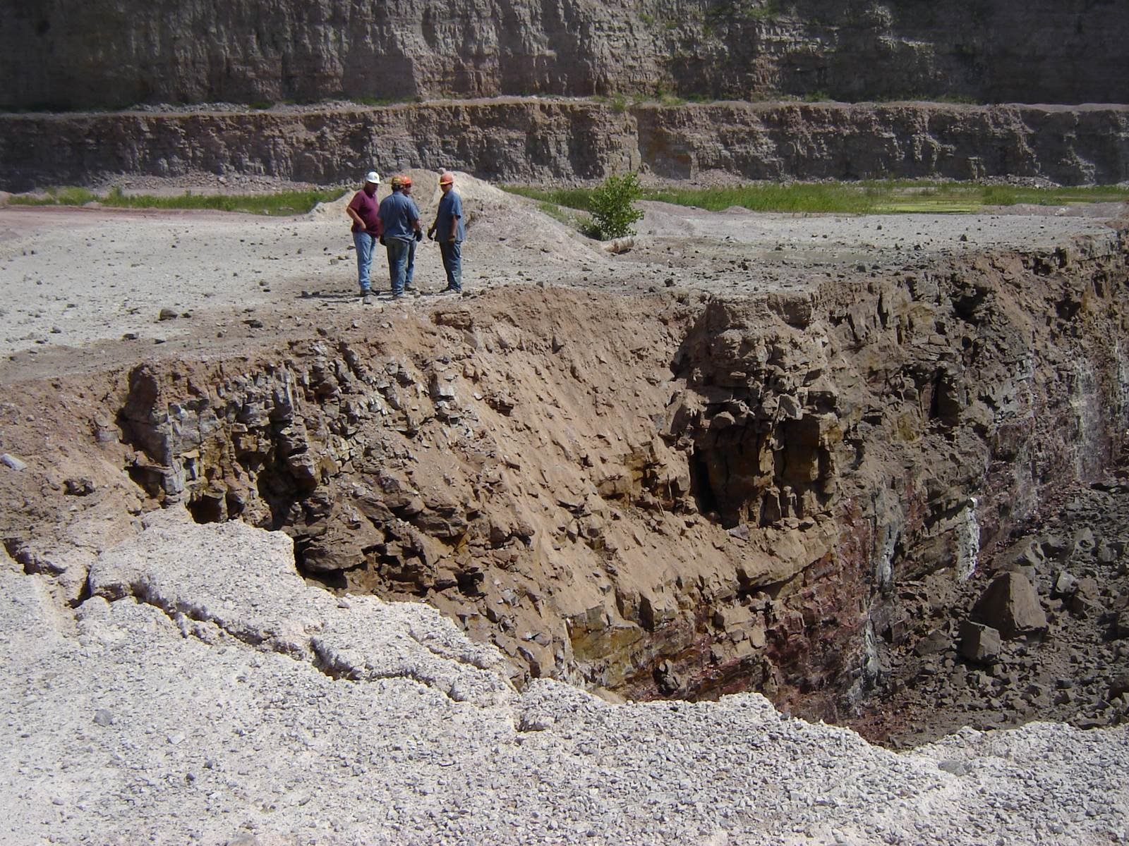
Review - What is required again?
Prior to work commencing
Location examined
Date of exam
Name of person conducting exam
Description of adverse condition found
Notify affected miners of adverse conditions
Promptly initiate appropriate corrective action
Date of the corrective action completed
Kept on file for 1 year

Slide 20
MSHA requires workplace exams be done by a competent person properly task trained to do the job.
Part of being competent and task trained is the ability to recognize hazards that may not be so obvious

Slide 21
Who is affected by the new rule?
Everyone who works at a mine.
You may not do the workplace exam today, but in your future that may change.
And remember:
You may not begin work until a workplace exam has been completed in your working area.

