Slide 1
Weather and Climate

Slide 2
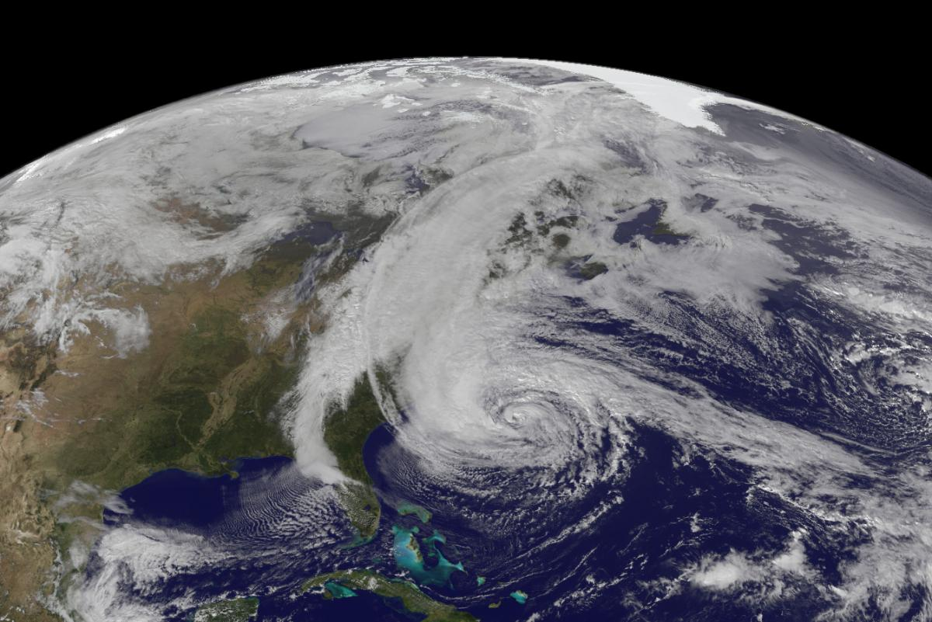
Introduction
WEATHER AND CLIMATE
Before the end of June 2011, the National Oceanic and Atmospheric Administration (NOAA) officially declared the year as being among the most extreme weather-event years in recorded U.S. history (Morello & ClimateWire, 2011).
Even though it is impossible to directly link global climate change to a particular event, many of these extreme events are consistent with expected changes from a warming climate.
Evidence is beginning to show a pattern consistent with scientists’ predictions of consequences resulting from climate change.

Slide 3
What You Will Be Able To Do After This Module
WEATHER AND CLIMATE
Differentiate between weather, and climate.
Characterize the five general types of climate, as defined by Koppen’s Climate classification system.
Explain the relationship between global warming and climate change.
Compare methods meteorologists use for forecasting weather to those used by climate scientists for predicting climate trends.
Analyze temperature data to identify recent heat waves at various locations on Earth.
Identify extreme weather events using the National Climatic Data Center (NCDC) website.

Slide 4
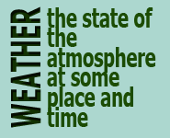
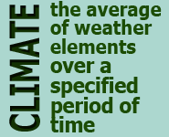
Are Weather and Climate the Same?
WEATHER AND CLIMATE
Weather is defined as the state of the atmosphere at some place and time, usually expressed in terms of temperature, air pressure, humidity, wind speed and direction, precipitation, and cloudiness.
Meteorologists study weather.
Climate is defined in terms of the average (mean) of weather elements (such as temperature and precipitation) over a specified period of time (30 years according to the World Meteorological Organization).

Slide 5
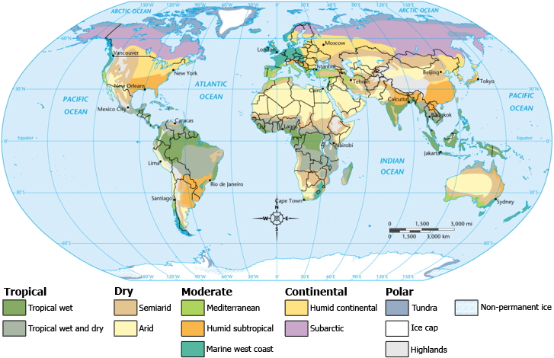
The Köppen Climate Classification System
WEATHER AND CLIMATE
In the early 20th century, a German scientist named Wladimir Köppen developed one of the most widely used classification systems. The Köppen system categorizes climate into five main types, which can be further divided into subcategories.

Slide 6
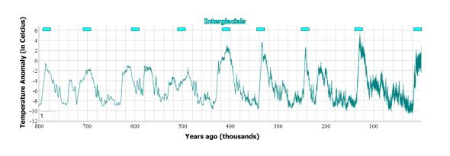
Temperature change in the atmosphere over the past 800,000 years
WEATHER AND CLIMATE
The planet’s climate has changed many times over Earth’s long geologic history. Over the past million years, Earth has experienced several glacial periods interspersed with interglacial (warmer) periods.
The relatively constant and favorable interglacial period of climate experienced over the past 8,000 years has made human civilization’s advancement possible.

Slide 7
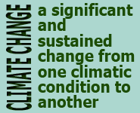
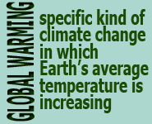
What Is the Difference between climate change and global warming
WEATHER AND CLIMATE
Climate change refers to a significant and sustained (over decades or longer) change from one climatic condition to another.
The term “global warming” refers to a specific kind of climate change in which Earth’s average temperature is increasing.
Abrupt climate change refers to a sudden, rapid change from one climate state to another (over a period of years rather than centuries or millennia).
What Is Abrupt Climate Change?
The United States Climate Change Science Program defines abrupt climate change as “a change in the climate (for example, in temperature or precipitation) that takes place over a few decades or less, persists for at least a few decades, and causes substantial disruptions in human and natural systems.” Abrupt climate change may affect the entire globe or just a region.

Slide 8
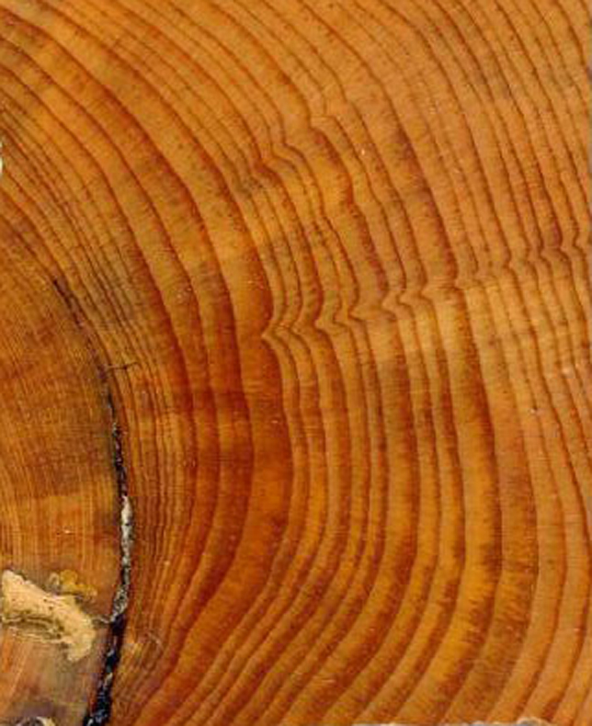
Forecasting Weather Versus Climate
WEATHER AND CLIMATE
Meteorologists focus primarily on real-time (current) data to predict local or regional atmospheric conditions for the hours, days, or weeks ahead. Thus, weather prediction tends to be more local and relates to conditions in the immediate future from days to weeks.
Climate scientists, on the other hand, look at atmospheric conditions in terms of averages and trends (patterns) that have occurred over many decades, centuries, and millennia.

Slide 9
What are Proxy Data?
WEATHER AND CLIMATE
Weather is variable, but can be averaged over time to indicate climate trends.
Therefore, climate scientists can use weather data plus proxy data to help them identify previous trends to improve their predictions of future trends.
What Are Proxy Data?
Proxy data include biological, cryological (which refers to frozen water), geological, and historical records that scientists use to deduce Earth’s atmospheric conditions in the distant past. By examining evidence such as the tree rings of old-growth trees and ice core samples taken from glaciers, scientists can figure out what Earth’s temperature, greenhouse gas composition, and precipitation levels were like over the course of its geologic history.

Slide 10
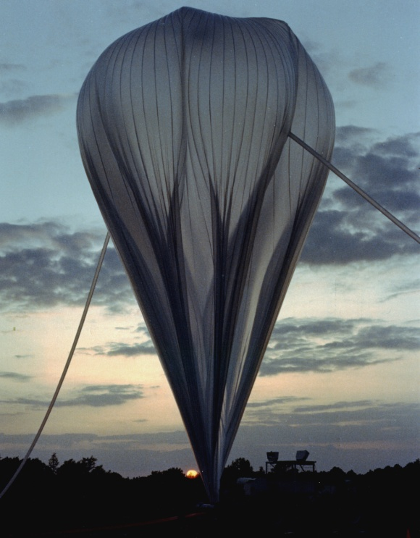
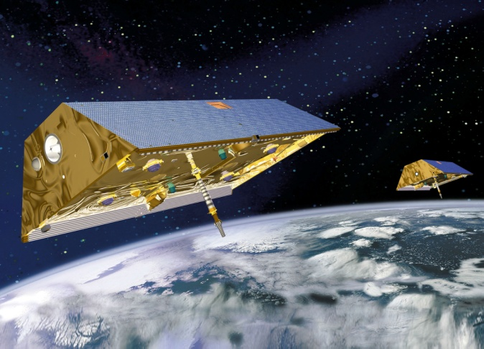
Tools Used to Forecast Climate and Weather
WEATHER AND CLIMATE
Weather balloons, satellites, specially designed airplanes, and radar and other ground-based data collection instruments are used to
measure wind speed,
precipitation,
air temperature,
humidity levels, etc.
Reliable records have been kept since 1800s and provide accurate weather forecasts (weekly and daily).
Sophisticated Earth-observing satellites equipped with remote-sensing equipment circle the globe to
record sea surface and other temperatures,
measure atmospheric gases and rainfall amounts,
take visible and infrared photos of Earth’s surface, and
calculate Earth’s outgoing infrared and reflected solar radiation.

Slide 11
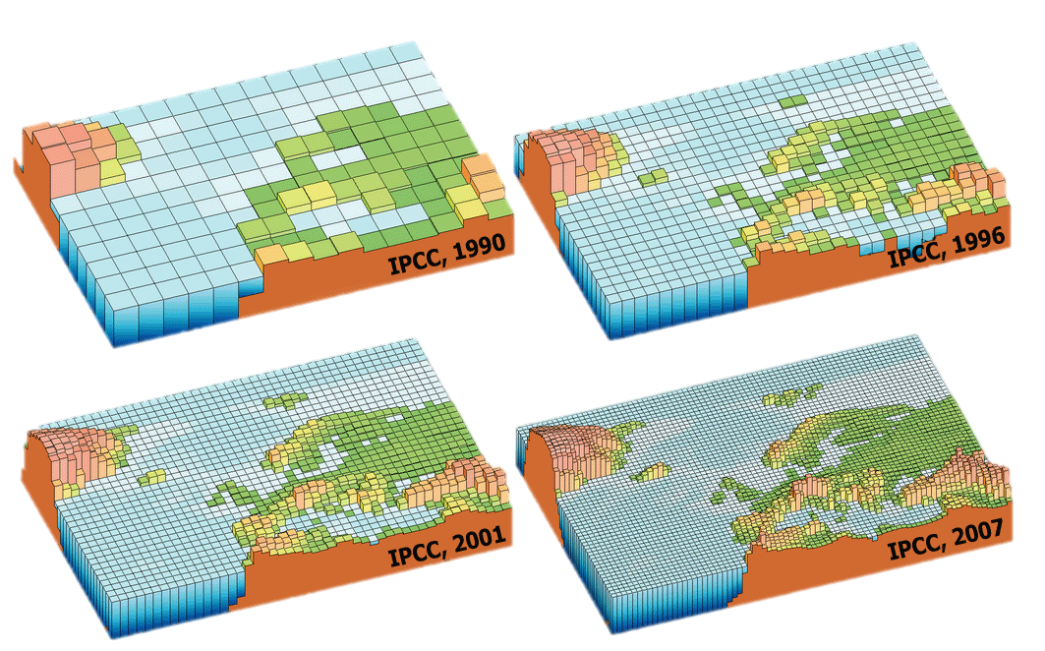
Increasing Resolution of Global Climate Models
WEATHER AND CLIMATE
Climate scientists also use increasingly higher resolution computer models, known as global climate models, to simulate the physical processes of the atmosphere and oceans and make predictions about future climate scenarios.

Slide 12
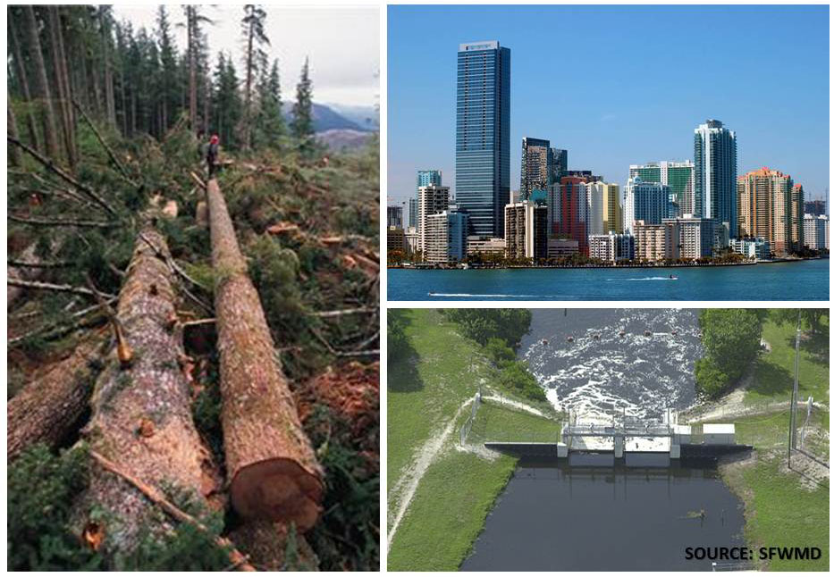
Extreme Weather Events
WEATHER AND CLIMATE
All weather events that cause loss of life, disrupt normal human activities, and result in property damage appear extreme.
Several variables (land-use practices, population density, and flood-control projects) can complicate making direct comparisons between past and present events.
Comparing death tolls, between recent and past events may not be the most meaningful indicator of a particular weather event’s intensity.

Slide 13
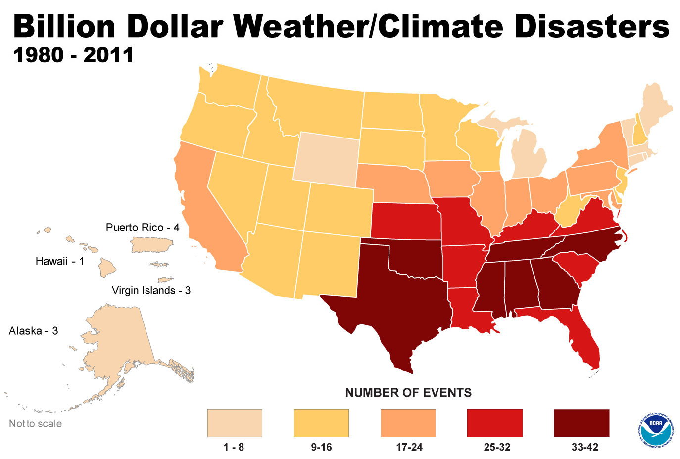
How “Extreme” is Extreme?
WEATHER AND CLIMATE
The growing body of meteorological data indicates an increase in the number of extreme weather events occurring here in the United States since 1980, and the number of extreme events also appears to be rising worldwide.

Slide 14
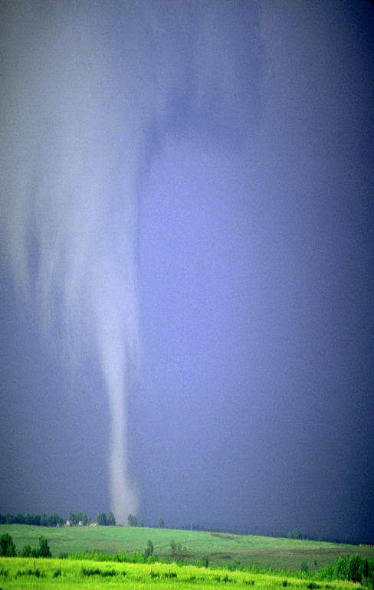
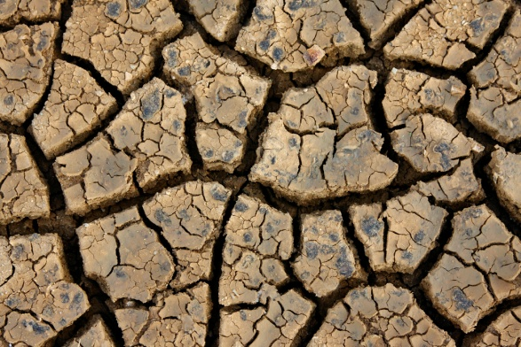
What Is the Significance of Weather Extremes?
WEATHER AND CLIMATE
The variability of extreme weather events is so great, that scientists need a long record of observations and data to establish definitive links between severe events and climate change.
By definition, extreme weather events are rare, which means that oftentimes there are very limited data available to use for comparison.

Slide 15
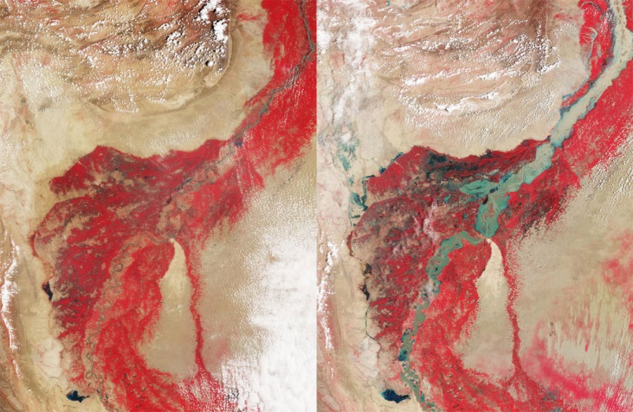
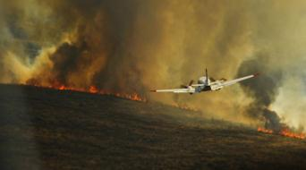
Recent Extreme Weather Events
WEATHER AND CLIMATE
Image Credit: NASA
2009-2010 Eastern US “Snowmageddon”
2010 Northern Pakistan Floods
Image Credit: NOAA
2010-2011 Texas’s Worst Drought and Fire Season in Recorded History
2012 Hurricane Sandy

Slide 16
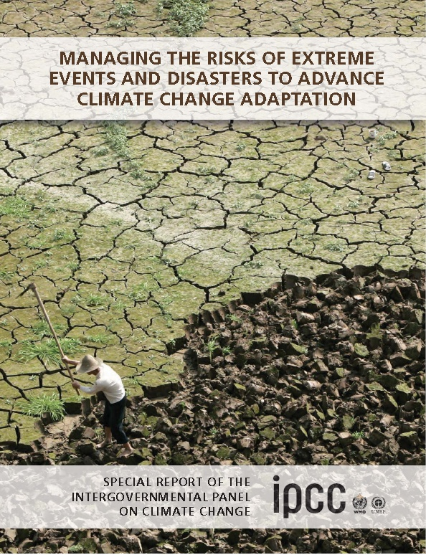
Are Extreme Weather Events Increasing?
WEATHER AND CLIMATE
IPCC’s 2012 report, Managing the Risks of Extreme Events and Disasters to Advance Climate Change Adaptation, indicates that scientists have enough confidence in the data collected since 1950 to definitively link extreme temperatures to global climate change.
In late June of 2012, more than 2000 record temperatures were recorded across the U.S.

