Slide 1
Suspicious Drug Screening: What am I seeing and what do I do about it?
Dr. Diane Tennies, PhD, LADC
Lead TEAP Health Specialist, Humanitas
6/10 & 6/12/2014

Slide 2
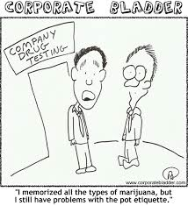

Slide 3
Today’s Discussion
Clarify Job Corps PRH regarding the procedures for conducting suspicious drug screens
Identify behaviors typically associated with licit and illicit drug use
Learn how to maintain the integrity of the chain of custody and what this really means
Define two differences between an observed and supervised urine collection

Slide 4
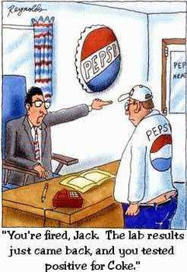

Slide 5
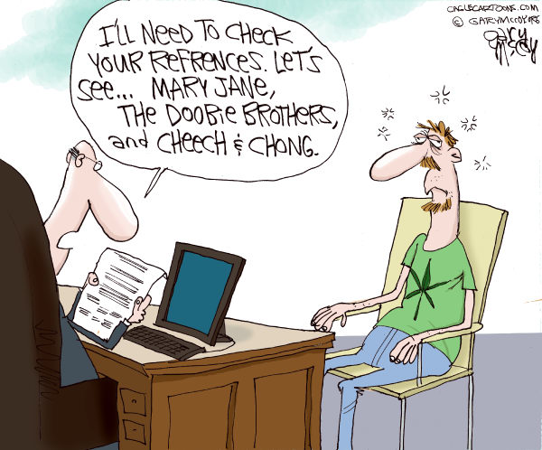
Why is there a Suspicious Screen Process?

Slide 7
PRH regarding Suspicious Screens
6.11 R1 e 1 (a) (3)
Students who are suspected of using drugs at any point after arrival on center (including during the 45-day intervention period) shall be tested
This testing shall take place as soon as possible after staff suspects use.

Slide 8
Well…that’s clear?

Slide 9
The Components of an Effective Suspicious Screening Process
Observable signs
Training the staff on the process – ESSENTIAL
SOP for direction/guidance
Clear and concise form
FOLLOW YOUR PROCESS
Assess and Intervene

Slide 10
Observable Behaviors
Distorted perceptions
Impaired coordination
Slow reaction time
Difficulty in thinking and problem solving
Red, blurry, bloodshot eyes
Constant, mucus-filled cough
Complaints of rapid heartbeat
Increased appetite
Complaints of dry mouth
Anxiety, paranoia, or fear

Slide 11
More Observable Signs
Sudden change in behavior
Mood swings
Withdrawal
Careless about grooming
Lost of interest in hobby, activities
Sleeplessness
Dizziness
Mental confusion
Dilated pupils
Delayed motor skills
Smell of alcohol/marijuana/chemical smells

Slide 12
Process to Ensure Staff Rely on Observable Behaviors
PRH 6.11 e. 1. (a) (3) – footnote
Reasonable suspicion includes:
direct observation of drug use or behavioral
signs or symptoms suggestive of drug use
(2) reliable information that a student recently used drugs.

Slide 13
Staff Guidance
Make sure regular training in place around observable signs and gestalt of signs
Do not rely on just one such as ‘sleeps in class’
Make good use of winter/summer breaks
Use of form which delineates observable behaviors CLEARLY

Slide 14
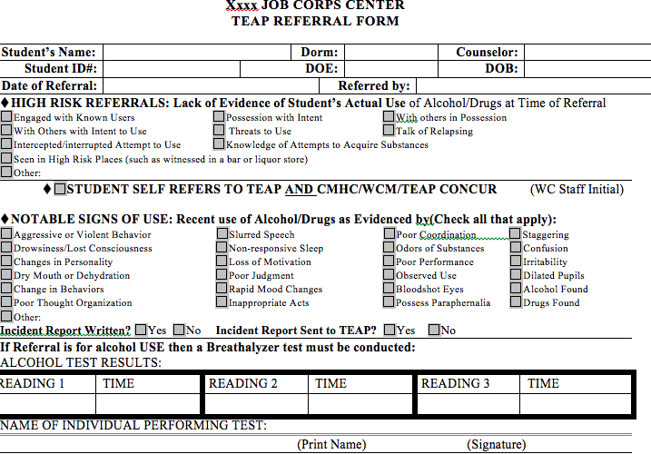

Slide 15
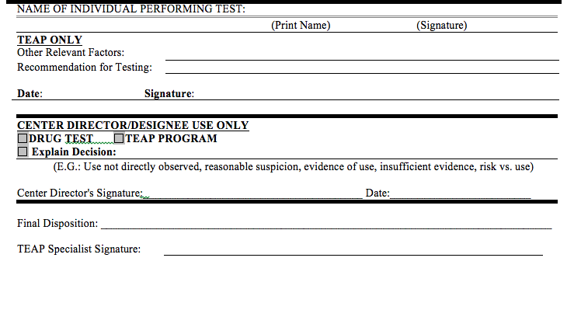

Slide 16
Urine Collection Process

Slide 17
Guidance?

Slide 18
Chain of Custody is Key to Integrity
Providing a private area for specimen collection (more on this later)
Supervising the collection process and ensuring that there is strict adherence to chain of custody principles.
Definition: The course of action of documenting the management and storage of a specimen from the moment a donor gives the specimen to the collector to the final destination of the specimen and the review and reporting of the final result.
All urine toxicology screening shall incorporate a Chain of Custody form and process to insure the integrity of the specimen to be tested.

Slide 19
More about Chain of Custody
Can there be medical explanation for a positive result?
Positive for opiates and student had a legitimate prescription
A student prescribed stimulants for ADHD
Consulting with toxicology professionals, such as staff at the nationally contracted laboratory (CDD), if required
Provide all students with results of all screens and document results in SHR (opportunity for further assessment and brief interventions)
If cannot produce sample or dispute their test result then refer to center physician
Students who refuse to provide specimen (or unexcused absence) are referred to Center’s behavior management system

Slide 20
Who collects the Urine?
PRH 6.11 R1 e. 1. d. and e.
Collection of urine for drug testing shall be in accord with chain- of-custody principles and conducted by health and wellness staff or a staff member trained in urine collection procedures.
Why Wellness staff is recommended:
Trained health care providers
Know Chain of Custody
No significant issues with waiting until Monday to test
The Job Corps nationally contracted laboratory shall be used for all required drug testing. On-center urine drug testing is prohibited.

Slide 21
Chain of Custody and Why Ryan Braun is so Happy

Slide 22
Ryan Braun Cleared as Chain of Custody is Decisive
People familiar with the details said the sample was not dropped off that day at FedEx to be sent to the MLB testing lab in Montreal because the collector thought it was too late and the shipping company was closed.
Instead, the collector kept the sample, and perhaps others, refrigerated at home for two days before making the shipment. Though the seals on the samples were unbroken upon arriving at the lab, that lapse in protocol became the crux of the hearing in which Braun's side contested the validity of the test itself.

Slide 23
Chain of Custody
The MLB drug policy (think SOP) states that "absent unusual circumstances, the specimens should be sent by FedEx to the laboratory on the same day they are collected."
The policy goes on to say, "If the specimen is not immediately prepared for shipment, the collector shall ensure that it is appropriately safeguarded during temporary storage. The collector must keep the chain of custody intact. The collector must store the samples in a cool and secure location.”
MLB officials argued that despite the delay in shipping, the collector did keep the chain of custody intact and store the samples in the proper environment. Das thought there was room for error in the process, however, and ruled accordingly.

Slide 24
Urine Collection Procedures: The Basics
Decrease the likelihood of adulteration of the specimen by:
Remove all cleaning products from the collection room area.
Perform visual and temperature checks. The sample temperature should fall between 90.5 F and 99 F. Visually should appear free of possible contaminants
Turn off additional water sources in the immediate collection area, if possible.
Place a blue chemical in the toilet tank to color the water.
Have the student wash (with water only) hands and clean under nails; hand the student a paper towel for hand drying before he/she provides the requested sample.

Slide 25
More Basics
Have the student remove outer garments (e.g., coats, sweaters, jackets).
Prohibit bags, packages, or purses in the collection area.
Have the student provide the specimen while in an examination gown, if urine collection is part of a medical exam.
Have collection personnel stand close to the door and be aware of unusual sounds when conducting a routine supervised collection.
Make sure the student hands the specimen directly and immediately to collection personnel.

Slide 26
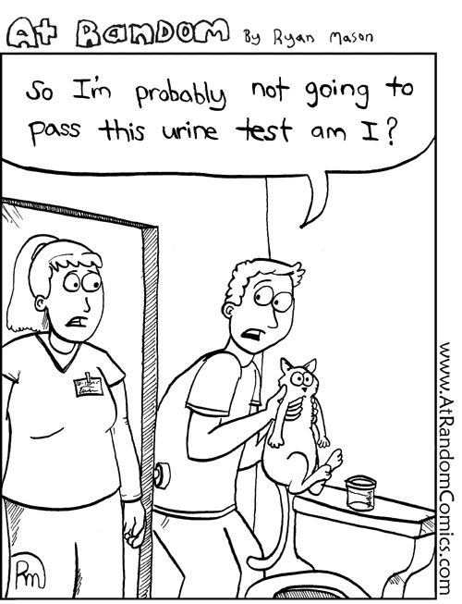

Slide 27
Supervised versus Observed
Observed ONLY recommended if adulteration possible: Watching the urine stream leave the body and enter the specimen container

Slide 28
Then What?
Review results – tie back to original referral
Combine with other data
Now what?
Intervention services if positive
Tie back to employability
Further assessment
MSWR?
CMHC referral?
Brief intervention, if negative
Document in SHR

Slide 29
Life would be easier if…

Slide 30
Comments, Questions and Concerns

