Slide 1
Developing an Effective Safety and Health Program
Texas and Oklahoma
2011
Notes:
Hello! And welcome to Oklahoma City! To get started today, I would like to get to know you a bit.
How many of you are from a single location?
How many of you are from a multiple location?
How many of you have an existing safety and health program?
How many of you have an effective safety and health program?

Slide 2
Why should you have an EFFECTIVE
Safety and Health Program?

Slide 3
Purpose/Goal of Presentation
The goal of my presentation is to give you some ideas on how to improve or develop the safety and health program for your company.
Cover basic concepts that should be included in a safety program
Describe useful examples/suggestions
Summarize the missing links to typical safety
1) developing a safety “attitude”
2) implementing a successful program
3) inspecting what you expect—continuous improvement
Provide a plan of action
Provide resources
Notes:
Read slide
___________
I sure as I share my information, you will recognize some of the components of a safety and health program. Each of you might recognize different aspects. So, to get us all on the same page, I am going to compare several different lists that itemize the components of a safety and health program.

Slide 4
Components from Seminar Flyer
Worksite and employee involvement
Worksite analysis
Hazard prevention
Training
Notes:
The first list I have is from the flyer advertising this seminar. Note there are four components.

Slide 5
Components From some Random Source
Management Commitment and Written Plan
Employee Orientation and Involvement
Hazard Identification, Evaluation and Control
Chemical Hazard Communication: Inventory, MSDS, Labeling
OSHA Recordkeeping: OSHA 300 Logs and Form 301
Emergency Preparedness: Fire Safety Plan, Bloodborne Pathogens
Notes:
The next list I found was from a website on the internet. But as is typical when I find something online, when I went back to quote the source, I couldn't find it again….but it has six components.

Slide 6
Components From OSHA
The credibility of management's involvement in the program
Inclusion of employees in safety and health decisions
Rigorous worksite analysis to identify hazards and potential hazards, including those which could result from a change in worksite conditions or practices
Stringent prevention and control measures
Thorough training
It addresses hazards whether or not they are regulated by government standards
Notes:
It made sense that I should also look to OSHA to see what they listed as the components of a S & H Program. Notice, they also have six components—but the are slightly different than the previous slide.

Slide 7
Components From William Gooding, 2008
Commitment Statement
Employee Responsibilities
Specific Job Duties
Training Required
PPE
Chemical & Material Handing
Reporting Requirements
Compliance Documentation
Communication
Hazard Assessment
Accident Investigation
Hazard Corrective Action
Training
Recordkeeping
Notes:
The fourth list I found was from a gentleman who had a long list of credentials. Along with his long list of credentials, he also has a long list of components for a S & H program.
So, what’s all this do for you? Confusing? Which one to use? Common sense says lets go to OSHA—but I wanted to put the lists together.

Slide 8
From William Gooding, 08/2008 | From OSHA | From Random Source | From Seminar Flyer | Julie's
Commitment Statement | Management Involvement | Management Commitment | see next item (worksite) | Management Commitment/Involvement
Employee Responsibilities | Inclusion of Employees | Employee Orientation and Inclusion | Worksite and Employee Involvement | Employee Involvement
Hazard Assessment | Worksite Hazard Identification | Hazard Identification | Worksite Analysis | Worksite Hazard Analysis (Evaluate)
Specific Job Duties
Accident Investigation
Hazard Corrective Action
PPE | Prevention and control Measures |  | Hazard Prevention | Prevention and Control Measures (physical/tangible measures) (Develop the Programs)
Chemical & Material Handing
Training | Thorough Training | Employee Orientation | Training | Training (Implementation)
Training Required
Reporting Requirements | duh! | OSHA 300 Recordkeeping |  | Documentation (Revaluate, Revise, Audit)
Compliance Documentation
Recordkeeping
Communication |  | Chemical Hazard Communication |  | ?
 |  | Emergency Preparedness |  | ?
Notes:
This table might be slightly hard to read, but the white blocks are the most interesting for right now. Even though Gooding had fourteen components to start with, several of them can be combined to fit more general categories.
Anyway—the last column is what I came up with for titles for our Safety and Health Program, today. Bottom line—you may find lists that have different names for the various components, but even though the words are different, the concepts still fit six slots.
Now—let me point out the white spaces and think through the logic of combiningg or discarding a topic.

Slide 9
Management Commitment/Involvement
Employee Involvement
Worksite Hazard Analysis (Evaluate)
Prevention and Control Measures (physical/tangible measures) (Develop the Programs)
Training (Implementation)
Documentation (Re-evaluate, Revise, Audit Goal is Continuous Improvement)
Notes:
So—this list is a bit easier to read. Here are the six components to an effective safety and health program. If you are familiar with the general “design” principles—you see that the components of this model fit standard planning/design process.

Slide 10
-What does this mean to you?
Management Commitment/Involvement-
Notes:
So—the 1st component is managements commitment and involvement to the safety and health program. What does “management commitment” mean to you? Give me some examples of how your management shows their commitment.
Give example: So, there was this Safety Director who was hired by a multi location cooperative. In his seven years there—he never made a presentation to the board of directors. When he asked to conduct a S & H program checkup survey, the GM questioned by the word “health” was included. Whenever the SD asked for safety supplies etc, he was never told no. But whenever he asked a location manager to help get the word out, they were always pretty busy and would take care of it when they had time. Do you think this company really had management commitment?

Slide 11
Commitment statement by board of directors?
Commitment statement posted on walls?
* Manager Attitude?
Paycheck stuffers?
Safety as an agenda item at every meeting at every level of operation?
Manager accountability for all types of safety involvement?
* Is the success of the safety program “measureable”?
Does the safety program strive to be proactive rather than reactive?
Do managers have “time” for safety or are they too busy?
Not enough.
Meaningless unless there is more.
Major issue.
Not enough.
Good idea.
Yes.
It should be!
Good idea!
Hear this too much! Goes back to
Attitude!
Notes:
Read questions and advance for answers.

Slide 12
Employee Involvement
Notes:
Next component to an effective s & h program is employee involvement. Doesn’t this make sense? Employees are the workforce, the do the jobs that are impacted by many of the programs involved in the s & h program.
Employees should be involved to a much greater extent than what we have traditionally done. The people who use the equipment, who do the work, should be involved in evaulating the hazards. They should review procedures. They should help select PPE.
Give example: Sidewalks at ISU. Monkey guy. Air monitors.

Slide 13
Include employees in the analysis and planning process—either upfront or after the fact.
Employees know when a “near miss” occurs—do they know how to follow up?
What about employee observations?
An employee should not begin work until safety orientation has been conducted—what message are they given when they start work?
Notes:
I need a couple of volunteers for this one. Marty, Rob. Okay—you are both new employees. Okay Rob, we’ve gone over all your paperwork so you can get insurance and a paycheck. You have received your employee handbook and I have your acknowledgement form that you have received it. Now you need to go see you immediate superviisor. He should go over a couple of safety things with you. But he might be busy this week, so he will get around to it sometime. If you have any questions, just ask.
Now Marty….Same as Rob on all the HR, stuff…but we are going to take some time to go over the company safety proceudres. Here is a checklist we are going to go over, and in this bag is all the company issued safeaty equipment. Please keep in mind that whenever you are on company property…..

Slide 14
Worksite Hazard Analysis:
Evaluation
Notes:
Third component is hazard analysis. This starts getting to the “meat” of the S & H program.

Slide 15
Job task analysis.
Job hazard analysis.
Confined space hazard analysis—Look at all your spaces and determine how to classify them.
Lockout tagout analysis—look at your equipment and electrical.
Hazard communication program analysis.
Notes:
Some of the terms you might have heard are job task analysis, job hazard analysis, etc, etc. The whole purpose behind this component is to evaluate what you have in order to give you the information you need to write any required programs, to determine any safety measures that need to be implemented or constructed, to help you know what personal protective equipment you might need to purchase.
For most of your locations most of our existing programs were written years ago and we have no documentation from the hazard anallysis. So, it is probably time to go back and conduct these critical evaulations. There are examples available from OSHA. There are simple forms. There are complex forms. But this is a component that must be done. This is where you can get employees involved. When you get to identifying confined spaces, you need to thoroughly understand what you want your company procedures to be….you don’t want to start identifying spaces, labeling them, then find out that the procedure is too complicated for employees to use, so they just ignore the whole process….for example…boot pits, are they a confined space or not? Well, it depends…

Slide 16
Notes:
As you evaluate your facility and the jobs that employees do, take a look at everything. Do you see any thing wrong in this picture? It looks like someone has put wire around the safety mechanism to override the system. Is this appropriate?

Slide 17
Notes:
In evaluating your facility you need to keep in mind both employee safety and regulations. For a ladder like this, you might need fall protection on the employee, you might need a safety cage on the ladder, through procedure, you might want to prohibit employees from using this ladder.

Slide 18
Prevention and Control Measures:
Program Development
Notes:
The fourth component of an effective s & h program is the actual determination of what prevention and control measures needed including written programs, procedures, etc. and developing them.

Slide 19
Determine and develop programs that are needed (and/or required).
Determine and put into place any control measures that are needed—machine guards in place; are ladders appropriate; are railings adequate?
Determine what PPE is required, purchase it, disseminate it, and encourage the use of it! Train on it, train with it. Managers must set an example in using it!
Determine any signage that may be required: electrical warnings, CS warnings, LOTO warnings; warnings on ladders; warnings if contractors are working in electrical room; fire extinguishers; egress signs; etc.
Develop a plan for reviewing, revising, auditing your programs and compliance.
Notes:
There are several problems when we get to the programs. 1) do you have the work place. Job analysis completed? 2) how are you going to review and revise your programs? How are you going to track any changes? Who is responsible for the updating? Do you have just one set of programs? Do you conduct training on your specific programs? Have employees even read/seen the program?

Slide 20
Notes:
One of the things that seems rather simple, is actually a really big part of making you safety and health program work. If you have 20 written programs, is it better to have them in one three in binder? Or would they be more useful in individual binders? If you have a system for reviewing and updating your programs, do you have an effective method to make sure all the “manuals” are the latest version?

Slide 21
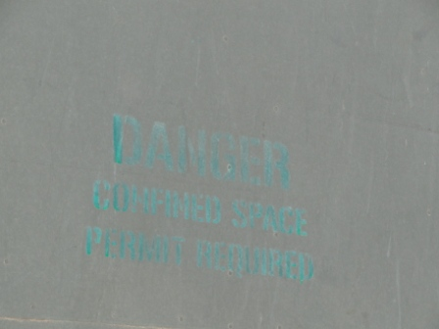
Notes:
As you develop your programs, you will review the signage that is required by various programs. Take a look a the signage you currently have and make sure it is appropriate.

Slide 22
Notes:
Is additional signage needed to enforce the policies you have developed?

Slide 23
Training
IMPLEMENTATION
Notes:
The training is a major component to haaving an EFFECTIVE program. Training can also be considered the implementation phase. Training does not just refer to watching videos or taking quizzes. How else could/should you train employees so they know, understand and use the proceudres that have been written? Hands on. Drills. Practice.

Slide 24
Require and conduct new employee training BEFORE an employee starts to work.
Videos only cover the basics.
Conduct onsite hands on/mentor training.
Vary the training methods.
Employees are included in training—at least in watching videos. Are there regularly scheduled drills for employees? Do you include your emergency responders? Come up with some “what if” scenarios and put them into action. Can you react quickly enough?

Slide 25
What if an employee has a heart attack while on the catwalk—what would you do?

Slide 26
What if an employee “goes down” while in the boot pit—what would you do?

Slide 27
Emergency Preparedness: Exercise, practice, improve

Slide 28
Documentation

Slide 29
Written programs are documentation.
Housekeeping and preventive maintenance records are documentation
OSHA 300 and 300A are documentation.
Audits are documentation.
Employee signoff on training or procedure reviews are documentation.
Procedures are documentation.
If you don’t have written procedures, how do employees know what to do?
If you don’t have complete documentation of training, how do you know how effectively an employee was educated on their job and on safety?
What method do employees use to document housekeeping?
Employees must complete much of the documentation—Do they have adequate tools (forms)?

Slide 30
Notes:
Are proceudres readily available to employees? Are all the forms readily available. Do employees know how to fill out the forms. Where do forms go after a procedure is completed? How long do you retain documents?

Slide 31
Do not have all your safety/procedure manuals in your OSHA Inspector“ staging area”

Slide 32
Do not have multiple versions of safety/procedure manuals.

Slide 33
Hazard Communication Program
Lock out Tag Out Program
Hearing Conservation Program
Confined Space/Bin Entry Program
Fall Protection Program
Housekeeping Program
Preventive Maintenance Program
Truck and Rail Safety Program
Office Ergonomics Safety Program
Emergency Action Plan
Fire Prevention Program
First Aid/Bloodborne Pathogen Program
Contractor Notification Program
Regulatory Inspection Policy/Program

Slide 34
Inspect what you expect!!!
Who follows up to see that the documentation actually fits the job that was done?
This is key to continuous improvement.
Notes:
Does any one check to see if forms are filled out properly? Does anyone check to see if houskeeping was completed as the employee says? Do you have any method to follow up if any dispariaaties are found? Do you inspect the facility to see that all the physical safeaty measures are in place? Again, do you have any method to follow up if any issues are found?

Slide 35
Communication
Notes:
This was one of the components that were not on all four of those lists, but it is actually integral in all of them, therefore not a component on its own.

Slide 36
If an employee sees something unsafe, what should they do?
If an employee observes another employee doing something unsafe, what should they do?
If something has “gone wrong”, how is the rest of the company notified?
If something has “gone wrong”, how is “retraining” conducted to fix the problem?
Notes:
But these are some other communication items that should be considered.

Slide 37
Emergency Preparedness
Knowledge replaces fear!
Notes:
Emergency preparedness is a part of the implementation phasae. It is not separate, it should be inherent.

Slide 38
Closing the Loop…

Slide 39
The Missing Links in many Safety & Health Programs
Developing a safety “attitude”
Implementing the program successfully
Inspecting what you expect –Continuous Improvement
Notes:
My final discussion will be summarizing the missing links to typical safety programs—how to “close the loop” so to speak: 1) developing a safety “attitude” 2) successful devellementation; and 3) inspecting what you expect .

Slide 40
Developing a safety “attitude”
…a safety culture!
Notes:
Safety is an Attitude..a cutlure…a way of life. Occupational Health and Safety is a program. You cannot make your safety and health program effective unless you have a good safety attutude at your company. If you don’t have a safety culture or a good safety attitude at your company, your people war their required ppe because of compliance. If you a safety culture or attitude, then choose to wear ppe because its what you do…. This is where the management commitment and involvement gets really critical. Lead by example. Start at the beginning..set the employee up with the safety attitude when they first start.

Slide 41
Implementing the program successfully
Notes:
Besides needing a good safety culture, you need the proper implementation. Don’t just sit you employees down to watch a video and expect them to understand how your company should do lockout tagout— Don’t take for granted that your employees know what to do if something goes wrong, practice, exercise, drill. Have the program/proceudres available. If the employees need locks and tags in the electrical room, should they be kept in the office; but if a manager is to sign off on the lockout procedure, then maybe the locks should be where the written procedure forms are, and where the manager is available.

Slide 42
Inspecting what you expect—
Continuous Improvement
Notes:
Is the success of your safety and health program measureable? If not, how do you know it is successful. In order to measure, you need to inspect what you expect. Build a mechanism into your program for auditing. Along with auditing, determine how you correct any difficiencies found during an audit whether it is an audit of a program, an audit of a physical facility, or an audit of completed documentation. Who will fix any difficiencies, when will they be fixed.

Slide 43
Management Commitment/Involvement
Employee Involvement
Worksite Hazard Analysis (Evaluate)
Prevention and Control Measures (physical/tangible measures) (Develop the Programs)
Training (Implementation)
Documentation (Re-evaluate, Revise, Audit)
Notes:
Now to summarize

Slide 44
The Missing Links in many Safety & Health Programs
Developing a safety “attitude”
It’s a culture, not just a program.
Implementing the program successfully
Must be hands on by all employees all the time.
Inspecting what you expect
If you can’t measure it, how do you know it is working?

Slide 45
Getting Started on Your Health and Safety Program
Look at What You Have
Review and Compare
Develop Procedures, Policies and Plans
Develop an Action Plan for Implementation
Take Action
Open Communication
Maintain Your Program-Inspect/Audit

Slide 46
Where can you go for help?

Slide 47
NGFA
OSHA
Insurance Companies
Consultants
State safety organizations
National Safety Council
Other Industries

Slide 48
Google: Developing a Safety Program
Guide to Your Written Health and Safety Program; Developed by: State of Wisconsin Department of Administration Bureau of State Risk Management http://www.doa.state.wi.us/docview.asp?docid=668
http://www.tdi.state.tx.us/wc/safety/videoresources/onlinepubsb.html
The Texas Department of Insurance, Division of Workers’ Compensation (TDI, DWC) Resource Center offers a workers’ health and safety video tape library. Call (512) 804-4620 for more information or visit our web site at www.tdi.state.tx.us. Disclaimer: Information contained in this training program is considered accurate at time of publication.

Slide 49
Sample Mission Statement 1
“The health and safety of our employees is a major consideration in the operation of this company. Management and supervisory personnel will be accountable for the health and safety of the employees working under their supervision and will be expected to conduct operations in a safe manner at all times.
Management will also be responsible for establishing safe working conditions and proper attitudes toward safety and for promoting the health and health and safety of all employees”.

Slide 50
Sample Mission Statement 2
“It is the intent of this company to comply with all applicable state and federal health and safety standards. To do this, we must constantly be aware of conditions in all work areas that can produce occupational injuries and illnesses. Your cooperation in detecting and reporting hazards and, in turn, controlling them, is a condition of your employment. Inform your supervisor immediately of any unsafe situation beyond your ability to correct."

Slide 51
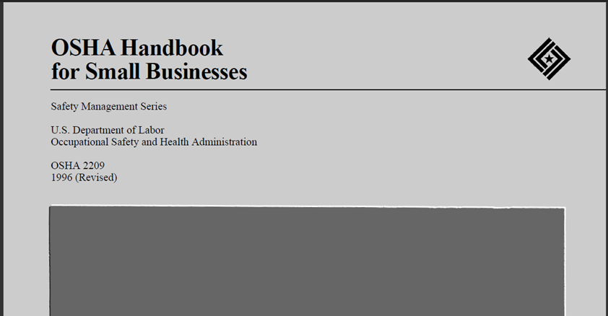

Slide 52
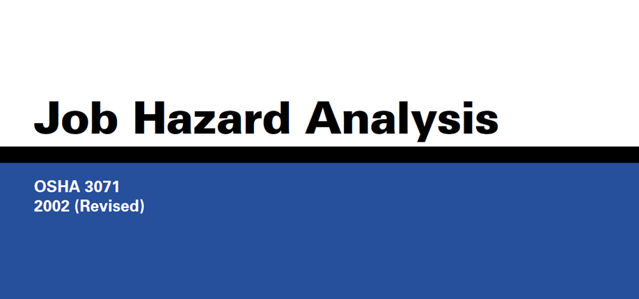

Slide 53
The Missing Links in many Safety & Health Programs
Developing a safety “attitude”
It’s a culture, not just a program.
Implementing the program successfully
Must be hands on by all employees all the time.
Inspecting what you expect
If you can’t measure it, how do you know it is working?

Slide 54
Julie Bell Waltz
515.975.7845
julie.bell@rci-safety.com

