Slide 1
The Indiana Department of Correction
presents
New Employee Orientation: Hazardous Materials

Slide 2
Performance Objectives:
Identify the information listed on a Material Safety Data Sheet (MSDS).
Identify lockout and tagout procedures.
Identify the 5 classes of fires.
Identify the 5 types of fire extinguishers.

Slide 3
Right to Know Law
In the past, workers were not always aware of the hazardous materials they might come into contact with on the job. In many cases, container labels and warning sheets did not give enough information about hazardous materials.
Today, new laws and regulations have been enacted to help employees stay safe on the job.
One of these laws is the employee “Right To Know Law” (OSHA 29, CFR 1910-1200). This law affects every organization that uses hazardous materials.
The law requires employers to take steps to ensure that employees are made aware of the hazardous materials being used on the job.

Slide 4
Health Hazards
Health Hazard is the possibility that exposure to a material will cause injury or harm. Toxic Action of a substance can be divided into two types:
1. Acute – short term high concentrations which causes illness, irritation, or death. Usually acute effects are related to an accident (spill) or lack of effective controls.
2. Chronic – occurs after continued exposure over long periods. The body accumulates substances which injures body cells and serious irreversible damage may occur.
Key elements to be considered when evaluating health hazards are:
1. Amount of material required to cause the injury.
2. Probability of absorption from contact.
3. Total time of contact.
4. Control measures in use.

Slide 5
Chemicals Are Hazardous
To Human Health In Two Ways
Materials that attack the body externally:
Corrosives
Cryogenics
Flammables
Materials that attack the body internally:
Irritants
Asphyxiates
Carcinogens

Slide 6
Modes of Internal Entry
Ingestion – the least common as far as occupational hazards are concerned.
Careless Washing
Smoking
Eating
Skin Absorption – the most common as far as occupational hazards are concerned.
Spills
Leaks
Mishandling of Materials
Inhalation – the most critical because of the speed in which a substance can reach the lungs, pass into the bloodstream and reach the brain.

Slide 7
Internal
Signs and Symptoms of Exposure
Confusion, light-headedness, anxiety, and dizziness
Blurred vision
Changes in skin color or blushing
Coughing or painful respiration
Tingling or numbness of extremities
Loss of coordination
Nausea, vomiting, abdominal cramping, diarrhea
Unconsciousness

Slide 8
External
Signs and Symptoms of Exposure
Pain on contact with the skin
Greasy slick feeling on the skin
Burning around the eyes, nose, or mouth
Nausea and vomiting
Localized burning or skin irritation

Slide 9
Material Data Safety Sheet
A Material Safety Data Sheet (MSDS)
is a document that contains information on the potential health effects of exposure to chemicals, or other potentially dangerous substances, and on safe working procedures users should adhere to when handling chemical products.

Slide 10
Material Data Safety Sheet
The Safety Hazard Manager at each facility is responsible for maintaining a master file of Material Safety Data Sheets on all products used at their facility.
A duplicate Master File will also be maintained and located in the Medical Department.
Employees are required to know the hazards of the products they may use.
Any employee who may be exposed to a hazardous product has a right to read the MSDS.
A copy of the MSDS sheet may be obtained by making a written request to the Safety Hazard Manager.

Slide 11
Material Data Safety Sheets Provide The Following Information
Manufacturer’s name, address, emergency telephone number, and the date the MSDS was prepared.
How to use, store, and handle the product.
Hazardous ingredients, chemical components and common names. This is where you will find the permissible exposure limits.
Physical and chemical characteristics, i.e. appearance and odor under normal conditions.
Physical hazards, such as fires and explosive hazards, and ways to handle these hazards.

Slide 12
Material Data Safety Sheets Provide The Following Information
Reactivity information tells you whether the substance is stable, and what other substances must be kept separated.
Health hazards of the substance, which is the most important section to the employee. This section describes how the chemical could enter the body and the possible hazards of exposure. This section also lists the signs and symptoms of exposure, as well as emergency and first aid procedures.
Spill and leak procedures
Personal Protection equipment needs

Slide 13
Labeling
Manufacturer’s labels must be kept intact on the container at all times. If torn, or defaced, or removed it must be replaced immediately.
Chemical containers may contain an NFPA 704 label. This label explains the following:
Chemical Identity – Product name.
Health Hazard – 0 to 4 – Blue – shows degree of acute health hazard.
Flammability – 0 to 4 – Red – shows susceptibility of materials to burning.
Reactivity – 0 to 4 – Yellow – shows susceptibility to react and release energy.
Specific Hazard – White – shows specifics hazards. Specific hazards would include such things as oxidizers, acids, alkalis, corrosives, etc.

Slide 14
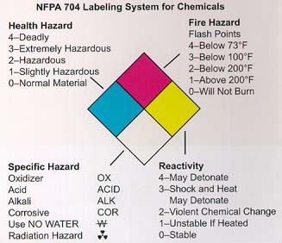
NFPA 704 Labeling System for Chemicals

Slide 15
Labeling - Hazardous Materials Identification System
Chemical containers may also have a Hazardous Materials Identification System (HMIS) label.
The color and numbering coding are identical to the NFPA 704; however, the HMIS uses a colored bar system instead of the diamond.
HMIS deals more with chronic hazards and NFPA 704 deals with more acute hazards.

Slide 16
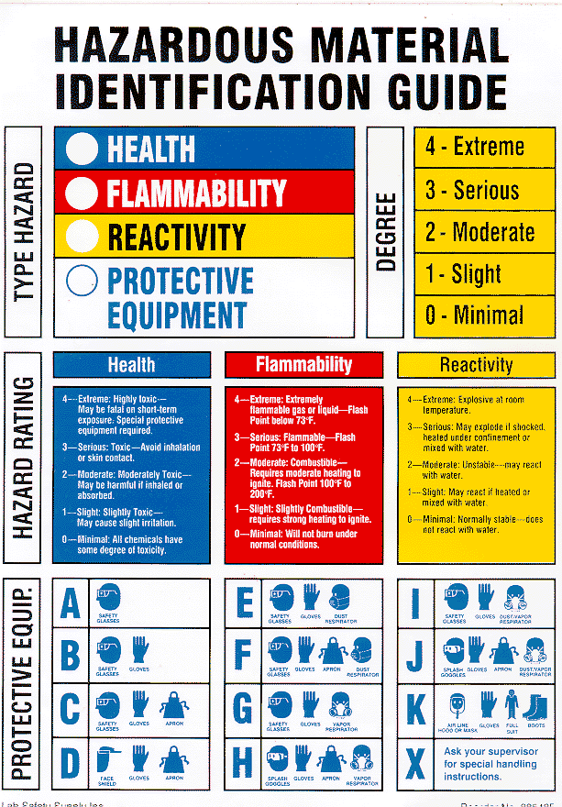
Hazardous
Material
Identification
System
Guide

Slide 17
Controlling Hazardous Materials
Only authorized staff will issue flammable, caustic, or toxic materials.
Only the amount of materials necessary for the immediate use will be issued.
All offenders using hazardous materials will be closely supervised.
All hazardous substances will be accounted for before, during, and after use.
All receipts and issues will be on the “Flammable Toxic & Caustic Inventory Issue Log”.

Slide 18
Lockout and Tagout Procedures

Slide 19
Lockout/Tagout
Lockout/Tagout refers to specific practices and procedures to safeguard employees from the unexpected startup of machinery and equipment, or the release of hazardous energy during service or maintenance activities.

Slide 20
Injuries
Approximately 3 million workers service equipment and face the risk of injury if lockout/tagout is not properly implemented.
Compliance with the lockout/tagout standard prevents an estimated 120 fatalities and 50,000 injuries each year.

Slide 21
Lockout/Tagout
Lockout/Tagout requires that a designated individual turns off and disconnects the machinery or equipment from its energy source(s) before performing service or maintenance.
Authorized employee(s) either lock or tag the energy-isolating device(s) to prevent the release of hazardous energy and take steps to verify that the energy has been isolated effectively.

Slide 22
Lockout/Tagout Procedures
Lockout/Tagout devices should be removed by the individual who originally placed the lockout/tagout device. If the employee who applied the device is unavailable, it may only be removed after management has verified the employee is not available and has ensured it is safe to remove the device.
Management must then make all reasonable efforts to contact the employee and inform them that the device has been removed.

Slide 23
Fire Safety

Slide 24
The Fire Triangle
The “Fire Triangle” identifies three (3) elements that must be present for a fire to exist. They are:
Oxygen
Fuel is a vital component of the triangle. Examples of fuel are:
Solid: Wood
Liquid: Flammable Liquids
Gas: Propane
Ordinary Combustible: Animal Fat or Vegetable Oil
Fuel
Heat

Slide 25
Fire Classification
Fires are classified by fuel type.
There are five (5) classes of fires.
Class A Ordinary Combustibles
Class B Flammable Liquids
Class C Electrical
Class D Combustible Metals
Class K Animal Fat or Vegetable Oil

Slide 26
Fire Extinguishers
Fire extinguishers are the most visible forms of fire control equipment. It is important to be familiar with the five (5) types of extinguishers.
Class A Fire Extinguisher
Extinguishing agent (water) works by cooling and absorbing heat.
Uses pressurized water for use on solid combustible fuel fire.
Class B Fire Extinguisher
Uses dry chemicals for use on flammable liquids.
Extinguishing agent (dry chemical displaces oxygen and smothers the fire.
Class C Fire Extinguisher
Uses dry chemicals for use on electrical fires.
Extinguishing agent (carbon dioxide) displaces oxygen and smothers the fire.

Slide 27
Fire Extinguishers (cont.)
Class D Fire Extinguisher
Uses dry powder for use on combustible metals
Class K Fire Extinguisher
Uses dry or wet chemical for use on animal fat or vegetable oil
Fire extinguishers can be rated for multiple fire classes. An example of this is the ABC fire extinguisher. The ABC fire extinguisher can be used on A, B, and C classes of fires.

Slide 28
P.A.S.S. Method
The method used to fight a fire with a fire extinguisher is called the P.A.S.S. method.
P.A.S.S. Method:
P = Pull the pin
A = Aim at the base of the fire
S = Squeeze the handle
S = Sweep the base of the fire

Slide 29
Fire Safety Procedures
RACE
R = Rescue - move any person who is in immediate danger
A = Alarm – pull the alarm
C = Confine - keep the fire confined, if you can, this could include shutting doors to the room where the fire is located
E = Extinguish – put the fire out if you can include

Slide 30
You have now completed the Hazardous Materials module. Please continue to the next training module by exiting this program to return to the selection list.

