Slide 1
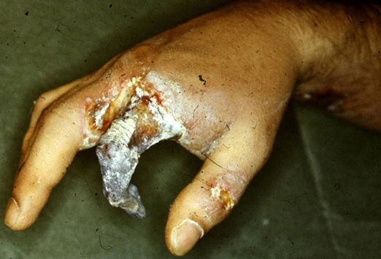
TOP WORKER COMPLAINTS ABOUT SAFETY PROGRAMS\

Slide 2
TOP `WORKER COMPLAINTS ABOUT SAFETY PROGRAMS

Slide 3
TOP `WORKER COMPLAINTS ABOUT SAFETY PROGRAMS

Slide 4
TOP `WORKER COMPLAINTS ABOUT SAFETY PROGRAMS

Slide 5
TOP `WORKER COMPLAINTS ABOUT SAFETY PROGRAMS

Slide 6
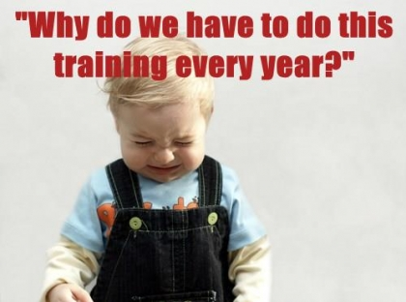
TOP `WORKER COMPLAINTS ABOUT SAFETY PROGRAMS

Slide 7
TOP `WORKER COMPLAINTS ABOUT SAFETY PROGRAMS

Slide 8
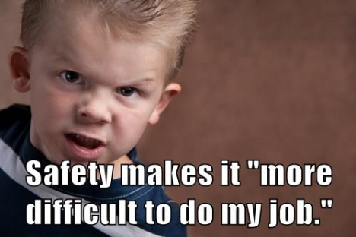
TOP `WORKER COMPLAINTS ABOUT SAFETY PROGRAMS

Slide 9
TOP `WORKER COMPLAINTS ABOUT SAFETY PROGRAMS

Slide 10
TOP `WORKER COMPLAINTS ABOUT SAFETY PROGRAMS

Slide 11
TOP `WORKER COMPLAINTS ABOUT SAFETY PROGRAMS

Slide 12
TOP `WORKER COMPLAINTS ABOUT SAFETY PROGRAMS

Slide 13
TOP `WORKER COMPLAINTS ABOUT SAFETY PROGRAMS

Slide 14
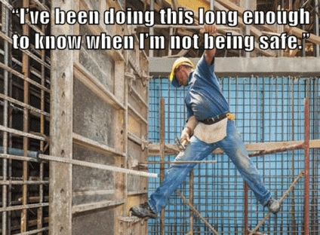
TOP `WORKER COMPLAINTS ABOUT SAFETY PROGRAMS

Slide 15
TOP `WORKER COMPLAINTS ABOUT SAFETY PROGRAMS

Slide 16
TOP `WORKER COMPLAINTS ABOUT SAFETY PROGRAMS

Slide 17
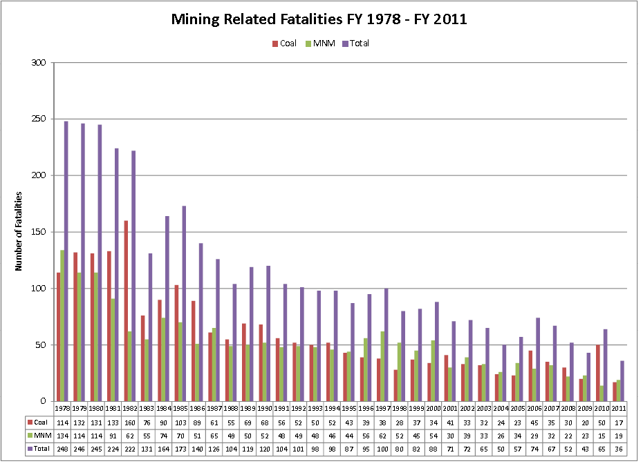
TOP `WORKER COMPLAINTS ABOUT SAFETY PROGRAMS
TOP `WORKER COMPLAINTS ABOUT SAFETY PROGRAMS

