Slide 1
Heat Stress
Notes:
The information in this presentation is provided voluntarily by the N.C. Department of Labor, Education Training and Technical Assistance Bureau as a public service and is made available in good faith. This presentation is designed to assist trainers conducting OSHA outreach training for workers. Since workers are the target audience, this presentation emphasizes hazard identification, avoidance, and control – not standards. No attempt has been made to treat the topic exhaustively. It is essential that trainers tailor their presentations to the needs and understanding of their audience.
The information and advice provided on this Site and on Linked Sites is to provided solely on the basis that users will be responsible for making their own assessment of the matters discussed herein and are advised to verify all relevant representations, statements, and information.
This presentation is not a substitute for any of the provisions of the Occupational Safety and Health Act of North Carolina or for any standards issued by the N.C. Department of Labor. Mention of trade names, commercial products, or organizations does not imply endorsement by the N.C. Department of Labor.

Slide 2

Objectives
Definitions
Causal factors
Heat disorders and health effects
Prevention and control
Engineering controls
PPE
Notes:
2
Photo: Microsoft Clip Art

Slide 3

Objectives
Work practice controls
Acclimatization
Re-acclimating
Administrative controls
Work monitoring
Training
Notes:
3
Photo: Microsoft Clip Art

Slide 4
Definitions
Heat stress
  Sum of environmental and metabolic heat loads on an individual minus the heat loss to the environment, primarily through evaporation
Heat strain
  Overall physiological response resulting from heat stress
Notes:
4
Illustration: OSHA Technical Manual

Slide 5
The Four Environmental Factors
Temperature
  Ambient air temperature
Humidity
  Amount of moisture in the air
Radiant heat
  Such as from the sun or a furnace
Air velocity
  Circulating air
Notes:
Photo: Microsoft Clip Art

Slide 6

Causal Factors
Age, weight, degree of physical fitness
Degree of acclimatization, metabolism
Use of alcohol or drugs
… as well as a variety of
medical conditions such as
hypertension all affect a
person’s sensitivity to heat.
Notes:
6
Photo: Microsoft Clip Art

Slide 7
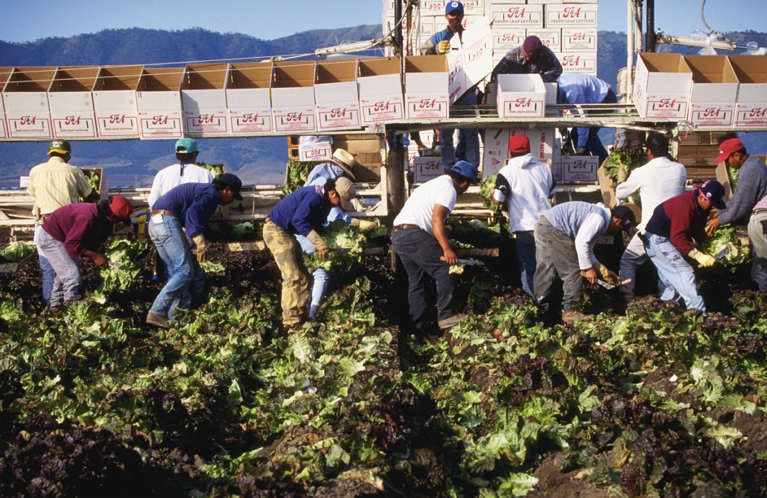
Causal Factors
Prior heat injury predisposes an individual to additional injury
Type of clothing worn must be considered
Notes:
7
Photo: Microsoft Clip Art

Slide 8
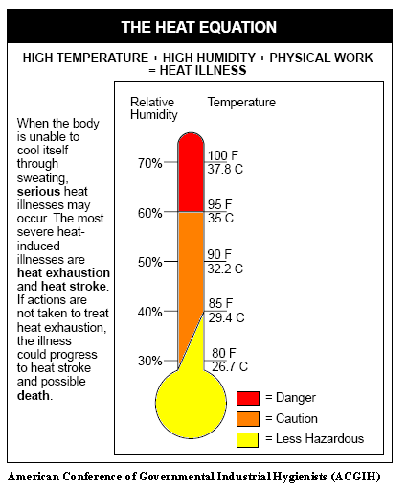
The Heat Equation

Slide 9
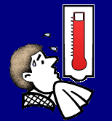
Heat Disorders and Health Effects
Heat rash
Heat cramps
Heat exhaustion
Heat stroke
Notes:
9
Illustration: OSHA Technical Manual

Slide 10
Heat Rash
Most common problem in hot work environments
Symptoms
  Prickly heat is manifested as red papules and usually appears in areas where the clothing is restrictive
  Sweat cannot freely evaporate from the skin and sweat ducts become plugged
Notes:
10
Photo: Microsoft Clip Art

Slide 11
Heat Rash
Prevention
  Prevented by breathable clothing, thorough cleansing of the skin
Treatment
  Treated by keeping skin dry, use of cooled sleeping quarters, calamine lotion
Notes:
11
Photo: Microsoft Clip Art

Slide 12

Heat Cramps
May result after excessive water loss, sweating, dehydration
Symptoms
  Shriveled skin, sunken eyes, dry mouth and tongue
  Severe pain and cramps in legs and abdomen, fainting or dizziness, weakness, profuse
  sweating, and headaches
Notes:
12
Illustration: United States Navy

Slide 13

Heat Cramps
Treatment
  Increase fluid intake, increase salt intake, rest and move to a cool place
Notes:
13
Photo: Microsoft Clip Art

Slide 14
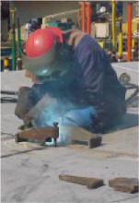
Heat Exhaustion
Blood moves toward outer body to remove heat.
  Blood pools in the skin leaving less for the brain.
Symptoms
  Fatigue, headache, dizziness, profuse sweating, rapid pulse, thirst, loss of appetite, nausea, vomiting, and fainting
Notes:
14

Slide 15
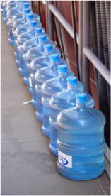
Heat Exhaustion
Treatment
  Get to the shade, cool off, increase fluids, cold wet towels or ice, fan, elevate legs above heart, loosen clothing, don’t give any liquids containing alcohol or caffeine, may need IV.
  If condition worsens, seek medical
  attention immediately.
  If left untreated, heat exhaustion can
  lead to HEAT STROKE.
Notes:
15
Photo: OSHA.gov

Slide 16

Heat Stroke
A medical emergency and a life threatening condition caused by the failure of the heat-regulating mechanisms of the body, due to high heat and humidity.
  Core temperature rises, body stops sweating
Notes:
16
Photo: Microsoft Clip Art

Slide 17
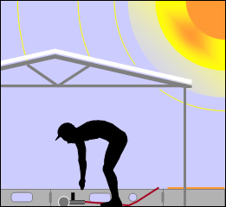
Heat Stroke
Symptoms
  Skin is hot and dry, flushed; rapid pulse; confusion; nausea; convulsions; rectal temp. > 105.8° F; unconsciousness
Notes:
17
Photo: OSHA.gov

Slide 18

Heat Stroke
Treatment
  Remove to cooler location, loosen clothing, immerse in cool water, wrap in wet sheets, cold compresses to the head, neck and groin. SEEK MEDICAL ATTENTION IMMEDIATELY.
Notes:
18
Photo: Microsoft Clip Art

Slide 19
Citations for Heat Stress?
Heat stress hazards are cited using the “General Duty Clause.”
General Duty Clause
  Each employer shall furnish to each of his employees conditions of employment and a place of employment that are free from recognized hazards that are causing or are likely to cause death or serious injury or serious physical harm to his employees.
Notes:
Microsoft ClipArt

Slide 20
The “General Duty Clause”
NCGS 95-129(1)
The employer failed to keep the workplace free of a hazard to which employees of that employer were exposed and:
  The hazard was recognized in the industry,
  The hazard was causing or likely to cause death or serious physical harm, and
  There was a feasible and useful method to correct the hazard.
Notes:
MS Clip Art

Slide 21
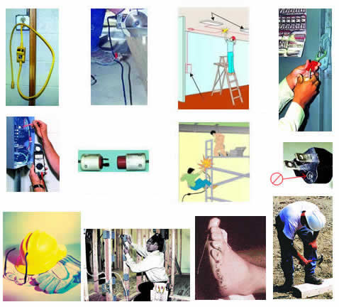
Prevention and Control
Engineering controls
Personal protective equipment (PPE)
Work practice controls
Notes:
21
Photo: CDC.gov

Slide 22

Engineering Controls
General ventilation
Air treatment/air cooling – air conditioning
Local air cooling
Convection
Heat conduction
Radiant heat sources
  Shielding
  Insulation and surface modification
Notes:
22
Photo: OSHA.gov

Slide 23
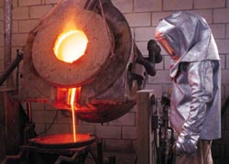
Personal Protective Equipment
Reflective clothing
Auxiliary body cooling
  Ice vests
  Wetted clothing – low humidity
  Water-cooled garments – hoods, vests and “long johns”
  Circulating air – vortex tubes, compressed air
Notes:
23
Photo:OSHA.gov

Slide 24

Work Practice Controls
Work rate
  The fastest way to decrease the rate of heat production is to decrease the work rate.
Age – (over 40)
  The maximum possible output of heat decreases with age.
  Older people start sweating later and at a lower rate.
Body size
  Skin area to weight ratios
Notes:
24
Photo: OSHA.gov

Slide 25
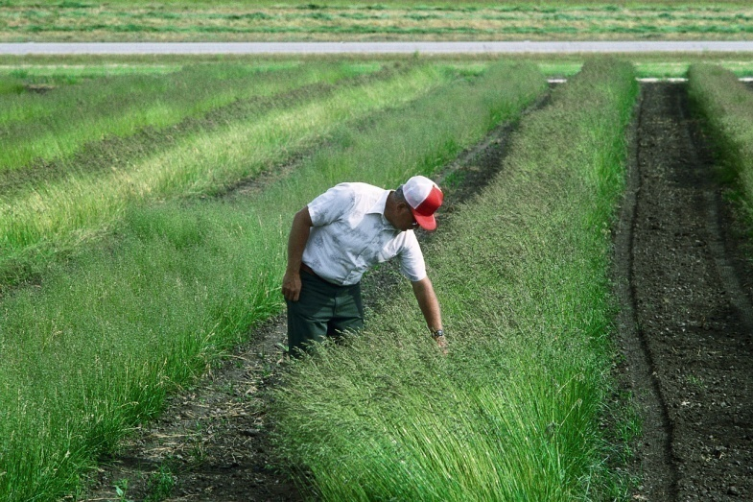
Acclimatization
Acclimatization
  Successive heat exposures of at least one hour per day
  Initially, 20% exposure for the first day, followed by 20% per day increase in exposure over the next four days
Notes:
25
Photo: Microsoft Clip Art

Slide 26
Re-Acclimating
After long absences
  50% exposure on day back
  20% per day increase for the next 2 days
  Final 10% on the 3rd day
Notes:
26
Photo: Microsoft Clip Art

Slide 27

Administrative Controls
Administrative controls
  Perform work activities during cooler periods of the day
  Minimize activity in hot area
  Slow down the work pace
  Reduce the number and duration of exposures
  Wear proper clothing
  Provide recovery areas
Notes:
27
Photo: Microsoft Clip Art

Slide 28

Work Monitoring Programs
Personal monitoring
  Heart rate
  Recovery heart rate
  Oral temperature
  Extent of body water loss
Notes:
28
Photo: Microsoft Clip Art

Slide 29
Training
Knowledge of hazards
Predisposing factors – age, etc.
Signs and symptoms
PPE
First aid
Health effects of heat stroke
Notes:
29
Photo: Microsoft Clip Art

Slide 30
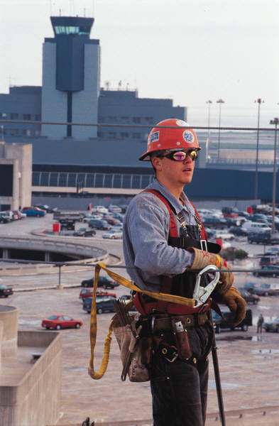
Bottom Line
Excessive heat in the work environment can lead to:
  Serious physical harm, and
  Even death
The keys are:
  Recognition of the potential, and
  Prevention
Notes:
30
Photo: Microsoft Clip Art

Slide 31
Summary
Definitions
Causal factors
Heat disorders and health effects
Prevention and control
Engineering controls
PPE
Notes:
Photo: Microsoft Clip Art

Slide 32
Summary
Work practice controls
Acclimatization
Re-acclimating
Administrative controls
Work monitoring
Training
Notes:
32
Photo: Microsoft Clip Art

Slide 33
Thank You For Attending!
Final Questions?
Notes:
For web training: Tell students that now is time they log out of the session, if they have no further questions.

