Slide 1
Heat Illness Prevention 2014 DOL Safety Training Stand Down Heather Martin, MSPH

Slide 2
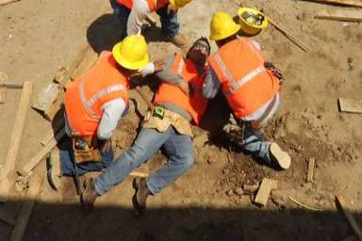
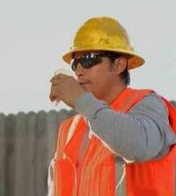
Heat Illness: Matter of Life or Death
Heat is the leading weather-related killer in the US- more than hurricanes, tornadoes, floods, lightning or any other weather event combined.
In 2012 there were 31 heat-related worker deaths and 4,120 heat-related worker illnesses
Many people may work through early symptoms
Early and quick action can save lives

Slide 3
Background: Heat Illness
Heat Illness most affects those who have not built up a tolerance to the heat (acclimatization)
OSHA found that acclimatization programs were an integral part of heat illness prevention programs
Lack of acclimatization related to severe heat illness or death in 74% of OSHA heat-related 5(a)1 citations from 2012 and 2013
Notes:
Heat Illness most affects those who have not built up a tolerance to the heat (ac·cli·ma·ti·za·tion).
Acclimatization allows us to handle the heat better. The workload for these workers should be gradually increased or they should be allowed more frequent breaks during the first week. Workers might be at greater risk than others if they have not built up a tolerance to hot conditions because they are new to working in hot environments or they have been away from hot working conditions for more than a week. That means that even if the worker has been doing this every summer for many years, there is still an adjustment period when the weather becomes hotter. Everyone is at risk during a heat wave.
OSHA found that acclimatization programs were an integral part of heat illness prevention programs.
OSHA conducted a systematic review of 19 enforcement cases in 2014. 12 were fatalities and the rest were severe heat-related illnesses.
Lack of acclimatization related to severe heat illness or death in was found in 74% of OSHA heat-related 5(a)1 citations from 2012 and 2013.
In addition, lack of heat illness prevention programs in general, but especially the lack of acclimatization, puts workers more at risk for heat-related illness or death.
The focus for this year’s Campaign is getting the word out about acclimatization as an essential element of a comprehensive heat illness prevention program.
Allow workers to get used to hot environments by gradually increasing exposure. New workers and all workers returning from a prolonged absence should begin with 20% of the workload on the first day, increasing incrementally by no more than 20% each subsequent day. During a rapid change in excessively hot weather, even experienced workers should begin on the first day of work in excessive heat with 50% of the normal workload and time spent in the hot environment, 60% on the second day, 80% on day three, and 100% on the fourth day. Full acclimatization may take up to 14 days or longer depending on factors related to the individual or the environment.

Slide 4
What is heat illness?
The body normally cools itself by sweating.
During hot weather, especially with high humidity, sweating isn't enough.
Body temperature can rise to dangerous levels if precautions are not taken.

Slide 5
Risk factors for Heat Illness
Personal factors
Medical conditions
Physical fitness
Age
Physical activity
Medications (prescription and OTC)
Level of hydration
Caffeine and alcohol
Clothing
Notes:
Medical conditions:
Diabetes
Heart disease and high blood pressure
Obesity
Thyroid disease
Infections
GI disease
Pregnancy
Skin problems - sunburns
Medications:
Muscle relaxants
Aspirin, Ibuprofen, and other non-steroidal anti-inflammatory meds (NSAIDs)
Cold and allergy medication, including over-the-counter (decongestants, anti-histamines)
Illegal drugs (amphetamines, cocaine)
Blood pressure medication (diuretics and others)
Thyroid medications
Psychiatric and anxiety medication
Personal factors-we each handle stress differently
Key systems in the front line of heat regulation are the skin and the heart – need the heart to be able to pump all that blood to the the periphery to allow it to reach the capillary cooling beds, the skin must be working so that sweat and evaporation occurs as efficiently as possible.
medical conditions—diabetes, thyroid disease, infections and GI disease
Physical activity – especially if new to the job. With moderate exercise 10-15 times more heat is produced than resting, with exercise 70-80% of the heat produced nust be dissipated.
Medications—blood pressure meds and OTC cold medications can limit heat intolerance
Clothing- may decrease movement of air through fabric, best to wear lightweight, light colored loose fitting clothing which may not be appropriate for most outdoor work environments
Hydration- inadequate water intake during the workday
Caffeine-acts as a diuretic

Slide 6
Types of Heat Illness
Heat Exhaustion
Heat Rash
Heat Cramps
Heat Exhaustion
Heat Stroke
Heat Stroke

Slide 7
Symptoms of Heat Exhaustion
Dizziness
Headache
Sweating
Weakness
Cramps
Nausea, vomiting
Fast heartbeat
Heat Exhaustion

Slide 8
Treatment for Heat Exhaustion
Move out of sun, lay down and loosen clothing
Apply cool, wet cloths
Move to air conditioning
Seek medical attention for evaluation and treatment.

Slide 9
Symptoms of Heat Stroke
Red, hot dry skin
High temperature
Confusion
Convulsions
Fainting
Heat Stroke

Slide 10
Treatment for Heat Stroke
Heat stroke is a severe medical emergency!
Get emergency medical assistance and/or get the individual to the hospital immediately.
Move the individual to a cooler, air-conditioned environment.
Do not give fluids.

Slide 11
We Can Prevent Heat Illness
Heat Exhaustion and Heat Stroke can be prevented:
Have a program including acclimatizion
Recognize signs and symptoms of heat exhaustion and heat stroke
Know when to take action
Know what to do when early symptoms are identified
Include frequent water breaks, provide shade and allow ample time to rest
Heat Exhaustion
Heat Stroke
Notes:
Employers are responsible for providing workplaces that are safe from excessive heat.
Employers should establish a complete heat illness prevention program to prevent heat illness.
This includes elements such as:
Track and identify the hazard (using wet bulb globe temperature (WBGT) thermometer, NOAA Heat index with 15 degree correction in direct sunlight, OSHA heat tool smartphone application)
Gather and have supplies handy to supply water, rest and shade to workers.
Plan for and allowing acclimatization to gradually build a tolerance for working in the heat, especially for new or returning workers or for all during a heat wave
Modified Work Schedules as necessary
Training to workers and supervisors
Emergency Planning and Response
Physiological, Visual, Verbal Monitoring
OSHA's key pieces of advice for workers are:
Drink water every 15 minutes, even if you're not thirsty.
Rest in the shade to cool down.
Wear a hat and light-colored clothing.
Learn the signs of heat illness and what to do in an emergency.
Keep an eye on fellow workers.
“Easy does it” on your first few days of work to get used to it and acclimatize.

Slide 12
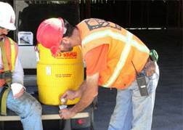
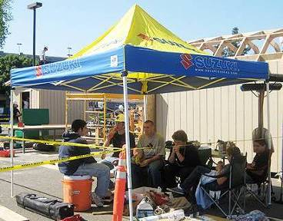
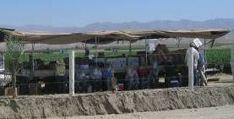
Prevention Campaign
REST
WATER
SHADE
Notes:
OSHA’s Heat Illness Prevention Campaign stresses that workers should be taught three simple things: Water, Rest, Shade.
Providing these three basics to workers will greatly reduce the workplace heat illness risk.
Employers should remind workers not to wait until they are thirsty; they should be encouraged to drink small amounts of water before they become thirsty to maintain good hydration.
OSHA’s 2014 Heat Illness Prevention Campaign aims to raise awareness and educate workers and employers about the dangers of working in hot weather and provide resources and guidance to address these concerns. OSHA’s 2014 Heat Campaign aims to promote these resources available and disseminate the message of “Water, Rest, Shade” to all outdoor workers and their employers.
The campaign’s focus is outreach and guidance and OSHA utilizes media public service announcements, a partnership to provide heat advisory messages with the National Oceanic Atmospheric Administration (NOAA) National Weather Service as well as other stakeholders and Cooperative Program participants, social marketing, and trainings to reach workers, employers and community organizations. We ask you to help disseminate this message as well and promote these resources to get the message and information out. Use #(hashtag)WaterRestShade on twitter and Facebook messages to join the conversation.

Slide 13
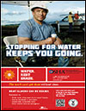
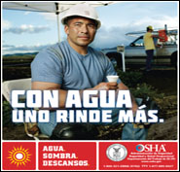
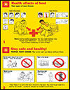
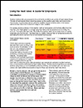
Heat Illness Prevention Resources www.osha.gov/heat
Website
Illustrated, Low-Literacy Fact Sheets
Worksite Poster
Community Poster
Training Guide
Using the Heat Index:
A Guide for Employers
Outreach Wallet Card
OSHA's Heat Smartphone App
OSHA Compliance Assistance
1-800-321-OSHA
All are free and available in SPANISH
Notes:
OSHA has developed a number of resources to raise awareness, educate workers and employers about the dangers of heat illness and guidance to prevent it in the workplace. They are available in English and Spanish on OSHA’s website.
Illustrated, Low-Literacy Fact Sheets have pictured heat illness symptoms and prevention strategies.
Worksite Poster is a Poster to hang in worksite with heat illness symptoms and prevention strategies. Community Poster is an awareness poster with heat illness prevention messages and OSHA contact information.
OSHA Heat Illness Prevention Training Guide is a guide to carry out heat safety training, with short lesson plans that can be used during tailgate or toolbox talks.
Using the Heat Index: A Guide for Employers is a guide to planning for heat at the workplace and taking precautions based on heat index. Describes work/rest schedules, precautions to take based on the heat index and how to take them, training, and checklists.
Outreach Wallet Card is a two-sided business card with message on one side and heat illness symptoms on the other. QR Code links to OSHA Heat Illness Prevention Website to access more materials. Can be kept in wallet to use in event of an emergency and great to hand out at worksites.
OSHA's Heat Smartphone App App calculates heat index for current location and provides guidance to prevent illness.
All of these resources are available in Spanish! There are links to some resources available in other languages on the website.

Slide 14
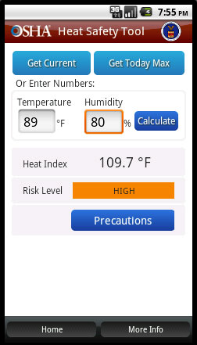
OSHA Smartphone App
Calculates heat index
Displays risk level
Provides protective measures (precautions) based on risk
Notes:
We have a great tool to allow workers and supervisors to calculate the heat index for their worksite, and, based on the heat index, displays a risk level.
Then, with a simple "click," you can get reminders about the protective measures that should be taken at that risk level to protect workers from heat-related illness-reminders about drinking enough fluids, scheduling rest breaks, planning for and knowing what to do in an emergency, adjusting work operations, gradually building up the workload for new workers, training on heat illness signs and symptoms, and monitoring each other for signs and symptoms of heat-related illness.
Join the other 130,000 people and counting who have downloaded it too and download it as well, use it throughout the day to get the latest recommendations based on your location.

Slide 15
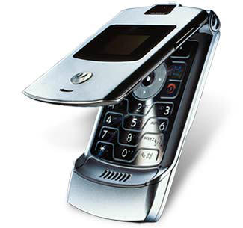
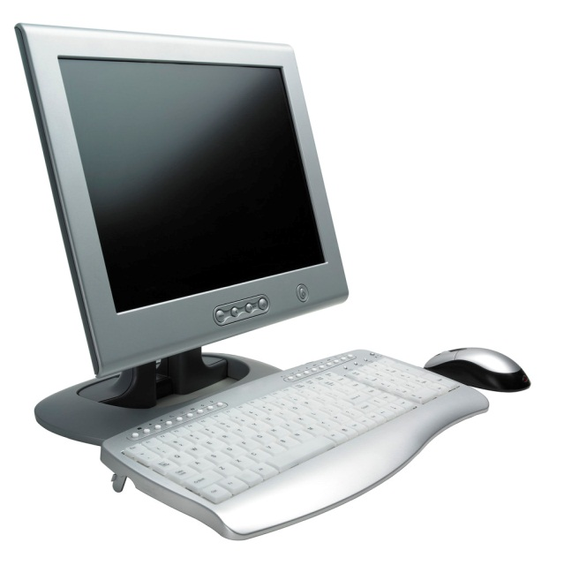
Compliance Assistance
OSHA offers compliance assistance to employers:
Contact OSHA
1-800-321-OSHA (6742). It’s free.
For other compliance assistance information and services…
www.osha.gov
Occupational Safety
and Health Administration
U. S. Department of Labor
Notes:
Additional information about heat illness and the OSHA resources available to assist you in addressing this hazard can be found at www.osha.gov or by contacting OSHA at 800-321-6742.”

Slide 16
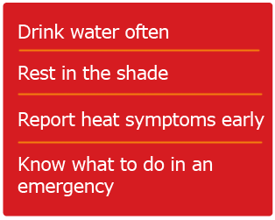
Thank you!
Questions?
#WaterRestShade

