Slide 1
SAFETY TALK
Winter Driving
Winter is an especially dangerous time for Colby workers who must drive on the job. Winter conditions in Central Maine can extend from early November to the end of April. And “winter” is more than just snow and ice. Freezing rain, fog, and reduced visibility are all part of winter hazards for Colby’s drivers. The following tips will help you reduce your risk of an accident while driving at work this winter.
Winter Driving Tips:
Make sure that your vehicle is winter road worthy: good tires, working heater/defroster, and good brakes.
Make sure your vehicle windows and headlights are clear of ice and snow before operating.
Accelerate and decelerate slowly. Don’t try to get moving in a hurry. And take time to slow down.
Drive slowly. Everything takes longer on snow-covered roads. Accelerating, stopping, turning—nothing happens as quickly as on dry pavement.
The normal dry pavement following distance of two to four seconds should be increased to eight to ten seconds.
Don’t power up hills. Applying extra gas on snow-covered roads just starts your wheels spinning. Try to get a little inertia going before you reach the hill and let that inertia carry you to the top. As you reach the crest of the hill, reduce your speed and proceed downhill as slowly as possible.

Slide 2
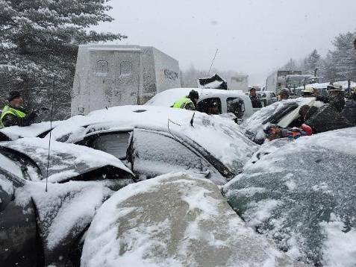
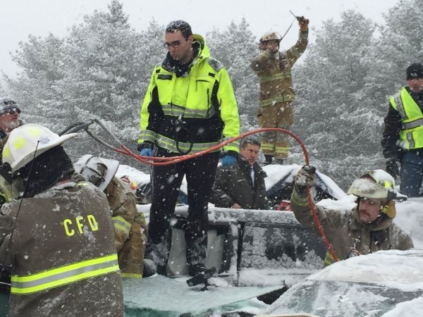
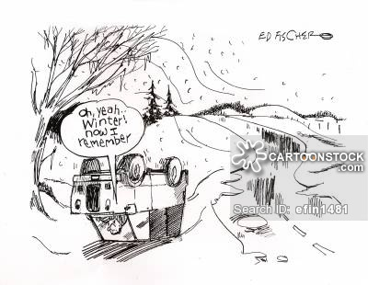
Walk like a penguin with arms extended to the side and weight centered over your front leg.
SAFETY TALK
Winter Driving
Accident Case Study:
February 25, 2015: speed, following too closely, the weather conditions, and limited visibility all played a role in the worst highway crash in Maine history.
75 cars on I-95 were involved in a chain-reaction crash.
50 of the cars had to be towed from the scene.
17 people were severely injured , however there were no fatalities.
I-95 was closed for 5 hours.
At the time of the accident there was less then an inch of snow, however the road was slippery and the reduced speed limits (45mph) were in effect.
Due to the chaos at the scene and size of the accident, the exact cause of the accident could not be determined.
The Numbers:
1.5 million vehicular crashes annually in the United States due to winter road conditions
70% of winter weather deaths in the US are caused by icy road accidents
116,000 Americans are hospitalized annually due to winter road conditions

Slide 3
SAFETY TALK
Winter Driving
Review / Discussion Questions:
What are your biggest challenges driving for Colby in the winter?
How do you personally manage the hazards?
Are Colby’s vehicles properly equipped for winter operation?
Printed Name
Signature
Questions, concerns or comments contact the EHS Director at extension 5504 .

