Slide 1
Subpart CC
Cranes & Derricks
in Construction
Effective 11/8/2010

Slide 2
Important Dates
Release Date: July 28, 2010
Publish Date: August 9, 2010
Effective Date: November 8, 2010
Rigger Certification Date: November 8, 2010
Operator Certification Date: August 9, 2014

Slide 3
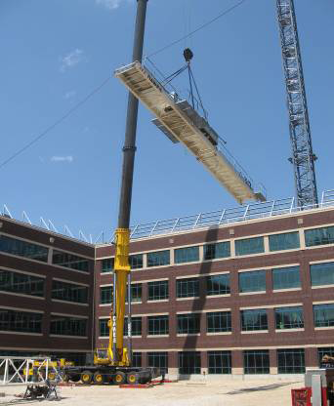
Scope
The standard applies to power operated equipment, when used in construction, that can hoist, lower and horizontally move a suspended load.
1926.1400

Slide 4
Includes
Articulating (knuckle-boom) Cranes
Crawler cranes
Floating cranes
Cranes on barges
Locomotive cranes
Mobile cranes (wheel- mounted, rough-terrain, all- terrain, commercial truck- mounted, and boom truck cranes)
Multi-purpose machines when configured to hoist and lower (by means of a winch or hook) and horizontally move a suspended load
Industrial cranes (such as carry-deck cranes); dedicated pile drivers; service/mechanic trucks with a hoisting device
Crane on a monorail
Tower cranes (such as fixed jib, “hammerhead boom”, luffing boom and self-erecting)
Pedestal cranes
Portal cranes
Overhead and gantry cranes
Straddle cranes
Side-boom tractors
Derricks
1926.1400

Slide 5
Excludes
Power shovels, excavators, wheel loaders, backhoes, loader backhoes, track loaders. This machinery is also excluded when used with chains, slings or other rigging to lift suspended loads
Automotive wreckers and tow trucks
Digger derricks when used for augering holes for poles carrying electric and telecommunication lines, placing and removing the poles, and for handling associated materials to be installed on or removed from the poles
Telescopic/hydraulic gantry systems
1926.1400

Slide 6
Excludes
Bucket Trucks & Aerial Lifts
Stacker cranes
Powered industrial trucks (forklifts), except when configured to hoist and lower (by means of a winch or hook) and horizontally move a suspended load
Mechanic’s truck with a hoisting device when used in activities related to equipment maintenance and repair
Machinery that hoists by using a come-a-long or chain fall
Dedicated drilling rigs
Gin poles used for the erection of communication towers
1926.1400

Slide 7
Excludes
Tree trimming and tree removal work
Anchor handling or dredge related operations with a vessel or barge using an affixed A-frame
Roustabouts
Helicopter cranes
Material Delivery when the articulating/knuckle-boom crane is used to hold, support or stabilize the material to facilitate a construction activity, such as holding material in place while it is attached to the structure; steel members, prefabricated units, etc.
1926.1400

Slide 8
Attachments
The standard applies to “included equipment” when used with attachments whether crane-attached or suspended. These attachments include, but are not limited to: Hooks, magnets, grapples, clamshell buckets, orange peel buckets, concrete buckets, drag lines, personnel platforms, augers or drills and pile driving equipment
1926.1400

Slide 9
Definitions
Attachments: any device that expands the range of tasks that can be done by the equipment. Examples include, but are not limited to: An auger, drill, magnet, pile-driver, and boom-attached personnel platform.
Controlling Entity: an employer that is a prime contractor, general contractor, construction manager or any other legal entity which has the overall responsibility for the construction of the project.
Hoist; mechanical device for lifting and lowering loads by winding a line onto or off a drum.
1926.1401

Slide 10
Definitions
Multi-purpose machine: a machine that is designed to be configured in various ways, at least one of which allows it to hoist (by means of a winch or hook) and horizontally move a suspended load.
Proximity Alarm: a device that provides a warning of proximity to a power line and that has been listed, labeled, or accepted by a Nationally Recognized Testing Laboratory
1926.1401

Slide 11
Definitions
Qualified Person: person who, by possession of a recognized degree, Certificate, or professional standing, or who by extensive knowledge, training and experience, successfully demonstrated the ability to solve/ resolve problems relating to the subject matter, the work, or the project.
Qualified Rigger: a rigger who meets the criteria for a qualified person.
1926.1401

Slide 12
Ground Conditions
Ground conditions means the ability of the ground to support the equipment (including slope, compaction, and firmness).
The equipment must not be assembled or used unless ground conditions are firm, drained, and graded to a sufficient extent so that, in conjunction (if necessary) with the use of supporting materials, the equipment manufacturer’s specifications for adequate support and degree of level of the equipment are met
1926.1402

Slide 13
Ground Conditions
Controlling Entity must:
  Provide adequate conditions sufficient to support the crane (i.e. firm, drained & graded) in conjunction with blocking, mats, etc.
  Inform User and Equipment Operator of Known Underground Hazards (voids, utilities, etc.)
1926.1402

Slide 14
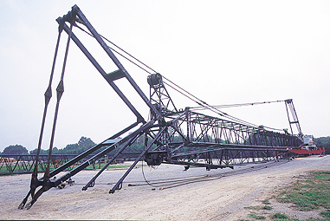
Assembly/Disassembly
Two Options:
Manufacturer procedures or
Employer procedures (criteria requirements)
1926.1403 to 1406

Slide 15
Assembly/Disassembly
Assembly/Disassembly Supervisor must be a competent and qualified person
Assembly/Disassembly Supervisor must understand procedures and:
  Review procedures (unless they’ve used them before)
  Check that crew members understand their tasks and hazards
  Follow manufacturer’s prohibitions
  All rigging work is by a Qualified Rigger
  When using outriggers, fully extended or deployed per the load chart
1926.1403 to 1406

Slide 16
Assembly/Disassembly
Assembly/Disassembly Supervisor must addresses 12 Key Hazards Including:
  Adequate site and ground conditions
  Sufficient blocking for load and stability
  Suitable boom and jib pick points
  Identify center of gravity
  Stability for pin removal
  Consider wind speed and weather
1926.1403 to 1406

Slide 17
Assembly/Disassembly
12 Key Hazards (continued):
  The suitability of blocking material
  Verification of the loads for assist cranes
  Snagging of cables or components
  Struck by counterweights
  Boom hoist brake failure
  Loss of backwards stability
1926.1403 to 1406

Slide 18
Employer Procedures
Must be developed a Qualified Person
When using employer procedures, the employer must ensure that:
  Prevent unintended dangerous movement, and prevent collapse, of any art of the equipment.
  Provide adequate support and stability of all parts of the equipment.
  Position employees involved in the assembly/disassembly operation so that their exposure to unintended movement or collapse of part or all of the equipment is minimized.
1926.1403 to 1406

Slide 19
Power Lines < 350kV
If crane assembly/disassembly or operation occurs within 20 feet of a power line, the employer must:
  Identify Work Zone
    Work Zone = marking boundaries of operation OR
    Define area as 360 degrees around crane, up to maximum working radius
  Determine if any part of the equipment, load line or load could get closer than 20 feet to a power line. If so, the employer must meet the requirements in Option (1), Option (2), or Option (3)
1926.1407 to 1408

Slide 20
Power Lines < 350kV
Option (1)—Deenergize and ground.
Option (2)—20 foot clearance. Ensure that no part of the equipment, load line, or load gets closer than 20 feet to the power line by implementing the measures specified in the Preventing Encroachment/Electrocution section.
Option (3)—Table A clearance.
  (A) Determine the line’s voltage and the minimum approach distance permitted under Table A (see § 1926.1408).
  (B) Determine if any part of the equipment, load line or load could get closer than the minimum approach distance of the power line permitted under Table A. If so, then the employer must follow the Preventing Encroachment/Electrocution section to ensure that no part of the equipment, load line, or load gets closer to the line than the minimum approach distance.
1926.1407 to 1408

Slide 21
Power Lines < 350kV
Preventing Encroachment/Electrocution (all req’s must be met)
Conduct a planning meeting with operator /workers to review the location of the power line(s), and the steps that will be implemented to prevent encroachment/ electrocution.
Use non-conductive tag lines.
Erect and maintain an elevated warning line, barricade, or line of signs, in view of the operator, equipped with flags or similar high-visibility markings, at 20 feet from the power line or at the minimum approach distance under Table A (whichever is less)
If the operator is unable to see the elevated warning line, a dedicated spotter must be used in addition to implementing at least one of the measures described in §§ 1926.1408(b)(4)(i), (iii), (iv) and (v).
1926.1407 to 1408

Slide 22
1926.1408(b)(4)(i), (iii), (iv) and (v)
(4) Implement at least one of the following measures:
    A proximity alarm
    A dedicated spotter
    A device that automatically warns the operator when to stop movement,
    A device that automatically limits range of movement, set to prevent encroachment.
    An insulating link/device, as defined in § 1926.1401, installed at a point between the end of the load line (or below) and the load.
1926.1407 to 1408

Slide 23
Power Lines > 350kV
Same Rules apply as in <350kV lines, except:
  For power lines at or below 1000 kV, the specified distance is “50 feet” not “20 feet”
  For power lines over 1000 kV, the minimum clearance distance must be established by the utility owner/operator or registered professional
1926.1409

Slide 24
All Power Lines
If any operations closer than then minimums defined in Table A, all of the following requirements must be met
Employer must determine that it is infeasible to complete work without breaching the Table A minimum distance
Employer & Power Line Owner must determine that it is infeasible to ground and/or deenergize line
The Power Line Owner or an RPE must determine the minimum working distance from the line
The Employer & Power Line Owner (RPE if applicable) must meet to develop specific procedures for the work (See Minimum Procedures)
1926.1410

Slide 25
All Power Lines (continued)
"Minimum Procedures" must be documented and immediately available on-site
Employer & Power Line Owner must meet with the equipment operator and workers to review the procedures
Power Line Owner & all employers of employees involved in the work must identify one person who will direct the implementation of the procedures
Employer must stop work if there are indications these procedures will be ineffective. They must develop new procedures or deenergize and visibly ground or relocate the power line before resuming work
1926.1410

Slide 26
All Power Lines (continued)
Devices originally designed by the manufacturer for use as a safety device, operational aid, or a means to prevent power line contact or electrocution, when used to comply with this section, must comply with the manufacturer’s procedures for use and conditions of use
Employer must train each operator and crew member assigned to work with the equipment in accordance with § 1926.1408(g)
1926.1410

Slide 27
Minimum Procedures
Minimum Procedure must include:
Power line is reenergizing circuitry must be made inoperative
A dedicated spotter
An elevated warning line, or barricade in view of the operator
Insulating link/device (many exceptions apply)
Use of nonconductive rigging
If a tag line is used, it must be of the nonconductive type
1926.1410

Slide 28
Minimum Procedures (continued)
Minimum Procedure must include:
If equipment is equipped with range limiting device, it must be set to prevent breaching the minimum distance
Establish 10’ perimeter around equipment with barricades
Workers other than the operator must be prohibited from touching the load line above the insulating link/ device
Only personnel essential to the operation are permitted to be in the area of the crane and load.
The equipment must be properly grounded.
Insulating line hose or cover-up must be installed by the utility owner/ operator
1926.1410

Slide 29
Crane Movement – No Load
When moving cranes near power lines w/ no load:
The boom/mast and boom/mast support system are lowered sufficiently
The clearances specified in Table T of this section are maintained
Consider effects of speed & terrain on equipment movement (including movement of the boom/mast)
Dedicated spotter if any part of the equipment while traveling will get closer than 20 feet to the power line
Night /Poor Visibility = illuminate lines/designate safe path
1926.1411

Slide 30
Table T
TABLE T—MINIMUM CLEARANCE DISTANCES WHILE TRAVELING WITH NO LOAD
Voltage (nominal, kV, alternating current) While traveling—minimum clearance distance (feet)
up to 0.75 ................................................................................................. 4 over .75 to 50 ........................................................................................... 6 over 50 to 345 .......................................................................................... 10 over 345 to 750 ........................................................................................ 16 Over 750 to 1,000 .................................................................................... 20 Over 1,000 (as established by the utility owner/operator or registered professional engineer who is a qualified person with respect to electrical power transmission and distribution).
1926.1411

Slide 31
Equipment Inspections
What | When | By Who
Modified Equipment | After modifications & prior to use | Qualified Person
Repaired/Adjusted Equipment | After repair & prior to use | Qualified Person
Post Assembly | Prior to use | Qualified Person
Each Shift | Before or during shift | Competent Person
Monthly | Monthly per Each Shift Criteria | Competent Person
Annually/Comp. | At least every 12 months w/ “Each Shift” & extended inspection criteria | Qualified Person
Severe Service | Reasonable probability of damage | Qualified Person
Not In Use (90 days) | Monthly inspection prior to use | Qualified Person
Monthly Inspection must be documented per standard
Annual Inspection must be documented per standard
1926.1412

Slide 32
Each Shift Inspection
Control mechanisms for maladjustments interfering with proper operation
Control/drive mechanisms for apparent excessive wear of components
Air, hydraulic, & other pressurized lines for deterioration or leakage
Hydraulic system for proper fluid level
Hooks and latches for deformation, cracks, excessive wear, or damage
Wire rope reeving for compliance with the manufacturer’s specifications
Wire rope
Electrical apparatus for malfunctioning
1926.1412

Slide 33
Each Shift Inspection
Tires (when in use) for proper inflation and condition
Ground conditions around the equipment for proper support
The equipment for level position within the Operator cab windows for significant cracks, breaks, or other deficiencies
Rails, rail stops, rail clamps and supporting surfaces when the
equipment has rail traveling
Safety devices and operational aids for proper operation
Any deficiencies that constitute safety hazard means equipment must be taken out of service
1926.1412

Slide 34
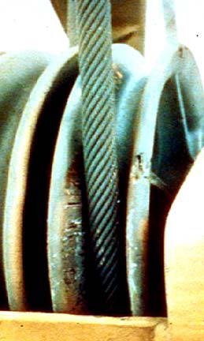
Wire Rope Inspection
Shift Inspection: A competent person must visually inspection equipment prior to each shift. Must be completed before or during that shift
Monthly: A qualified person must complete an inspection using Shift Inspection criteria. Inspection must be documented
Annual: A qualified person must complete an inspection using Shift Inspection & additional criteria. Inspection must be documented
1926.1413

Slide 35
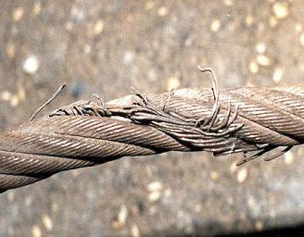
Wire Rope Inspection (continued)
Shift inspection includes:
Apparent deficiencies (Categories I, II, & III)
Critical review items
Removal from service
criteria
1926.1413

Slide 36
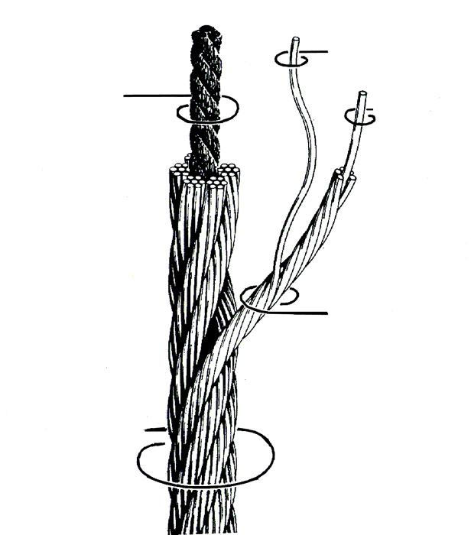
Wire Rope Selection
Original equipment wire rope and replacement wire rope must be selected and installed in accordance with the Standard. Selection of replacement wire rope must be in accordance with the recommendations of the wire rope manufacturer, the equipment manufacturer, or a qualified person
1926.1414

Slide 37
Safety Devices
Operations must not begin until all devices listed below are in proper working order
Crane level indicator
Boom stops, except for derricks and hydraulic booms
Jib stops (if a jib is attached), except for derricks
Equipment with foot pedal brakes must have locks
Hydraulic outrigger & stabilizer jacks must have an integral holding device/check valve
Equipment on rails must have rail clamps and rail stops, except for portal cranes
Horn
1926.1415

Slide 38
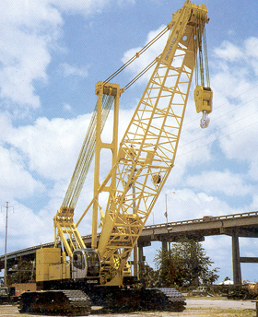
Operational Aids
Required on all equipment except articulating cranes and digger derricks manufactured before 11/8/2011
Category I Aids must be repaired within 7 days after deficiency occurs
Category I Aids must be repaired within 30 days after deficiency occurs
Temporary Alternative Measures are allowed during repair period
1926.1416

Slide 39
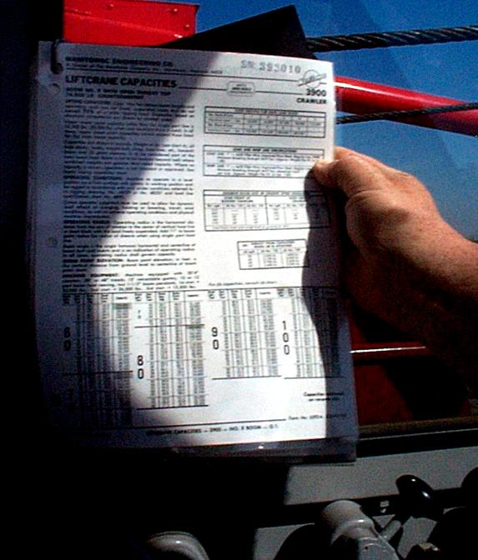
Operational Aids
Category I Aids
  Boom hoist limiting device
  Luffing jib limiting device
  Anti two blocking device
Category II Aids
  Boom angle or radius indicator
  Jib angle indicator luffing jib in use
  Boom length indicator (telescoping boom)
  Load weighing/similar device
  Outrigger/stabilizer position sensor/monitor (after 11/8/2011)
  Hoist drum rotation indicator (after 11/8/2011)
1926.1416

Slide 40
Operations
Operation must follow manufacturer’s recommendations
If manufacturer’s recommendations are not available, procedures must be developed by a qualified person
If manufacturer’s recommendations are not available, capacities must be developed by an RPE
Load charts, operator’s manuals, etc. must be readily available in the cab at all times
All loads that are to be received must be rigged by a qualified rigger
No operator distractions including no cell phone unless used for signaling
1926.1417

Slide 41
Operations
Suspended loads cannot be left unattended unless specific requirements are met
Tag Out requirement for out of service equipment
Storm warning requirement for equipment securing
Notification of required repairs by operator (in writing)
Various operational requirements & restrictions
Equipment must not be operated in excess of its rated capacity
Operator must verify the load is within the rated capacity of the equipment using various means
1926.1417

Slide 42
Authority to Stop Work
Whenever there is a concern as to safety, the operator must have the authority to stop and refuse to handle loads until a qualified person has determined that safety has been assured
1926.1418

Slide 43
Signals
Signal Person - When Required:
  Point of operation not in full view of operator
  View of direction of travel is obstructed
  Site specific safety concerns
  Signal Types:
  Hand, voice, audible or “new”
  Only time an operator can use a cell phone while lifting
1926.1419 through 1422

Slide 44
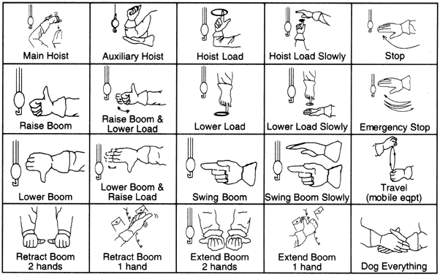
Signals
Hand signals must be posted on or near the equipment
If voice signals used, operator & signalman must meet in advance to discuss signals
1926.1419 through 1422

Slide 45
Signal Person Qualifications
Qualification | Documentation Required? | Portable?
3rd Party Qualified Evaluator | Yes | Yes
Employer Qualified Evaluator | Yes | No
  Know & understand signals
  Competent in using signals
  Basic understanding of crane operation
  Verbal or written test & practical test
1926.1428

Slide 46
Fall Protection
Specific rules for physical protective systems (walkways, guardrails, etc.) on cranes built after 11/8/2011
Tie off requirement at 6 feet for non-assembly & disassembly work (horizontal lattice boom is 15 feet)
Tie off req’s15 feet for assembly & disassembly work
Specific requirements for fall arrest & restraint anchorage
Anchorage to load line is allowed in specific situations
1926.1423

Slide 47
Work Zone Safety
Swing radius hazards (counterweights) must be protected by warning lines or other systems. Must include signage that says, “Danger – Swing/Crush Zone”
Employees must be trained in how to ID this hazard
When employees work in this area, specific controls apply
1926.1424

Slide 48
Operator Qualification & Certification
1926.1427
All operators must be either qualified/certified per the standard or be operating during a training period per the standard
Operator qualification/certification is not required for operators of derricks, sideboom cranes, or equipment with maximum manufacturer-rated hoisting/lifting capacity of 2,000 pounds or less

Slide 49
Operator Qualification & Certification
Certification by accredited crane/derrick operator testing organization
Qualification by an audited employer program
Qualification by U.S. Military
Licensing by a government entity
All options must meet criteria set forth in 1427 (j) (1) & (2)
1926.1427

Slide 50
Operator Qualification & Certification
Qual./Cert. Type | Portable? | Validity Length
Accredited Testing Organization | Yes | 5 years
Employer Qualification Program | No | 5 years
US Military License | No | Set by issuing entity
State/Local License (valid only in entity’s jurisdiction) | No | Set by issuing entity, not to exceed 5 years
1926.1427

Slide 51
Testing Requirements
1926.1427
  Knowledge (Written Test)
    Controls/performance characteristics
    Calculate capacity (with or without calculator)
    Preventing power line contact
    Ground support, site hazards, site access
    Read and locate info in operating manual
    Appendix Q subjects
  Practical Test

Slide 52
General Training
Specific training requirements apply to all of the following:
  Overhead Power Lines (all exposed workers)
  Operators
  Signal Persons
  Competent & Qualified Persons
  Crush & Pinch Points (all exposed workers)
  Tag Out (all exposed workers)
1926.1430

Slide 53
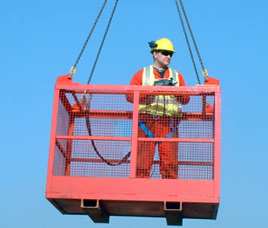
Hoisting Personnel
  Only allowed when all other means of worker positioning/placement are not feasible
  Does not apply to Subpart R applications
  Provides specs for various types of personnel hoisting
1926.1431

Slide 54
Equipment Specific Standards
1926.1432 Multiple-crane/derrick lifts - supplemental requirements
1926.1433 Design, construction and testing
1926.1434 Equipment modifications
1926.1435 Tower cranes
1926.1436 Derricks
1926.1437 Floating cranes/derricks and land cranes/derricks on barges
1926.1438 Overhead & gantry cranes
1926.1439 Dedicated pile drivers
1926.1440 Sideboom cranes
1926.1441 Equipment with a rated hoisting/lifting capacity of 2,000 pounds or less

Slide 55

Questions?

