Slide 1
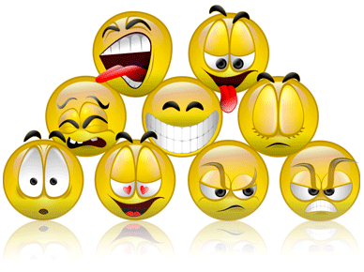
Attitudes
“Attitude is a little thing that makes a big difference.” – Winston Churchill

Slide 2
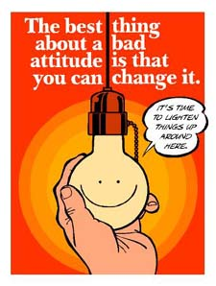
Bad Attitudes
“Weakness of attitude becomes weakness of character.” – Albert Einstein

Slide 3
Examples of a Bad Attitude
Negativity
Criticalness
Rebellion
Defiance
Impatience
Uncooperative
Discouragement
Presumption
Arrogance
Self-Centeredness
Rudeness
Apathy

Slide 4
Risks of a Bad Attitude
Negative attitude creates an unpleasant future.
Negativity harms others.
Negative attitude produces negative effects.
Negative attitude is harmful to your health.
The more you complain, the more you will find to complain about.
A negative mood affects the people around you. “Misery loves company.”
Your thinking CREATES your circumstances.
Becoming angry, upset and frustrated increases stress. Increased stress increases risk for heart related illness and reduces the ability for your immune system to work.

Slide 5
What Causes a Bad Attitude?
Social Factors
Poverty
Family
Health
Negative Friends
Physical Accidents
Pain
Illness
World Events & Media
Constant negative reporting
Catastrophic weather or accidents

Slide 6
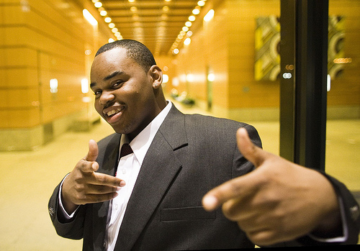
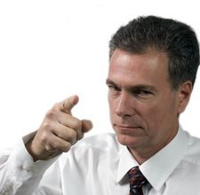
What Causes a Bad Attitude?
Ultimately, a bad attitude comes from YOU

Slide 7
A Good Attitude
“The pessimist sees difficulty in every opportunity. The optimist sees the opportunity in every difficulty.” – Winston Churchill

Slide 8
Examples of a Positive Attitude
Selflessness
Compassion
Empathy
Positivity
Patience
Cooperation
Optimism
Resiliency
Confidence
Hope
Calmness
Encouraging

Slide 9
Benefits of a Positive Attitude
You are more motivated
Positive expectations lead to positive results
Problems become opportunities
Higher self-esteem
Creative thinking
Generally happier

Slide 10
Benefits of a Positive Attitude
Less stress and better health
More influential
Become a better leader
People enjoy being around you more
You have more energy
You will live longer

Slide 11
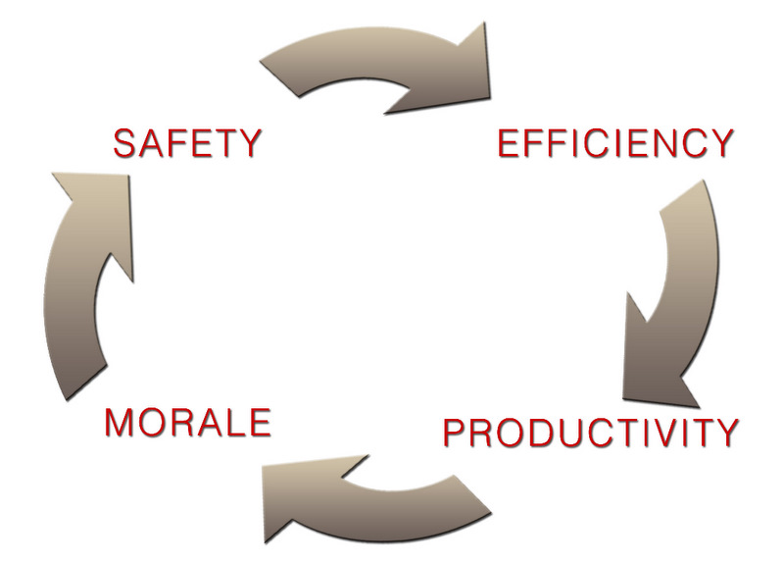
Safety Attitude
“Safety is understanding, it is an attitude of mind. It is not necessarily a simple following of rules or directions.” – Garry Richards

Slide 12
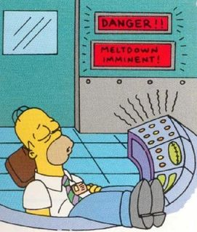
Bad Attitudes lead to Increased Injury
Laziness creates hazards.
Aggression creates dangerous situations, especially while driving.
Carelessness is the number one cause of workplace accidents
Recklessness and taking chances with tools, machinery and chemicals are dangerous.
Anger clouds judgment.

Slide 13
Attitudes Influence Safe Driving
Immature drivers carry emotional reactions to the extreme.
These reactions range from excessive happiness to impatience and overconfidence.
These drivers are often aggressive, take excessive risks and loose their self-control.
This results in:
Reduced attention span
Poor judgment
Decline in driving performance

Slide 14
Attitudes Influence Safe Driving Most driving skills are mental skills:
Attitude
Alertness
Judgment
A mature attitude gives a driver an increased attention span and good judgment
Safe drivers stay alert and are never taken by surprise
Safe drivers know and obey the rules, but they also make safe choices. Just because you have the right-of-way doesn’t mean it’s safe to proceed.
Routine
Emotions
Driving routines dull the senses, increasing the chance of a collision
Emotions such as stress are distracting, causing a lack of attention, becoming a major contributing factor in car accidents.

Slide 15
How to Change Your Attitude
“When you change the way you look at things, the things you look at change.” – Max Planck

Slide 16
Ways to Have and Keep a Positive Attitude
Set Goals
Be fired up
Encourage each other
Goals create a sense of purpose and a feeling of accomplishment when completed.
Being positive is the best way to help the people around you become positive.
Find out your co-workers goals and be a supporter of them reaching them.
Be Flexible
Take the time to learn how the people around you like to communicate.
Listen
Listen to know what needs to be changed, or the reasons they can’t be.

Slide 17
Ways to Have and Keep a Positive Attitude
Promote Respectfulness
Respect what each individual brings to the job. Success is created when the entire team respects the diversity of thinking, talents and styles of each person.
Be Appreciative
Make an effort to let others know you have noticed they are doing a good job.
Practice Random acts of Kindness
Offer a cup of coffee to a busy co-worker.
Make work fun
Dress up Monday or Silly Hat Wednesday is all it takes.
Make sure people are rewarded
Wall of stars?

Slide 18
Remember…
Whatever your attitude at the moment, it is the one you are presently choosing.

