Slide 1
Hospital Violence
Active Shooter
CHI-Franciscan Education Plan

Slide 2
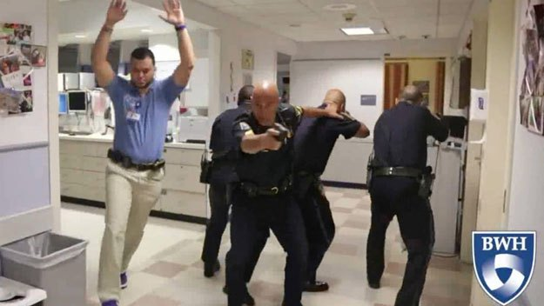
http://www.wcvb.com/news/brigham-womens-personnel-trained-for-active-shooter-event/30824614

Slide 3

Objectives
Define and discuss active shooter events
Outline planning process
Education and training
Sample exercises

Slide 4

What is the problem
Healthcare workers are at risk for violence.
  Patient stress is the most common cause of hospital violence.
  The person inflicting the violence is usually known to the agency.
  Your top priority when violence occurs is to protect yourself and your patients.

Slide 5
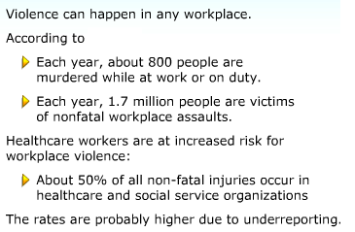
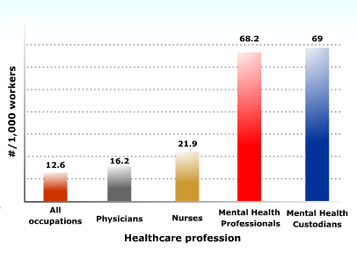
What’s the Risk
OSHA

Slide 6
Active Shooter Events

Slide 7
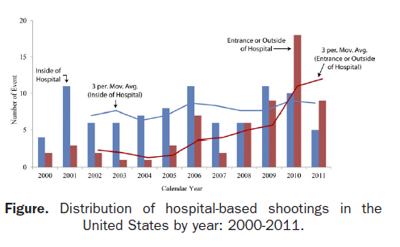
Hospital Based Shooting
“Hospital Based Shooting in the United States 2000-2011 “ Kelen et al

Slide 8
Workplace violence categories
TYPE 1: Violent acts by criminals who have no other connection with the workplace, but enter to commit robbery or another crime.
TYPE 2: Violence directed at employees by customers, clients, patients, students, inmates, or any others for whom an organization provides services.
TYPE 3: Violence against coworkers, supervisors, or managers by a present or former employee.
TYPE 4: Violence committed in the workplace by someone who doesn’t work there, but has a personal relationship with an employee—an abusive spouse or domestic partner.

Slide 9
Health Care Violence
According to Bureau of Labor Statistics data: violence-related nonfatal occupational injuries for health care and social assistance workers was 15.1 per 10,000 full-time workers in 2012. For private industry overall, the rate was 4.0.
2014 Hospital Crime Study ihhsf.org

Slide 10
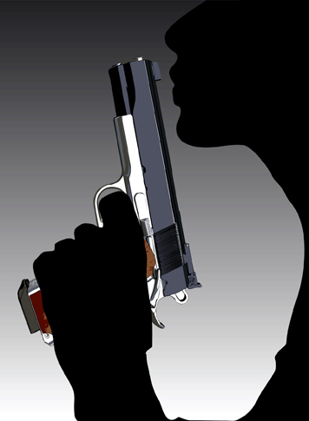
Active Shooter
Actively engaged in killing or attempting to kill people in a confined and populated area
  one or more guns
  Intends to kill people not commit another crime
Narrow definition –

Slide 11

Active Shooter Events
Unpredictable
Dynamic
May occur inside or outside a facility
Usually short duration
Require immediate action to reduce loss of life

Slide 12

Active Shooter
Male
Personal association with victims
  32 % estranged or current intimate relationship
  25 % former or current patient
  5 % employee
  13 % no known association
Motive-determined shooter with specific target
  Grudge or revenge
  Suicide
  Euthanasia
  Escape attempts
  Societal violence

Slide 13
FBI Behavioral Indicators
Personal grievance
Inappropriate acquisition of multiple weapons
Escalation of target practice and weapons training
Inappropriate interest in explosives
Intense interest with previous shootings and mass attacks
Significant perceived or real personal loss
Previous arrest for violent crime

Slide 14
Planning
Multidisciplinary
Ongoing
Include threats and risks
Include or establish planning framework for hospital violence
Include key stakeholders
Know your facility
One size does not fit all
Keep it simple
Integrated with security procedures
Avoid planning paralysis

Slide 15

Security Procedures
Employees wear name badges with picture ID
No fault reporting
Card or badge access readers that can be quickly programed
Ensure locked doors remain locked and closed
Identify staff report locations
Treat Assessment Teams
  Activated to assess
Culture of respect

Slide 16
Elements of Plan
Recognition of potential problem
Reporting process
Notification/Communication
Emergency escape routes
Evacuation procedures
Lockdown procedures
Integration with Incident Command, Unified Command, EOP
Information concerning emergency response agencies/contacts

Slide 17
Sample plans
Active Shooter Planning and Response in a Health Care Setting http://www.fbi.gov/about-us/cirg/active-shooter-and-mass-casualty-incidents/active-shooter-planning-and-response-in-a-healthcare-setting
Multiple plan examples: http://www.calhospitalprepare.org/active-shooter
Lockdown and Active shooter: http://www.fha.org/health-care-issues/emergency-preparedness/workplace-violence-toolkit/active-shooter.aspx
Multiple plan examples and resources: https://www.urmc.rochester.edu/emergency-preparedness/Preparedness-and-Response-Tools-Resources/Active-Shooter.aspx

Slide 18
Active Shooter Communication
Reporting
  911 vs on site code line
  Panic buttons
  Security monitoring
Code terms
  Silver, Black,
Who needs to know
Alert process
  External clinics
  Mobile staff
  Visitors
  Emergency responders
Plain English
Mass Notification
Multiple communication processes

Slide 19
Active Shooter Response
Minimize loss of life
Recognize struggle between need to provide care versus personal protection
Recognize the differences within care settings, facilities
Take immediate action
Multiple models available
  Run Hide Fight
  Avoid Deny Defend
  4 As
  ALICE
  Window of Life

Slide 20
Emergency Escape Routes
Avoid known escape routes
Leave the immediate area if able
Avoid elevators and escalators
Take others with you
Evacuation routes
External Collection or assembly points
Building considerations
Special consideration for staff, patients with mobility issues

Slide 21
Special considerations
Patients that cannot move easily
  ICU, NICU, dialysis
Emergency Department
  EMTALA
Surgical areas-OR
Hazards or threats to first responders
  MRI
  Hazardous materials
  Kitchen
Regulatory
  Pharmacy
Off site clinics
  Notification
Code Team and Emergency Response

Slide 22
Patient Care/EMTALA
The need to continue to provide care was identified in early responses
Hospital has obligation to continue to provide a screening exam for patients seeking care
  Risk Management
  Nationwide search
  Reviewed with EMTALA
Explored options with partners
  King County-fire department will set up triage outside of hospital grounds
  Police can set up perimeter and direct to other locations
Identified alternate triage location and team
  Tested and revised with exercises

Slide 23
Hide/Defend
Unable to escape
Safe or defensible space
  Lockable area
  Ability to barricade
Make appear unoccupied
  Turn out lights
  Close doors
  Close blinds
  Avoid detection
    Turn off communication devices, cell phones, etc.
    Hide along wall out of site of door
Communicate with law enforcement
Remain in place until “clear”

Slide 24
Fight/Defend
Decision to stay or go is dependent on circumstances, what is important is to make a decision and react
If unable to get away, and faced with an immediate threat prepare to fight
Identify potential weapons
Work together with others
Distraction
51 events, shooter stopped 17 times by intended victims

Slide 25
Police Response
Focus is on finding and removing the threat (shooter)
Rapid entry
Move toward early entry of fire behind police
Employees
  Remain calm and follow instructions,
  Raise hands and spread fingers
  Provide requested information
  Avoid quick movements toward officers such as holding on to them for safety
  Do not stop to ask officers for help or direction when evacuating

Slide 26
Police Response
Focused on locating and removing the threat
Weapons drawn
Rapid entry
EMS
Cordon or perimeter
Employees
  Follow instructions
  Raise hands and open fingers
  Provide requested information
  Avoid quick movements toward officers
  Do not stop to ask officers for help or direction when evacuating

Slide 27

Lockdown Procedures
Lock OUT not IN
Department versus facility
Zone versus full facility
Law Enforcement
Patient care
Staff access

Slide 28
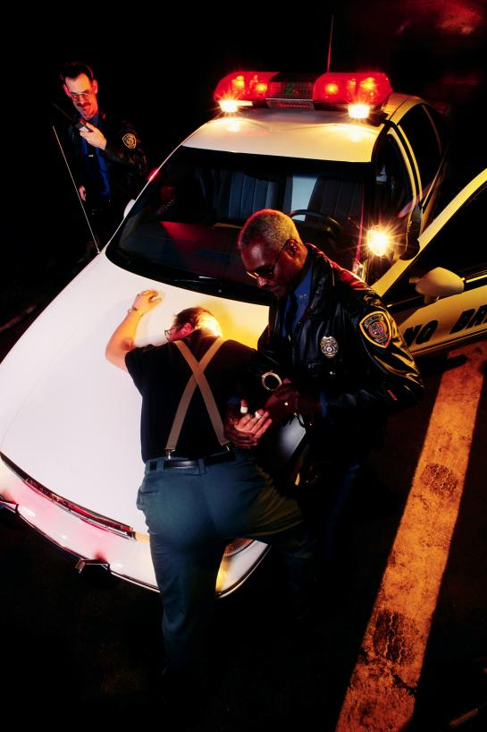
Coordination of response
Virtual Command
Alternate Command Center
Liaison with law/fire
Unified Command
  Police
  Fire
  Emergency Management
  Hospital Leaders

Slide 29
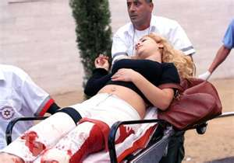
Rescue & Treatment of victims
Early entry by Fire/EMS
Activation of trauma system
Where do they go for care?
  ED versus another hospital
  DMCC

Slide 30

Media
Part of the problem or part of the solution
Coordinated message
Spokesperson
Early and frequent updates
  Contact numbers
  Safety messages
  Family

Slide 31

Patient/Family
Response
  Visitor/Family communications
Communications plan
  Arriving patients/families
Recovery
  Family reunification

Slide 32
Crime Scene Issues
Complete facility search
  Security of searched departments
Restoration of essential services
Access of medical personal
Evidence collection
Control of photographs
Witness statements/interview
Evidence Collection

Slide 33
Recovery
Triage and treatment of victims
Notification, line of duty death
Accounting for staff, patients, visitors
Evidence Recovery
Legal Proceedings
Memorial
Psychological Support
  Psychological First Aid
  http://www.nctsn.org/content/psychological-first-aid
  PsyStart- psychological triage
  CISD

Slide 34
Integrated Planning
Share your plans
Preposition maps, access badges, master keys
Plan together
Exercise together
Provide blueprints, facility plans
Equipment cache
Integrating into the care/security teams
Transport or treat at the facility decisions
Visiting LE duties/Off duty officer duties (ED)

Slide 35
Training/Exercise
Educate before your drill
Building blocks
Interactive
Integrated
The big three
  Tabletop
  Functional
  Full Scale
Non-traditional exercises
  2 minute exercises
  E-mail
  Communication
Break down into pieces
  Notification
  Surveillance
  Decision

Slide 36
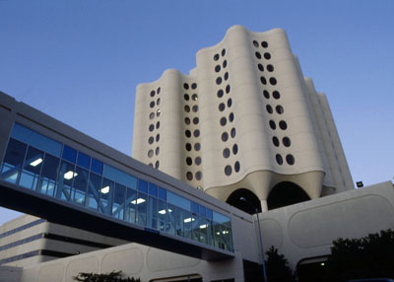

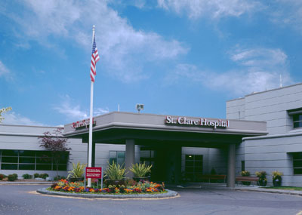
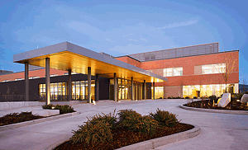
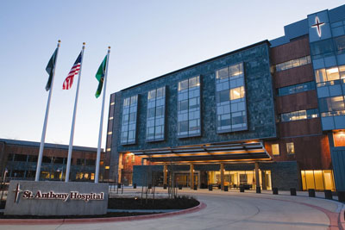
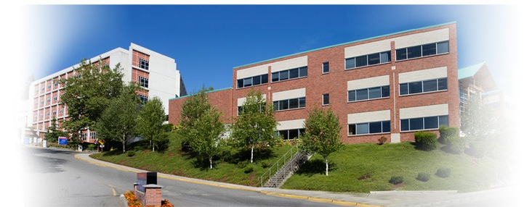
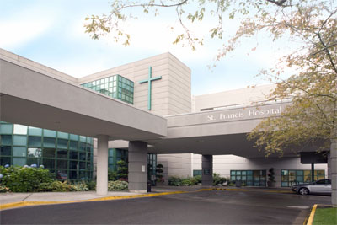
CHI-Franciscan

Slide 37
CHI -Franciscan
9 hospitals
65 business occupancy buildings
140 clinics
4 dialysis centers
1 ambulatory surgery
4 Prompt care
1 Inpatient hospice
11,000 employees
3 counties
  King, Pierce, Kitsap

Slide 38
Code 5 Workgroup
Met in 2011-2012
  Revised policy
  Identified best practices
  Addressed communication gaps
  Identified and proposed education model
Members included:
  Security
  Education
  Emergency Department
  Marketing
  Disaster
  Acute Care
  Patient Access
  Risk Management
Code 5 events are reviewed at Disaster committee

Slide 39
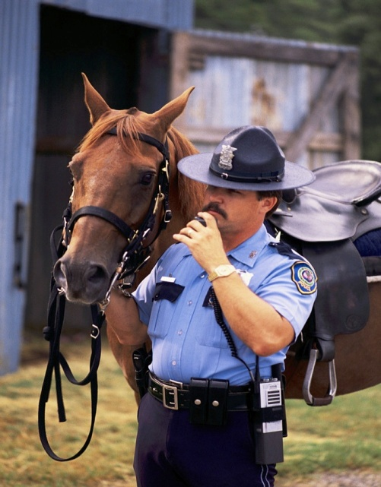
Communication
Scripts
Clarified roles and responsibilities
Where to go for information
Mass notification
  Expanded notification group
  Surrounding buildings
  Conference Calls
Plain English
  JC “Clear the Hallways”
St. Elizabeth Code 5 Internal Shelter in place ** For your safety please move out of the hallways and remain within patient rooms and departments until further notice.

Slide 40

Communications cont.
Patient
  Signage to direct patients
  Patient information sheets
  Staff Scripts
Code 5 notification groups include core leadership
Notification group built to include surrounding buildings
  Met with leadership of offices in surrounding buildings
Remember EMTALA

Slide 41

Social Media
Titter, Facebook, Instagram
  Reviewed use for communication
  Provided education to staff on policy
  Information in Leader/Horizon, included in tabletops
Assign someone to monitor and manage.

Slide 42

Incident Management
Need for early activation of ICS
  Take charge
  Coordinate communication
  Site versus regional
Virtual Command Center
  Conference Call
  Manage from multiple locations, but single set of objectives
  Security assigned role of liaison

Slide 43
Code 5 Events at FHS 2012-2014
Report of man with gun
Police activity in parking lot
Shooting outside of hospital
Man with gun at clinic
Potential bomb on SJMC ED lid
Patient threatens suicide, gun found in car
Patient attempting to break in ED door
Visitor attack in ED
Bear in parking lot
Potential bomb at bus stop
Threat of violence against health care facility
Shooting on 19th
Post Education
Man walking on street making shooting gestures
Bomb Threat at SFH
Bomb Threat at SJMC
Disruptive patient
Domestic violence (armed entry with gun retrieved)

Slide 44
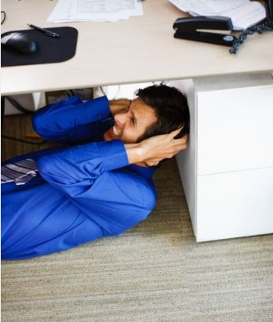

Education Initiative
LEARN module
Rolled out over 2 years
Joint venture
  Security
  Disaster
  Education
  FMG
Tabletop exercise
  Community participation
  Leadership
  Rounding with staff
  Repeated off shift
Key points include personal safety, taking action, uncertainty
Covers:
  External Code 5
  Internal Code 5
  Law Enforcement Response
  Fight or flight

Slide 45
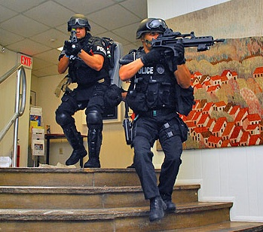
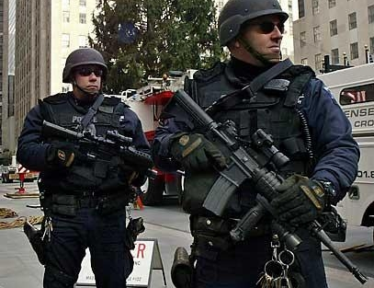
Education Phase 2
Focused training on how to respond to police, decision making under pressure
Video/Learn
Department based exercises

Slide 46
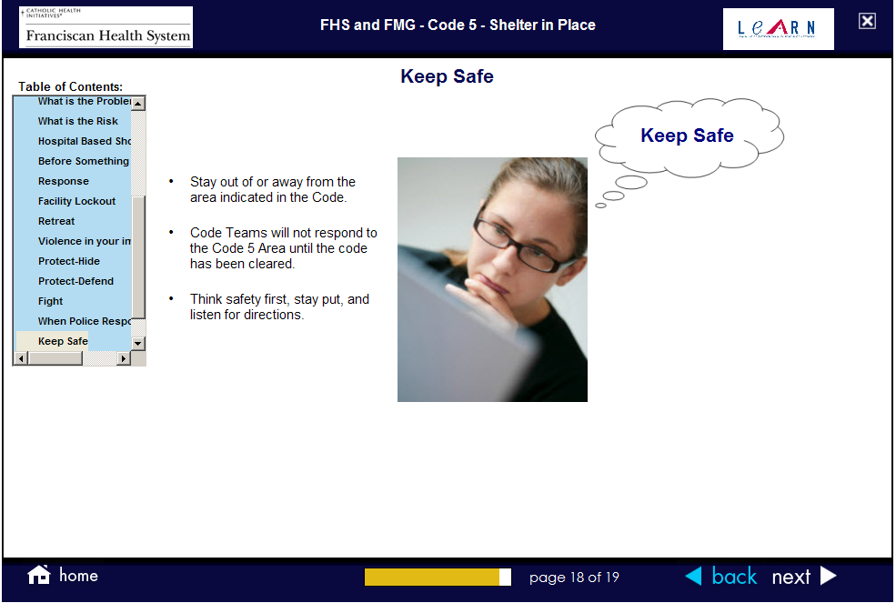
Education
Marked difference in staff after education during real events
Very positive response from staff, community partners, security

Slide 47

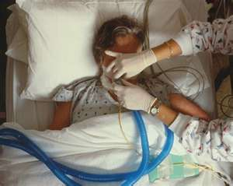
Putting Policies into Practice
Scenario: 1
Mr. Clark’s wife, Allison, was a patient in your hospital who has been in the critical care unit for several days. She was hit by a car, had a severe head injury, and was admitted several days ago. The physicians have determined that she has no brain activity and the family has decided to stop life support.
After meeting with the family, Allison’s life support machine was turned off.
Allison’s brother becomes very angry and blames the doctor and the hospital for Allison’s death. He leaves the hospital very angry and threatening revenge on her husband and the doctor.
As he leaves, he threatens to return and seek “ an eye for an eye!”

Slide 48
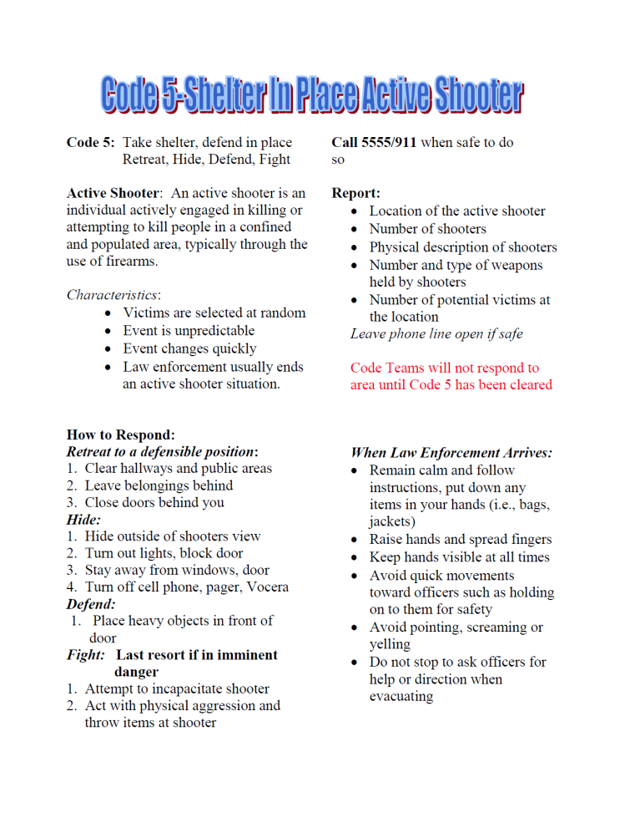
Department Based Exercise
Team approach
  Security
  Clinical staff
Every department visited
  Grouped when possible
10 minutes per floor

Slide 49
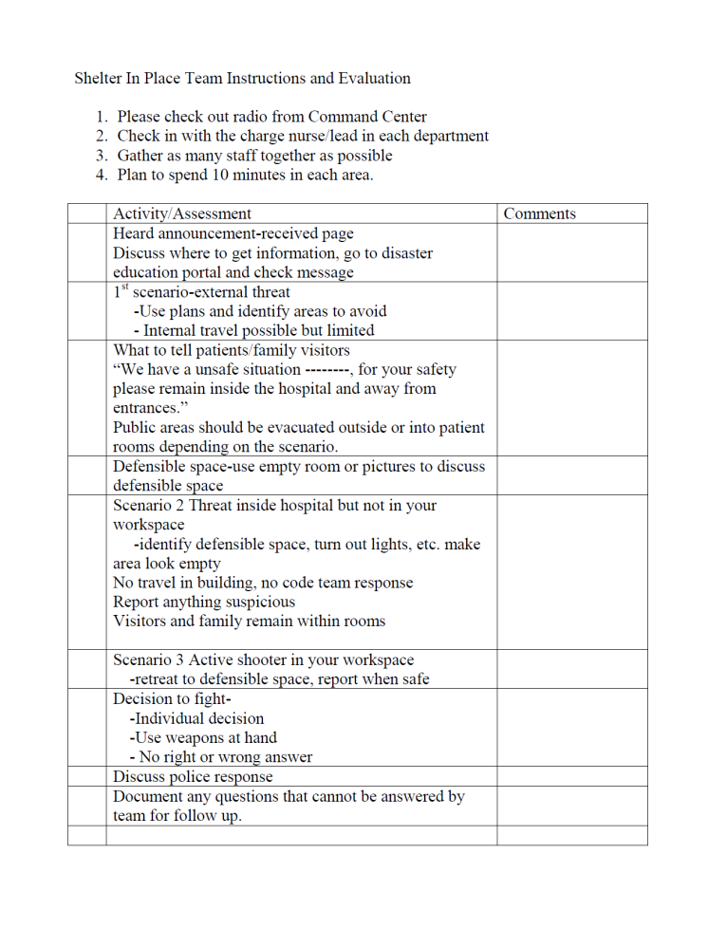
Department Exercise
Identify hiding space
External and internal scenarios, and flight/fight
Demonstrate communication
ANSWER QUESTIONS

Slide 50
Mini Exercises
Notification drill
  Test notification groups
  Send message-ask question about response
  Track acknowledgement
E-mail
  Describe scenario-give choices
  Security Alert
2 Minute Exercise (shift huddle, report)
Virtual Command-send notification for conference call
Timed exercise-locate and secure department
Increased surveillance
  Traveling gnomes
Objective Driven

Slide 51

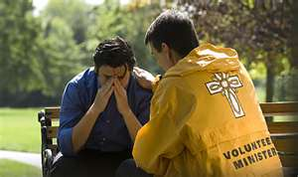

Discussion/Evaluation:
Is there reason for an assessment/intervention based behavioral display/comments?
How would the threat assessment process be activated?
Do you have grievance counselors to help?
When do you notify Hospital Security and Staff concerning this type of incident/threat?
Notes:
Do you have a Healthcare/Hospital Threat Assessment Program?

Slide 52
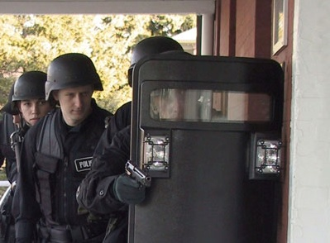
Tabletop opportunities
Domestic Violence
  Identification
  Information release to law enforcement
Line of Duty death policies
Reinforced need for security to act as liaison
Staff surprised at law enforcement response
Rapid lockdown and assignment at SEH

Slide 53

Tabletop Resources
USCD Tabletop Exercise: http://www.calhospitalprepare.org/active-shooter
Active Shooter Template: http://ghca.info/ghca-content/uploads/2014/12/Active-Shooter-combined-final-document.pdf
Active Shooter Tahttp://www.google.com/url?sa=t&rct=j&q=&esrc=s&frm=1&source=web&cd=9&cad=rja&uact=8&ved=0CE4QFjAI&url=http%3A%2F%2Fweb.spcollege.edu%2FWorkArea%2FDownloadAsset.aspx%3Fid%3D16067&ei=XCFcVdyeNYyXygSNnYGADA&usg=AFQjCNGoXWtXPSDUMKv2rAjkcFGRvV-YOw

Slide 54
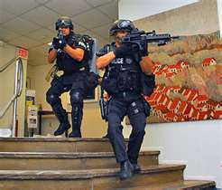
Functional Exercises
Medical Mayhem -http://www.drc-group.com/project/mm.html
Active Shooter Template: http://ghca.info/ghca-content/uploads/2014/12/Active-Shooter-combined-final-document.pdf
Functional Exercise Template

Slide 55
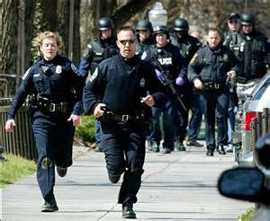
Training Videos
MESH
https://vimeo.com/meshcoalition/review/108575641/dd69fdb233
Avoid Deny Defend: https://www.youtube.com/watch?v=j0It68YxLQQ
Run Hide Fight: https://www.youtube.com/watch?v=5VcSwejU2D0
Homeland Security Options for Consideration
http://www.dhs.gov/video/options-consideration-active-shooter-preparedness-video
Shots Fired: http://www.cpps.com/healthcare

Slide 56
Full Scale Exercises
Difficult to do correctly
Limited number of staff
Immersion experience
Integrated Exercise
Location
Safety Concerns
Active Shooter Full Scale
https://vimeo.com/70432491
http://www.hasc.org/active-shooter-drill-resources

Slide 57

Questions

