Slide 1
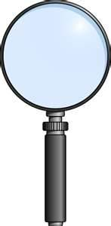
Risk Management and Safety
Camp Auburn Safety Annex
971 Camp Auburn Road
Auburn University, Alabama
CIDENT
AC
I
NVESTIGATION

Slide 2
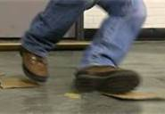
What is an Accident
An unintended happening, mishap.
Most often an accident is any unplanned event that results in personal injury or in property damage.
The failure of people, equipment, supplies or surroundings to behave or react as expected causes most accidents.

Slide 3
Types of Accidents
Minor Accidents
Accidents that cause minor injury/illness, requiring little or no treatment or property damage.
Serious Accidents
Accidents that cause lost time cases, visits to the local emergency room, accidents where victims are hospitalized, an accident involving a fatality, or damage to equipment and/or property.

Slide 4
Types of Accidents
Near Miss
An unplanned event that interrupts the completion of an activity which directly involves the workers and does not result in personal injury, illness or in property damage.

Slide 5
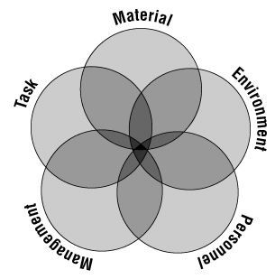
Causes and Contributing Factors of Accidents
Accident Causation Model

Slide 6
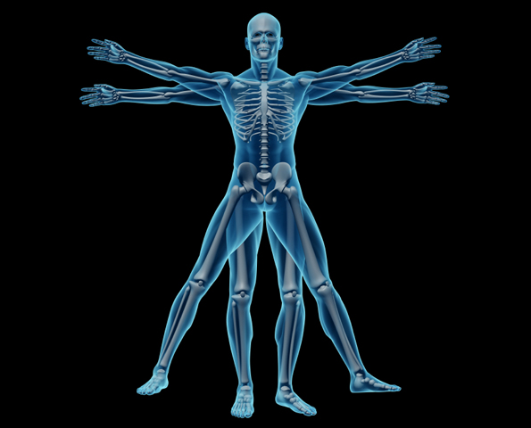
Causes and Contributing Factors of Accidents
Task
Ergonomics
Safety work procedures
Condition changes
Process
Materials
Workers
Appropriate tools/materials
Safety devices (including lockout)

Slide 7
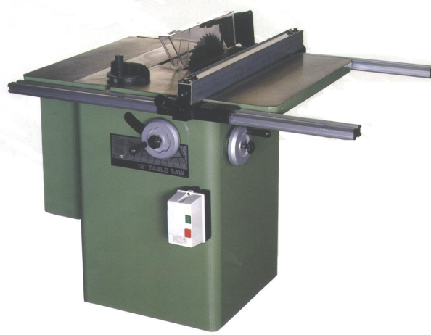
Causes and Contributing Factors of Accidents
Material
Equipment failure
Machinery design/guarding
Hazardous substances
Substandard material

Slide 8
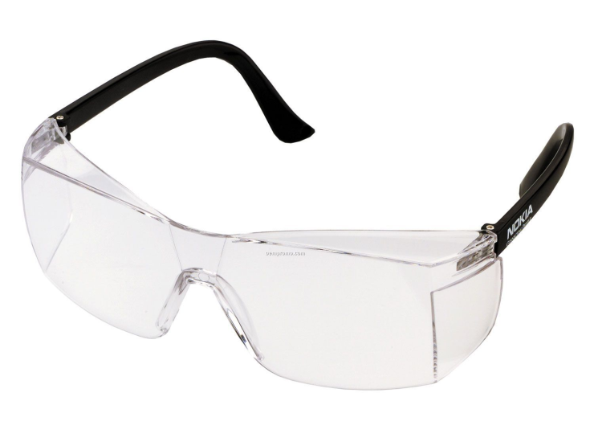
Causes and Contributing Factors of Accidents
Environment
Weather conditions
Housekeeping
Temperature
Lighting
Air contaminants
Personal protective equipment

Slide 9
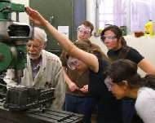
Causes and Contributing Factors of Accidents
Human Factor
Level of experience
Level of training
Physical capability
Health
Fatigue
Stress

Slide 10
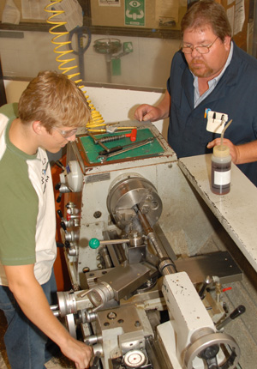
Causes and Contributing Factors of Accidents
Management/Process Failure
Visible active senior management support for safety
Safety policies
Enforcement of safety policies
Adequate supervision
Knowledge of hazards
Hazard corrective action
Preventive maintenance
Regular audits

Slide 11
Who Should Perform the Accident Investigation?
Supervisor
Minor accidents
Near Misses
Trends i.e., slip, trips, and falls
RMS
Serious accidents
Trends i.e., struck by

Slide 12
Purpose of Accident Investigation
Determine the sequences of events leading to failure.
Identify the cause of the accident.
Find methods to prevent accident from recurring.
Investigation is not intended to place blame.

Slide 13
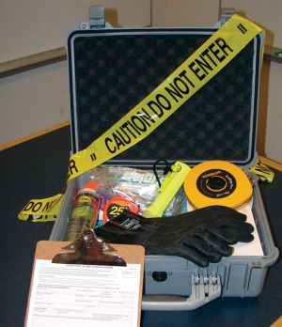
Be Prepared
Accident Investigation Kit - Preparing a kit of necessary forms and tools will help you be more effective once your investigation begins. Keep the kit where it is easily accessed.
Accident investigation forms
Accident Statements
Interview Question forms
Graph Paper
Other forms and worksheets, as applicable (or can be accessed online when needed)

Slide 14
Be Prepared
Barricade tape
Camera
Flashlight
Pens/pencils
Rubber gloves
Sample bags or containers with labels
Tape measure
Personal protective equipment
Safety glasses
Hearing protection
Gloves
Steel-toed shoes (dependent upon location)
Hard hat (dependent upon location)
Coveralls

Slide 15
Initial Response (Serious Accident)
Get the first aid kit and assist the victim following accepted standards of care, if trained to do so. Otherwise, wait for emergency medical services to arrive.
Do not move the victim unless it is absolutely necessary (e.g. the building is on fire, there are hazardous fumes in the area, etc.)
Turn off any equipment or power switches that need to be turned off.
Do not move anything in the area.

Slide 16
Initial Response (Serious Accident)
Make a note of the people involved that will need to be interviewed later.
Use barricade tape or other means to block off the area.
Notify your departmental safety representative, management, and RMS at 844-4870.
Employees and students should be directed to return to work to reduce interference with rescue workers and to prevent secondary accidents.
Make sure an On the Job Injury Claim is completed and filed.

Slide 17
Initial Response (Minor Accident)
Get the first aid kit and assist the victim following accepted standards of care, if required.
Turn off any equipment or power switches that need to be turned off. Do not move anything in the area.
Make a note of the people involved that you will want to interview later.
Notify your departmental safety representative and management.
Get your accident investigation kit and begin your investigation.
Make sure an On the Job Injury Claim is completed and filed.

Slide 18
Principal Questions to be Answered

Slide 19
WHO?
Who was working with him/her?
Who else witnessed the accident?
Who else was involved in the accident?
Who is the employee's immediate supervisor?
Who rendered first aid or medical treatment?

Slide 20
WHAT?
What was the injured employee’s explanation?
What were they doing at the time of the accident?
What was the position at the time of the accident?
What is the exact nature of the injury?
What operation was being performed?
What materials were being used?
What safe-work procedures were provided?

Slide 21
WHAT?
What personal protective equipment was used?
What PPE was required?
What elements could have contributed?
What guards were available but not used?
What environmental conditions contributed?
What related safety procedures need revision?
What hours were the employee or student working?
What ergonomic factors were involved?

Slide 22
WHEN?
When did the accident occur?
When did the employee or student start work?
When did the employee begin employment or student begin classes?
When was job-specific training received?
When did the supervisor last visit the job?

Slide 23
WHY?
Why did the accident occur?
Why did the employee or student do what he/she did?
Why did co-workers or other students do what they did?
Why did conditions come together at that moment?
Why was the employee or student in the specific position?
Why were the specific tool/equipment selected?

Slide 24
WHERE?
Where did the accident occur?
Where was the employee or student positioned?
Where were eyewitnesses positioned?
Where was the supervisor at the time?
Where was first aid initially given?

Slide 25
HOW?
How did the accident occur?
How did the employee or student get injured (specifically)?
How could the injury have been avoided?
How could witnesses have prevented it?
How could witnesses have better helped?
HOW COULD THE ACCIDENT HAVE BEEN PREVENTED?

Slide 26
Facts and Physical Data
Scene
Before objects are moved, cleaned, or removed, record the scene as it was at the time of the accident.

Slide 27
Facts and Physical Data
Take Photos!
Take pictures of the accident area from different angles and distances to preserve the scene for later review. Take a shot of the general area, a closer shot of the object involved in the accident, and a close up shot of any detail which might be important. It may be helpful to place an object, such as a ruler or pencil, of known size into the picture to show proportion.

Slide 28
Facts and Physical Data
Sketch the Layout
Using graph paper, make a sketch of the objects in the area and their locations. Use a tape measure to note the actual distances between objects for exact reference. Remember to include vertical measurements as well as horizontal. Check the entire area (ceiling, walls, equipment, and floor) for signs of damage or disturbance, or which may in any way be related to the accident. Be thorough!

Slide 29
Facts and Physical Data
Document Conditions
Slips and trips are one of the most common accidents at Auburn University, and therefore an accident investigation is always recommended. As you are gathering data at the scene, if a slip or trip hazard is suspected, use the Slip and Trip Worksheet to record conditions and help identify contributing and root causes.

Slide 30
Facts and Physical Data
Sequence of Events
You will also want to begin to establish the sequence of events leading up to the accident. Identify the key events involved. Begin by recording the accident. Work your way backwards to fill in events leading up to the accident based on witness statements and interviews. This information can be referred to later when determining contributing causes and identifying the root cause.

Slide 31
Facts and Physical Data
People
It will be necessary to talk to people who were involved in the accident, a witness to the accident, or who were involved in the reporting and response to the accident. First, identify such persons and have them write their account of what happened as soon as possible. The more time people have to discuss the accident, the more their account may be influenced by other's accounts and memory retention. Interview witnesses separately. The accident statement form is used to record witness, supervisor, and the injured employee or student accounts. You will need to have several copies on hand to accommodate all involved.

Slide 32
Facts and Physical Data
Employee/Student Statement
As soon as feasibly possible, have the injured/ill employee(s) or student(s) complete an accident statement regarding the circumstances leading up to the accident and what happened that resulted in the injury/illness. The employee or student should state in his/her own words what happened. Explain that this type of paperwork is routine in accident investigations.

Slide 33
Facts and Physical Data
Witnesses
It is important to have all witnesses to the accident complete an accident Statement so that information can be reviewed later for consistencies in each account. The witnesses should state in their own words what they witnessed, and be encouraged to include as much detail as possible, whether they feel it is relevant or not. Explain that this type of paperwork is routine in accident investigations.

Slide 34
Facts and Physical Data
Supervisor
Often the supervisor is the first person notified of an accident. He or she should complete an accident Statement regarding details of notification and actions taken. The supervisor may also be able to provide information regarding earlier behavior, activities of the person(s) involved in the accident, or related personnel issues.

Slide 35
Facts and Physical Data
After all statements have been taken, the investigator (RMS, Safety Supervisor as applicable) should review them for consistencies/inconsistencies and common themes or unique information. This will help the investigator determine who will need a follow up interview and what questions will need to be asked. Use the Interview Questions form to write down what questions will be asked for the face-to-face interview. Not all questions must be written down since many will arise based on what information is provided at the time of the interview; however, all responses should be documented.

Slide 36
Facts and Physical Data
Paperwork - There may be existing documentation that you may need to review to determine what policies, practices, protocols, training, and assessments are already in place. Review the following, as appropriate.
Written policies related to the activities of personnel
Related health and safety programs
Hazard assessment forms or monitoring results
Training records
Disciplinary action or counseling of the employee or student injured
Operator's manual if machinery or equipment was involved
Written standard operating procedures (SOP)

Slide 37
Facts and Physical Data
Parts
Parts involved in an accident can be any material, machine, equipment, or structure involved. Identify "parts" to be further investigated and use the Parts Worksheet to identify areas of concern. For complicated systems, technical experts, manufacturer representatives, or inspectors may need to be involved in the review.

Slide 38
Facts and Physical Data
The first priority is to preserve the evidence. Do not move objects or remove components until interviews and pictures have been taken and all parties that will be involved in the investigation are present and agree to proceed. In serious incidences involving manufactured products, parts or components may be taken as evidence for legal purposes, and a chain of custody may be required to prove that parts and components have not been tampered with. You must notify RMS of investigations involving outside manufacturers, inspectors, or other representatives.

Slide 39
Data Analysis
The purpose of analyzing the data is to identify all of the causes for which a corrective action is possible. Management must review and select the corrective action(s) most likely to be effective (i.e. the root cause), beneficial (i.e. contributing causes), cost-effective, and acceptable, and implement them.
There are a variety of accident investigation and analysis techniques available, some of which are more complicated than others and may require specialized training. There are benefits and limitations associated with every method. This program provides techniques that most investigators can use immediately.

Slide 40
Data Analysis
Sequence of Events and Contributing Causes
Fill out the Sequence of Events and Contributing Causes flow chart. You will need to consider the event in each rectangle and ask if there was some reason (i.e. contributing cause) which caused the event to be present or to occur. As you fill it in, you will begin to see where you need more information and what questions will need to be answered during interviews and analysis.
Once all of the events and conditions have been filled in, review the chart to identify the event or condition which could have prevented the accident had it been controlled or did not occur. There may be more than one causal factor. Further investigation of events or conditions may be necessary.

Slide 41
Data Analysis
Fishbone Diagram
For more complicated accidents involving various elements, it may be helpful to use the Fishbone Diagram to identify ideas regarding contributing causes. Both tools guide you through the process of considering various aspects and causes by providing categories to brainstorm on or common questions to ask.
To use the Fishbone Diagram, first state the problem in the form of a "why" question to help stimulate ideas. The investigator or team should agree on the statement of the problem. The "bones" or branches of the diagram are categories that can be changed or modified to suit your subject matter.

Slide 42
Data Analysis
Suggested categories include:
People
Policies
Procedures
Processes
Machinery
Materials
Environment (facilities, weather, noise, lighting, etc.)
Technology

Slide 43
Data Analysis
Consider each category when brainstorming causes for the problem statement. Write the cause along the vertical line connected to the related category. The investigator or team should review the causes to determine which one(s) warrant further investigation.

Slide 44
Data Analysis
The Guide for Identifying Causal Factors and Corrective Actions is relatively self-explanatory, and also provides possible corrective actions to consider. Simply go through the list of questions in the "Causal Factors" column and identify all possible contributing causes. Once you have answered all of the questions, you may want to further investigate each causal factor to identify the root cause. Lastly, note the corrective action(s) to be taken in the last column.

Slide 45
Data Analysis
Change Analysis
This technique emphasizes change to correct the problem.
Examination of deviations from the norm are scrutinized.
Consider all problems to result from some unanticipated change.
Analyze the changes to determine its cause.

Slide 46
Data Analysis
Use the following steps in this method:
Define the problem (What happened?).
Establish the norm (What should have happened?).
Identify, locate, and describe the change (What, where, when, to what extent).
Specify what was and what was not affected.
Identify the distinctive features of the change.
List the possible causes.
Select the most likely causes.

Slide 47
Data Analysis
Ergonomic Issues
Certain activities, such as lifting, carrying, pushing, pulling, or repetitive motion, may have been involved in the accident. The following worksheets can be useful in gathering certain information for further analysis. It is recommended that you consult with RMS for a complete and effective analysis where these activities are potentially contributing or root causes.
Lifting Strain Worksheet
Carrying Worksheet
Pushing/Pulling Worksheet

Slide 48
Data Analysis
Behavior Analysis
Studies indicate that 90-95% of all accidents have a human performance causal factor. This is not to say that the person is at fault 90-95% of the time! It simply means that a person's behavior and attitudes, along with the culture of the workplace, are common elements which can influence or contribute to the cause of an accident. Where human performance is suspected as a contributing or causal factor, further investigation is warranted.

Slide 49
Data Analysis
Begin by filling in the Behavior Analysis Chart. Start with the second column (i.e. the physical behavior that resulted in injury or illness). Next, investigate all possible things or events (i.e. antecedents) which may have triggered the behavior. Last, for each trigger or antecedent, evaluate the persons' perception of the consequences to identify areas that may need intervention or correction.

Slide 50
Data Analysis
This evaluation will involve three factors:
Significance - whether the person perceives the consequence as positive (+) or negative (-).
Timing - whether the person believes that the consequence will occur sooner (s) rather than later (l).
Consistency - whether the person perceives the consequence as certain (c) or uncertain (u).

Slide 51
Data Analysis
Example: An employee was injured and sent to the hospital because he operated a chop saw without a guard.
Triggers (2) | Behavior (1) | Consequences (3) | Evaluation (4)
1. Needed to get the job done | Operated chop saw without guard | 1. Save time and get job done | +, s, c
2. Everyone else uses it that way |  | 2. Will fit in with others | +, s, c
3. "It won't happen to me" attitude |  | 3. Gets the job done. Fit in | +, s, c
4.Operating procedure was unclear |  | 4. Injury | -, l, u

Slide 52
Data Analysis
Once the triggers and consequences have been identified and evaluated, you should use the Behavior Analysis Worksheet to determine why the triggers were present and why the consequences were perceived as they were. This will provide you with contributing causes, which can be reviewed to determine the root cause.

Slide 53
Root Cause(s)
5 Why
Once you've identified contributing causes and/or causal factors using one of the methods above, the next step involves investigating why they occurred and determining the root cause(s). (Note: It is now generally accepted that there may be more than one root cause to a problem.) Again, there are many methods for determining the root cause, and all have their limitations; however, one of the simplest methods is the "5 Why" technique. By repeatedly asking the question "why?" you can sort through the layers of symptoms that lead to the root cause.

Slide 54
Root Cause(s)
To complete the "5 Why" method, write down the specific problem on the form (i.e. contributing cause, causal factor, or the accident itself) to help formalize and describe it. Next, ask why the problem happens and write the answer below the question. If the answer just provided doesn't adequately identify the root problem, ask why again and write down that answer. Repeat this process until you have identified the root cause and the team is in agreement. Asking why five times is a good rule of thumb; however, you may only need to ask why three or four times (or six or seven) to get to the root of the problem.

Slide 55
Root Cause(s)
Causal Factors & Root Causes Worksheet
Another convenient tool to use when identifying contributing and root causes is the Causal Factors & Root Causes Worksheet. This worksheet provides you with a list of common causes grouped by categories. After you have completed your data gathering and analysis, the possible causes can be checked off (on the left) and reviewed to identify contributing causes (check the box in the “CC” column) and the root cause(s) (check the box in the "Root" column).

Slide 56
Corrective and Preventative Action(s)
Depending on the situation, there may only be one corrective action identified to address the root cause, or there may be several corrective actions that need to be taken to address other root or contributing causes. The Corrective and Preventative Actions form can be used to list those causes which require additional action. Once the corrective or preventative action has been identified, it should be assigned a due date and a responsible person to coordinate completion. This form should be reviewed periodically to ensure progress and eventually close out the action item by filling in the completion date. At this point, the accident is considered "closed".

Slide 57
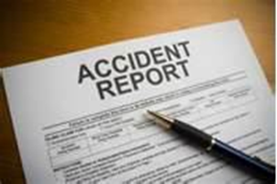
Investigation Report
An accident investigation is not complete until a report is prepared and submitted to the proper authorities.
Suggestion of items to include in your report.

Slide 58
Investigation Report
Background Information
Where and when the accident occurred
Who and what were involved
Operating personnel and other witnesses
Account of the Accident (What happened?)
Sequence of events
Extent of damage
Accident type
Agency or source (of energy or hazardous material)

Slide 59
Investigation Report
Discussion (Analysis of the Accident - HOW; WHY)
Direct causes (energy sources; hazardous materials)
Indirect causes (unsafe acts and conditions)
Basic causes (management policies; personal or environmental factors)

Slide 60
Investigation Report
Recommendations (to prevent a recurrence) for immediate and long-range action to remedy:
Basic causes
Indirect causes
Direct causes (such as reduced quantities or protective equipment or structures)

Slide 61
Follow-Up

Slide 62
Summary
Get help for the injured.
Survey the scene.
Secure the scene (initiate interim controls).
Collect evidence.
Analyze data (review past investigations).
Determine causes (scientific methods).
Follow up (eliminate hazards).

Slide 63
Case Studies
Texas Tech University (CSB)
Yale University (OSHA Investigation)
Yale University (Alumni Magazine)
UCLA (DIR Investigation Report)
UCLA (C&EN)

Slide 64
Activity
John has to change a fluorescent bulb in a ceiling fixture. The ceiling is twelve feet from the floor. John hurriedly selects the seven foot fiberglass step ladder from those present in the tool shed. Even though John has been trained differently he stands on the top rung to reach the light fixture. Bob was holding the replacement bulb for John and reported that as John struggled with the bulb removal the ladder slipped and John fail to the floor.
What is the root cause of the accident?

Slide 65
Activity
The top rung of a ladder should not be used.
The ladder was not long enough
The ladder was not secure
There is not enough information to determine the root cause.
Notes:
B

Slide 66
Quiz

Slide 67
Question 1
An accident is
An unintended happening, mishap.
An unplanned event that results in personal injury or in property damage.
The failure of people, equipment, supplies or surroundings to behave or react as expected causes most accidents.
Any of the above
Notes:
D

Slide 68
Question 2
A near miss is an unplanned event that interrupts the completion of an activity which directly involves the workers and does not result in personal injury, illness or in property damage.
True
False
Notes:
A

Slide 69
Question 3
Causes and contributing factors of accidents include tasks, material, environment, personnel, and management
True
False
Notes:
A

Slide 70
Question 4
The Supervisor investigates which type of accidents?
Minor accidents
Near Misses
Trends
All of the above
Notes:
D

Slide 71
Question 5
The purpose of accident investigation is to determine who was at fault.
True
False
Notes:
B

Slide 72
Question 6
The first priority regardless of the type of accident is to assist the victim?
True
False
Notes:
A

Slide 73
Question 7
In accident investigation the principal questions to be answered are who, what, why, when, where, and how?
True
False
Notes:
A

Slide 74
Question 8
Before objects are moved, cleaned, or removed, record the scene as it was at the time of the accident by:
Taking photos
Sketching the scene
Documenting site conditions
All of the above
Notes:
D

Slide 75
Question 9
Interviews should be conducted as soon as possible and of the following:
Accident victim(s)
Supervisor
Witnesses
All of the above
Notes:
D

Slide 76
Question 10
It is important to establish the sequence of events leading up to the accident.
True
False
Notes:
A

Slide 77
Question 11
The purpose of analyzing the data is to identify all of the causes for which a corrective action is possible.
True
False
Notes:
A

Slide 78
Question 12
Once the corrective or preventative action has been identified, it has been assigned a due date and a responsible person has been identified to coordinate completion the accident investigation can be considered closed.
True
False
Notes:
B

Slide 79
Question 13
The investigative report should address:
Direct causes
Indirect causes
Basic causes
All of the above
Notes:
D

Slide 80
Question 14
A student is using a table saw when the stock kicks back. There is no injury or property damage. This is referred to as a
Minor accident
Reportable accident
A near miss
None of the above
Notes:
C

Slide 81
Question 15
An accident investigation is not complete until a report is prepared and submitted to the proper authorities.
A. True
B. False
Notes:
A

