Slide 1
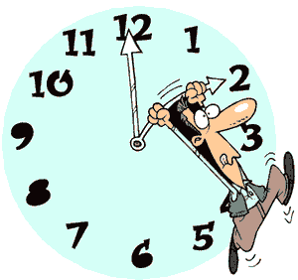
15 Minute Timer
Use for:
Mad Minutes
Game playing
Center Rotation
Partner Time
Silent Reading Time
This PowerPoint is editable. Add more minutes or take minutes away. Add Sound or different pictures.
Pick a slide for the minutes you want to set.
Start the PowerPoint. (slide show, start from current slide)
Slides will change every minute counting down to 0 minutes.
Everyone in the room will know how much time is left.
All Clipart is free on the web.

Slide 2

15 Minutes Left

Slide 3
14 Minutes Left

Slide 4

13 Minutes Left

Slide 5

12 Minutes Left

Slide 6

11 Minutes Left

Slide 7

10 Minutes Left

Slide 8
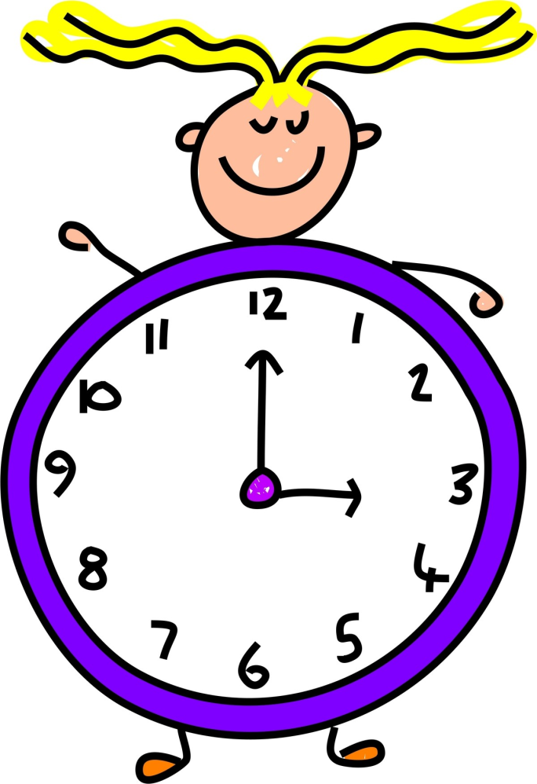
9 Minutes Left

Slide 9

8 Minutes Left

Slide 10
7 Minutes Left

Slide 11

6 Minutes Left

Slide 12

5 Minutes Left

Slide 13

4 Minutes Left

Slide 14
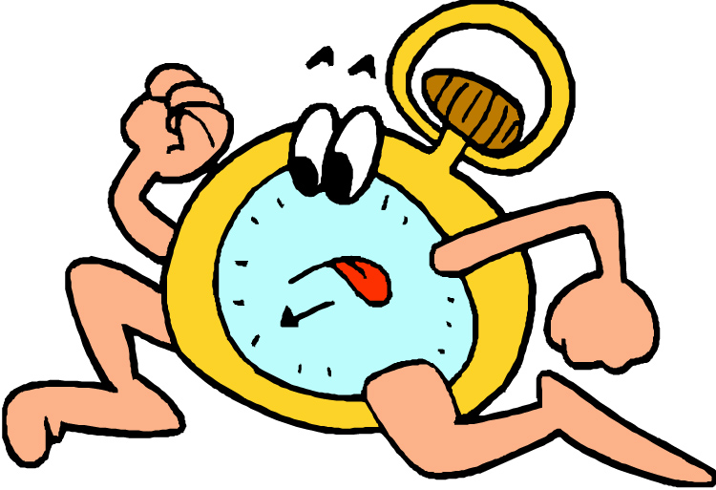
3 Minutes Left

Slide 15

2 Minutes Left

Slide 16

1 Minutes Left

Slide 17

0 Minutes Left
Times up!

Slide 18

For more Freebies, try here:

