Slide 1

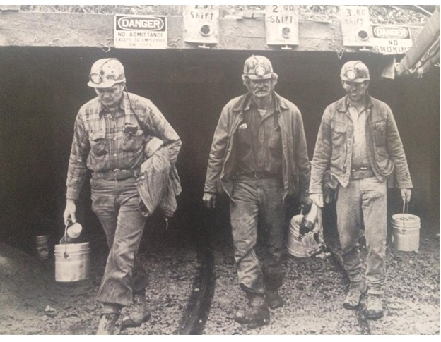

39th Annual
2015 Day 2 Judges Book

Slide 2
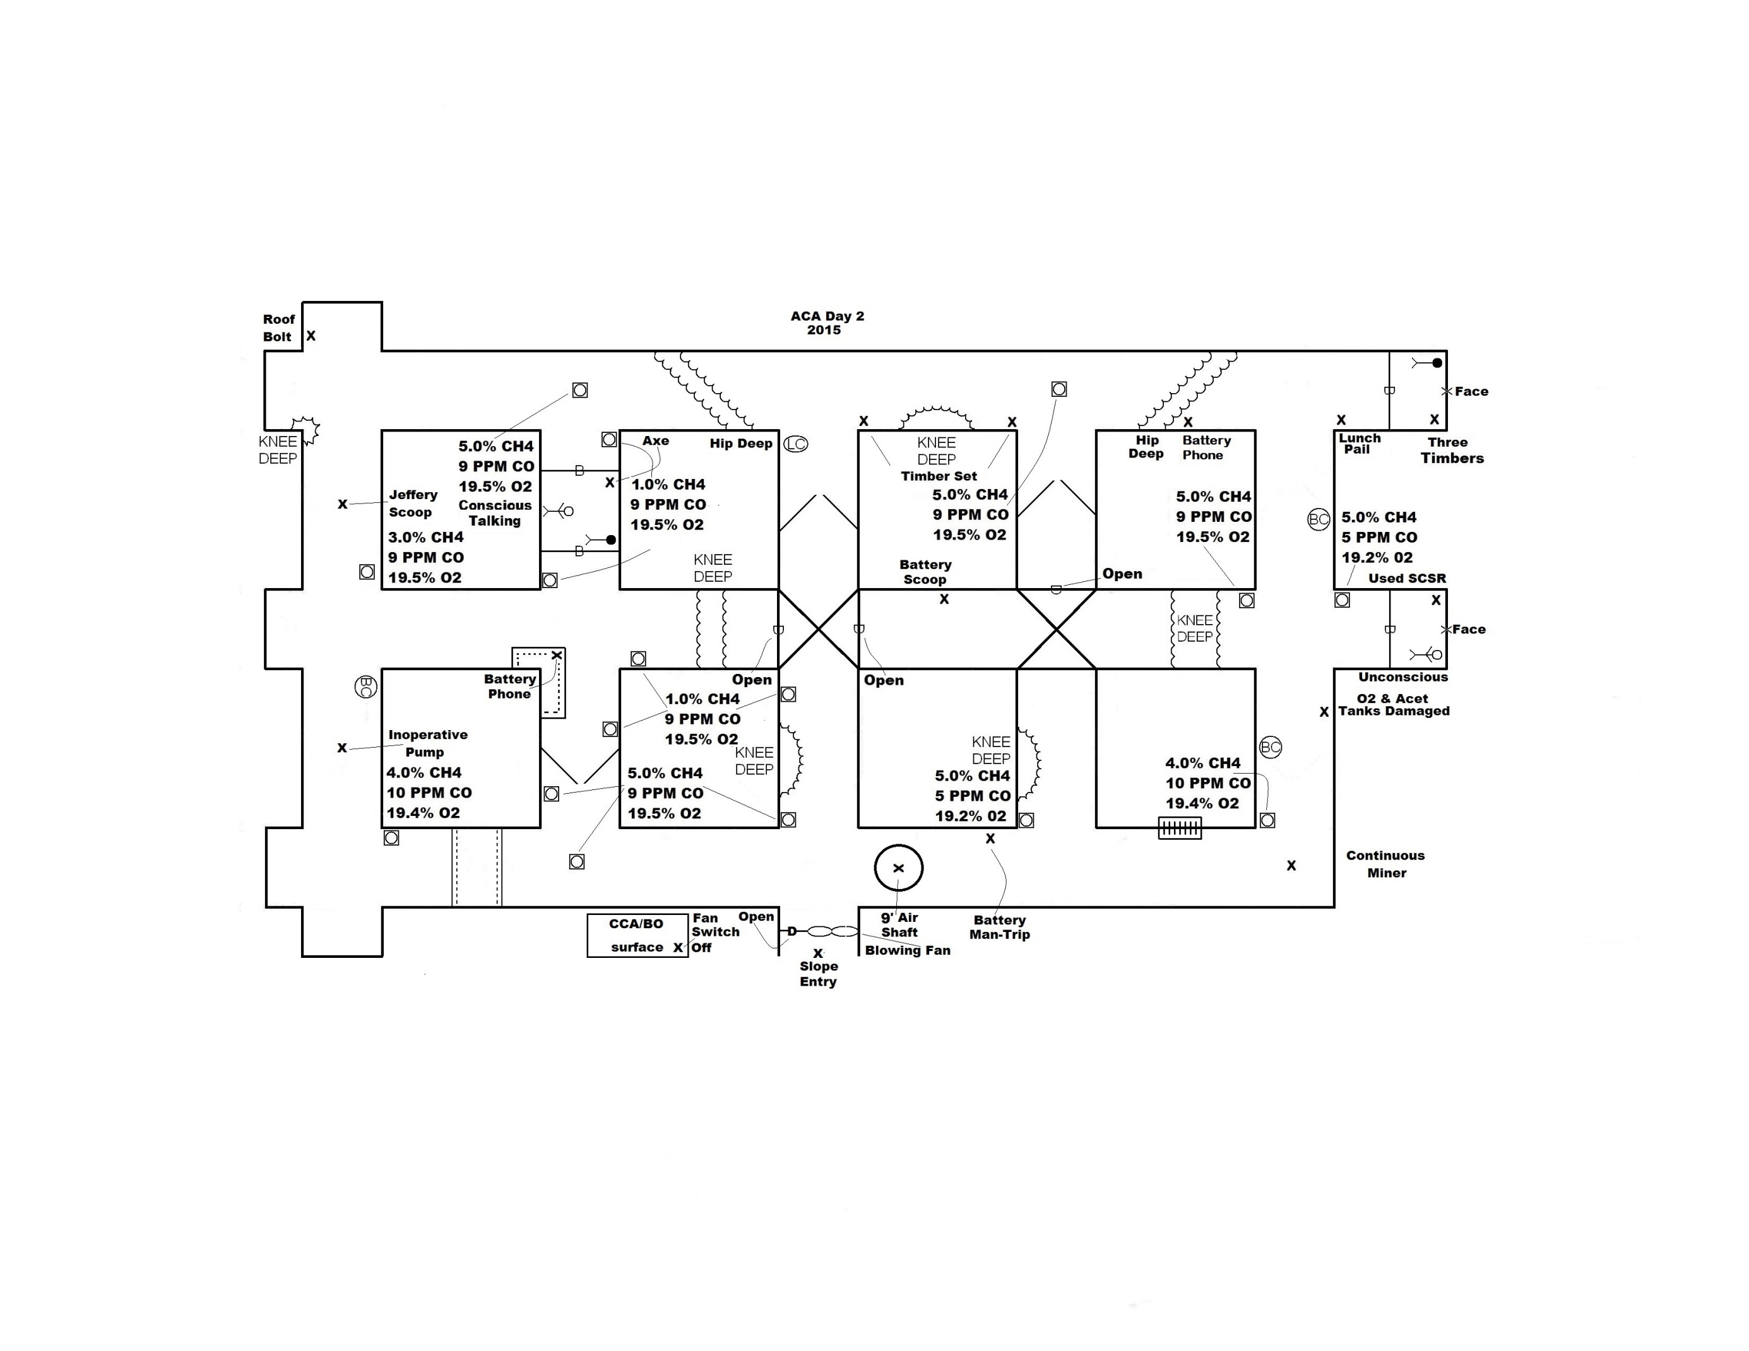

Slide 3
2015 ACA
DAY 2 PROBLEM
GENTLEMEN, WE THANK YOU FOR ANSWERING OUR CALL FOR HELP…….
Four people were working on the No.1 unit early this morning when the explosion door on the fan blew open and the fan stopped. The outside dispatcher called underground and could not get anyone by phone or radio. The RP went down the slope/fan entry and found high methane levels inby the first crosscut underground and decided not to go any further inby and came back outside. You are on the surface and can travel the slope entry into the mine. The mine is driving five entries inby the slope at this time and plans to turn to the north and drive three entries in the near future. The mine just completed an airshaft that can be used for ventilation if needed. A fresh air base has been established here on the surface.
All authorities have been notified and are here on site. A backup team is present and ready. The mining maps are up to date and will be given to you when you start the clock.
Please be careful during your exploration ………

Slide 4
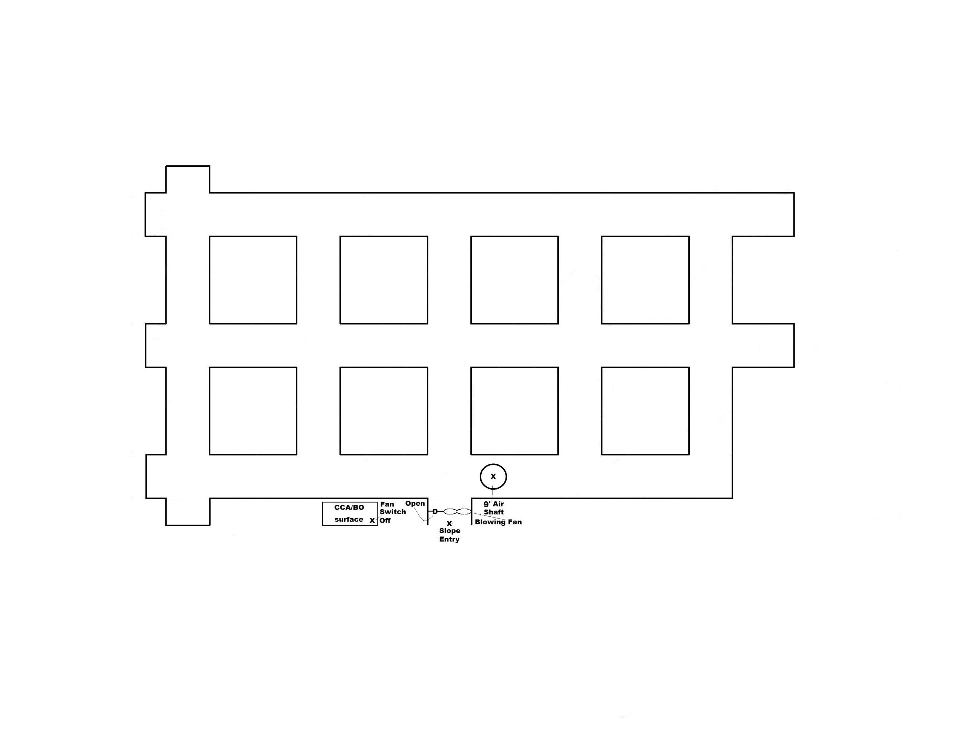

Slide 5
WRITTEN INSTRUCTIONS
2015 ACA Day 2
ACCOUNT FOR ALL MISSING MINERS
BRING ALL SURVIVORS TO THE SURFACE
THE BLOWING FAN CAN BE STOPPED AND STARTED BY USING THE FAN SWITCH INSIDE THE CCA/BO STATION ON THE SURFACE
THE BLOWING FAN CANNOT BE REVERSED AND CANNOT BE STALLED WHILE IN OPERATION
YOUR TEAM WILL HAVE 80 MIN. TO COMPLETE THE PROBLEM

Slide 6
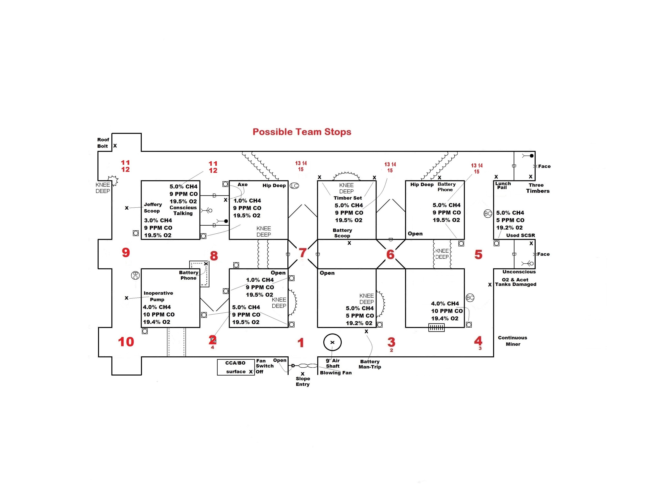

Slide 7
Conscious Miner Statement
Statement behind both barricades in second crosscut
Help! I have a airtight barricade behind me !

Slide 8
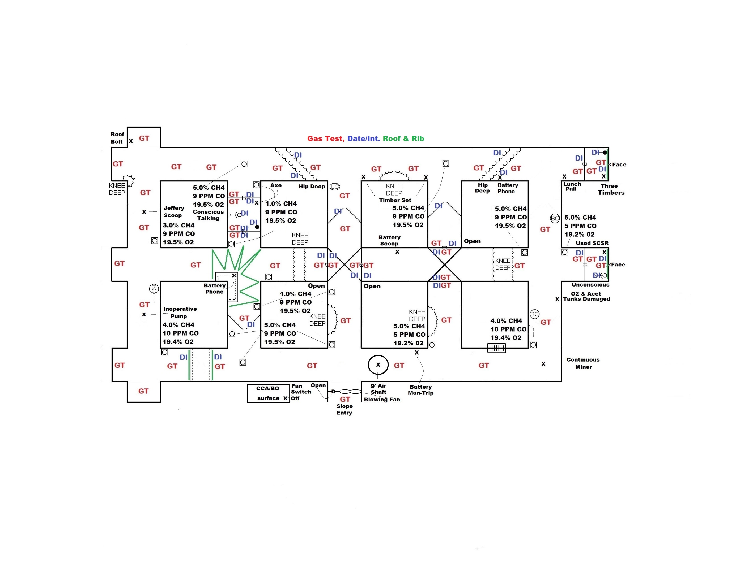

Slide 9
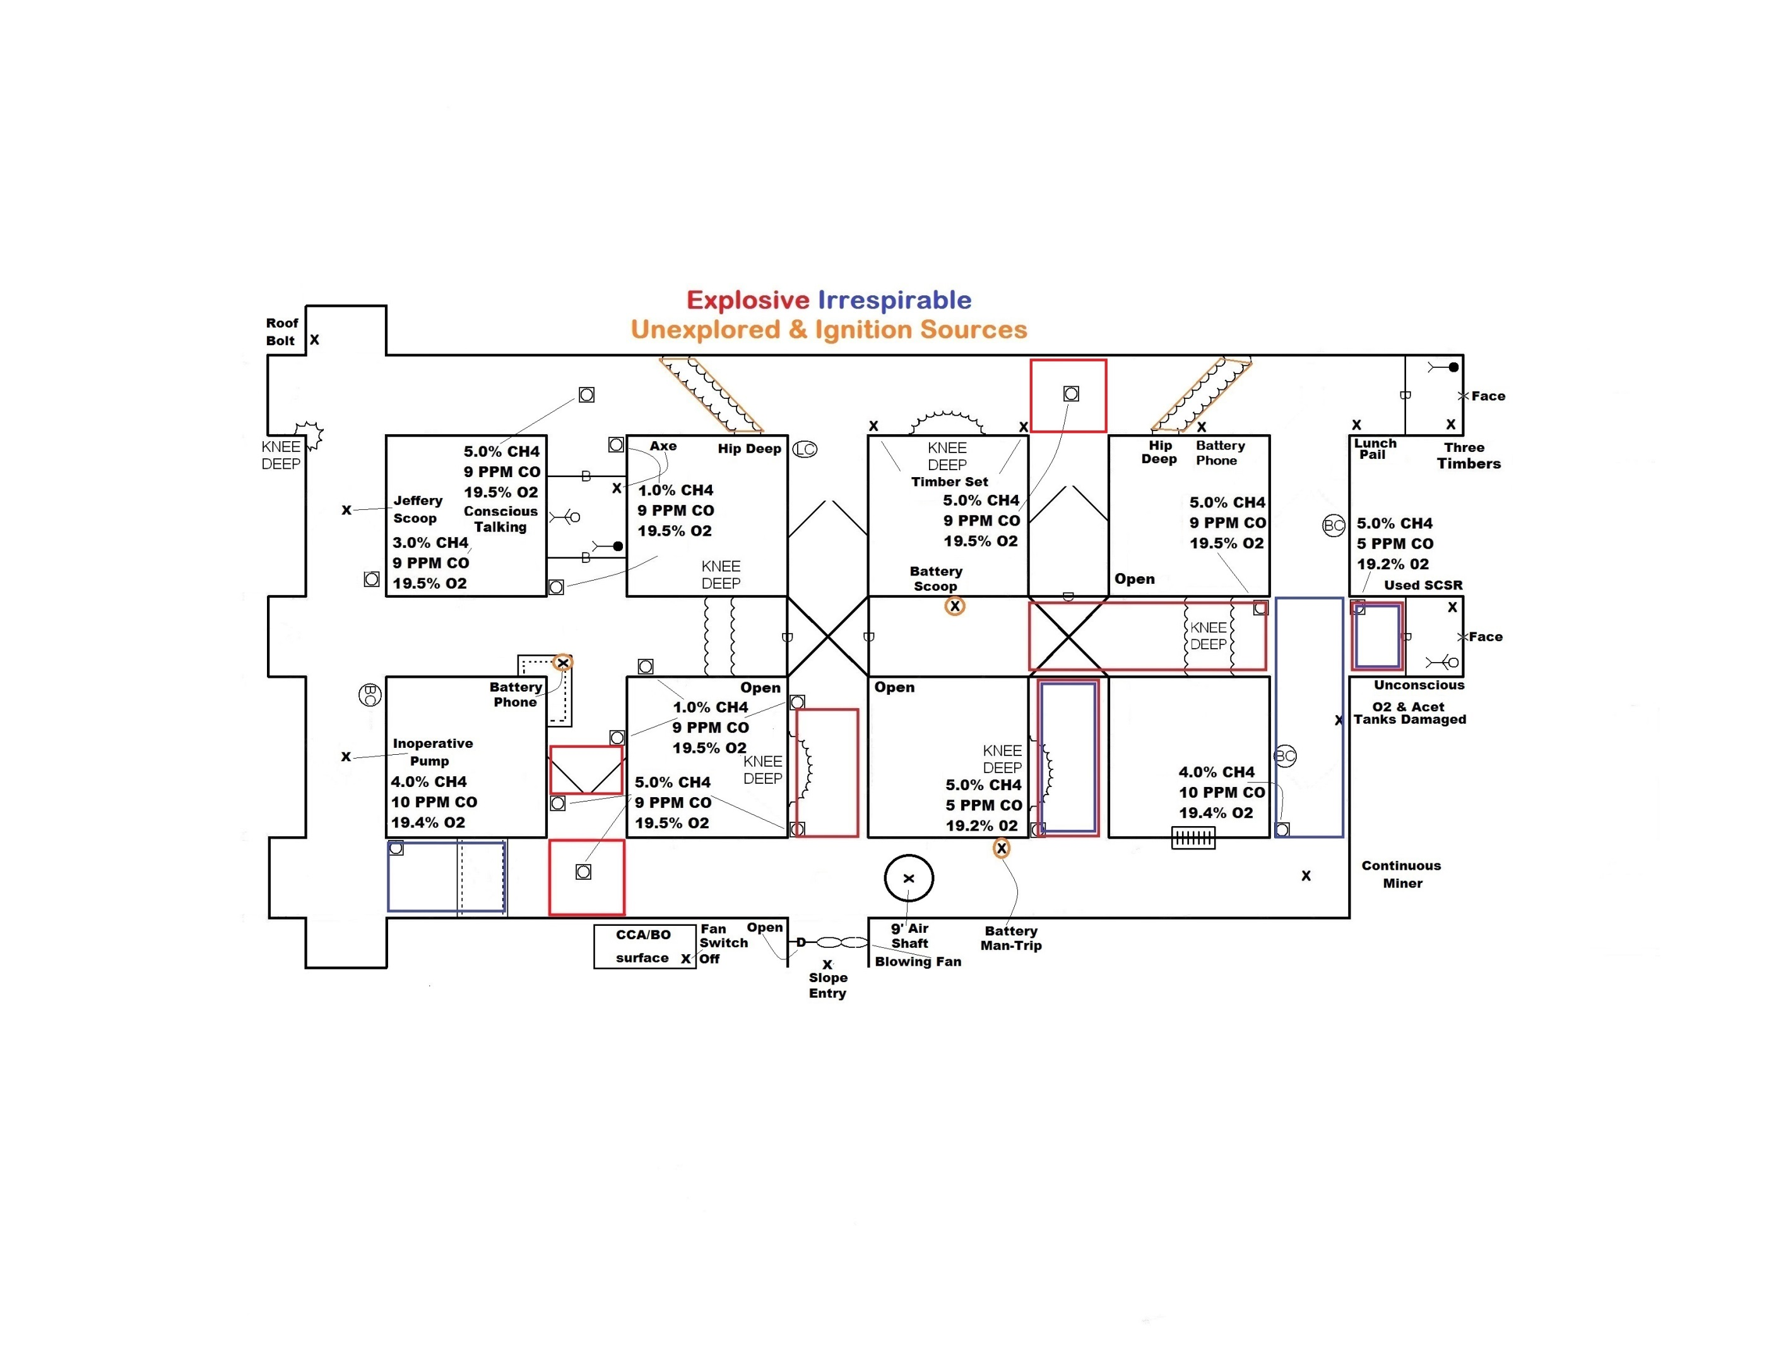

Slide 10
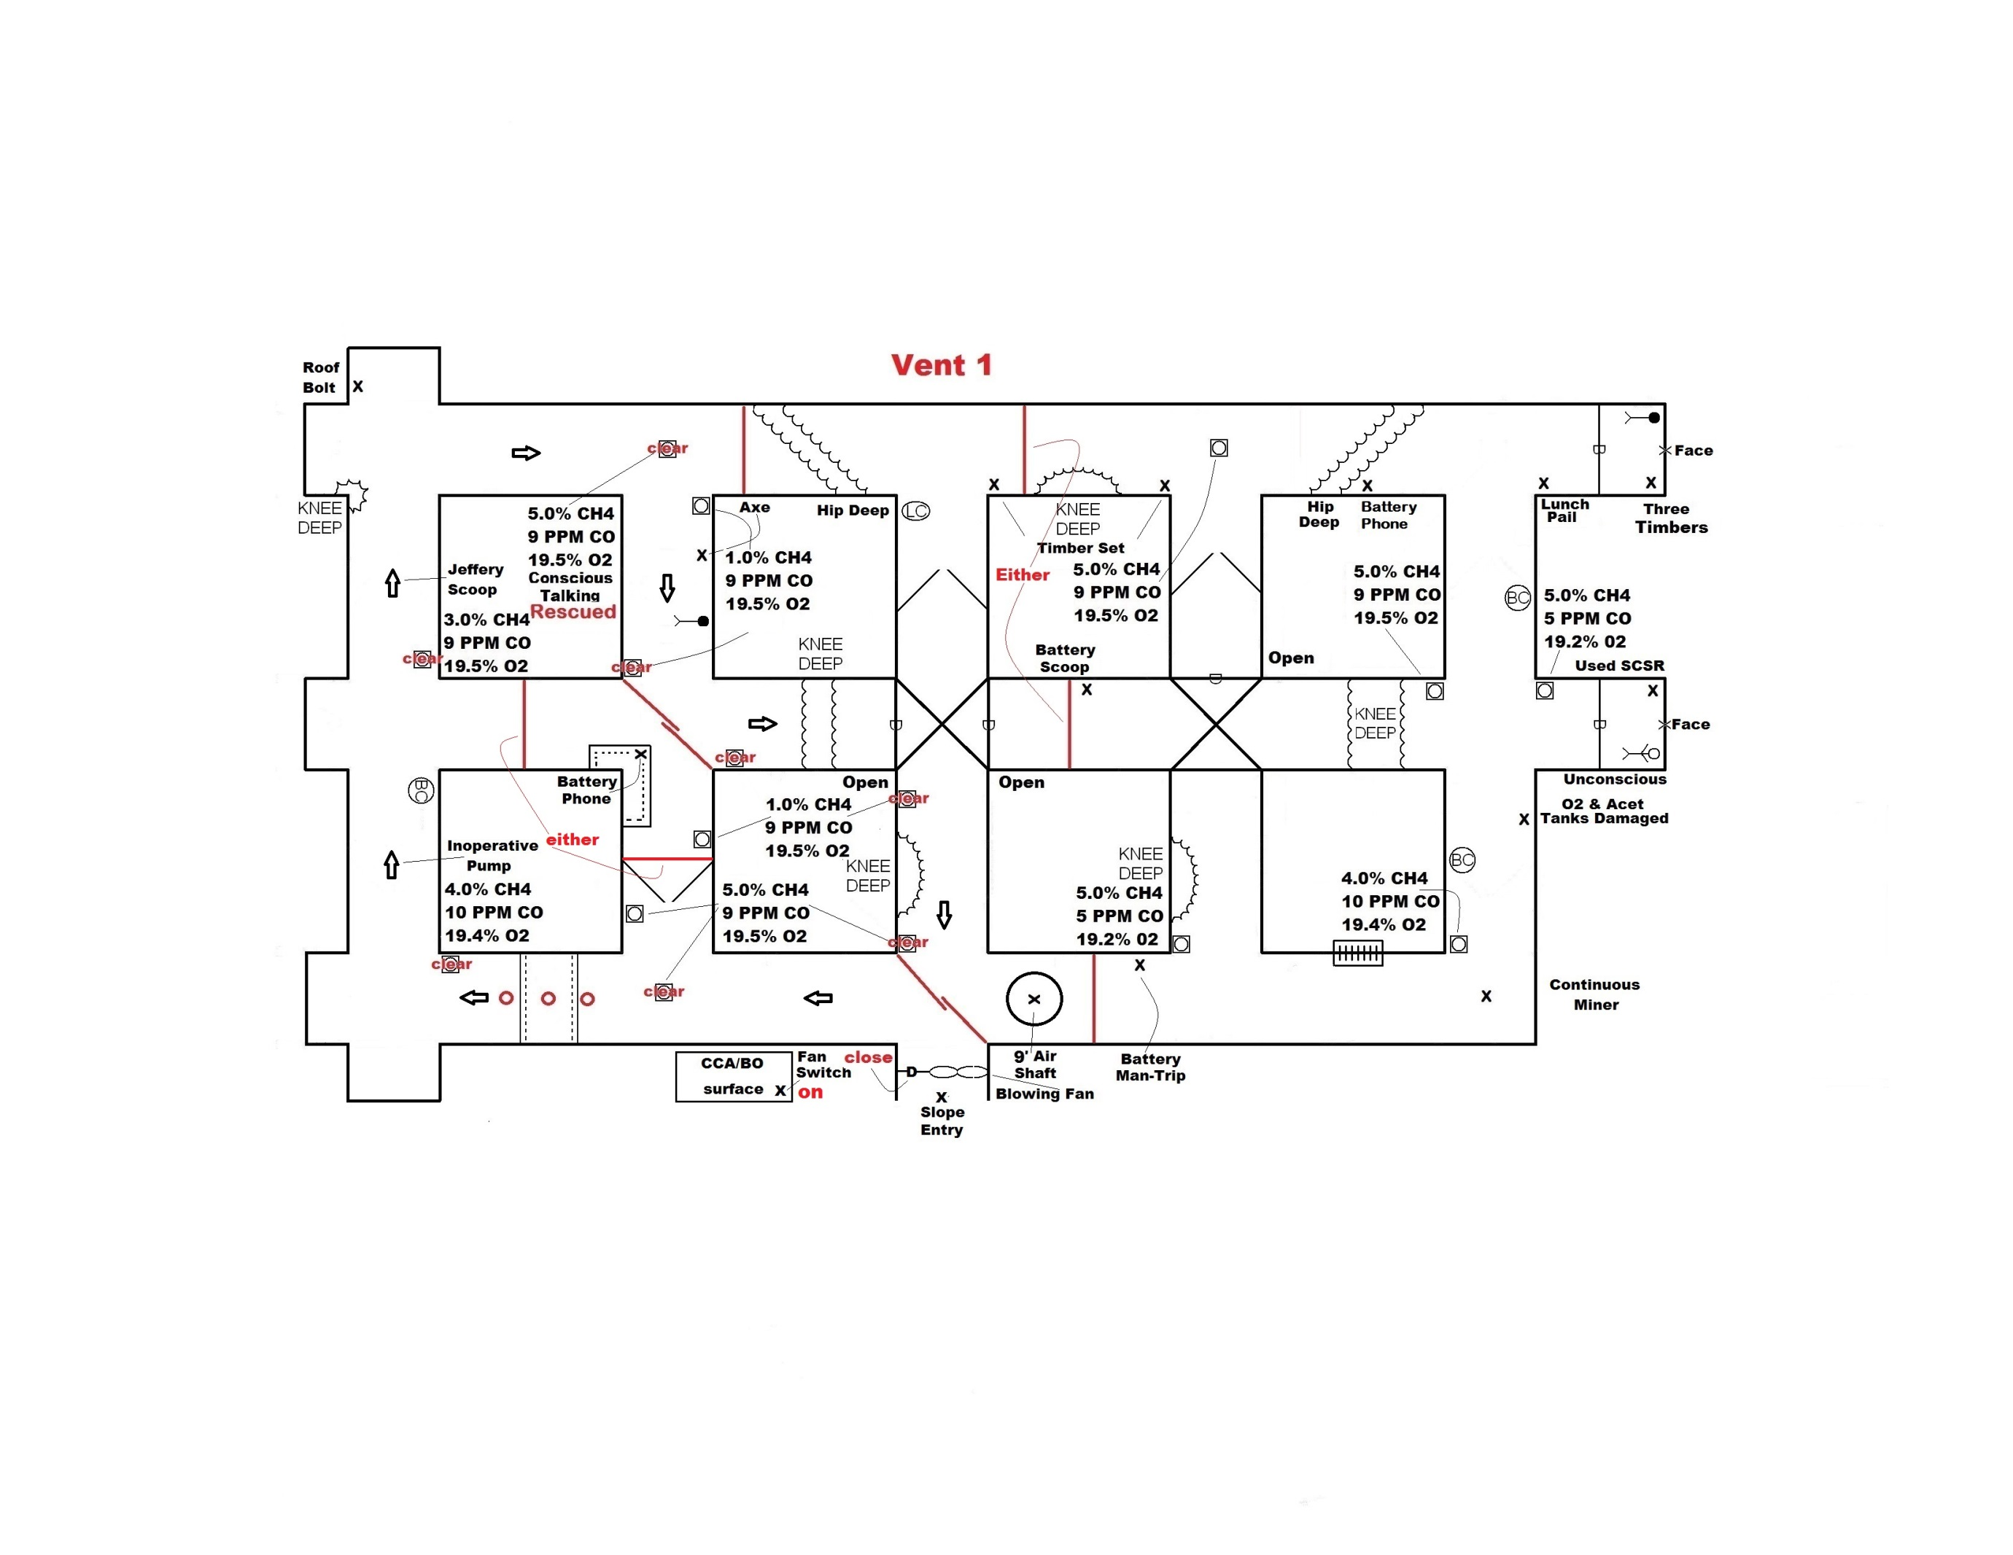

Slide 11
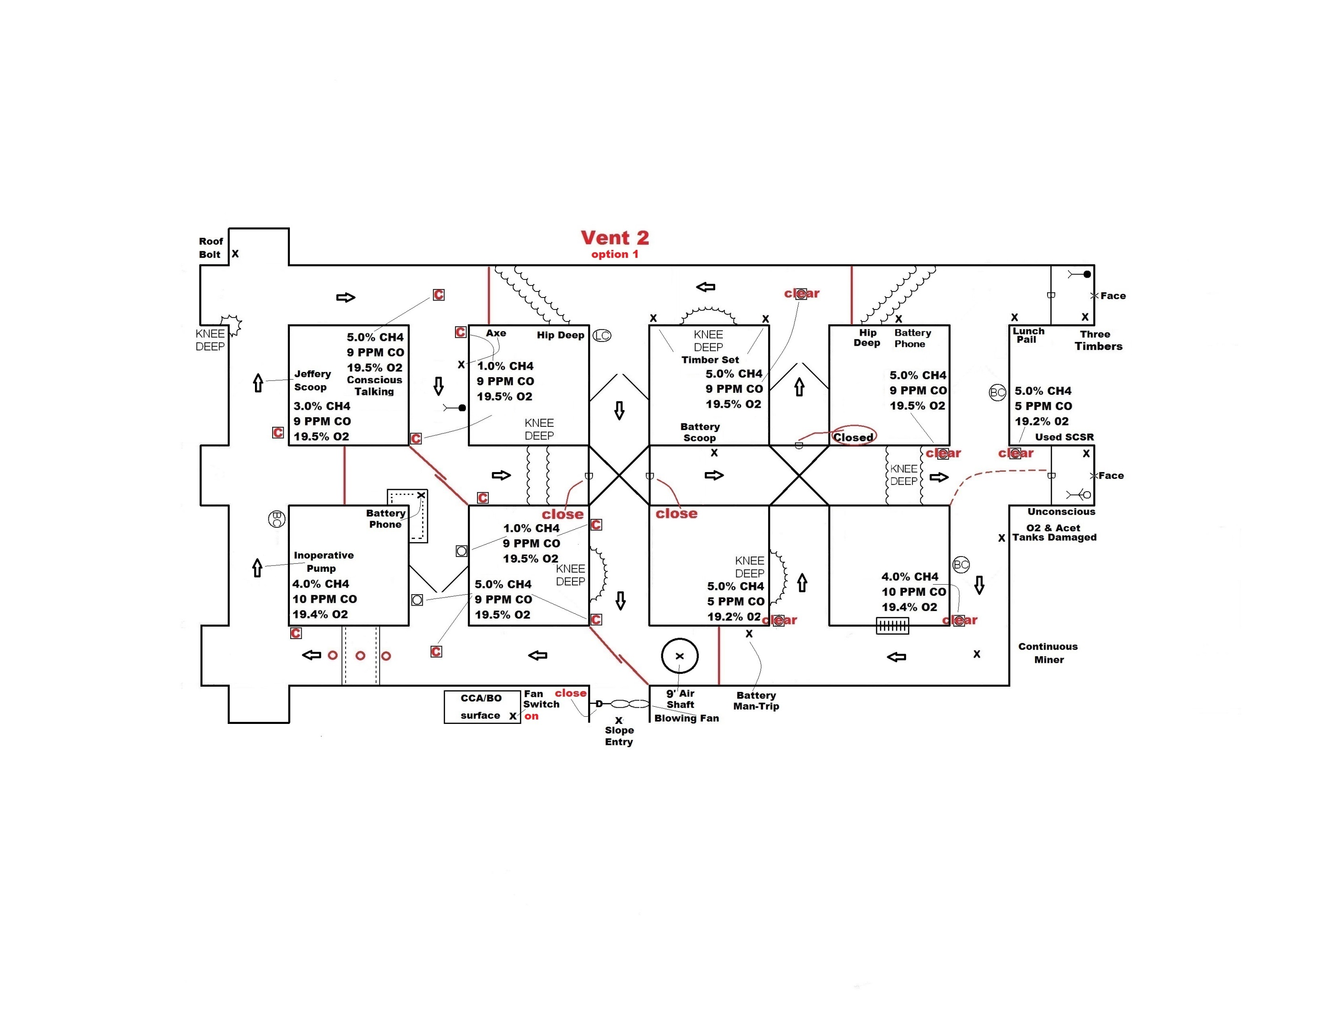

Slide 12
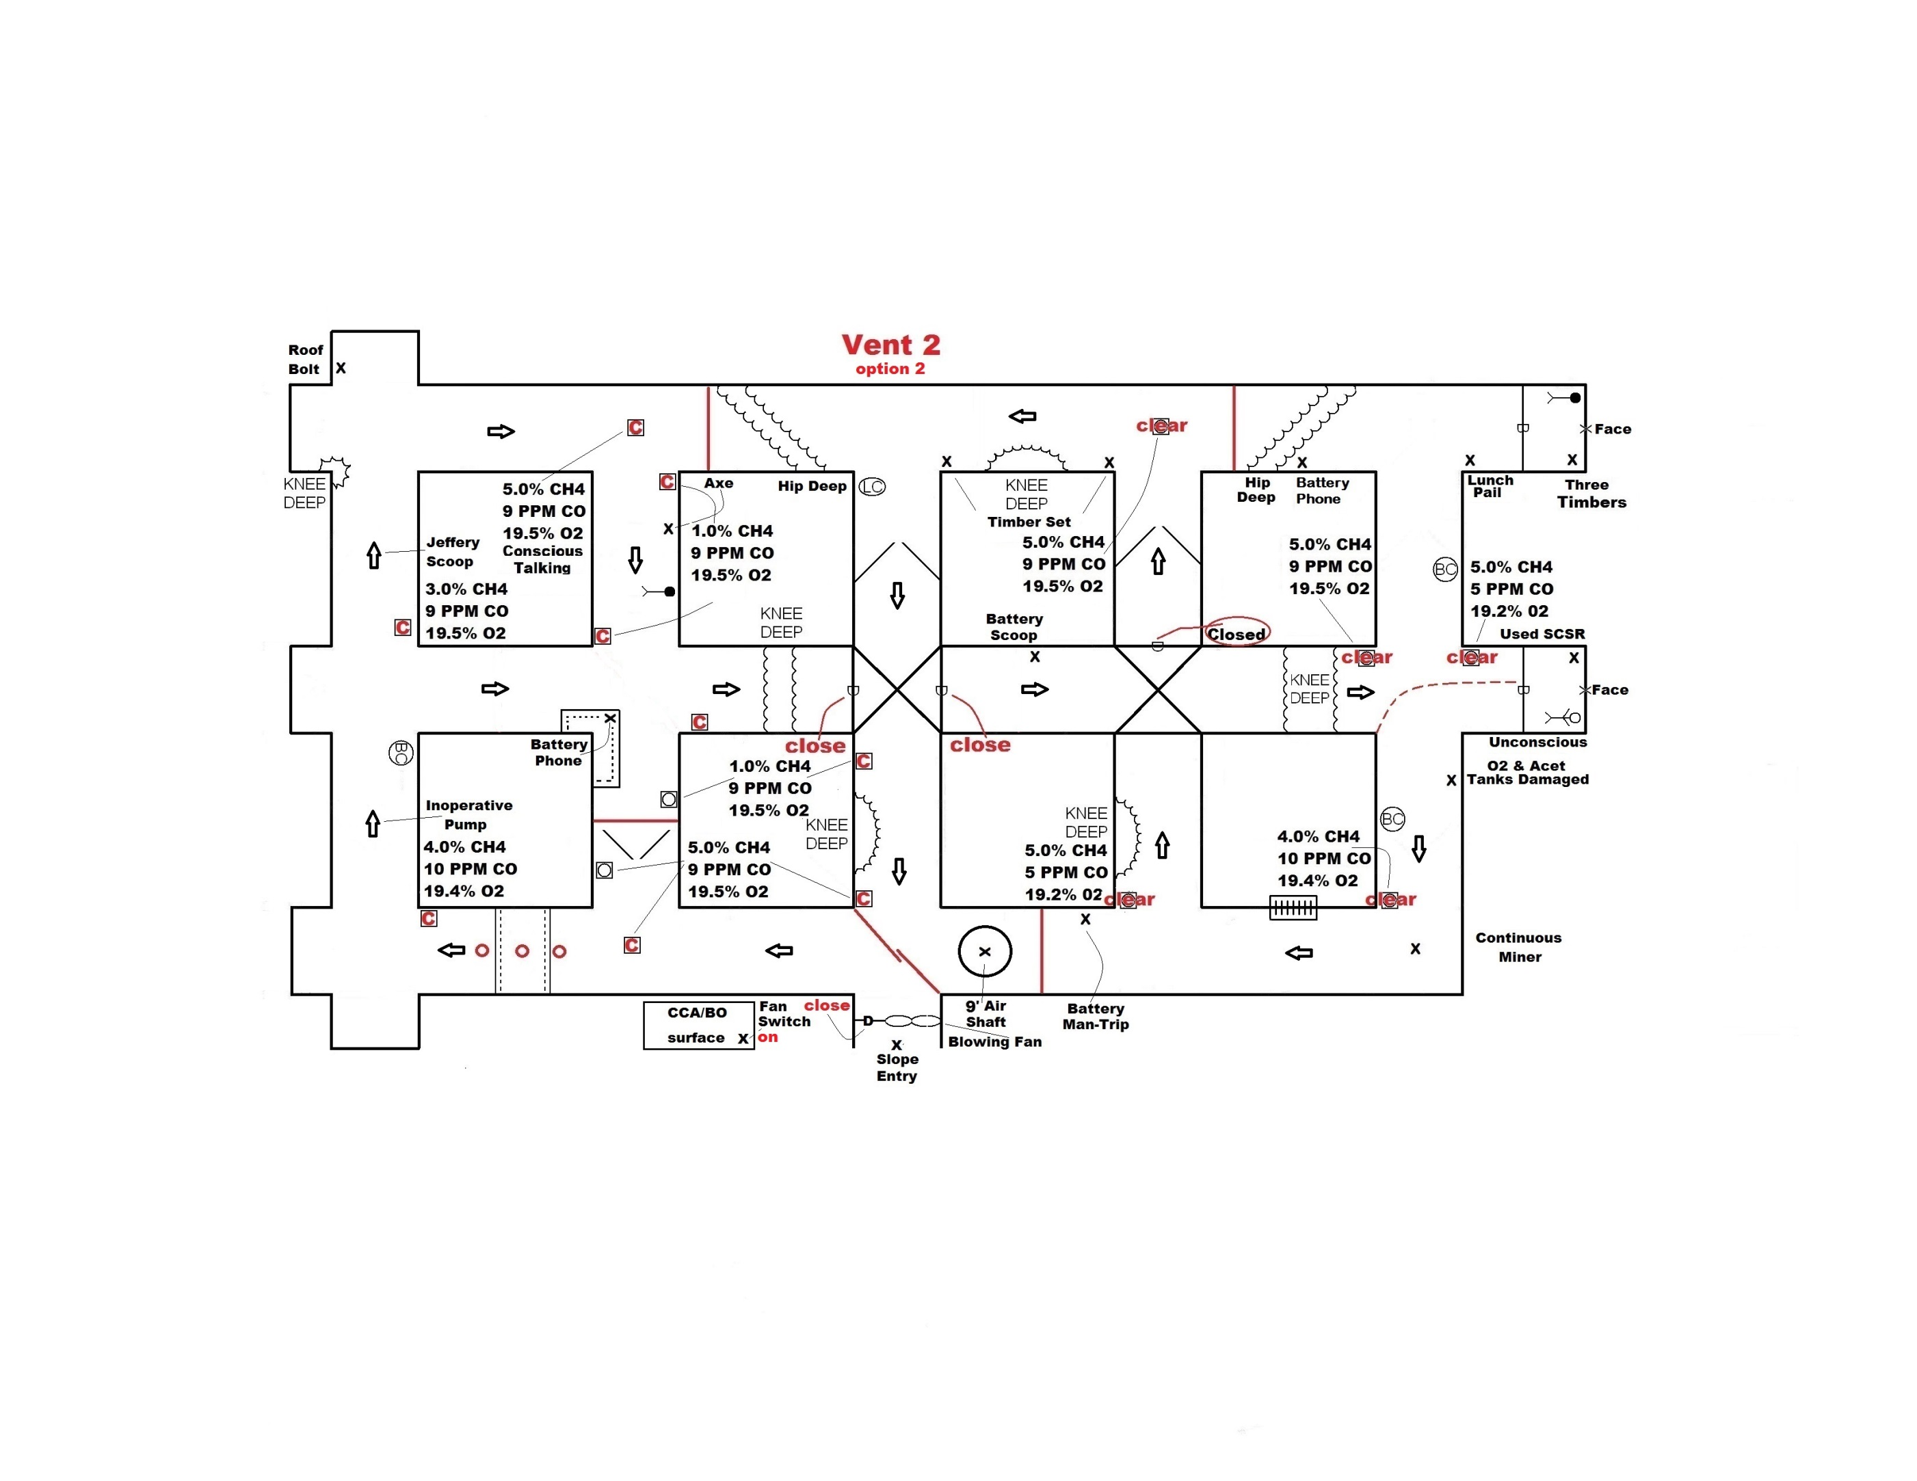

Slide 13
Problem Keys
Team must tie across and behind before traveling inby while exploring ….(five entries in this problem/see team stop map)
Team must advance in the contaminated entry or adjacent entry while exploring (five entries in this problem/see team stop map)
No vent required to rescue conscious patient from between the two barricades in second crosscut
Must find timbers behind barricade in last open before any vent can be done correctly (no vent required for barricade with 3 timbers)
Team must use 3 timbers at unsafe roof rib to rib (not enough timbers to timber to battery phone/takes 4 timbers for intersection)
Team must close door at fan. (Fan is inby FAB)
Team must not move explosive mixture over any battery equipment or unexplored areas

