Slide 1
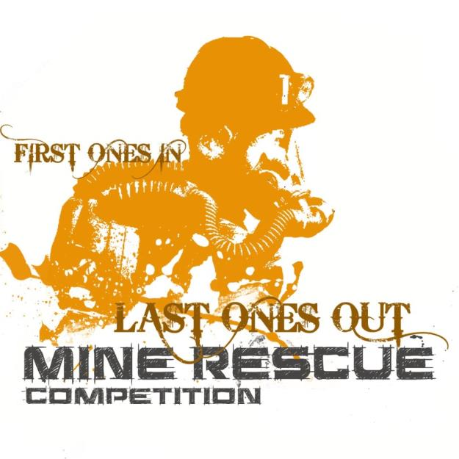
10th Annual Nevada Mine Rescue Contest
March 12 & 13, 2014
Winnemucca Events Center
Winnemucca, NV

Slide 2
On behalf of the MSHA Western District, the Nevada Mine Rescue Association, and the Winnemucca Convention and Visitors Authority, I welcome you to the 10th Annual Nevada Mine Rescue Contest.
There have been changes to the Contest Rules this year, so the contest is sure to be a little different. This is also a “National Contest Year.” Teams from across the country will travel to Kentucky to test their skills in August. The regional contests are a means for the teams to practice.
We hope that you enjoy the contest and thank you for coming to cheer the teams on!
Schedule of Events
Wednesday, March 12, 2014
6:00 am Lockup for mine rescue teams Winnemucca Events Complex Exhibit Hall
7:00 am First teams to be out on fields Winnemucca Event Center
Thursday, March 13, 2014
6:00 am Lockup for First Aid & Technician Team Contests Winnemucca Events Complex Exhibit Hall
7:00 am First Aid Contest begins Winnemucca Event Center
7:00 am Technician Team Contest begins Winnemucca Event Center
6:00 – 7:00 pm Social Hour
7:00 – 8:00 pm Banquet and Awards Presentation
Winnemucca Convention Center, West Hall

Slide 3
Briefing Statement
Your team has arrived at the American Flag Mine, a small multiple level zinc/silver mine. This mine operates 24 hours a day, 7 days per week. Three underground crews work 8 hour shifts each day. Each crew consists of 1 shifter, 5 miners, 2 nippers, 1 mechanic and 2 equipment operators. The day shift crew was underground and 11 people had brassed in.
This morning at about 10 a.m., a loud boom was heard from the shop. A loader operator heard the boom and ran into the shop to find flames near the oil storage and smoke starting to fill the area. The loader operator tried to close the overhead fire door at XC-2/entry 2, but it wouldn’t budge. He called and informed the dispatcher about the emergency and ran out of the mine. Stench was dumped and the mine rescue team was called out. Shortly thereafter heavy black smoke started coming out of the exhaust. The main fan was turned off from the surface.
At 10:15 a.m. the dispatcher received a call from the shifter informing him that he was with 2 others in refuge and that someone was hurt. The dispatcher heard what sounded like a scuffle and the Femco went dead. We haven’t heard from anyone since then.
The Fresh Air Base is set up underground near the shop area. There are back-up teams on site, one is almost ready to go. If your team is ready we need you to explore the mine, extinguish any fires and bring any survivors to the surface. Bringing survivors out may require ventilating the mine. Good Luck!

Slide 4
Mine Information
American Flag Mine (02-00000)
Classification of the mine – Category IV
Frequency of explosive gas being found – Not applicable
Accuracy of the mine map – A year old
Possibility of the mine being cut into another mine - None
Condition of the fan – Main fan was shut off, non-reversible, one small auxiliary fan brought out of the mine last night for repair.
Have guards been posted – Yes, at fan controls & MCC
Electric power cut off from the mine or affected parts of the mine – power is off
Recovery work that has been accomplished - None
Notification of the local, state, and federal agencies – Police are at the gate, MSHA is here (under a “K” Order) and the state is 15 minutes out, ambulances & FD are here.
Reserve rescue teams – Are on site, one is gearing up to serve as back-up, others are on the way.

Slide 5
Mine Information II
Equipment, and materials that are available – Stopping materials and timber for cribbing/support are available.
Explosives – Stored on the surface, shouldn’t be any underground.
Fuel or oil storage – Oil storage in the shop. They just delivered a pallet of oil to the shop. A fuel island is elsewhere in the mine, but tanks are empty (waiting on shipment) it is not affected.

Slide 6
Team/FAB/Alternate map
As you can see, there is going to be quite a bit of mapping that needs to be done. The map man will need to draw in the dump, split the left inby pillar, draw in the sump and the furthest inby entry and crosscut.

Slide 7
Normal ventilation schematic
Air is drawn up entry #3 and exhausted through entry #1 using a fan. To provide maximum air to the working areas inby, permanent stoppings have been erected in crosscut 1 and 2. The permanent stopping in crosscut #1 has a door that can be opened and closed, but is normally kept closed. Curtains are used in crosscut #3.
Ventilation controls in crosscut #1 have been damaged or changed. The permanent stopping between entry 2 and 3 has been blown out and the doors are unusable. The doors between entry 1 & 2 have been converted to a temporary stopping (hot to the touch). Placards will be in place to show the changes.

Slide 8
The fire has caused a build-up of smoke, high CO and low O2 in the mine. The closed airdoor in the far right entry is causing fresh air to be drawn into the fire. Initially the air behind the airdoor is clear with slightly elevated CO. Once the team takes the first set of miners out of the refuge chamber and out of the mine, a ground fall will occur, smoke will appear and the CO will rise to a level that will require them to protect any remaining miners.
The problem is designed with emphasis on the new rules. Three areas with bad back have been put in to test their timbering knowledge under different conditions. The team will need to clear the air in the back of the mine to take the miner out as CO will be too high to build-in and get to him. There will also be a need to take one of the non-ambulatory patients inside of the refuge chamber out under supplied air (SCSR).

Slide 9
As always there’s more than one way to solve any problem. Keep in mind that the team is not under obligation to enter into areas with unsupported/unsafe ground conditions during their initial entry into the mine. However, they must eventually explore these areas to complete the problem. What the team does first depends on which side the team wishes to enter. If the team enters under smoke (entry 1) in the first crosscut they will encounter a miner under bad back. Since they encounter bad ground immediately a team may decide not to enter, however, if they do they will need to support the back (the placard will indicate good ribs) before entering to check the miner. When they reach him they will find no signs of life. The captain will D&I, stretch out and find a temporary stopping. The stopping will be warm to the touch. A gas test will show no change in concentrations. The captain will D&I. The team will continue into the mine, and at the second crosscut find a permanent stopping. This stopping is permanent and cannot be breached. Gas tests will show no change in concentration. The captain will D&I the stopping, back out and stretch north. The captain will D&I the furthest point of advance. The team will retreat from the mine.
When the team enters entry 3 (clear air) as they travel into the first cross cut they will encounter smoke and increased CO. As they travel further in they will encounter intense heat and an uncontrollable fire. The team may try to put out the fire. Their efforts will be in vain. The captain will have to D&I the fire out of control.
The team must erect a regulated seal outby the intense heat placard. This will entail gathering supplies to build the seal. Before erecting it, the team will have to check the back for loose ground. Once the seal is up, the captain will D&I the seal. Since regulating a fire is not considered changing ventilation, they do not need to seek permission to build (if they seal the fire, that is considered a ventilation change and will need to get permission).
Since the team is aware of the fire and knows where it is they must look for the back side of the fire to seal it. They will retreat back into entry and move further inby. The team will encounter a set of closed airdoors. The doors are cool to the touch. (If the team started the problem in fresh air by going into entry 3, they will need to travel to entry 1 and explore. If they did not continue beyond the airdoors in entry 3, 2+3 rule applies).

Slide 10
The team will need to airlock to travel northward in entry 3. Once the airlock is properly constructed they can open the airdoors and continue to the next crosscut. There the team will encounter a refuge chamber. Gas tests will show respirable air with levels of CO and O₂ near normal range and no smoke. This will allow the team to breach the refuge chamber. Inside they will find 5 miners. 4 of the miners are uninjured and able to walk out (1 is distraught and will need to be controlled). 1 miner will have a leg injury that needs to be treated and be carried out. The team will be capable of handling 4 of the patients. The team will take the 4 miners out through the airlock & out to the FAB. The team will reenter, airlock and open the doors. This time the team will encounter a placard showing that gas levels have changed, requiring them to bring the 5th miner out under supplied air (he will be unconscious requiring the team to use their spare unit or SCSR with a full face mask). Don’t forget to watch for gas tests and D&I’s.
There is always the possibility that the team may decide to pass up the refuge chamber and continue to look for the back side of the fire. If the team began the problem by entering in clear air (through entry 3), the 2+3 rule will apply.

Slide 11
Once crosscut #2 has been explored the team can continue up to crosscut #3. If traveling up entry 1, the team will test for gasses and find no change in concentrations. They will go through the check curtain and will find a pile of timbers along the right rib (they are looking for the back side of the fire, if they go forward into XC-4 it is undue delay). Ahead of them in crosscut #3 in front of the other check curtain they will find loose back with incompetent ribs. To explore further they will need to timber using the appropriate technique. North in entry 2 they will find a 2 yard mucker. Traveling southward they will encounter loose back in the intersection. They must support the ground in all four directions (they will need to explore east and west) before they continue forward. Past the intersection they will encounter a damaged acetylene bottle, a burned up switch box and miner 6. Miner 6 is laying in a shallow puddle of water and is not showing signs of life. Past miner 6 they will find a welder, an intense heat placard and the back side of the fire. The team will have to retreat and build a regulated seal. Gas tests in the area will show no change in gas concentrations. The captain will need to D&I the stoppings, fire out of control, FPA northward and body.
If the team travels up Entry 3 they will need to support the ground going through the check curtain using the timber back by the refuge chamber.

Slide 12
The team will have to complete exploring south of crosscut #3 before continuing on to crosscut #4. The team will need to explore all of crosscut #4. There the team will find Miner #7 laying near the front of a haul truck. Miner #7 is not showing any signs of life. Gas concentrations will not show any change. The team will check the temporary stopping in entry 2. When they knock they will find there is a miner behind the stopping. Since the CO is still high the team will need to ventilate the mine to enter and retrieve the trapped miner. Once the team has explored the mine, the team can call for and start making ventilation changes.

Slide 13
Ventilation changes to clear the mine of smoke and gas are fairly straight forward.
The team will have to close the regulator in XC-1/entry 3
remove the airlock in entry 3
Open the check curtain in XC-3/entry 3
Close the regulator in the stopping behind the fire in entry 2
Convert the check curtain in XC-3/ entry 1
Build a wing curtain from the northwest corner of third pillar inby the barricaded miner in entry 2
Turn on the fan.

Slide 14
With the smoke & gas removed the team can enter the barricade and retrieve the miner. The miner inside will tell the team that there are solid ribs surrounding him, so the team won’t need to airlock in. The team will enter into the drift, take gas readings and explore (don’t forget the captain’s D&I’s). The miner inside is uninjured and thankful. The team can remove the miner from the mine. Since one miner is unaccounted for the team will need to check the sump area (if they haven’t already done so). Once they have explored all areas the team can leave the mine and stop the clock.

