Slide 1
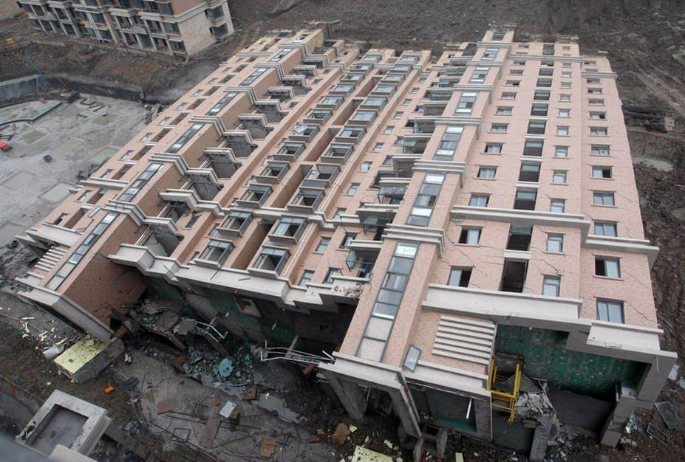
YES, IT IS A 12 STORY BUILDING IN CHINA . LYING ON THE GROUND.

Slide 2
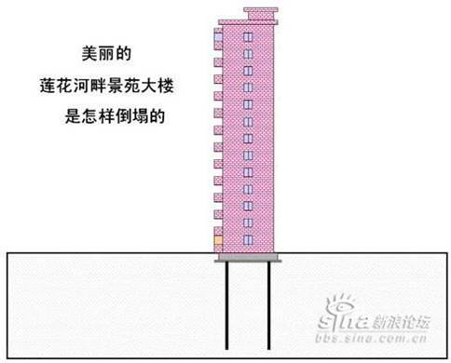
(1) An underground garage was being dug on the south side, to a depth of 4.6 meters. (2) The excavated dirt was being piled up on the north side, to a height of 10 meters. (3) The building experienced uneven lateral pressure from south and north. (4) This resulted in a lateral pressure of 3,000 tons, which was greater than what the pilings could tolerate. Thus the building toppled over in the southerly direction.
First, the apartment building was constructed.

Slide 3
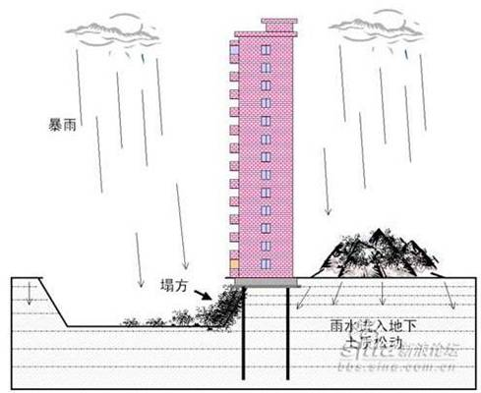
Then the plan called for an underground garage to be dug out. The excavated soil was piled up on the other side of the building.
Heavy rains resulted in water seeping into the ground.

Slide 4
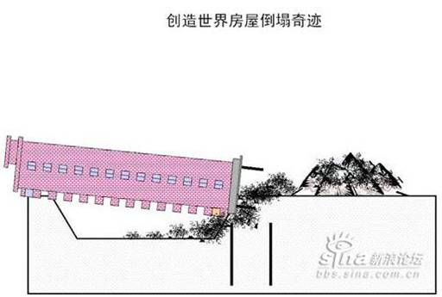
The building began to tilt.
And thus was born the eighth wonder of the world.

Slide 5
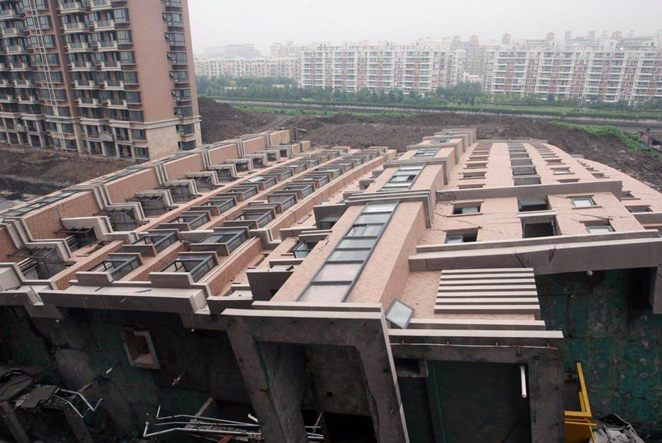

Slide 6
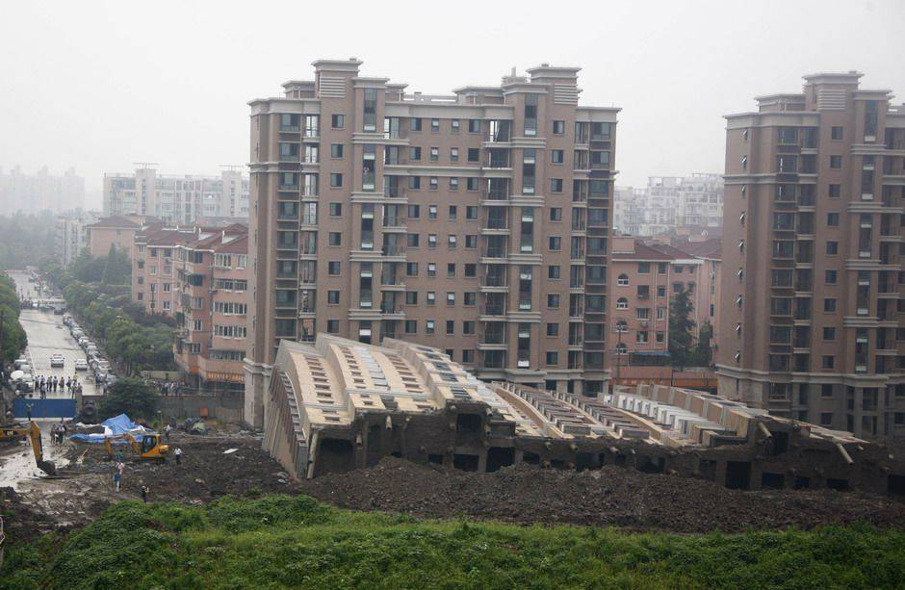

Slide 7
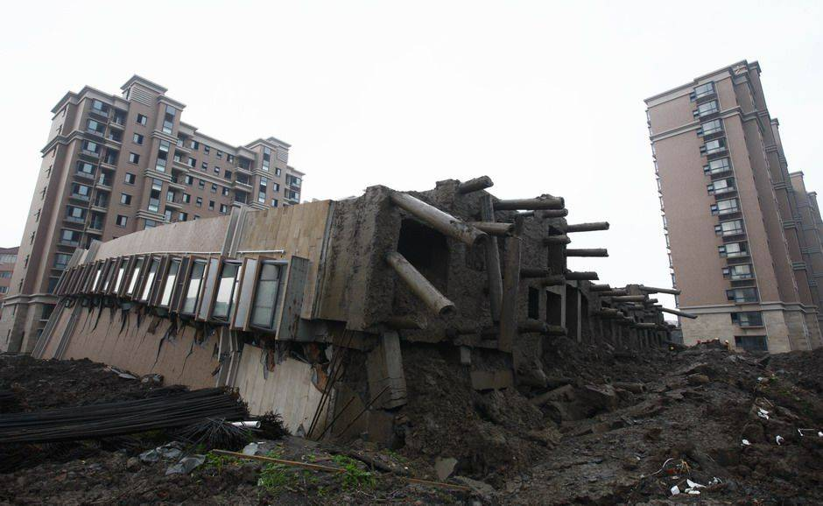

Slide 8
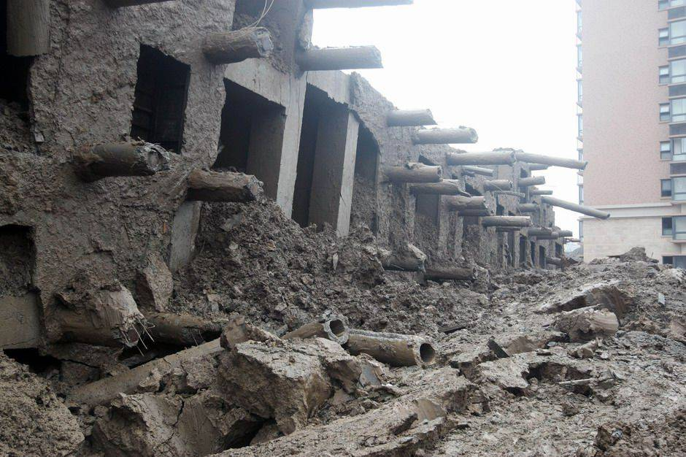

Slide 9
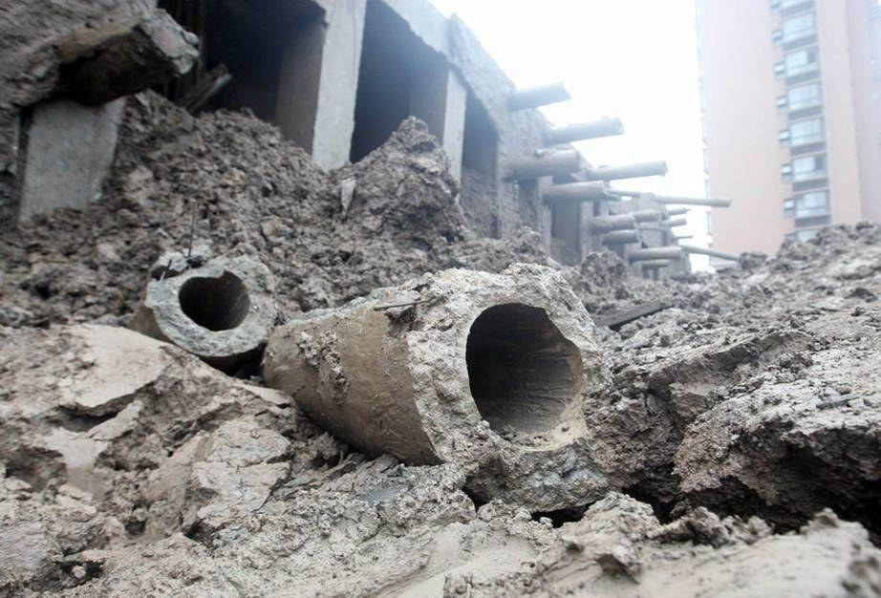

Slide 10
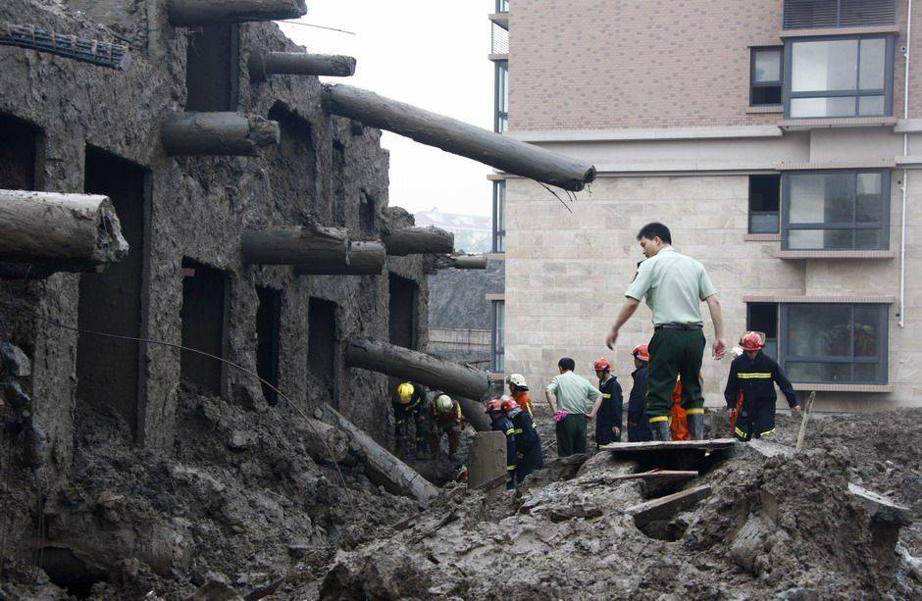

Slide 11
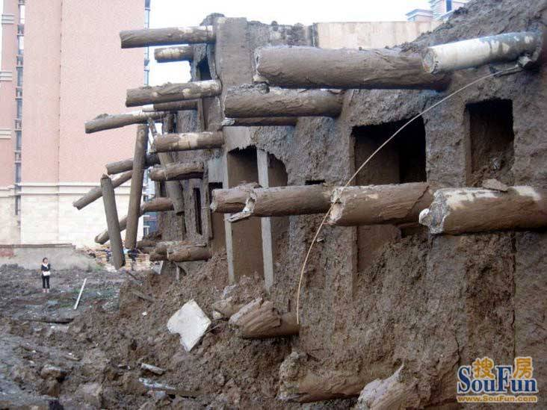

Slide 12
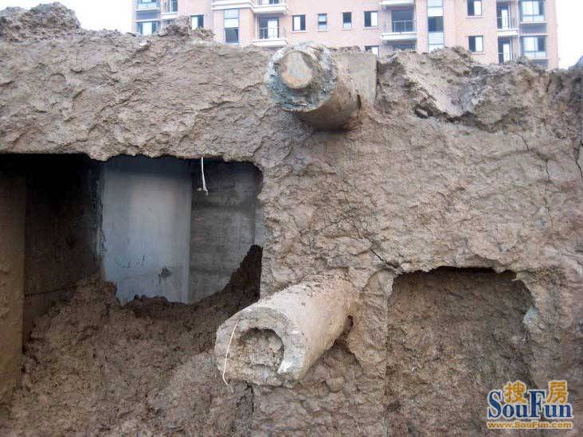

Slide 13
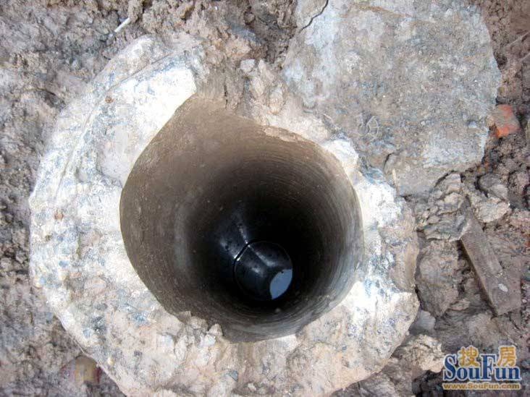

Slide 14
