Slide 1
Opioid Treatment Programs (OTP) & Medication Assisted Treatment (MAT) IN ARMS September 26, 2016
Prepared by
Leslie Hulvershorn, MD
Medical Director,
Division of Mental Health and Addiction, FSSA
Leslie.Hulvershorn@fssa.IN.gov
Presented by
Dennis Ailes, MA
Assistant Deputy Director of Addiction Services
Division of Mental Health and Addiction, FSSA
Dennis.Ailes@fssa.IN.gov

Slide 2
Session Description
Medication-assisted treatment (MAT), including opioid treatment programs (OTPs), combines behavioral therapy and medications to treat substance use disorders. Medications, when used in combination with counseling and behavioral therapies, provide a whole-patient approach to the treatment of opioid dependency to help people reduce or quit their use of heroin or other opiates

Slide 3
Summary
What are opioids?
What are opioid use disorders?
What are the treatment options?
Why medications?
How successful is MAT?
What about pregnant women and their babies?
What is new in Indiana for the treatment of opioid use disorders?

Slide 4
Opiates
Prescription pills: morphine/morphine like substances (e.g., OxyContin, Percocet, Vicodin, Lortab, Opana, methadone)
Pills are ingested, snorted or injected
Heroin: Street drug, derived from morphine
23% who try will become addicted
Powder is injected, snorted, smoked
Produce euphoria and then sedation

Slide 5
Opioid Use Disorders: DSM-5 “Opioid Addiction”
Take more than intended
Desire/unsuccessful efforts to cut back or quit
Time spent using, obtaining or recovering
Craving
Failure to fulfill work, school, home obligations
Continued use despite problems (social, psychological, physical)
Activities given up
Use in hazardous situations
Tolerance
Withdrawal

Slide 6
Consequences of Opiate Use Disorder
Overdose: respiratory depression
Use of narcotic analgesics resulted in nearly ½ million visits to U.S. ED’s in 2007
Injection: HIV and Hepatitis
Overdose mortality has been reported with both methadone and buprenorphine
Notes:
Opioid abuse can result from both the use of illegal (e.g., heroin) and legal substances (e.g., prescription opioid pain relievers).
Indiana residents ages 12 and older report lifetime use of nonmedical prescription pain relievers at 15.0%, 6.1% of residents reporting past year use, and 2.0% of residents reporting past month use.
The use of opioids together with other drugs that depress the central nervous system can result in reduced heart and respiration rates, and may potentially lead to death.
In 2007, use of narcotic analgesics resulted in 483,612 visits to U.S. emergency departments.
Low overdose mortality has been reported with both methadone and buprenorphine.

Slide 7
Treatment Options
Opiate Addiction
Buprenorphine
Detox/Maintenance
Program
Naltrexone
(Vivitrol)
Program
Methadone
Detox/Maintenance Program

Slide 8
History of Methadone
Synthesized in Germany: Less addictive than morphine
1930s
Research demonstrated efficacy for heroin addiction
1964
Federal regulations developed for methadone maintenance treatment
1971
Used in US for pain
1947
Federal regulations updated to allow more effective and consistent use 2001
http://www.cesar.umd.edu/cesar/drugs/methadone.asp

Slide 9
Federal and State Rules for OTPs

Slide 10
Methadone Maintenance
Maintenance = help avoid negative consequences of illicit opiate misuse
Dosed once daily
<80-100 mg daily
When properly managed, reduce narcotics related deaths, users' involvement in crime, the spread of AIDS, and helps users gain control of their lives
If used correctly, few side effects, no high

Slide 11
Methadone: Does it work?
11 clinical trials
More effective than non-methadone treatments at keeping people in treatment, staying off of opiates
(Cochrane Review, 2009)

Slide 12
Opioid Treatment Programs (OTPs)
Only source of methadone for maintenance
(Reminder: Also prescribed by physicians for pain)
Provide a multi-modal approach including medication, counseling, and other supportive services, to treat opioid addiction
Heavily regulated by state and federal agencies
Notes:
Opioid treatment programs (OTPs) have been found to effective in treating patients that have opioid dependence.
OTPs use a combination of medication, counseling, and other supportive services, to treat severe, chronic, and long-term opioid addiction.
Treatment may include detoxification from short-acting opioids, medically supervised withdrawal treatments, and pharmacotherapy to stabilize patients.
Since OTPs dispense controlled substances, they are heavily regulated by state and federal agencies.
Currently, there are 1,200 OTPs in the United States. In Indiana, there are 13 OTPs under the state’s supervision.

Slide 13
“Take Homes”
Privilege earned through drug screens:
Negative for illicit drug use
Positive for methadone metabolites
Incentive for “good behavior”
Improves compliance, sobriety from other drugs

Slide 14
PROS CONS
Close supervision: daily dosing
Enforce therapy
Incentivize “take homes”
Most effective treatment
Hassle: interfere with employment, parenting, etc.
Expensive
Societal consequences for take homes

Slide 15
Treatment Options
Opiate Addiction
Buprenorphine
Maintenance
Program
Naltrexone
(Vivitrol)
Program
Methadone
Maintenance Program

Slide 16
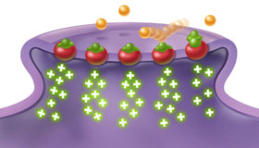
Buprenorphine/Naloxone
Semi-synthetic partial agonist (limited effects) + antagonist
Does not require daily dispensing
Safer in overdose = much less regulation
Easier to stop than methadone, milder withdrawal

Slide 17
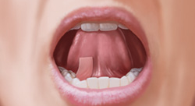
Sublingual Film

Slide 18
PROS CONS
Convenient
Safer to have at home
Easier to stop
$$$$ (now generic)
Still taking an opiate
Hard to find qualified providers
Less effective than methadone

Slide 19
Treatment Options
Opiate Addiction
Buprenorphine
Maintenance
Program
Naltrexone
(Vivitrol)
Program
Methadone
Maintenance Program

Slide 20
Naltrexone
Vivitrol (monthly intramuscular injection)
FDA approved for alcohol, opiate use disorders
Opiate antagonist: blocks receptor

Slide 21
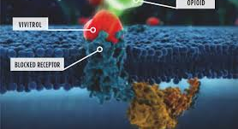
Action of Naltrexone

Slide 22
PROS CONS
Non-narcotic
Cannot decide to “miss a dose”
$$$$
Can cause liver damage
Occasional overdoses
Must be off opiates for 2 weeks to start

Slide 23
Opiate Use Disorders and Pregnancy
Detoxification is associated with high rates of spontaneous abortions in the first trimester and premature delivery in the third trimester
Babies exposed to heroin have lower birth weights
Babies exposed to heroin were more likely to require morphine than those with methadone treated mothers (40% vs. 19%)
Current recommendations: Treat with Methadone or Buprenorphine

Slide 24
Neonatal Abstinence Syndrome
“Neonatal abstinence syndrome is an expected and treatable condition that follows prenatal exposure to opioid agonists.”
-American College of Obstetricians and Gynecologists

Slide 25
Benefits vs. Risks
Risks: side effects, costs, take home doses
Benefits: Decrease drug use, improve health, reduce high risk behaviors, increase employment

Slide 26
What is new in Indiana for Opioid Treatment?
Senate Enrolled Act in 2015, SEA 464
SAMSHA Grant: Medication Assisted Treatment – Prescription Drug and Opioid Addiction (MAT-PDOA)
Senate Enrolled Act in 2016, SEA 297

Slide 27
Opioid Treatment Programs (OTPs) in INDIANA
Currently 13 clinics (3 CMHCs)
Serve approximately 15,000 people
Can also administer buprenorphine
Moratorium on new programs
Opioid use disorders are widespread and Indiana is still underserved

Slide 28
Senate Enrolled Act 464

Slide 29
Senate Enrolled Act 464
Effective July 1, 2015 the following types of entities may apply to the Division to operate an Opioid Treatment Program
Licensed Hospital under IC 16-21
Licensed Private Psychiatric Institution (PIP) under IC 12-25
Community Mental Health Center under IC 12-21

Slide 30
Senate Enrolled Act 464
Before June 30, 2018, the division may approve the operation of not more than five (5) additional opioid treatment programs only if the division determines that there is a need for a new opioid treatment program in the proposed location and the requirements of this chapter are met. All approvals need to be in compliance with the article and federal law.

Slide 31
Senate Enrolled Act 464 (continued)
The report must include the following:
(1) The impact on access to opioid treatment programs.
(2) The number of individuals served in the opioid treatment programs approved under subsection (c).
(3) Treatment outcomes for individuals receiving services in the opioid treatment programs approved under subsection (c).
(4) Any recommendations the division has concerning future treatment programs.

Slide 32
Senate Enrolled Act 464 (continued)
Location, Location, Location
(e)The division shall adopt rules under IC 4-22-2 setting forth the manner in which the division will determine whether there is a need for a new opioid treatment program in a proposed program location’s geographic area.

Slide 33
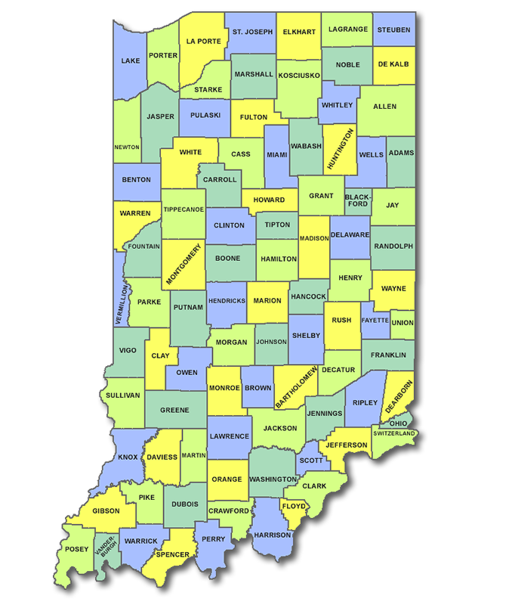
Indiana Map of Opioid Treatment Programs
The State of Illinois currently has 71 Certified Opioid Treatment Programs.
The State of Kentucky currently has 15 Certified Opioid Treatment Programs.
The State of Ohio currently has 24 Certified Opioid Treatment Programs.
The State of Michigan currently has 41 Certified Opioid Treatment Programs.

Slide 34
Process to Become a Certified Opioid Treatment Clinic
Application for certification and accreditation from SAMSHA/CSAT and within CSAT to the Division of Pharmacologic Therapies (DPT). http://www.dpt.samhsa.gov/regulations/regindex.aspx
Must obtain a separate Drug Enforcement Administration (DEA) registration as a Narcotic Treatment Program, to administer and dispense approved Schedule II controlled substances (that is, methadone) for maintenance and detoxification treatment. http://www.deadiversion.usdoj.gov
Application to the Division of Mental Health and Addition (DMHA) to become a Certified Opioid Treatment Program.

Slide 35
Process to Become a Certified Opioid Treatment Clinic (continued)
SAMHSA-Approved Opioid Treatment Program Accrediting Bodies
Commission on Accreditation of Rehabilitation Facilities (CARF) 6951 East Southpoint Road Tucson, Arizona 85756 http://www.carf.org
Council on Accreditation (COA) 45 Broadway, 29th Floor New York, New York 10006 Telephone: 212-797-3000 ext.268 or 866-262-8088 Fax: 212-797-1428 http://www.coanet.org
Division of Behavioral Health, Missouri Department of Mental Health 1706 East Elm St. P.O. Box 687 Jefferson City, Missouri 65102 Telephone: 573-526-4507 Fax: 573-751-7814 http://dmh.mo.gov/ada/index.htm

Slide 36
Next Steps for Division of Mental Health & Addiction
Rule outlining determination of need has been written and process of promulgation completed September 2016
A request for information (RFI) will likely be published and applications will be solicited.
An agreement with up to 5 programs will be made…then those programs can begin the process to apply for all the relevant approvals and certifications (DEA, SAMHSA, CARF, DMHA, State Pharmacy Board, etc.)

Slide 37
Medication Assisted Treatment – Prescription Drug and Opioid Addiction (MAT-PDOA)
SAMHSA Grant

Slide 38
Medication Assisted Treatment – Prescription Drug and Opioid Addiction (MAT-PDOA)
WHAT?: Federal funding to promote the use of medication assisted treatment for opioid use disorders
WHO?: Individuals with lower income in rural areas, and those at-risk for HIV, Hepatitis C
WHERE?: Lake, Porter, Starke and Scott Counties
HOW MANY? Up to 500 people
WHEN?: Started in January 2016
FOR HOW LONG?: 3 years

Slide 39
What does the grant fund
Medication Assisted Treatment
Outreach efforts
Recovery supports (transportation, child care, financial support)
Case management (link to mental health, medical, vocational and educational services)
Testing and education for HIV and Hepatitis C

Slide 40
Senate Enrolled Act 297
SEA 297 – Expands the criteria FSSA Medicaid uses to determine medical necessity for inpatient detoxification and requires Medicaid coverage for inpatient detoxification in accordance with ASAM (American Society of Addiction Medicine) Patient Placement Criteria to include treatment of opioid or alcohol dependence. SEA 297 is a product of the Attorney General’s Prescription Drug Abuse Prevention Task Force.

Slide 41
Questions?

