Slide 1
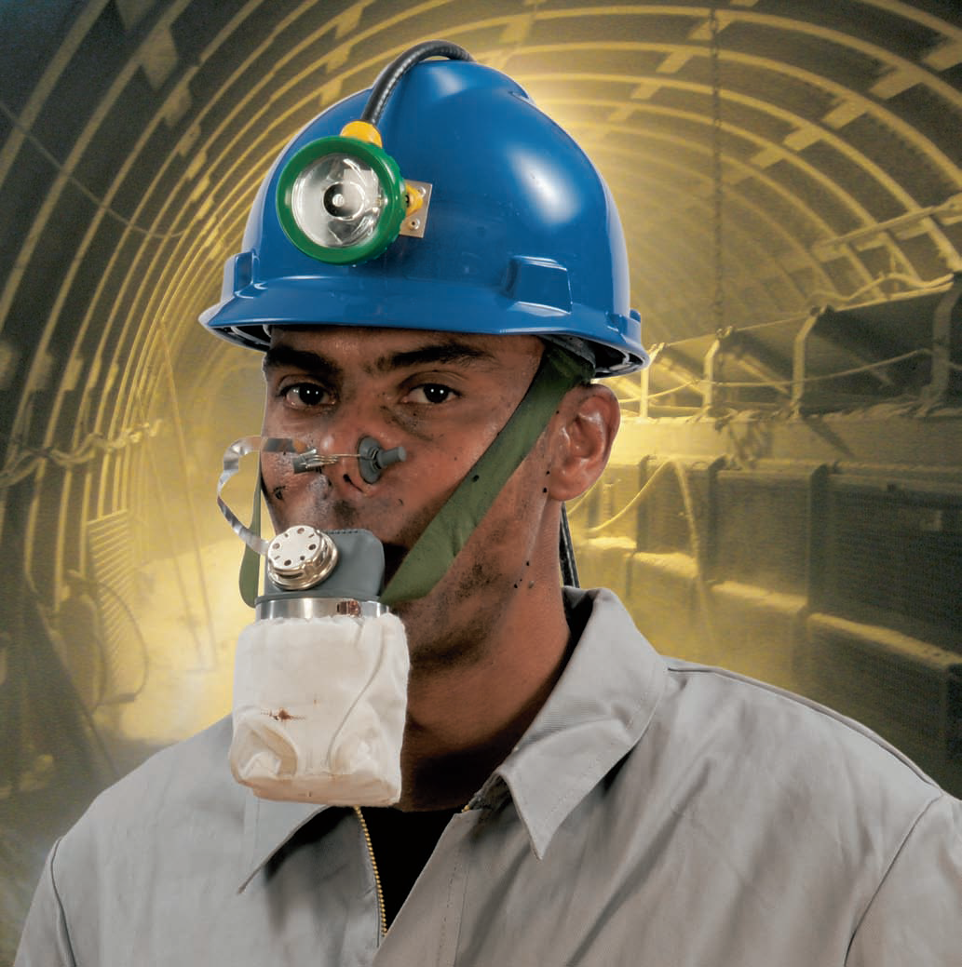
Donning Instructions for MSA W-65 Filter Self Rescuer

Slide 2
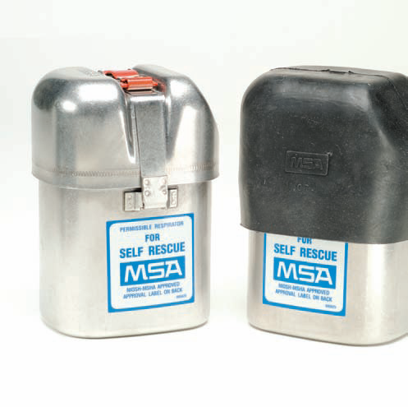
1
If the protective boot is covering the device, remove it.

Slide 3
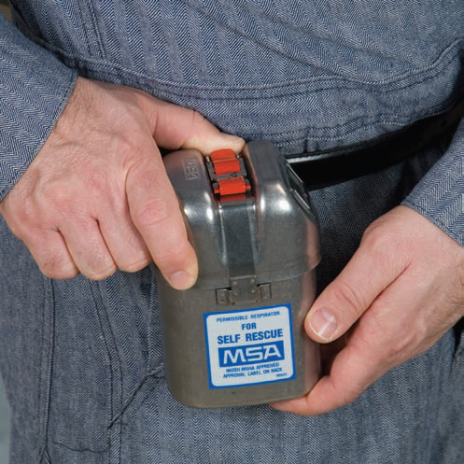
2
Release the locking device by pressing the thumb under the red release lever and pushing up . . .

Slide 4
3
. . . until Tamper Evident Seal is broken.

Slide 5
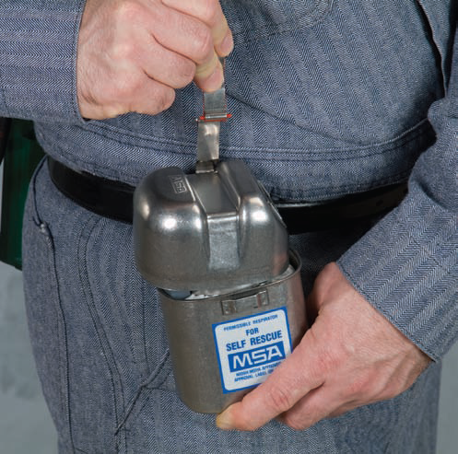
4
Grip the red release lever between thumb and forefinger and pull up hard. This should break the seal and release the locking mechanism to loosen the cover.

Slide 6
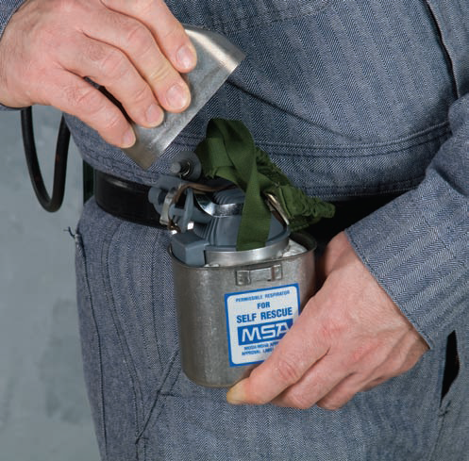
5
Remove the cover from the container and discard it.

Slide 7
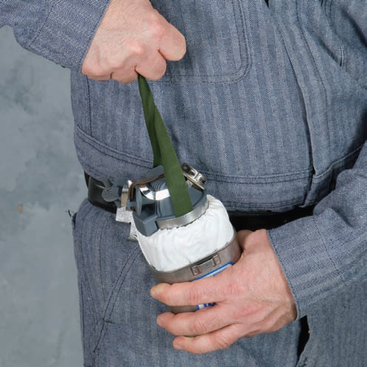
6
Grip the head harness of the respirator, and pull the respirator out of the container. (If the container is dented, preventing release, see step 14.)
Discard container.

Slide 8
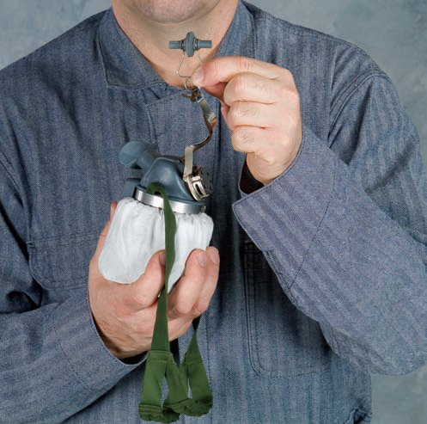
7
Pull the nose clip away from the mouthpiece.

Slide 9
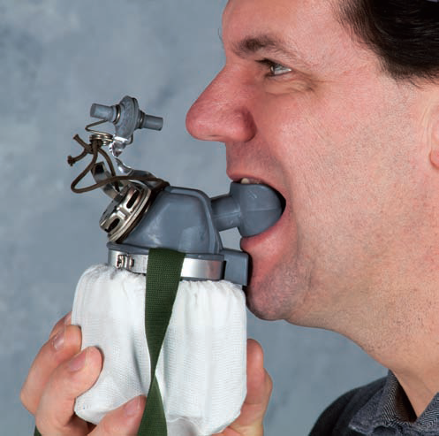
8
Insert mouthpiece lugs into mouth . . .bite the lugs firmly.

Slide 10
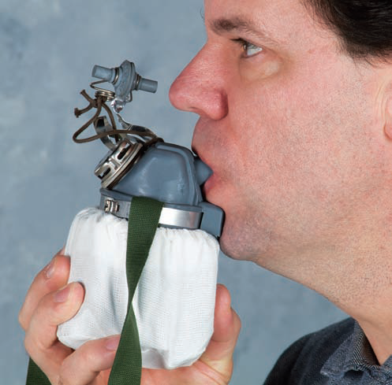
9
Close the lips tightly around the mouthpiece. A tight seal must be maintained throughout escape to safety.

Slide 11
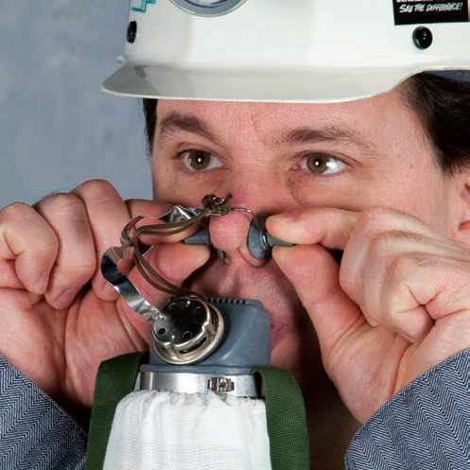
10
Pull the pads of the nose clip apart and position pads over the nostrils

Slide 12
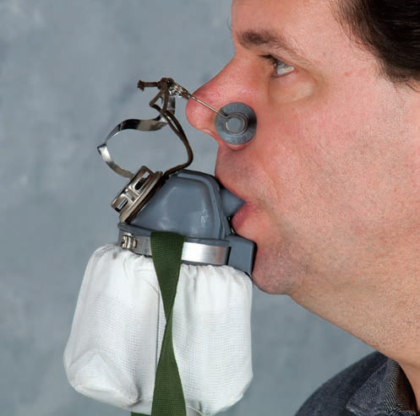
11
When released, the pressure of the pads seal the nasal passage.

Slide 13
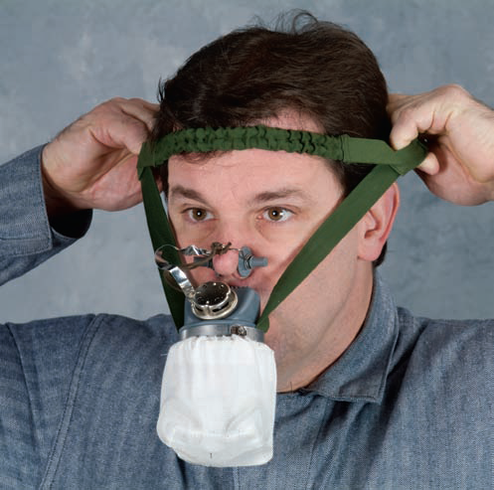
12
Take off headgear and pull harness over head. Put lower strap behind the head, and upper band above the forehead as shown. The head harness will support the weight of the respirator.

Slide 14
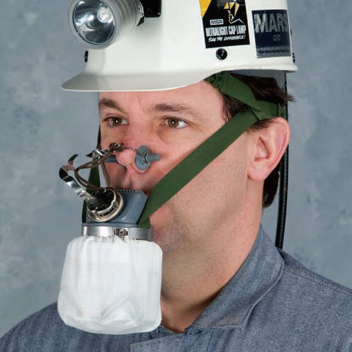
13
Replace headgear. Be sure not to dislodge the head harness.
The Self-Rescuer is now ready for use. Breathing though the devise is obviously somewhat more difficult than breathing under normal conditions. This will become more apparent under extreme exertion. Therefore, when escaping, keep calm and avoid exerting yourself too much. If possible, rest for short periods

Slide 15
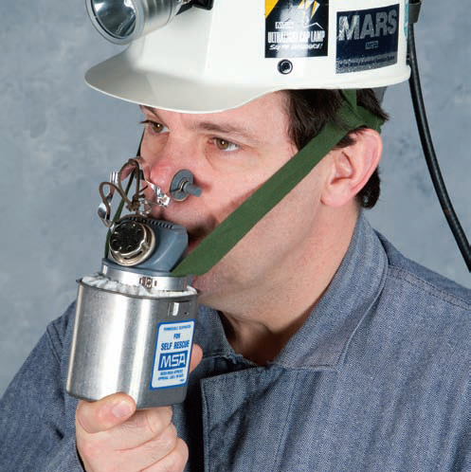
14
Before going underground, every miner should examine his Self-Rescuer for any external damage.
If the container is dented, it may not be possible to remove the respirator from the container. In this case, the wearer can still breathe with the filter and the inner wall in the container. The space between the filter and the inner wall is large enough to allow normal breathing. Because of the greater weight, it would be advisable to ease the load on the teeth and jaw by supporting the container with one hand.

Slide 16
Inspection
The Self-Rescuer should be periodically checked for air tightness by immersing it in warm water and looking for escaping air bubbles as you would check an inner tube for a leak. Another method is to weigh the apparatus periodically. The weight-as-shipped, which includes the metal name plate weight, is indicated in grams on the bottom of each unit; any leakage will result in heavier weight due to moisture absorption. An increase of up to 10 grams is considered acceptable. If the weight increase more than that, dispose of unit.
Also check each Self-Rescuer periodically for dents, and damage to seals.

Slide 17
Approvals
The Self-Rescuer Respirator W65 is approved by the Mine Safety and Health Administration and the National Institute of Occupational Safety and Health (Approval No. TC-14G-82) for self-rescue from carbon monoxide. (Previously assigned Bureau Approval No. 14F-76.)
Service life
The Self-Rescuer exceeds government-specified (NIOSH/MSHA) service-life requirements of 60 minutes against 1% carbon monoxide in air.

