Slide 1
Violation 101
Start to Finish!
© 15-April-2015 Alpha Natural Resources, Inc.

Slide 2
violate: verb \ˈvī-ə-ˌlāt\ to break a law; to fail to observe a law
violation: noun \ˌvī-ə-ˈlā-shən\ an infringement or breach of the law

Slide 3
The Mine Act is a strict liability statue.
What does this mean?
Every operator is liable for any violation on it’s property, regardless of circumstances.
Even deliberate sabotage is no defense.

Slide 4
Strive to prevent violations, first and foremost, before they happen.
Availability
Productivity
At-Risk Observations
Injuries
Cost
violations

Slide 5
Strive to prevent violations, first and foremost, before they happen.
How?

Slide 6
prevent violations
We must conduct good examinations, and not wait on MSHA to show us
Fix what we find → what’s in the record books
Keep accurate and factual notes
Be knowledgeable
Don’t wait for MSHA
Notes:
Gary, is the last line kind of a repeat of the first?

Slide 7
But when we get a violation anyway?

Slide 8
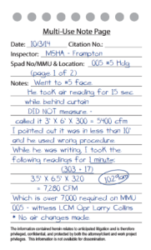
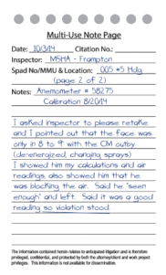
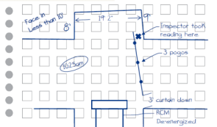
Information wins cases

Slide 9
MSHA Citation & Order Writing Handbook
Page 2:
“MSHA personnel must constantly strive for accuracy in writing citations and orders.”

Slide 10
A significant percentage of citations and orders are overturned during the legal process for reasons such as:
Failure to cite the appropriate standard
Assumptions or suspicions not based on facts
Failure to properly evaluate:
the degree of gravity,
exposure to the hazard or
the operator’s negligence
look for these things

Slide 11
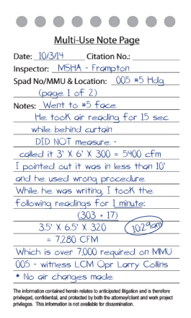
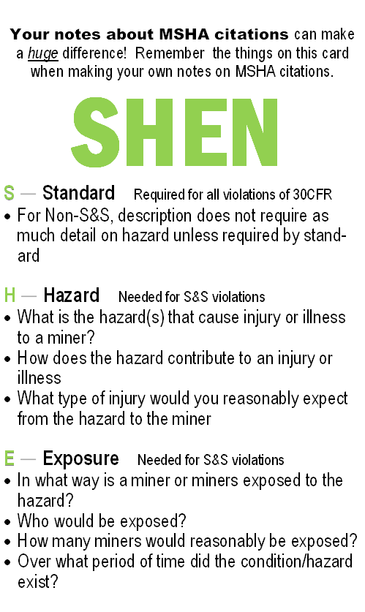
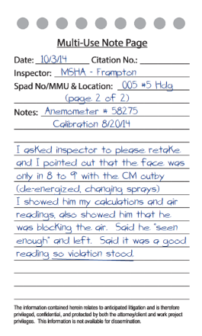
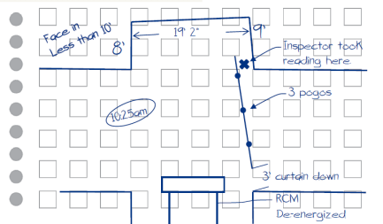
SHEN card your notes
Notes:
Brief intro discussion about SHEN card - Standard, Hazard, Exposure, Negligence

Slide 12
Your notes about MSHA citations can make a huge difference! Remember the things on this card when making your own notes on MSHA citations.
SHEN
S — Standard Required for all violations of 30CFR
For Non-S&S, description does not require as much detail on hazard unless required by stan-dard
H — Hazard Needed for S&S violations
What is the hazard(s) that cause injury or illness to a miner?
How does the hazard contribute to an injury or illness?
What type of injury would you reasonably expect from the hazard to the miner?
E — Exposure Needed for S&S violations
In what way is a miner or miners exposed to the hazard?
Who would be exposed?
How many miners would reasonably be exposed?
Over what period of time did the condition/hazard exist?
Notes:
Now begin to break down SHEN card portions and talk about them…

Slide 13
Your notes about MSHA citations can make a huge difference! Remember the things on this card when making your own notes on MSHA citations.
SHEN
S — Standard Required for all violations of 30CFR
For Non-S&S, description does not require as much detail on hazard unless required by stan-dard
H — Hazard Needed for S&S violations
What is the hazard(s) that cause injury or illness to a miner?
How does the hazard contribute to an injury or illness
What type of injury would you reasonably expect from the hazard to the miner
E — Exposure Needed for S&S violations
In what way is a miner or miners exposed to the hazard?
Who would be exposed?
How many miners would reasonably be exposed?
Over what period of time did the condition/hazard exist?
Notes:
Now begin to break down SHEN card portions and talk about them…

Slide 14
Your notes about MSHA citations can make a huge difference! Remember the things on this card when making your own notes on MSHA citations.
SHEN
S — Standard Required for all violations of 30CFR
For Non-S&S, description does not require as much detail on hazard unless required by stan-dard
H — Hazard Needed for S&S violations
What is the hazard(s) that cause injury or illness to a miner?
How does the hazard contribute to an injury or illness?
What type of injury would you reasonably expect from the hazard to the miner?
E — Exposure Needed for S&S violations
In what way is a miner or miners exposed to the hazard?
Who would be exposed?
How many miners would reasonably be exposed?
Over what period of time did the condition/hazard exist?
Notes:
Now begin to break down SHEN card portions and talk about them…

Slide 15
Your notes about MSHA citations can make a huge difference! Remember the things on this card when making your own notes on MSHA citations.
SHEN
S — Standard Required for all violations of 30CFR
For Non-S&S, description does not require as much detail on hazard unless required by stan-dard
H — Hazard Needed for S&S violations
What is the hazard(s) that cause injury or illness to a miner?
How does the hazard contribute to an injury or illness?
What type of injury would you reasonably expect from the hazard to the miner?
E — Exposure Needed for S&S violations
In what way is a miner or miners exposed to the hazard?
Who would be exposed?
How many miners would reasonably be exposed?
Over what period of time did the condition/hazard exist?
Notes:
Now begin to break down SHEN card portions and talk about them…

Slide 16
Your notes about MSHA citations can make a huge difference! Remember the things on this card when making your own notes on MSHA citations.
SHEN
S — Standard Required for all violations of 30CFR
For Non-S&S, description does not require as much detail on hazard unless required by stan-dard
H — Hazard Needed for S&S violations
What is the hazard(s) that cause injury or illness to a miner?
How does the hazard contribute to an injury or illness
What type of injury would you reasonably expect from the hazard to the miner
E — Exposure Needed for S&S violations
In what way is a miner or miners exposed to the hazard?
Who would be exposed?
How many miners would reasonably be exposed?
Over what period of time did the condition/hazard exist?
Notes:
Now begin to break down SHEN card portions and talk about them…

Slide 17
Your notes about MSHA citations can make a huge difference! Remember the things on this card when making your own notes on MSHA citations.
SHEN
S — Standard Required for all violations of 30CFR
For Non-S&S, description does not require as much detail on hazard unless required by stan-dard
H — Hazard Needed for S&S violations
What is the hazard(s) that cause injury or illness to a miner?
How does the hazard contribute to an injury or illness
What type of injury would you reasonably expect from the hazard to the miner
E — Exposure Needed for S&S violations
In what way is a miner or miners exposed to the hazard?
Who would be exposed?
How many miners would reasonably be exposed?
Over what period of time did the condition/hazard exist?
Notes:
Now begin to break down SHEN card portions and talk about them…

Slide 18
Your notes about MSHA citations can make a huge difference! Remember the things on this card when making your own notes on MSHA citations.
SHEN
S — Standard Required for all violations of 30CFR
For Non-S&S, description does not require as much detail on hazard unless required by stan-dard
H — Hazard Needed for S&S violations
What is the hazard(s) that cause injury or illness to a miner?
How does the hazard contribute to an injury or illness
What type of injury would you reasonably expect from the hazard to the miner
E — Exposure Needed for S&S violations
In what way is a miner or miners exposed to the hazard?
Who would be exposed?
How many miners would reasonably be exposed?
Over what period of time did the condition/hazard exist?
Notes:
Now begin to break down SHEN card portions and talk about them…

Slide 19
Your notes about MSHA citations can make a huge difference! Remember the things on this card when making your own notes on MSHA citations.
SHEN
S — Standard Required for all violations of 30CFR
For Non-S&S, description does not require as much detail on hazard unless required by stan-dard
H — Hazard Needed for S&S violations
What is the hazard(s) that cause injury or illness to a miner?
How does the hazard contribute to an injury or illness
What type of injury would you reasonably expect from the hazard to the miner
E — Exposure Needed for S&S violations
In what way is a miner or miners exposed to the hazard?
Who would be exposed?
How many miners would reasonably be exposed?
Over what period of time did the condition/hazard exist?
Notes:
Now begin to break down SHEN card portions and talk about them…

Slide 20
N — Negligence
How obvious or extensive is the violation?
How long has the violation existed?
Has the area been examined?
Is an agent in the area?
Was the condition or practice reported to the operator or his agent?
Is it recorded in a book or form?
Has the operator been warned?
Does the practice or condition create the presence of a high degree of risk to the health and/or safety of miners?
Was individual committing the act a supervisor?
Was adequate effort made to correct the condition?
Has the condition been cited before by MSHA?
Has there been a recent history of similar violations?
Did the negligence constitute unwarrantable failure? Was it more than ordinary negligence (high negligence, reckless disregard, intentional misconduct, a serious lack of reasonable care)?
Remember: A significant percentage of citations and orders are overturned during the legal process for reasons such as the ones here. Use this card when making your notes.
Notes:
Now begin to break down SHEN card portions and talk about them…

Slide 21
N — Negligence
How obvious or extensive is the violation?
How long has the violation existed?
Has the area been examined?
Is an agent in the area?
Was the condition or practice reported to the operator or his agent?
Is it recorded in a book or form?
Has the operator been warned?
Does the practice or condition create the presence of a high degree of risk to the health and/or safety of miners?
Was individual committing the act a supervisor?
Was adequate effort made to correct the condition?
Has the condition been cited before by MSHA?
Has there been a recent history of similar violations?
Did the negligence constitute unwarrantable failure? Was it more than ordinary negligence (high negligence, reckless disregard, intentional misconduct, a serious lack of reasonable care)?
Remember: A significant percentage of citations and orders are overturned during the legal process for reasons such as the ones here. Use this card when making your notes.
Notes:
Now begin to break down SHEN card portions and talk about them…

Slide 22
N — Negligence
How obvious or extensive is the violation?
How long has the violation existed?
Has the area been examined?
Is an agent in the area?
Was the condition or practice reported to the operator or his agent?
Is it recorded in a book or form?
Has the operator been warned?
Does the practice or condition create the presence of a high degree of risk to the health and/or safety of miners?
Was individual committing the act a supervisor?
Was adequate effort made to correct the condition?
Has the condition been cited before by MSHA?
Has there been a recent history of similar violations?
Did the negligence constitute unwarrantable failure? Was it more than ordinary negligence (high negligence, reckless disregard, intentional misconduct, a serious lack of reasonable care)?
Remember: A significant percentage of citations and orders are overturned during the legal process for reasons such as the ones here. Use this card when making your notes.
Notes:
Now begin to break down SHEN card portions and talk about them…

Slide 23
N — Negligence
How obvious or extensive is the violation?
How long has the violation existed?
Has the area been examined?
Is an agent in the area?
Was the condition or practice reported to the operator or his agent?
Is it recorded in a book or form?
Has the operator been warned?
Does the practice or condition create the presence of a high degree of risk to the health and/or safety of miners?
Was individual committing the act a supervisor?
Was adequate effort made to correct the condition?
Has the condition been cited before by MSHA?
Has there been a recent history of similar violations?
Did the negligence constitute unwarrantable failure? Was it more than ordinary negligence (high negligence, reckless disregard, intentional misconduct, a serious lack of reasonable care)?
Remember: A significant percentage of citations and orders are overturned during the legal process for reasons such as the ones here. Use this card when making your notes.
Notes:
Now begin to break down SHEN card portions and talk about them…

Slide 24
N — Negligence
How obvious or extensive is the violation?
How long has the violation existed?
Has the area been examined?
Is an agent in the area?
Was the condition or practice reported to the operator or his agent?
Is it recorded in a book or form?
Has the operator been warned?
Does the practice or condition create the presence of a high degree of risk to the health and/or safety of miners?
Was individual committing the act a supervisor?
Was adequate effort made to correct the condition?
Has the condition been cited before by MSHA?
Has there been a recent history of similar violations?
Did the negligence constitute unwarrantable failure? Was it more than ordinary negligence (high negligence, reckless disregard, intentional misconduct, a serious lack of reasonable care)?
Remember: A significant percentage of citations and orders are overturned during the legal process for reasons such as the ones here. Use this card when making your notes.
Notes:
Now begin to break down SHEN card portions and talk about them…

Slide 25
N — Negligence
How obvious or extensive is the violation?
How long has the violation existed?
Has the area been examined?
Is an agent in the area?
Was the condition or practice reported to the operator or his agent?
Is it recorded in a book or form?
Has the operator been warned?
Does the practice or condition create the presence of a high degree of risk to the health and/or safety of miners?
Was individual committing the act a supervisor?
Was adequate effort made to correct the condition?
Has the condition been cited before by MSHA?
Has there been a recent history of similar violations?
Did the negligence constitute unwarrantable failure? Was it more than ordinary negligence (high negligence, reckless disregard, intentional misconduct, a serious lack of reasonable care)?
Remember: A significant percentage of citations and orders are overturned during the legal process for reasons such as the ones here. Use this card when making your notes.
Notes:
Now begin to break down SHEN card portions and talk about them…

Slide 26
N — Negligence
How obvious or extensive is the violation?
How long has the violation existed?
Has the area been examined?
Is an agent in the area?
Was the condition or practice reported to the operator or his agent?
Is it recorded in a book or form?
Has the operator been warned?
Does the practice or condition create the presence of a high degree of risk to the health and/or safety of miners?
Was individual committing the act a supervisor?
Was adequate effort made to correct the condition?
Has the condition been cited before by MSHA?
Has there been a recent history of similar violations?
Did the negligence constitute unwarrantable failure? Was it more than ordinary negligence (high negligence, reckless disregard, intentional misconduct, a serious lack of reasonable care)?
Remember: A significant percentage of citations and orders are overturned during the legal process for reasons such as the ones here. Use this card when making your notes.
Notes:
Now begin to break down SHEN card portions and talk about them…

Slide 27
N — Negligence
How obvious or extensive is the violation?
How long has the violation existed?
Has the area been examined?
Is an agent in the area?
Was the condition or practice reported to the operator or his agent?
Is it recorded in a book or form?
Has the operator been warned?
Does the practice or condition create the presence of a high degree of risk to the health and/or safety of miners?
Was individual committing the act a supervisor?
Was adequate effort made to correct the condition?
Has the condition been cited before by MSHA?
Has there been a recent history of similar violations?
Did the negligence constitute unwarrantable failure? Was it more than ordinary negligence (high negligence, reckless disregard, intentional misconduct, a serious lack of reasonable care)?
Remember: A significant percentage of citations and orders are overturned during the legal process for reasons such as the ones here. Use this card when making your notes.
Notes:
Now begin to break down SHEN card portions and talk about them…

Slide 28
N — Negligence
How obvious or extensive is the violation?
How long has the violation existed?
Has the area been examined?
Is an agent in the area?
Was the condition or practice reported to the operator or his agent?
Is it recorded in a book or form?
Has the operator been warned?
Does the practice or condition create the presence of a high degree of risk to the health and/or safety of miners?
Was individual committing the act a supervisor?
Was adequate effort made to correct the condition?
Has the condition been cited before by MSHA?
Has there been a recent history of similar violations?
Did the negligence constitute unwarrantable failure? Was it more than ordinary negligence (high negligence, reckless disregard, intentional misconduct, a serious lack of reasonable care)?
Remember: A significant percentage of citations and orders are overturned during the legal process for reasons such as the ones here. Use this card when making your notes.
Notes:
Now begin to break down SHEN card portions and talk about them…

Slide 29
N — Negligence
How obvious or extensive is the violation?
How long has the violation existed?
Has the area been examined?
Is an agent in the area?
Was the condition or practice reported to the operator or his agent?
Is it recorded in a book or form?
Has the operator been warned?
Does the practice or condition create the presence of a high degree of risk to the health and/or safety of miners?
Was individual committing the act a supervisor?
Was adequate effort made to correct the condition?
Has the condition been cited before by MSHA?
Has there been a recent history of similar violations?
Did the negligence constitute unwarrantable failure? Was it more than ordinary negligence (high negligence, reckless disregard, intentional misconduct, a serious lack of reasonable care)?
Remember: A significant percentage of citations and orders are overturned during the legal process for reasons such as the ones here. Use this card when making your notes.
Notes:
Now begin to break down SHEN card portions and talk about them…

Slide 30
N — Negligence
How obvious or extensive is the violation?
How long has the violation existed?
Has the area been examined?
Is an agent in the area?
Was the condition or practice reported to the operator or his agent?
Is it recorded in a book or form?
Has the operator been warned?
Does the practice or condition create the presence of a high degree of risk to the health and/or safety of miners?
Was individual committing the act a supervisor?
Was adequate effort made to correct the condition?
Has the condition been cited before by MSHA?
Has there been a recent history of similar violations?
Did the negligence constitute unwarrantable failure? Was it more than ordinary negligence (high negligence, reckless disregard, intentional misconduct, a serious lack of reasonable care)?
Remember: A significant percentage of citations and orders are overturned during the legal process for reasons such as the ones here. Use this card when making your notes.
Notes:
Now begin to break down SHEN card portions and talk about them…

Slide 31
N — Negligence
How obvious or extensive is the violation?
How long has the violation existed?
Has the area been examined?
Is an agent in the area?
Was the condition or practice reported to the operator or his agent?
Is it recorded in a book or form?
Has the operator been warned?
Does the practice or condition create the presence of a high degree of risk to the health and/or safety of miners?
Was individual committing the act a supervisor?
Was adequate effort made to correct the condition?
Has the condition been cited before by MSHA?
Has there been a recent history of similar violations?
Did the negligence constitute unwarrantable failure? Was it more than ordinary negligence (high negligence, reckless disregard, intentional misconduct, a serious lack of reasonable care)?
4 ?
Remember: A significant percentage of citations and orders are overturned during the legal process for reasons such as the ones here. Use this card when making your notes.
Notes:
Now begin to break down SHEN card portions and talk about them…

Slide 32
N — Negligence
How obvious or extensive is the violation?
How long has the violation existed?
Has the area been examined?
Is an agent in the area?
Was the condition or practice reported to the operator or his agent?
Is it recorded in a book or form?
Has the operator been warned?
Does the practice or condition create the presence of a high degree of risk to the health and/or safety of miners?
Was individual committing the act a supervisor?
Was adequate effort made to correct the condition?
Has the condition been cited before by MSHA?
Has there been a recent history of similar violations?
Did the negligence constitute unwarrantable failure? Was it more than ordinary negligence (high negligence, reckless disregard, intentional misconduct, a serious lack of reasonable care)?
Remember: A significant percentage of citations and orders are overturned during the legal process for reasons such as the ones here. Use this card when making your notes.
Notes:
Now begin to break down SHEN card portions and talk about them…

Slide 33
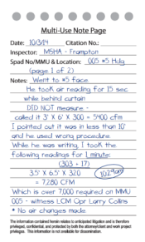
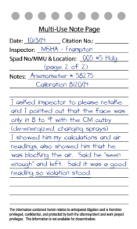
N — Negligence
How obvious or extensive is the violation?
How long has the violation existed?
Has the area been examined?
Is an agent in the area?
Was the condition or practice reported to the operator or his agent?
Is it recorded in a book or form?
Has the operator been warned?
Does the practice or condition create the presence of a high degree of risk to the health and/or safety of miners?
Was individual committing the act a supervisor?
Was adequate effort made to correct the condition?
Has the condition been cited before by MSHA?
Has there been a recent history of similar violations?
Did the negligence constitute unwarrantable failure? Was it more than ordinary negligence (high negligence, reckless disregard, intentional misconduct, a serious lack of reasonable care)?
Remember: A significant percentage of citations and orders are overturned during the legal process for reasons such as the ones here. Use this card when making your notes.
Notes:
Now begin to break down SHEN card portions and talk about them…

Slide 34
Two concepts of key importance
in evaluating enforcement actions:
Gravity and Negligence

Slide 35
What is Negligence?
Under the Mine Act mine operators are required to be on the alert for hazards that can affect employee safety
The Mine Act requires mine operators to take steps to prevent or correct these hazards
The mine operator’s failure to do so is called negligence

Slide 36
Negligence FINDINGS
Condition existed, but just occurred;
Condition was created by an hourly employee without the knowledge of management;
Condition occurred since the last examination;
Condition not obvious;
Area is not routinely inspected or traveled, or equipment is not used regularly;

Slide 37
Negligence FINDINGS
If the condition existed for a period of time, efforts were made to correct it; Document
If the condition existed for a period of time, correction was delayed by unavoidable events or because of a need to correct more significant conditions first.
Hazard not serious enough to warrant increased attention by the operator to prevent or correct it;

Slide 38
Negligence FINDINGS
Violation resulted from unforeseeable employee misconduct;
MSHA did not mention prior to the inspection the need to address certain conditions;
MSHA inspector had been in area recently, but did not cite the condition.

Slide 39
Gravity FINDINGS
Violation did not exist long
Few people exposed
Likelihood of injury is low
How many “ifs” before injury
Redundant protections
Injury would not be serious

Slide 40
What might help our defense?

Slide 41
use the TOOLS you have
tape measure
detector
mapping
sample bags
notebook
camera
heat gun
what else?

Slide 42
For every citation, STOP and identify the evidence
Arrange abatement and/or protective measures after you identify what cited condition really is.

Slide 43
Mitigating Circumstances
The term “mitigating circumstances” is crucial in determining your level of negligence in a citation.
In determining how diligent you have been in trying to protect the miners when a hazardous condition is found by an inspector, MSHA’s penalty assessment process takes into consideration what you have done to correct, prevent, or limit the condition that caused the violation to exist.

Slide 44
Mitigating Circumstances
In other words, mitigating circumstances explain how the operator minimized or eliminated a hazardous condition.
Mitigating circumstances may include, but are not limited to, efforts you have made to prevent, correct, or limit, an employees’ exposure to the hazard.
The levels of negligence are set forth in section 11 A-E.

Slide 45
taking NOTES and paying attention

Slide 46
Take notes of what the inspector did, what he looked at, who he talked to, and what he said.
Concentrate on the facts, i.e., who, what, where, when.
Don’t generalize.
Collect witness names,
inspector comments,
descriptions, measurements,
time, equipment, location.

Slide 47
Document conversations.
Quote word for word.
Do not add editorialized comments or opinion information in your notes. They may have to be produced in subsequent litigation.
Remember: documentation is discoverable.

Slide 48
Document when you take pictures.
Document everything about the pictures.
Chain of custody

Slide 49
Communicating with the inspector

Slide 50
Communicating with the inspector
Recognize that anything you say may well be used in later proceedings by MSHA.
Recognize that anything you do may be construed adversely.
Do not concede a violation
Do not blame another crew.

Slide 51
Communicating with the inspector
Many inspectors assume the facts relative to a condition observed.
Document any assumptions they verbalize
Point out that they are making assumptions.
Disagree respectfully.

Slide 52
statements to Avoid
“I guess you got us.”
“I didn’t know it was this bad.”
“It wasn’t like this when I was here yesterday.”
“They reported it to me but I didn’t get to it.”
“That’s mining.”
“That’s the way we have always done it.”

Slide 53
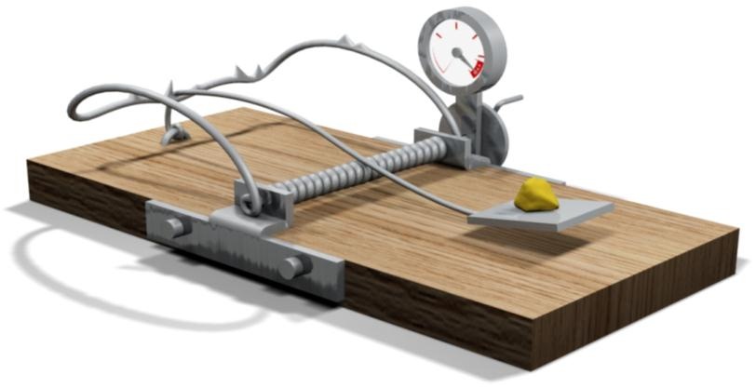
traps for mine operator personnel
Filling the conversational “vacuum”;
Making assumptions;
Wanting to appear knowledgeable when you lack direct information;
Not being assertive;
Not listening to the questions;
Answering more than the question asked.

Slide 54
Be objective.
Explain your position and point out /gather physical evidence in your favor.

Slide 55
rules of thumb on Documents
Prepare every document as though it will be reviewed by someone else in litigation.
Prepare as if it will be on CNN.
Consistency in information is critical.
Don’t reach premature conclusions or speculate.

Slide 56
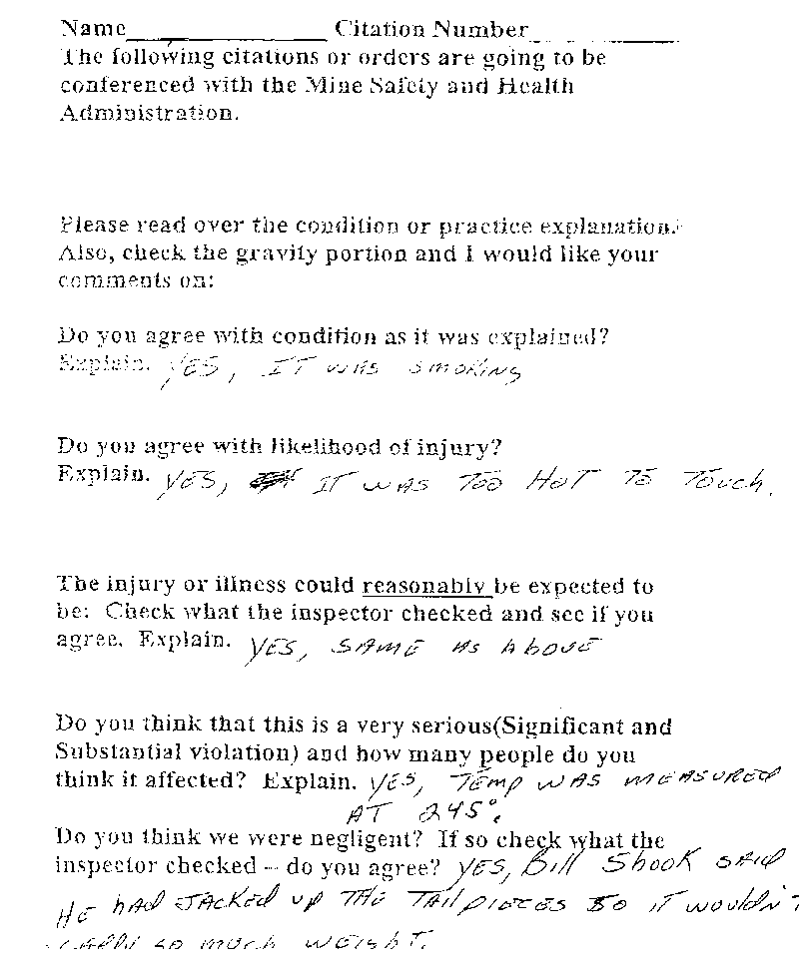

Slide 57
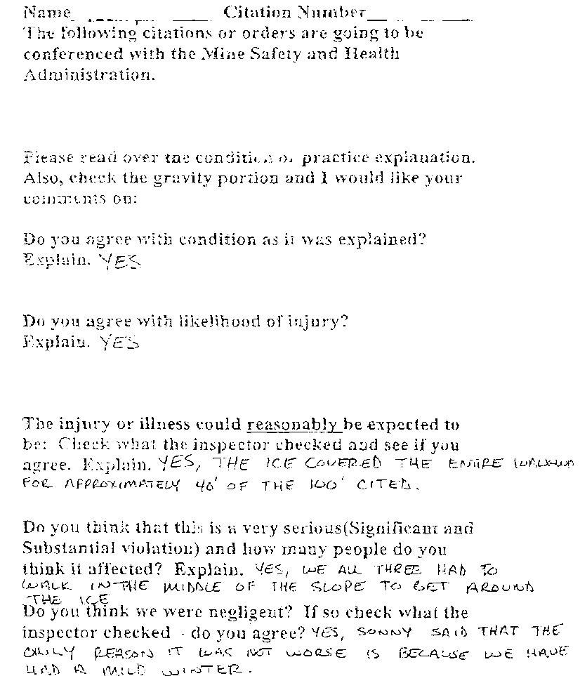

Slide 58
Protection from Disclosure
Only documents prepared at the request of legal counsel in anticipation of litigation
that are not widely distributed generally can be protected from disclosure in litigation.

Slide 59
Protection from Disclosure
Notes taken during or shortly after the inspection that contain factual information are not privileged and
must be disclosed.

Slide 60
Preservation of Evidence
Duty to preserve attaches
when a party [ you ] should have known that the evidence
may be relevant to future litigation.

Slide 61
Spoliation of Evidence
alteration, destruction or even concealment of evidence.

Slide 62
Spoliation of Evidence
Sanctions [penalties / negative results] for spoliation may include:
Adverse inference in factual findings [an unfavorable conclusion may be reached];
Requiring sanctioned party to provide additional discovery [means we’ll have to go back and try to gather more evidence];
Dismissal or directed verdict;
Other relief fashioned by the Court.

Slide 63
Examples of Spoliation of Evidence
Dynamic Energy, Inc., 33 FMSHRC 1998, 2009-10 (ALJ Paez Aug. 2011)
ALJ drew adverse inference against operator when certain pre-shift examination records were not retained.

Slide 64
Examples of Spoliation of Evidence
Consolidation Coal Co., 36 FMSHRC 615 (ALJ Barbour Feb. 2014)
Missing photographs, escort notes, and examination records
ALJ declined to impose sanctions
Decided case on record, which did not include missing information
Unwarrantable failure and S&S upheld

Slide 65
Information wins cases

Slide 66
But what kind of information?

Slide 67
But what kind of information?
Mine layout and mining processes
Objective, factual evidence
Maps
Photographs
Data
Witnesses: Direct evidence is best

Slide 68
The simplest answer is usually the correct one.
Point the Judge in the direction you want him/her to go.
Build a factual record.

Slide 70
Violation 101
Start to Finish!
This publication was created by, and is the property of, The Running Right Leadership Academy [the RRLA] of Alpha Natural Resources, Inc. and contains proprietary information developed by and belonging to Alpha Natural Resources. This publication may not be printed, duplicated or otherwise reproduced without written permission of the RRLA. If any part of the material to be used (for example, tables or figures) has appeared in our publication with credit or acknowledgment to another source, permission must also be sought from that source. If such permission is not obtained then such material may not be reproduced. © 2015 Alpha Natural Resources, Inc.

