Slide 1
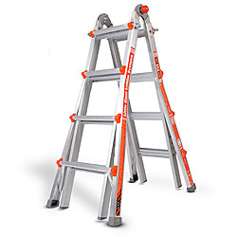
Ladder Safety Training

Slide 2
Agenda
Awareness/Statistics
General Condition
Duty Rating
Proper Use
Proper Ladder Length

Slide 3
Awareness/Statistics

Slide 4
Did You Know?
4,609 fatal work incidents in 2011
666 were the result of a falls, slips, or trips
Roughly 7%
Falls rank 2nd
behind automobile accidents
Roughly 1 out of 4 took place at 10 feet or less.

Slide 5
Questions to ask yourself
What potential hazards exist in the areas I will be using a ladder?
How do I know if a ladder is strong enough to carry my weight?
What ladder is best for the job I’m doing?
How can I be sure a ladder is in good working condition?

Slide 6
General Condition

Slide 7
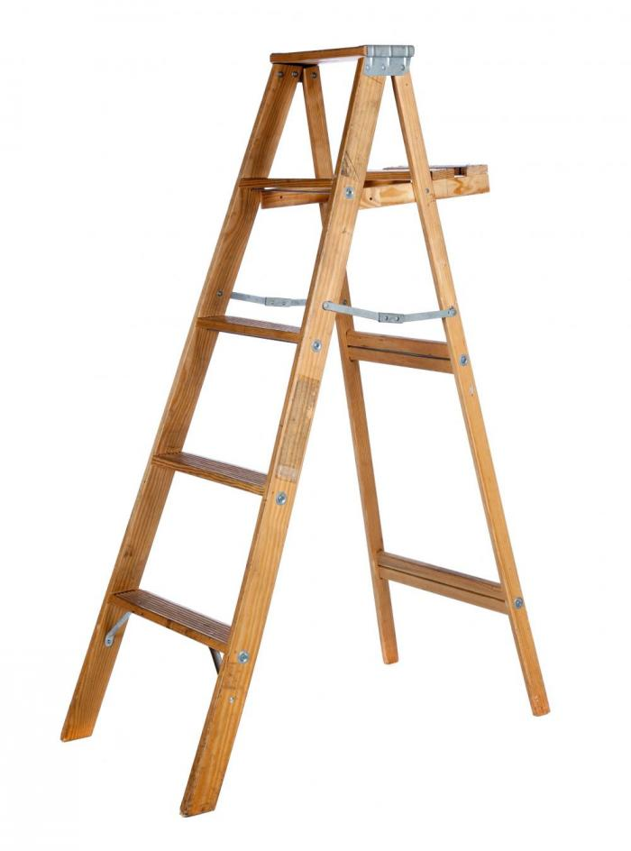
General Condition Wood Ladders
Constructed of a high-density wood
Free of sharp edges and splinters
No decay, or irregularities
Rungs not broken, in good condition

Slide 8
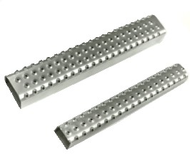
General Condition Metal Ladders
Free of sharp edges and are structurally sound
Must have rungs that are knurled, dimpled or treated to improve slip resistance

Slide 9
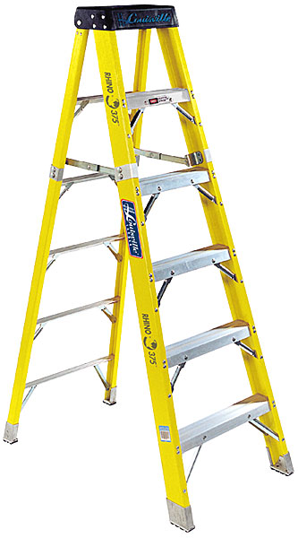
General Condition Fiberglass Ladders
OSHA does not address fiberglass ladders.
ANSI guidelines
Should be made of good, commercial-grade, thermosetting polyester resin reinforced with glass fibers.

Slide 11
Storage and Maintenance
Proper storage and maintenance will extend the life of a ladder and ensure its safety.
Extension ladders should be hung horizontally and supported every six feet.
All ladders should be stored in a well-ventilated area away from extreme heat and cold
Do not store items on top of ladder.

Slide 12
Storage and Maintenance
Clean and lubricate the ladder’s moving parts.
Keep the rungs and steps free of oil and dirt.
Wood ladders can be treated with a protective coating but must not be painted. Paint will cover defects.
When transporting a on a vehicle, make sure both ends are secure to prevent road shock that could damage the ladder.

Slide 13
Duty Rating

Slide 14
Duty Rating
Type 3 Type 2 Type 1 Type 1a
200 lbs 225 lbs 250 lbs 300 lbs
Determine “Your” Weight Capacity
Your weight +
Weight of PPE +
Weight of tool belt +
Weight of other supplies or tools brought up the ladder
Total Weight

Slide 15
Duty Rating
Your Weight +
Weight of Tools+
Weight of sign
175 lb employee +
5 lbs of tools +
30 lb sign
Total Weight
210 lbs total
Type of Ladder
Type 2 ladder

Slide 16
Proper Ladder Length

Slide 17
Proper Ladder Length
A² + B² = C²
20 feet
5 feet
The bottom of the ladder must be one foot away from the wall for every four feet of the building’s height to the point where the ladder rests against it. The further distance the ladder is from the base of the building, the longer the ladder must be to reach the same height.

Slide 18
Proper Ladder Length
21feet
A² + B² = C²
20 feet
5 feet
The bottom of the ladder must be one foot away from the wall for every four feet of the building’s height to the point where the ladder rests against it. The further distance the ladder is from the base of the building, the longer the ladder must be to reach the same height.

Slide 19
Proper Ladder Length
3 feet
The ladder must extend 3 feet beyond the roof line if you are going to climb onto the structure

Slide 20
Proper Ladder Length
The fly and the base sections must overlap approximately 1/12 of the total working height of the ladder.
1/12

Slide 21
How much ladder is needed?
3 feet
39 Feet
A² + B² = C²
33 feet
3 feet
32 feet
8 feet

Slide 22
Proper Use

Slide 23
Proper Use
Ladders must be placed to prevent slipping, or they should be lashed or held in position.

Slide 24
Proper Use
Ladders must be placed to prevent slipping, or they should be lashed or held in position.
Ladders must not be used for anything other than their intended purpose.

Slide 25
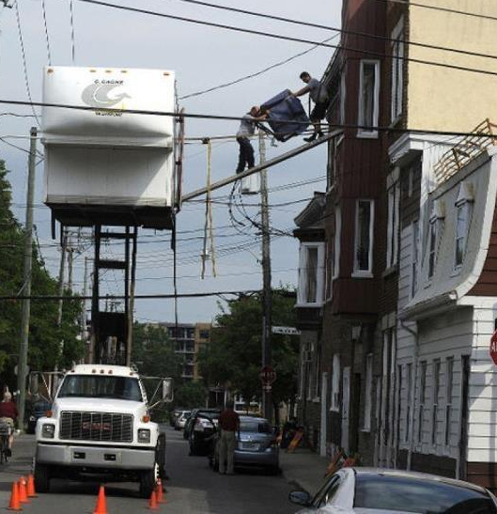
Proper Use
Ladders must be placed to prevent slipping, or they should be lashed or held in position.
Ladders must not be used for anything other than their intended purpose.

Slide 26
Proper Use
Ladders must be placed to prevent slipping, or they should be lashed or held in position.
Ladders must not be used for anything other than their intended purpose.
Ladders must not be placed on boxes, barrels or other unstable bases to obtain additional height.

Slide 27
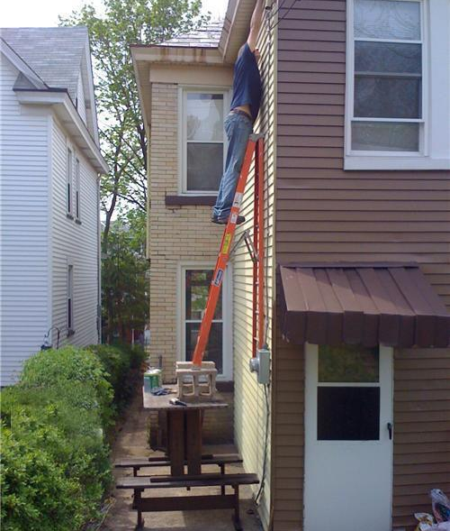
Proper Use
Ladders must be placed to prevent slipping, or they should be lashed or held in position.
Ladders must not be used for anything other than their intended purpose.
Ladders must not be placed on boxes, barrels or other unstable bases to obtain additional height.

Slide 28
Proper Use
Ladders must be placed to prevent slipping, or they should be lashed or held in position.
Ladders must not be used for anything other than their intended purpose.
Ladders must not be placed on boxes, barrels or other unstable bases to obtain additional height.
Do not place ladders in front of door openings toward the ladder unless the door is blocked, locked or guarded.

Slide 29
Proper Use
Ladders must be placed to prevent slipping, or they should be lashed or held in position.
Ladders must not be used for anything other than their intended purpose.
Ladders must not be placed on boxes, barrels or other unstable bases to obtain additional height.
Do not place ladders in front of door openings toward the ladder unless the door is blocked, locked or guarded.

Slide 30
Proper Use
Duty Rating

Slide 31
Questions?

