Slide 1
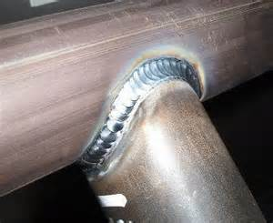
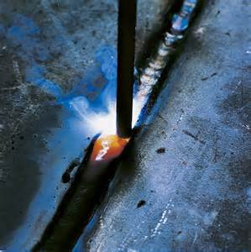
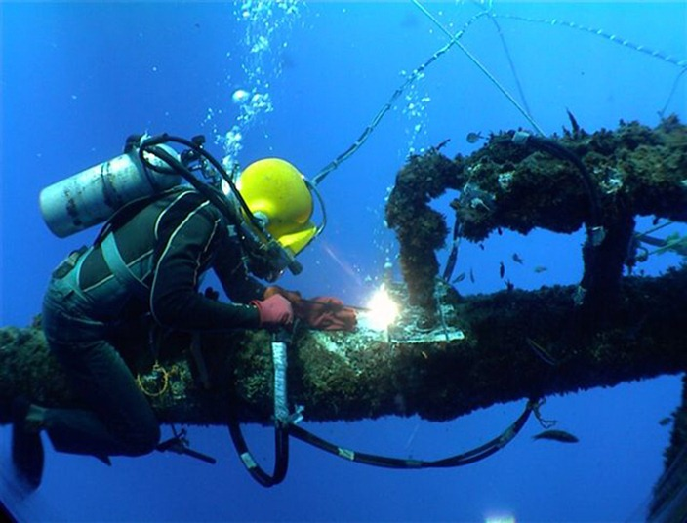
Welding Safety
Bureau of Workers’ Compensation
PA Training for Health & Safety (PATHS)
29 CFR 1926.350-354
Subpart J
Notes:
Welding, by its very nature, has the opportunity to injure those actively engaged.
Welding can use dual compressed gases or electrical sources; each capable of injury if not used properly.
Methods used and environment in which used should be evaluated to determine and remedy potential hazards.

Slide 2
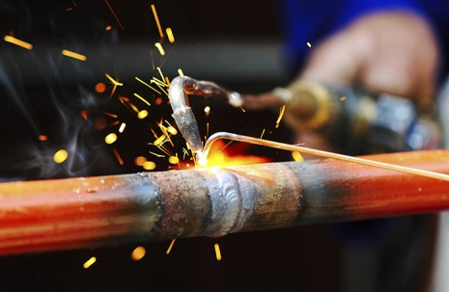
Topics
1926.350 Gas Welding
1926.351 Arc Welding
1926.352 Fire Prevention
1926.353 Ventilation
1926.354 Preservative Coatings
Notes:
Each one of the following topics will be addressed in this presentation:
1926.350 Gas Welding
1926.351 Arc Welding
1926.352 Fire Prevention
1926.353 Ventilation
1926.354 Preservative Coatings

Slide 3
Welding and Cutting
Subpart J 1926.350 - 354
Cylinders secured upright
Oxygen cylinder storage
Valve protection caps
Fire extinguishing equipment available
1. Cables need repair-in use
Notes:
Some violations found by inspectors show that each of the noted problems could have been remedied by proper policy, procedures and enforcement by supervisors and owners.
Each violation noted could cause injury or death depending upon circumstances.

Slide 4
OSHA Priorities
Welding, cutting, and brazing are hazardous activities which pose both safety and health risks to over 500,000 workers in a wide variety of industries.
The risk from fatal injuries is more than four deaths per thousand workers over a working lifetime.
OSHA is developing an action plan which will reduce worker exposures to these hazards.
Notes:
The fatality rate of 4 per 1,000 can be reduced and translated as 1 fatality in 250.
OSHA has not acted to update their standards yet.

Slide 5
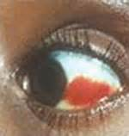
Welding Safety Overview
Hazard Statistics
An estimated 562,000 employees are at risk for exposure to chemical and physical hazards of welding, cutting and brazing.
For the construction industry, welders flash (burn to the eyes) accounts for 5.6% of all construction eye injuries.
Welding Eye Burn
Notes:
An estimated 562,000 employees are at risk for exposure to chemical and physical hazards of welding, cutting and brazing.
For the construction industry, welders flash (burn to the eyes) accounts for 5.6% of all construction eye injuries.

Slide 6
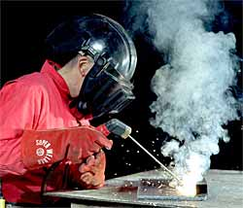
Health Hazards
There are numerous health hazards associated with exposure to fumes, gases and ionizing radiation formed or released during welding, cutting and brazing, including:
Heavy metal poisoning,
Lung cancer,
Metal fume fever,
Flash burns, and others
Notes:
There are numerous health hazards associated with exposure to fumes, gases and ionizing radiation formed or released during welding, cutting and brazing, including:
Heavy metal poisoning,
Lung cancer,
Metal fume fever,
Flash burns, and others

Slide 7
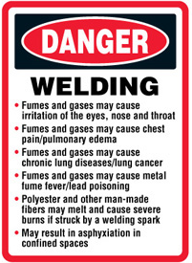
Health Hazards
FUMES MAY PRODUCE
METAL FUME FEVER
SYMPTOMS:
Respiratory disturbances
Infection - Influenza
Fever - Acute Bronchitis
Pneumonia - Chills, Shivering,
Trembling, Nausea, Vomiting
Notes:
FUMES MAY PRODUCE METAL FUME FEVER
SYMPTOMS:
Respiratory disturbances
Infection - Influenza
Fever - Acute Bronchitis
Pneumonia - Chills, Shivering, Trembling, Nausea, Vomiting

Slide 8
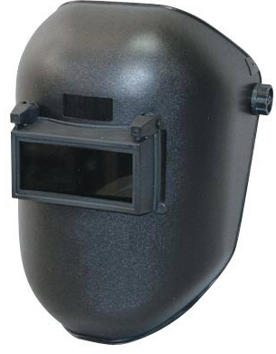
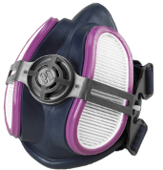
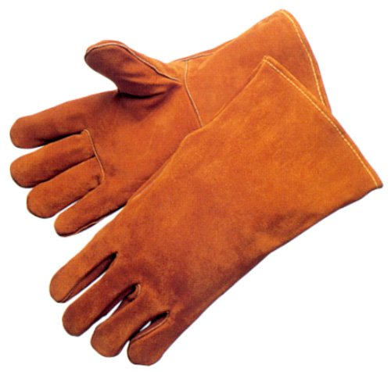
Use PPE
Welders should consider using appropriate protective clothing which should include:
Shield or helmet with a filtered lens;
Fire resistant gloves; a leather apron;
Boots;
Leather spats;
Felt skull-cap or beret and preferably overalls
Notes:
A total protective ensemble should be worn.
Welders should consider using appropriate protective clothing which should include:
Shield or helmet with a filtered lens;
Fire resistant gloves; a leather apron;
Boots;
Leather spats;
Felt skull-cap or beret and preferably overalls

Slide 9
Protective Ensemble
Eye Safety
Shield
Flameproof
Skullcap
No Pockets
Helmet with Filter
Lens
Full Sleeves
Collar Buttoned
Leather Apron
or Shirt Outside
Trousers
Fire Protection
Gauntlet Gloves
No Cuffs
Clean Fire
Resistant Clothing
Safety Shoes
Notes:
Plastic disposable cigarette lighters are very dangerous around heat and flame. It is very important that they not be carried in the pockets while welding. Always provide protection to bystanders or other workers by welding inside a properly screened area, if possible. If unable to work inside a screened area then protection to others should be provided by a portable screen or shield or by their wearing anti-flash goggles.
Not only do we not want to bring a hazard into the work location; we want to create a barricade between the worker and potential harm.

Slide 10


Dangers
The arc itself - the temperature can reach 6,000 degrees Fahrenheit (6,000 °F)
The intense ultraviolet and infra-red rays can be harmful to both the welder and anyone else nearby.
It is not unusual for welders who are not wearing overalls to suffer symptoms similar to extreme sunburn.
Arc Eyes
Notes:
Some dangers include the arc in welding.
The arc itself - the temperature can reach 6,000 degrees Fahrenheit (6,000 °F)
The intense ultraviolet and infra-red rays can be harmful to both the welder and anyone else nearby.
It is not unusual for welders who are not wearing overalls to suffer symptoms similar to extreme sunburn.

Slide 11
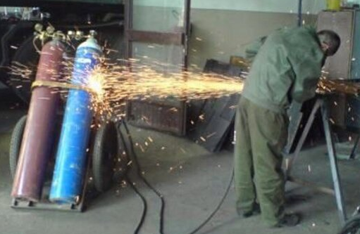
Volatile Combination
Of Heat and Gas:
Fatalities have resulted where drums and other containers have exploded as a result of some welding or cutting work.
Know the nature of the previous contents to ensure any heating does not liberate toxic fumes or cause an explosion.
Notes:
Welding concerns a volatile combination of heat and dual gases (oxygen, which is non-flammable and acetylene, which is flammable).
A volatile combination of Heat and Gas:
Fatalities have resulted where drums and other containers have exploded as a result of some welding or cutting work.
Know the nature of the previous contents to ensure any heating does not liberate toxic fumes or cause an explosion.

Slide 12
Gas Cylinders
Transporting, moving and storing:
Valve protection caps in place & secure
Cylinders hoisted on cradle, slingboard, or pallet only
No magnets or choker slings!
Move by tilting & rolling on edge
Transport by powered vehicle:
secured upright only
Notes:
Valve protection caps shall be in place and secured.
When cylinders are hoisted, they shall be secured on a cradle, slingboard or pallet. They shall not be hoisted or transported by means of magnets or choker slings.
Cylinders shall be moved by tilting and rolling them on their bottom edges. They shall not be intentionally dropped, struck, or permitted to strike each other violently.
When cylinders are transported by powered vehicles, they shall be secured in a vertical position and secured.

Slide 13
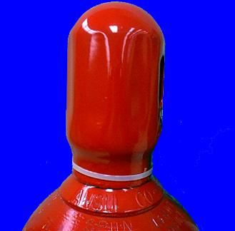
Transporting, Moving, Storing
Unless a special welding
cart is provided
cylinders shall
have their regulators
removed & valve protection
caps in place before
cylinders are moved
Notes:
Unless cylinders are firmly secured on a special carrier intended for this purpose, regulators shall be removed and valve protection caps put in place before cylinders are moved.

Slide 14
Valve Protective Caps
No hoisting of
cylinders via
Valve Protection
Caps!
No prying
of VALVE
CAPS with
bars
Notes:
Valve protection caps shall not be used for lifting cylinders from one vertical position to another. Bars shall not be used under valves or valve protection caps to pry cylinders loose when frozen.
Warm, not boiling, water shall be used to thaw cylinders loose. We don’t want to subject the cylinder or contents to thermal shock.
A suitable cylinder truck, chain, or other steadying device shall be used to keep cylinders from being knocked over while in use.

Slide 15
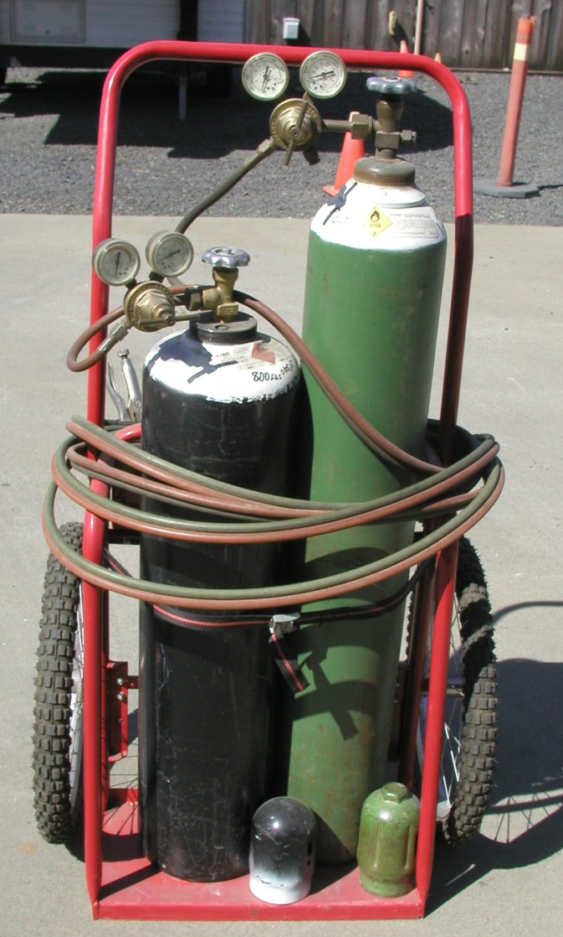
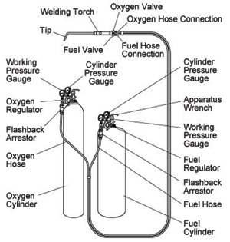
Welding Set-Up
Notes:
The slide shows an oxy-acetylene set-up.

Slide 16
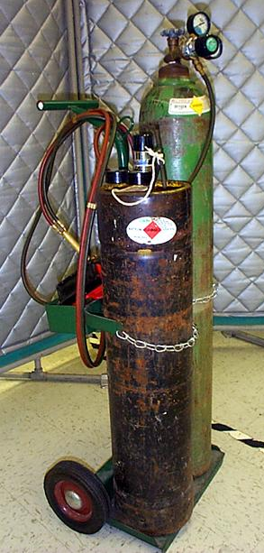
Gas Cylinder Safety
Transporting, moving and storing gas cylinders
When cylinders are in use, they shall be secured by chain, cart, or other steadying device
Notes:
A suitable cylinder truck, chain, or other steadying device shall be used to keep cylinders from being knocked over while in use.

Slide 17
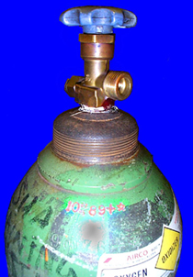
Gas Cylinder Safety
When work is finished, when cylinders are empty, or when cylinders are moved at any time, the cylinder valve shall be closed.
Notes:
When work is finished, when cylinders are empty, or when cylinders are moved at any time, the cylinder valve shall be closed.

Slide 18
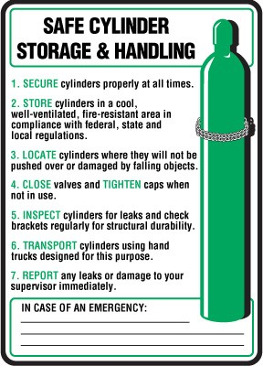
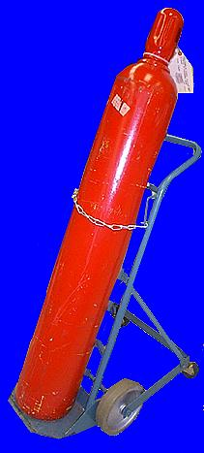
Gas Cylinder Safety
Cylinders secured in upright position at all times
Except for hoisting or carrying
Notes:
Compressed gas cylinders shall be secured in an upright position at all times except, if necessary, for short periods of time while cylinders are actually being hoisted or carried.

Slide 19
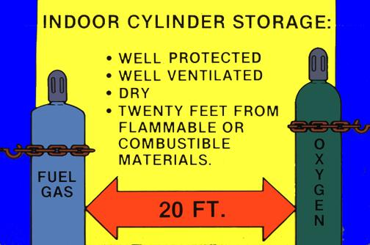
Storing
Separation of 20 feet for storage of oxygen/fuel cylinders
Notes:
Oxygen cylinders in storage shall be separated from fuel-gas cylinders or combustible materials (especially oil or grease), a minimum distance of 20 feet (6.1 m) or by a noncombustible barrier at least 5 feet (1.5 m) high having a fire-resistance rating of at least one-half hour.

Slide 20
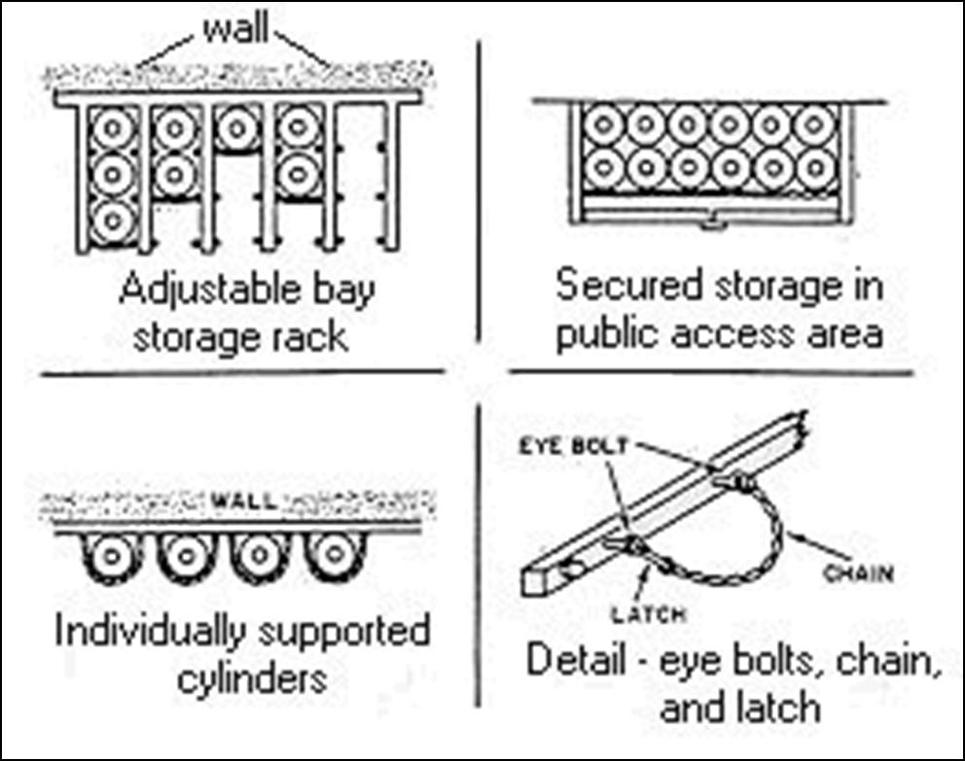
Storing
Separation of 20 feet for storage of oxygen & combustible materials (especially oils & grease) or a 5 foot high non-combustible barrier w/ fire rating of 1/2 hour.
Notes:
Inside of buildings, cylinders shall be stored in a well-protected, well-ventilated, dry location, at least 20 feet (6.1 m) from highly combustible materials such as oil or excelsior. Cylinders should be stored in definitely assigned places away from elevators, stairs, or gangways. Assigned storage places shall be located where cylinders will not be knocked over or damaged by passing or falling objects, or subject to tampering by unauthorized persons. Cylinders shall not be kept in unventilated enclosures such as lockers and cupboards.

Slide 21
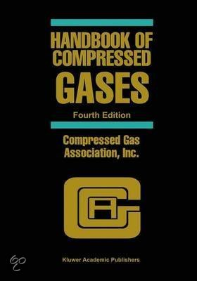
Safe Storage
Compressed Gas Association Pamphlet P-1-1965 required for all in-plant:
  Handling
  Storage
  Utilization of all compressed gases
For all cylinders, portable tanks,
rail tankcars, or motor vehicle
cargo tanks
Notes:
The in-plant handling, storage, and utilization of all compressed gases in cylinders, portable tanks, rail tankcars, or motor vehicle cargo tanks shall be in accordance with Compressed Gas Association Pamphlet P-1-1965. The “Handbook of Compressed Gases,” by the Compressed Gas Association, Inc., is an excellent source for characteristics and safety regarding a variety of gases.

Slide 22
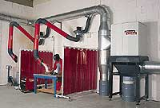
Use Safety
If sparks or hot slag can
reach the cylinders -
INSTALL
A
SHIELD!
No striking the electrode
to the cylinder
to strike an arc!
Notes:
Cylinders shall be kept far enough away from the actual welding or cutting operation so that sparks, hot slag, or flame will not reach them. When this is impractical, fire resistant shields shall be provided.
Cylinders shall be placed where they cannot become part of an electrical circuit. Electrodes shall not be struck against a cylinder to strike an arc.
Fuel gas cylinders shall be placed with valve end up whenever they are in use. They shall not be placed in a location where they would be subject to open flame, hot metal, or other sources of artificial heat.

Slide 23
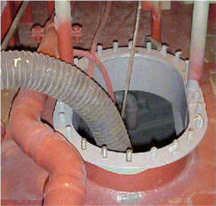
Use Safety
Never take OXYGEN or ACETELYNE
cylinders into
confined spaces!
Notes:
Cylinders containing oxygen or acetylene or other fuel gas shall not be taken into confined spaces.
Not only is there a possibility of having a fire incident, escaping gases may reduce breathable oxygen in the confined space.

Slide 24
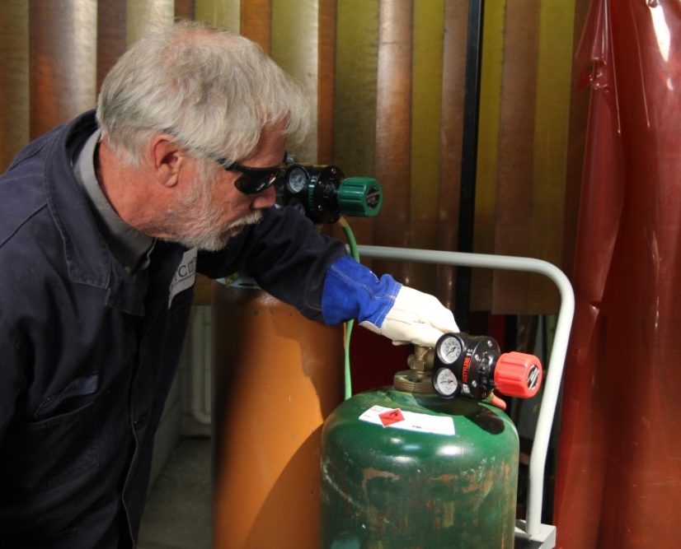
Use Safety
Never crack the cylinder in the presence of open flames, or where the gas could reach welding work or sparks!
Always stand to the side when cracking cylinders
Notes:
Never crack the cylinder in the presence of open flames, or where the gas could reach welding work or sparks!
Always stand to the side when cracking cylinders

Slide 25
Training
The employer shall instruct employees in the safe use of fuel gas as follows:
Pressure must be reduced through the use of regulators before fuel gas can be burned
Before connecting a regulator the cylinder must be opened slightly and closed (cracking the cylinder) to clear the valve of dirt
This prevents dirt from entering the regulator
Notes:
Before a regulator to a cylinder valve is connected, the valve shall be opened slightly and closed immediately. (This action is generally termed "cracking" and is intended to clear the valve of dust or dirt that might otherwise enter the regulator.) The person cracking the valve shall stand to one side of the outlet, not in front of it. The valve of a fuel gas cylinder shall not be cracked where the gas would reach welding work, sparks, flame, or other possible sources of ignition.

Slide 26
Training
Always open the cylinder valve slowly to prevent damage to the regulator
Only open the cylinder 1 and 1/2 turns (so it can be quickly closed!)
Leave the valve wrench in place when the cylinder is in use!
Close cylinder valve, and bleed the regulator before removing the regulator
Notes:
The cylinder valve shall always be opened slowly to prevent damage to the regulator. For quick closing, valves on fuel gas cylinders shall not be opened more than 1 1/2 turns. When a special wrench is required, it shall be left in position on the stem of the valve while the cylinder is in use so that the fuel gas flow can be shut off quickly in case of an emergency. In the case of manifolded or coupled cylinders, at least one such wrench shall always be available for immediate use. Nothing shall be placed on top of a fuel gas cylinder, when in use, which may damage the safety device or interfere with the quick closing of the valve.

Slide 27
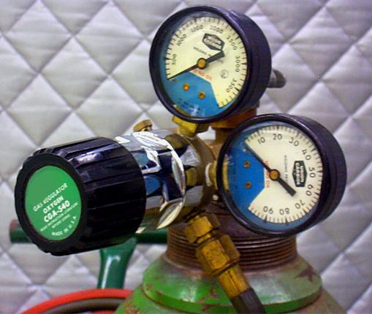
Regulators
Use of regulators required
Before removing regulator, close valve and release gas from regulator
Notes:
Fuel gas shall not be used from cylinders through torches or other devices which are equipped with shutoff valves without reducing the pressure through a suitable regulator attached to the cylinder valve or manifold.
Before a regulator is removed from a cylinder valve, the cylinder valve shall always be closed and the gas released from the regulator.

Slide 28
Fuel Gas/Oxygen Manifolds
Manifold Hose Connections
  Green hose for oxygen and right hand thread
  Red for acetylene and left-hand thread
Hose couplings must be the type that rotate to disconnect
Boxes used for hose storage must be ventilated
Hose kept clear of passageways, stairs and ladders!
Notes:
Fuel gas hose and oxygen hose shall be easily distinguishable from each other. The contrast may be made by different colors or by surface characteristics readily distinguishable by the sense of touch. Oxygen and fuel gas hoses shall not be interchangeable. A single hose having more than one gas passage shall not be used.
Manifold hose connections, including both ends of the supply hose that lead to the manifold, shall be such that the hose cannot be interchanged between fuel gas and oxygen manifolds and supply header connections. Adapters shall not be used to permit the interchange of hose. Hose connections shall be kept free of grease and oil.

Slide 29
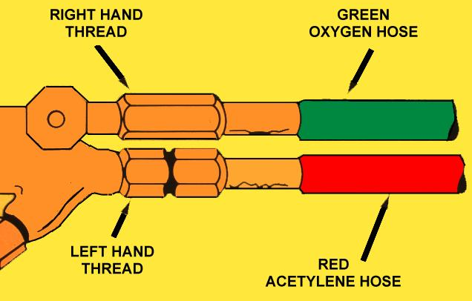
Manifold
Notes:
Markings for dual hose manifold; Green-oxygen hose; Red-acetylene hose.
Left and right-handed threads also will not permit misconnecting the hoselines.

Slide 30
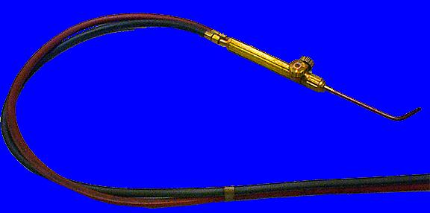
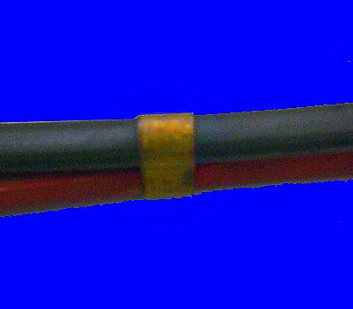
Welding Hose
Not more than four of twelve inches covered with tape for fuel and oxygen hoses taped together
Fuel hose inspected prior to each shift
Defective hose removed from service
Notes:
When parallel sections of oxygen and fuel gas hose are taped together, not more than 4 inches out of 12 inches shall be covered by tape.
All hose in use, carrying acetylene, oxygen, natural or manufactured fuel gas, or any gas or substance which may ignite or enter into combustion, or be in any way harmful to employees, shall be inspected at the beginning of each working shift. Defective hose shall be removed from service.

Slide 31
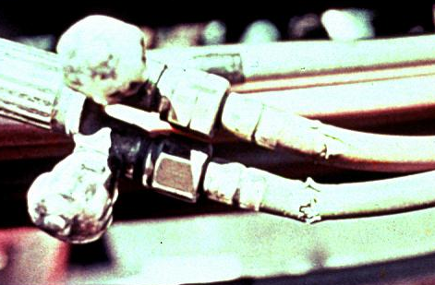
Inspect Hoses
What’s wrong here?
Notes:
Broken hoses. Should be replaced before use.

Slide 32
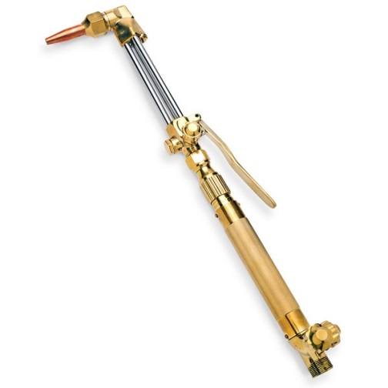

Torches
Clogged tips cleaned with suitable devices
Torches inspected prior to each shift
Torches lit by strikers or other approved methods
No matches!
Not off of hot work
Notes:
Clogged torch tip openings shall be cleaned with suitable cleaning wires, drills, or other devices designed for such purpose.
Torches in use shall be inspected at the beginning of each working shift for leaking shutoff valves, hose couplings, and tip connections. Defective torches shall not be used.
Torches shall be lighted by friction lighters or other approved devices, and not by matches or from hot work.

Slide 33
Oxygen
Cylinder valves, caps, couplings, regulators, hose and apparatus kept free from oil at ALL TIMES!
Never handle oxygen with oily clothes, hands, or gloves
Never direct oxygen at any oily surface
Never use oxygen inside a fuel oil, or other storage tank or vessel
Notes:
Oil and grease hazards. Oxygen cylinders and fittings shall be kept away from oil or grease. Cylinders, cylinder caps and valves, couplings, regulators, hose, and apparatus shall be kept free from oil or greasy substances and shall not be handled with oily hands or gloves. Oxygen shall not be directed at oily surfaces, greasy clothes, or within a fuel oil or other storage tank or vessel.
Additional rules. For additional details not covered in this subpart, applicable technical portions of American National Standards Institute, Z49.1-1967, Safety in Welding and Cutting, shall apply.

Slide 34
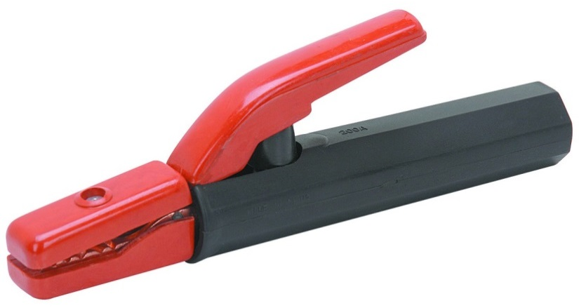
1926.351 Arc Welding
Personal Protection
Manual electrode holders must be designed for that purpose and capable of carrying the maximum rated electrode current
Only fully insulated holders to contact hands
Notes:
For personal protection, only manual electrode holders which are specifically designed for arc welding and cutting, and are of a capacity capable of safely handling the maximum rated current required by the electrodes, shall be used.
Any current-carrying parts passing through the portion of the holder which the arc welder or cutter grips in his hand, and the outer surfaces of the jaws of the holder, shall be fully insulated against the maximum voltage encountered to ground.

Slide 35
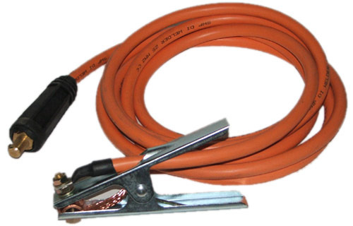
1926.351 Arc Welding
Arc welding cables completely insulated and flexible type.
Free of splice minimum ten feet from electrode cable end.
Cables in need of repair not allowed.
Notes:
All arc welding and cutting cables shall be of the completely insulated, flexible type, capable of handling the maximum current requirements of the work in progress, taking into account the duty cycle under which the arc welder or cutter is working.
Only cable free from repair or splices for a minimum distance of 10 feet from the cable end to which the electrode holder is connected shall be used, except that cables with standard insulated connectors or with splices whose insulating quality is equal to that of the cable are permitted.
Cables in need of repair shall not be used. When a cable, other than the cable lead referred to in paragraph (b)(2) of this section, becomes worn to the extent of exposing bare conductors, the portion thus exposed shall be protected by means of rubber and friction tape or other equivalent insulation.

Slide 36
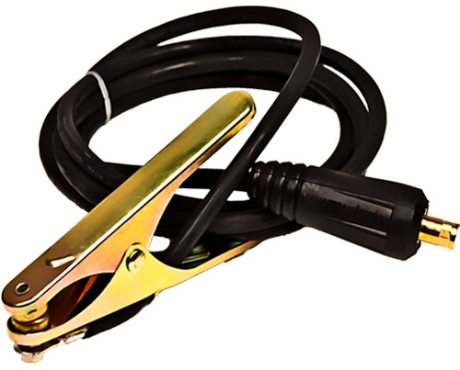
1926.351 Arc Welding
Ground return cables must have sufficient current carrying capacity for maximum voltage
No grounding on pipelines containing gasses or flammable liquid
When using pipelines for ground return, continuity of ground must be verified for all joints
Notes:
A ground return cable shall have a safe current carrying capacity equal to or exceeding the specified maximum output capacity of the arc welding or cutting unit which it services. When a single ground return cable services more than one unit, its safe current-carrying capacity shall equal or exceed the total specified maximum output capacities of all the units which it services.
Pipelines containing gases or flammable liquids, or conduits containing electrical circuits, shall not be used as a ground return. For welding on natural gas pipelines, the technical portions of regulations issued by the Department of Transportation, Office of Pipeline Safety, 49 CFR Part 192, Minimum Federal Safety Standards for Gas Pipelines, shall apply.
When a structure or pipeline is employed as a ground return circuit, it shall be determined that the required electrical contact exists at all joints. The generation of an arc, sparks, or heat at any point shall cause rejection of the structures as a ground circuit.

Slide 37
1926.351 Arc Welding
Employers instruct employees:
  Electrodes removed from holders when unattended
  No hot electrodes dipped in water
  Machine power opened when leaving machine or stopping work
  Faulty equipment reported to supervisor
Notes:
When electrode holders are to be left unattended, the electrodes shall be removed and the holders shall be so placed or protected that they cannot make electrical contact with employees or conducting objects.
Hot electrode holders shall not be dipped in water; to do so may expose the arc welder or cutter to electric shock.
When the arc welder or cutter has occasion to leave his work or to stop work for any appreciable length of time, or when the arc welding or cutting machine is to be moved, the power supply switch to the equipment shall be opened.
Any faulty or defective equipment shall be reported to the supervisor.

Slide 38
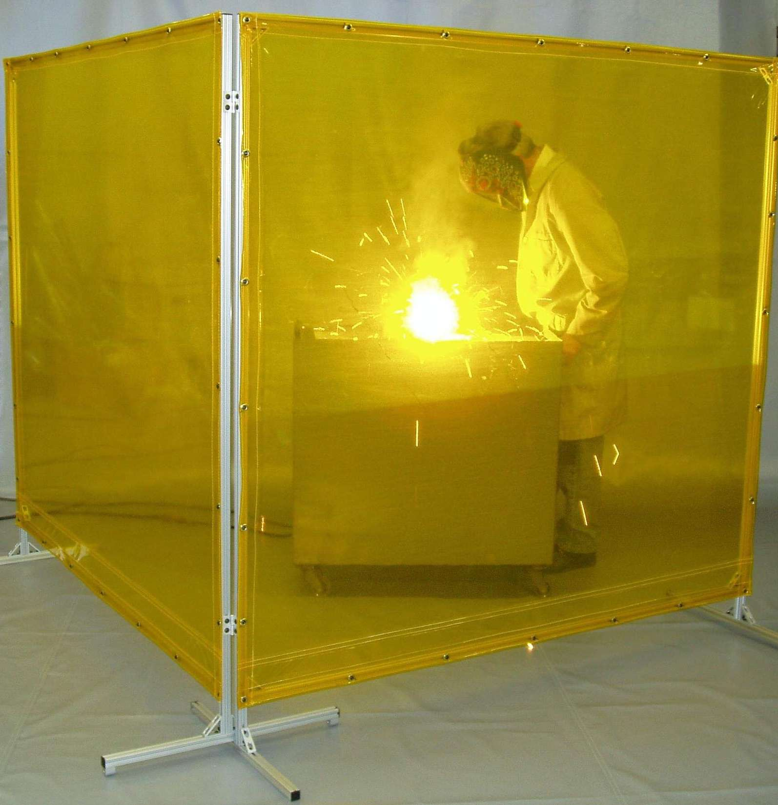
1926.351 Arc Welding
Always shield operations with flameproof screens to protect employees eyes
Notes:
Whenever practicable, all arc welding and cutting operations shall be shielded by noncombustible or flameproof screens which will protect employees and other persons working in the vicinity from the direct rays of the arc.

Slide 39
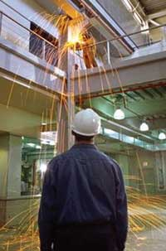
1926.352 Fire Prevention
Move objects to be welded to safe location, or
Remove fire hazards from the area, or
Confine the heat, sparks, and slag, and to protect the immovable fire hazards from them.
Notes:
When practical, objects to be welded, cut, or heated shall be moved to a designated safe location or, if the objects to be welded, cut, or heated cannot be readily moved, all movable fire hazards in the vicinity shall be taken to a safe place, or otherwise protected.
If the object to be welded, cut, or heated cannot be moved and if all the fire hazards cannot be removed, positive means shall be taken to confine the heat, sparks, and slag, and to protect the immovable fire hazards from them.

Slide 40
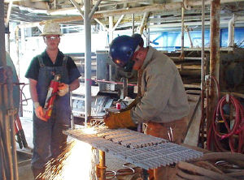
1926.352 Fire Prevention
No welding where paint or dust hazards are present
Extinguishing equipment present and ready
Notes:
No welding, cutting, or heating shall be done where the application of flammable paints, or the presence of other flammable compounds, or heavy dust concentrations creates a hazard.
Suitable fire extinguishing equipment shall be immediately available in the work area and shall be maintained in a state of readiness for instant use.

Slide 41
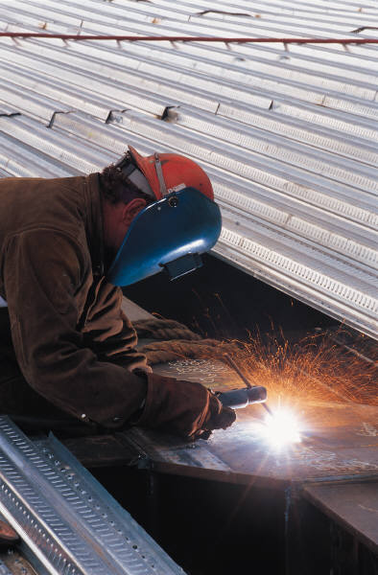
1926.352 Fire Prevention
When necessary additional personnel assigned to guard against fires
Trained to recognize welding fire hazards
Notes:
When the welding, cutting, or heating operation is such that normal fire prevention precautions are not sufficient, additional personnel shall be assigned to guard against fire while the actual welding, cutting, or heating operation is being performed, and for a sufficient period of time after completion of the work to ensure that no possibility of fire exists. Such personnel shall be instructed as to the specific anticipated fire hazards and how the firefighting equipment provided is to be used.

Slide 42
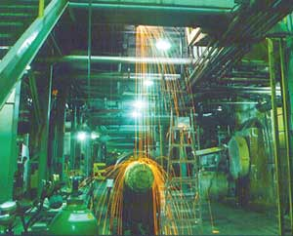
1926.352 Fire Prevention
When welding over walls, floors, ceilings where sparks may travel precautions must be taken in the adjacent areas
Notes:
When welding, cutting, or heating is performed on walls, floors, and ceilings, since direct penetration of sparks or heat transfer may introduce a fire hazard to an adjacent area, the same precautions shall be taken on the opposite side as are taken on the side on which the welding is being performed.

Slide 43
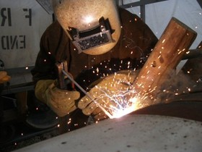
1926.352 Fire Prevention
When welding in confined spaces has ended, remove torch and hose
This eliminates possibility of accumulation of hazardous atmospheres in confined spaces
Notes:
For the elimination of possible fire in enclosed spaces as a result of gas escaping through leaking or improperly closed torch valves, the gas supply to the torch shall be positively shut off at some point outside the enclosed space whenever the torch is not to be used or whenever the torch is left unattended for a substantial period of time, such as during the lunch period.
Overnight and at the change of shifts, the torch and hose shall be removed from the confined space. Open end fuel gas and oxygen hoses shall be immediately removed from enclosed spaces when they are disconnected from the torch or other gas-consuming device.

Slide 44
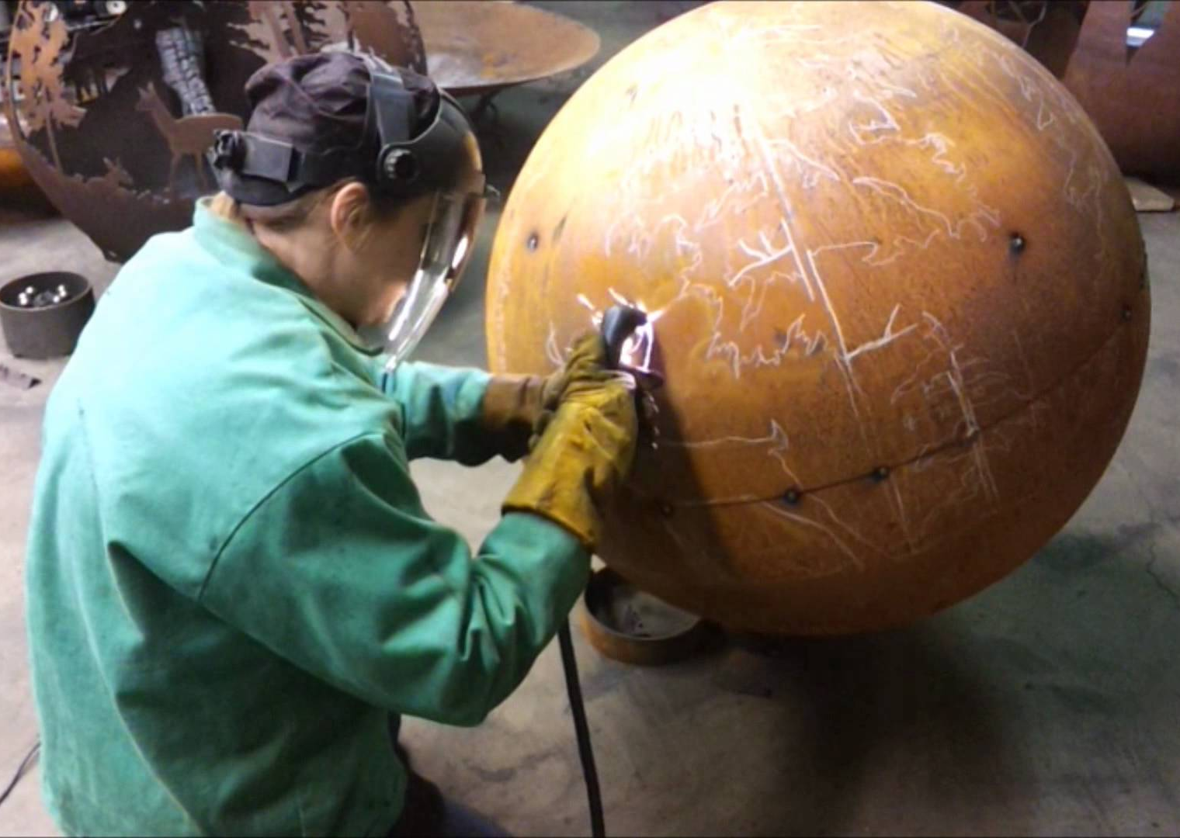
Welding Containers
Before welding on drums or hollow structures which have contained toxic or flammable materials either:
  Completely fill with water before proceeding, or
  Thoroughly clean, ventilate, and TEST
Before applying heat to any
container drum, or hollow
structure a vent or opening
must be provided
Notes:
Drums containers or hollow structures which have contained toxic or flammable substances shall, before welding, cutting, or heating is undertaken on them, either be filled with water or thoroughly cleaned of such substances and ventilated and tested.
For welding, cutting and heating on steel pipelines containing natural gas, the pertinent portions of regulations issued by the Department of Transportation, Office of Pipeline Safety, 49 CFR Part 192, Minimum Federal Safety Standards for Gas Pipelines, shall apply.
Before heat is applied to a drum, container, or hollow structure, a vent or opening shall be provided for the release of any built-up pressure during the application of heat.

Slide 45
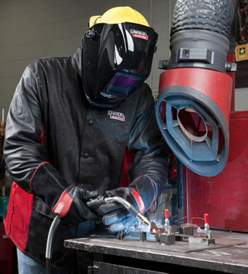
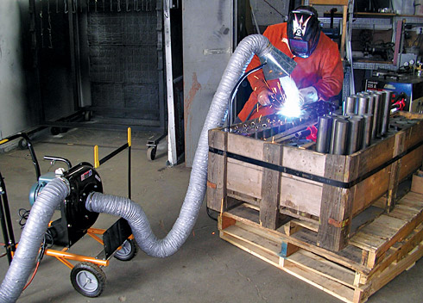
Ventilation & Protection
1926.353
General ventilation to maintain welding smoke and fumes within safe limits
When welding in confined spaces mechanical ventilation or local exhaust
If ventilation blocks access/egress to confined space, air line and attendant required
Notes:
General mechanical ventilation shall be of sufficient capacity and so arranged as to produce the number of air changes necessary to maintain welding fumes and smoke within safe limits, as defined in Subpart D of this part.
Except as provided in paragraph (b)(2) of this section, and paragraph (c)(2) of this section, either general mechanical or local exhaust ventilation meeting the requirements of paragraph (a) of this section shall be provided whenever welding, cutting, or heating is performed in a confined space.
When sufficient ventilation cannot be obtained without blocking the means of access, employees in the confined space shall be protected by air line respirators in accordance with the requirements of Subpart E of this part, and an employee on the outside of such a confined space shall be assigned to maintain communication with those working within it and to aid them in an emergency.

Slide 46
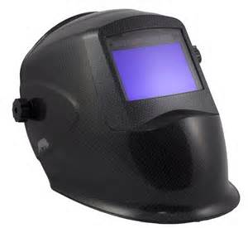
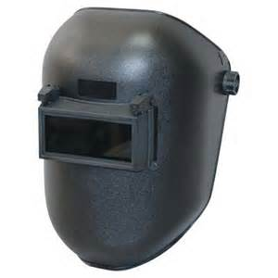
Eye Protection
1926.353
Any employee performing welding cutting or heating must have eye protection
Refer to requirements in Subpart E
Notes:
Employees performing any type of welding, cutting, or heating shall be protected by suitable eye protective equipment in accordance with the requirements of Subpart E of this part.

Slide 47
Eye/Face Protection
1. GOGGLES, Flexible Fitting - Regular Ventilation
2. GOGGLES, Flexible Fitting - Hooded Ventilation
3. GOGGLES, Cushioned Fitting - Rigid Body
4. SPECTACLES, Metal Frame, with Sideshields (1)
5. SPECTACLES, Plastic Frame - with Sideshields (1)
6. SPECTACLES, Metal-Plastic Frame - with Sideshields (1)
Notes:
Table E-1, Eye and Face Protector Selection Guide
Notes:
1-Non-side shield spectacles are available for limited hazard use requiring only frontal protection

Slide 48
Eye/Face Protection
7. WELDING GOGGLES, Eyecup Type - Tinted Lenses (2)
7A. CHIPPING GOGGLES, Eyecup Type - Clear Safety Lenses
8. WELDING GOGGLES, Coversepc Type - Tinted Lenses (2)
8A. CHIPPING GOGGLES, Coverspec Type - Clear Safety Lenses
9. WELDING GOGGLES, Coverspec Type - Tinted Plate Lens (2)
10. FACE SHIELD (Available with Plastic or Mesh Window)
11. WELDING HELMETS (2)
Notes:
Tabel E-1, Eye and Face Protector Selection Guide
Note 2: See Table E-2, in paragraph (b) of this section, Filter Lens Shade Numbers for Protection against Radiant Energy. (Thi s refers to Subpart E, 1926.102) See also slide #50 (next slide) for shades.

Slide 49
Shade Selection Numbers
WELDING OPERATION SHADE #
Shielded Metal-Arc Welding 1/16, 3/32, 1/8, 5/32 Inch Electrodes 10
Gas-Shielded Arc Welding (nonferrous) 1/16, 3/32, 1/8, 5/32 Inch Electrodes 11
Gas-Shielded Arc Welding (ferrous) 1/16, 3/32, 1/8, 5/32 Inch Electrodes 12
Shielded Metal Arc Welding 3/16, 7/32, 1/4 Inch Electrodes 12
Shielded Metal Arc Welding 5/16, 3/8 , Inch Electrodes 14
Atomic Hydrogen welding 10-14
Carbon Arc Welding 14

Slide 50
Preservative Coatings
1926.354
Before welding or cutting on a coated surface whose flammability is not known scrapings must be taken and tested
If scrapings burn, coating(s) must be removed before proceeding
Notes:
Before welding, cutting, or heating is commenced on any surface covered by a preservative coating whose flammability is not known, a test shall be made by a competent person to determine its flammability. Preservative coatings shall be considered to be highly flammable when scrapings burn with extreme rapidity.
Precautions shall be taken to prevent ignition of highly flammable hardened preservative coatings. When coatings are determined to be highly flammable, they shall be stripped from the area to be heated to prevent ignition.

Slide 51
Bibliography
29 CFR 1926.350 Gas Welding
29 CFR 1926.351 Arc Welding
29 CFR 1926.352 Fire Prevention
29 CFR 1926.353 Ventilation
29 CFR 1926.354 Preservative Coatings

Slide 52


Contact Information
Health & Safety Training Specialists
1171 South Cameron Street, Room 324
Harrisburg, PA 17104-2501
(717) 772-1635
RA-LI-BWC-PATHS@pa.gov
Like us on Facebook! - https://www.facebook.com/BWCPATHS

Slide 53

Questions

