Slide 1
Noise Levels
Guess the decibel Level!

Slide 2
Hearing Protection Policy
Ear plugs and/or muffs will be worn whenever personnel may be exposed to excessive noise levels as determined and designated by the Safety & Health Services Department
Hearing protection is required at 85 dBA
Dual hearing protection is required at 105 dBA
Do not do the task if the level exceeds 115 dBA

Slide 3
Exposure Time Limits: Without Hearing Protection

Slide 4
What is the decibel level of our everyday tools
Air Hammer
107.1 dBA

Slide 5
Needle Gun
With Chisel
100.8 dBA

Slide 6
Air Arc
114.7 dBA

Slide 7
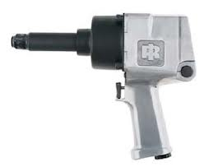
Impact Wrenches
3/8”
½”
Wide open rev
115.0
102.0 dBA
101.0 dBA
¾”
1”
110.8 dBA
105.5 dBA

Slide 8
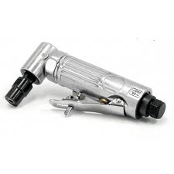
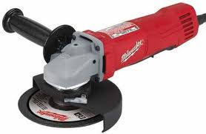
Air Die Grinder
Right Angle Grinder
88.7 dBA
88.6 dBA

Slide 9
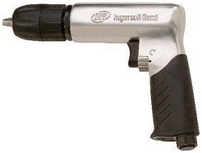
Air Drill
98.8 dBA

Slide 10
Load Boxing a Haul Truck
On the Deck
115.7 dBA
Stay in the Cab
On the Ground
In the Cab
104.5 dBA
89.3 dBA

Slide 11
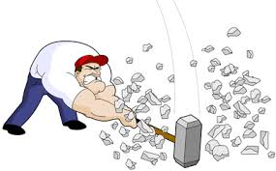
Sledge Hammer on Metal Pin
99.1 dBA

Slide 12
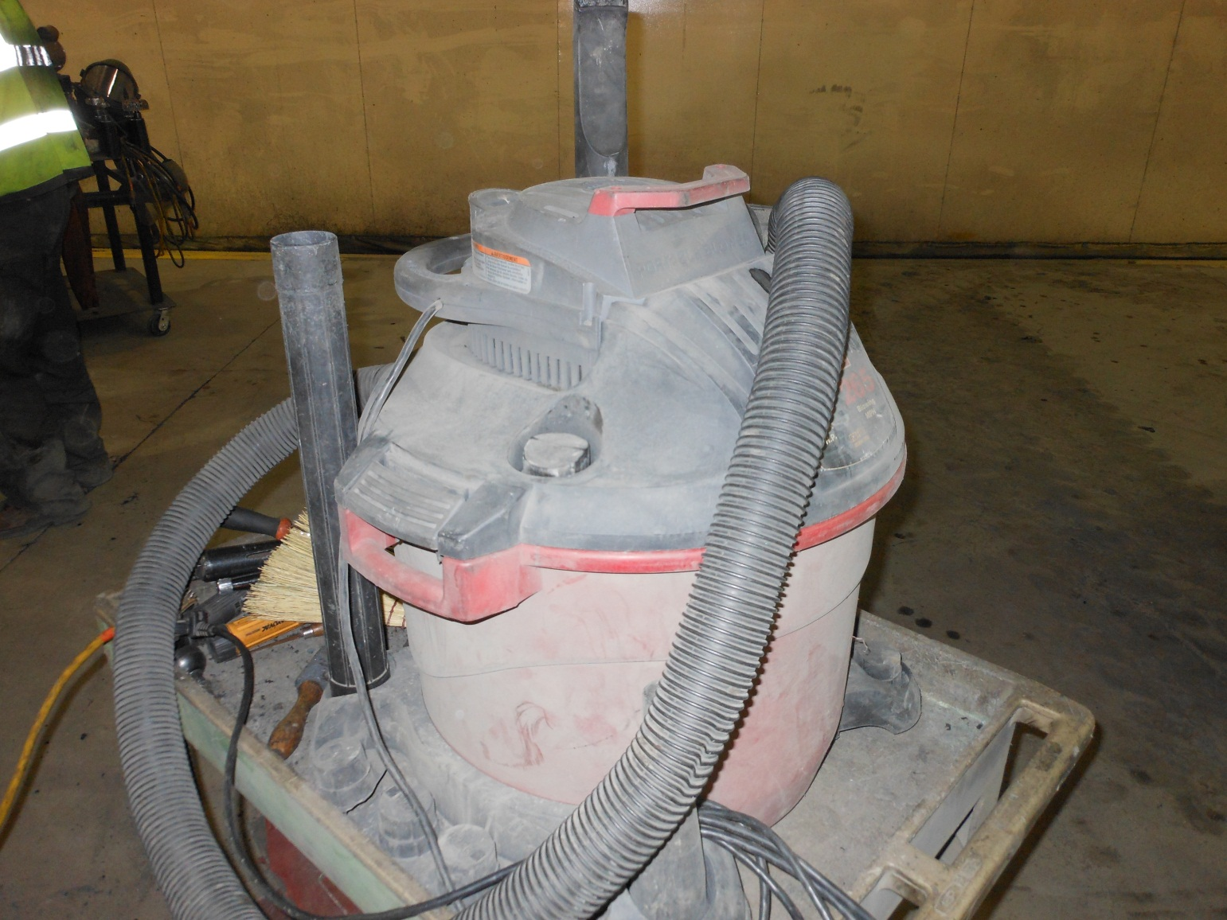
Shop Vacuum
88.3 dBA

Slide 13
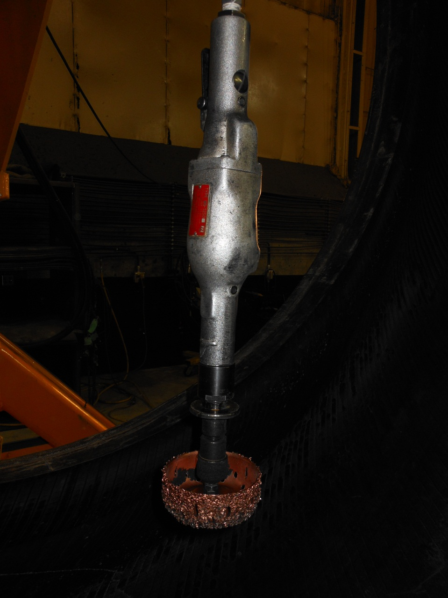
Tire Shop Tools
Tire De-Air System
Using a grinder inside of a truck tire
98.6-94.6 dBA
99.2 dBA

Slide 14
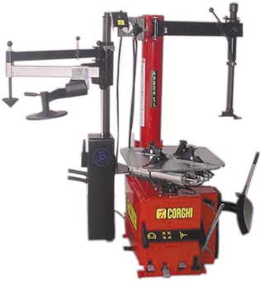
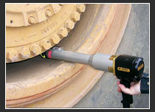
Tire Shop Tools
¾” Impact on wheel motor
Tire Changer
114.6 dBA
88.3- 91.8 dBA

Slide 15
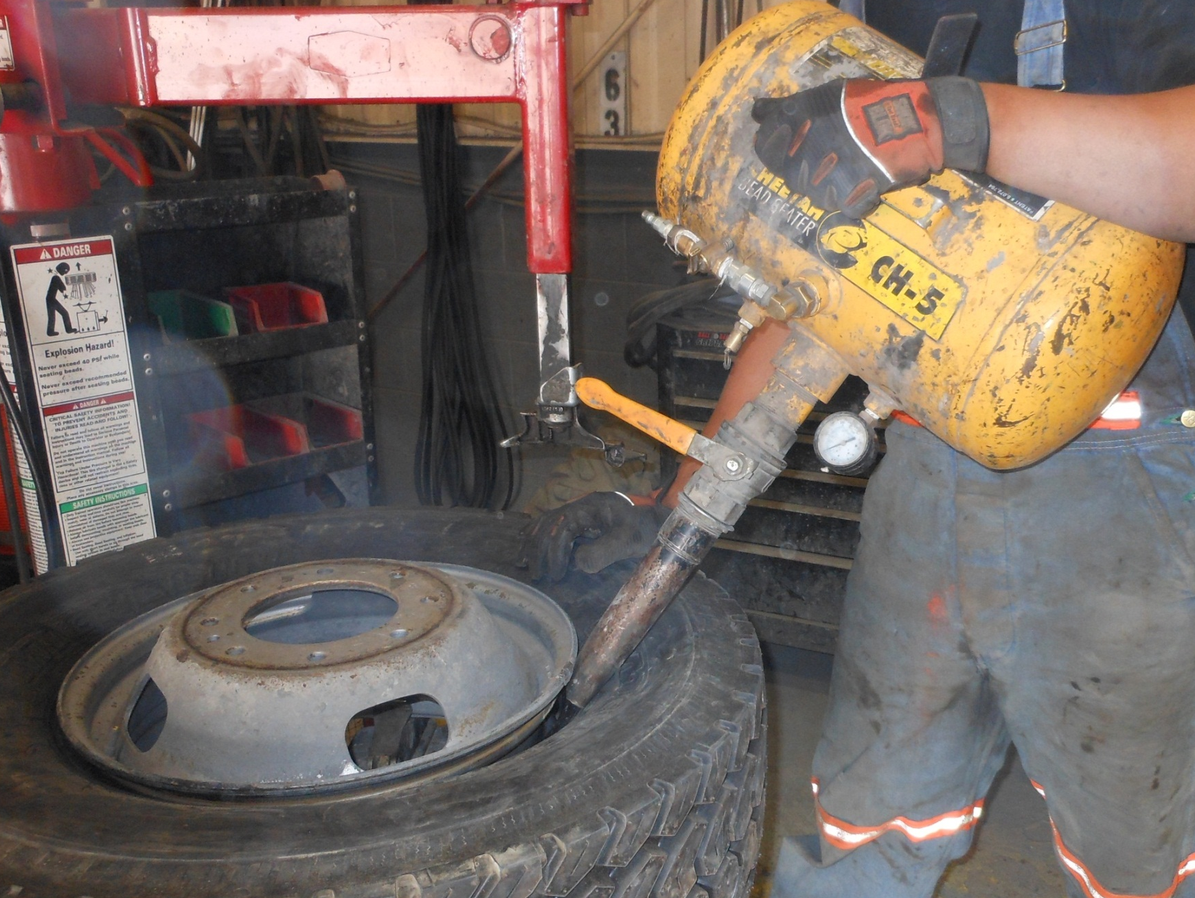
Bead Seater
Too loud and is under investgation to find a safer way

Slide 16
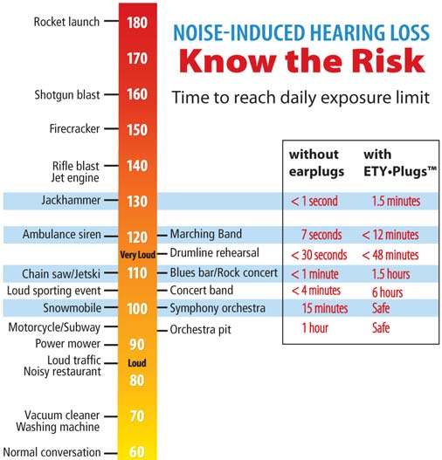
Ipod at full blast
120 dBA

Slide 17
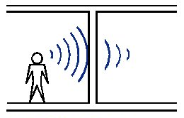
Distance and barriers
from the source
changes the decibel level

Slide 18
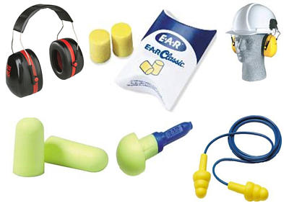
Some Approved
Hearing Protection

Slide 19
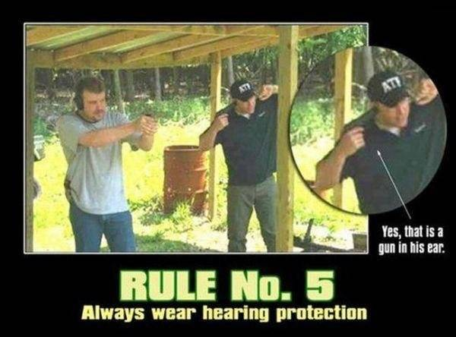
Questions?

