Slide 1
Tree Trimming Safety
K-State Research & Extension
This material was produced under grant number 46G3-HT04 and revised and updated under grant number SH-19503-09-60-F-20 from the Occupational Safety and Health Administration, U.S. Department of Labor. It does not necessarily reflect the views or policies of the U.S. Department of Labor, nor does mention of trade names, commercial products, or organizations imply endorsement by the U.S. government.

Slide 2
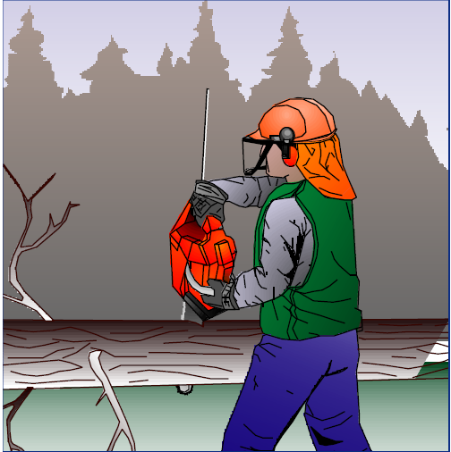
A worker had felled a large tree. He was cutting through the trunk by pulling a chainsaw towards himself in technique called a “backhander”.
Illustration Copyright © 2001, Workplace Health, Safety and Compensation Commission of New Brunswick
Workplace Health, Safety and Compensation Commission. (2003). Hazard alert: Chainsaw accident kills woodsworker. St. John, New Brunswick: WorksafeNB.
Notes:
Authority for use of illustration, see http://www.worksafenb.ca/pubs_e.asp which states,
“These documents may be printed, copied and distributed without express permission provided that the Commission's copyright mark is retained. Any modifications require the express permission of the Commission. Copyright © 2001, Workplace Health, Safety and Compensation Commission of New Brunswick.”

Slide 3
When he cut through the trunk, the chainsaw struck his thigh. Co-workers heard him yell and came running, but there was little they could do. He bled to death on the way to the hospital.
Illustration Copyright © 2001, Workplace Health, Safety and Compensation Commission of New Brunswick
Workplace Health, Safety and Compensation Commission. (2003). Hazard alert: Chainsaw accident kills woodsworker. St. John, New Brunswick: WorksafeNB.
Workplace Health, Safety and Compensation Commission. (2003). Hazard alert: Chainsaw accident kills woodsworker. St. John, New Brunswick: WorksafeNB.
Notes:
Authority for use of illustration, see http://www.worksafenb.ca/pubs_e.asp which states,
“These documents may be printed, copied and distributed without express permission provided that the Commission's copyright mark is retained. Any modifications require the express permission of the Commission. Copyright © 2001, Workplace Health, Safety and Compensation Commission of New Brunswick.”

Slide 4
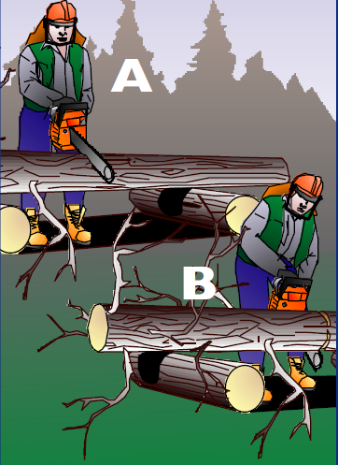
Proper Bucking
First cut: from the top side, to depth of 1/4 tree diameter.
B. Final cut: from bottom.
Workplace Health, Safety and Compensation Commission. (2003). Hazard alert: Chainsaw accident kills woodsworker. St. John, New Brunswick: WorksafeNB.

Slide 5
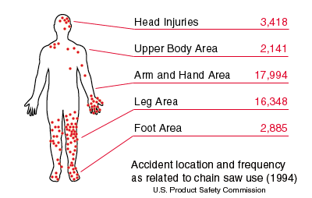
Chain Saw Injury Locations
Notes:
Illustration from U.S. government publication in public domain.

Slide 6
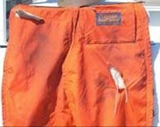
A worker was pulling the chain saw out from a cut.
He lost his balance and the running saw blade hit his leg.
He was wearing protective chaps, which stopped the chain immediately, and he was not injured.
Elvex Corporation, http://www.elvex.com
Notes:
Authority for use of photo: See http://www.elvex.com/photo-gallery-6.htm which states,
“Authorized Elvex distributors and dealers may download high resolution images of Elvex products, for purposes of marketing Elvex product line. Journalists may also download and publish our high resolution pictures, but must provide credit to Elvex Corporation. For web publication we request a link to the relevant product page or to Elvex home page (www.elvex.com).”

Slide 7
On a May afternoon, a worker was using a chain saw to cut branches overhead.
OSHA Inspection 108433095. Accident 887950. Report ID 0352440.
http://www.osha.gov/oshstats/index.html

Slide 8
On a May afternoon, a worker was using a chain saw to cut branches overhead.
Suddenly, the chain saw kicked back off a branch and struck him in the head. He was severely cut on the left side of his face from his forehead to his upper lip. He was hospitalized for his injuries.
OSHA Inspection 108433095. Accident 887950. Report ID 0352440.
http://www.osha.gov/oshstats/index.html

Slide 9
Tree-cutting Injuries Bureau of Labor Statistics Analysis of 1,086 Accidents
Struck by tree or limb
Fall
Chain saw injury
Muscle strain
Hit by cable, hook
Other
Bureau of Labor Statistics (1984). Work injury report (WIR) injuries in the logging industry. Bulletin 2203 (Ex. 2-1).

Slide 10
Group Problems

Slide 11
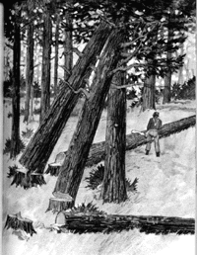
Problem #1
You are cutting down a large tree. The tree begins to fall, but it stops when it gets hung up in another tree.
1. What issues do you need to consider?
2. How do you safely bring down the lodged tree?
3. What could have been done in advance to prevent this situation?
Refer to Lesson 4 of Tree Trimming Safety book & OSHA handout.
Notes:
Illustration from OSHA’s logging e-tool, government publication in public domain.

Slide 12
A 42-year-old man was clearing debris and partially downed trees immediately after an ice storm. While he was cutting one of these trees with a chain saw, the tree fell, hit him on the head, and then landed across him, trapping him beneath the tree. Onlookers responded immediately; however, because of the weight of the tree, they were unable to free him. He died of his injuries
Shapiro, S., Lohff, C., & Laney, A (2008). Nonoccupational Logging Fatalities — Vermont, 1997–2007, Morbidity & Mortality Weekly Report, 57, 260-262.

Slide 13
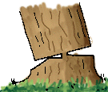
Problem #2
You are cutting down a large tree. The tree begins to fall, but is stopped by its own stump.
1. What issues do you need to consider?
2. How do you safely bring down the stalled tree?
3. What could have prevented this from happening?
Refer to Lesson 4 of Tree Trimming Safety book & OSHA handout.
Notes:
Illustration from OSHA’s logging e-tool, government publication in public domain.

Slide 14
A 60-year-old man was cutting a partially downed tree with a chain saw. The tree gave way, rolling over the man’s lower torso and killing him. Investigation revealed that the man was alive for some time, attempting to extract himself before his death. The cause of death was ruled as blunt impact of the torso and abdomen, resulting in exsanguination and respiratory arrest.
Shapiro, S., Lohff, C., & Laney, A (2008). Nonoccupational Logging Fatalities — Vermont, 1997–2007, Morbidity & Mortality Weekly Report, 57, 260-262.

Slide 15
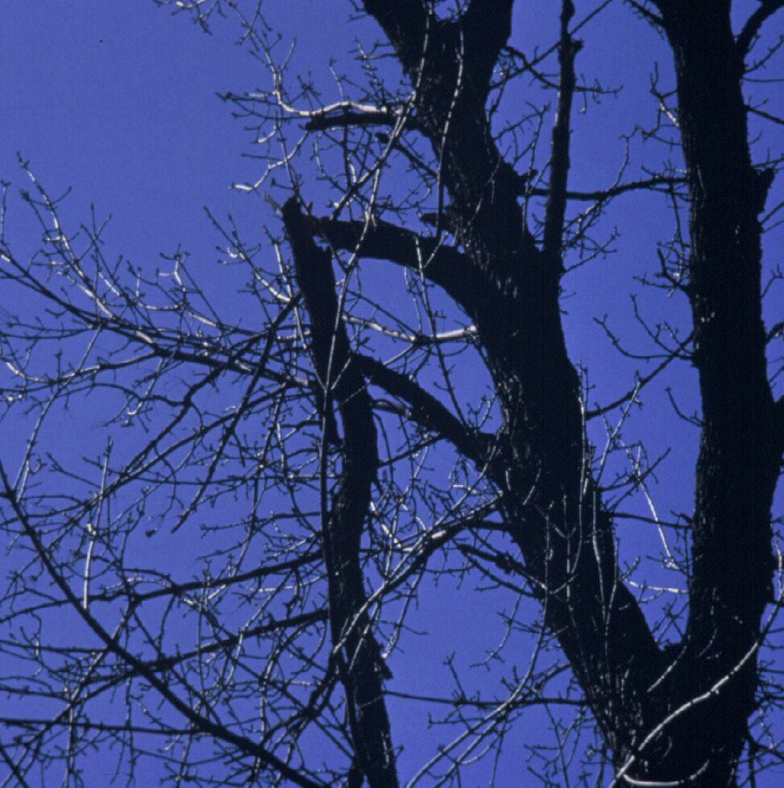
Problem #3
Photo used with permission from Manfred Mielke, USDA Forest Service
You are thinning trees in a grove of closely-spaced trees. You look up and notice that there are large broken limbs in some of the trees.
1. What issues do you need to consider?
2. How do you proceed?
Refer to Lesson 4 of Tree Trimming Safety book & OSHA handout.
Notes:
Photo from USDA Forest Service: http://www.fs.fed.us/treeclimbing/
-------- Original Message -------- Subject: Re: Request to use photo Date: Wed, 21 Oct 2009 07:48:57 -0500 From: Manfred Mielke <mmielke@fs.fed.us> To: <mrickett@ksu.edu> Permission granted. Manfred Mielke Plant Pathologist, Northeastern Area St. Paul, MN 651-649-5267 *<mrickett@ksu.edu>* 10/20/2009 04:41 PM To <mmielke@fs.fed.us> cc Subject Request to use photo A message from the NRS Web Site was received at: 10/20/2009 4:04:19 PM From: Mitch Ricketts Email: mrickett@ksu.edu Subject: Request to use photo Message: Manfred, I work at Kansas State University. We have an OSHA grant to provide safety training to landscape & horticultural services workers. I am working on a powerpoint presentation on tree-trimming safety, and I was wondering if I could have your permission to use a photo from your on-line document, "Hazardous Conditions: How to Identify Them Before You Climb." The photo I would like to use is your slide #18, "The Classic Widowmaker." If you grant permission, I will include a credit on the slide that identifies it was used with permission from Manfred Mielke, USDA Forest Service. I look forward to hearing from you. Mitch Ricketts, PhD, CSP Agricultural Experiment Station 105D Waters Hall Kansas State University Manhattan, KS 66506-4000 785-532-7068 mrickett@ksu.edu Source IP: 129.130.52.217

Slide 16
A 54-year-old man was handling the rope in a tree-felling operation at his home with the help of a friend, who was cutting branches above him. The decedent was struck on the head and killed by a branch of approximately 2 inches in diameter, which broke free from a tree and fell 40–50 feet. The cause of death was ruled as massive cranial instability attributed to blunt impact to the head. Both men had been wearing helmets, but the decedent had removed his shortly before the fatal incident.
Shapiro, S., Lohff, C., & Laney, A (2008). Nonoccupational Logging Fatalities — Vermont, 1997–2007, Morbidity & Mortality Weekly Report, 57, 260-262.

Slide 17
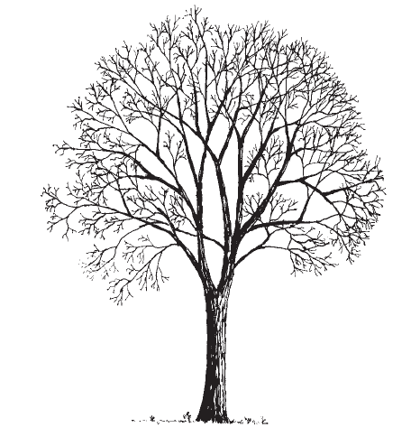
Problem #4
A 25 ft. maple tree has died and needs to be taken down. The tree stands 8 feet West of a 7,200 volt power line. The top of the tree is about 7 ft. taller than the power line.
1. What issues do you need to consider?
2. How do you proceed?
Refer to Lesson 2 of Tree Trimming Safety book
Notes:
Illustration from our own K-State Research & Extension publication: http://www.ksre.ksu.edu/library/hort2/c550.pdf

Slide 18
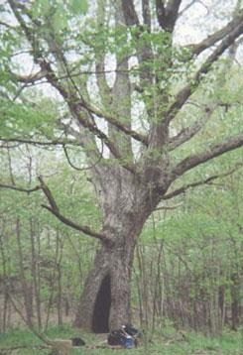
Problem #5
You need to cut down a large tree, but you notice that the trunk seems to be hollow.
1. What issues do you need to consider?
2. How do you proceed?
Refer to Lesson 4 of Tree Trimming Safety book & OSHA handout.
Notes:
Photo in public domain, from government website (Hoosier National Forest): http://www.fs.fed.us/r9/hoosier/docs/history/ccdw_history.htm

Slide 19
Training Wrap-Up

