Slide 1
WVB
TOOLS AND HOW TO USE THEM

Slide 2
SKIL SAW: A portable cutting tool used to make boards too short.

Slide 3
BELT SANDER: An electric sanding tool commonly used to convert minor touch-up jobs into major refinishing jobs.

Slide 4
WIRE WHEEL: Cleans paint off bolts and then throws them somewhere under the workbench with the speed of light. Also removes fingerprints and hard-earned calluses from fingers in about the time it takes you to say, 'Oh shit'.

Slide 5
DRILL PRESS: A tall upright machine useful for suddenly snatching flat metal bar stock out of your hands so that it smacks you in the chest and flings your beer across the room, denting the freshly-painted project which you had carefully set in the corner where nothing could get to it.

Slide 6
Channel Locks: Used to round off bolt heads. Sometimes used in the creation of blood-blisters.

Slide 7
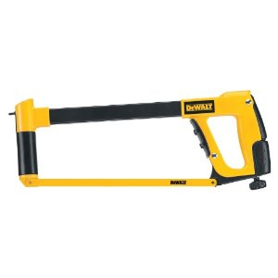
HACKSAW:
One of a family of cutting tools built on the Ouija board principle... It transforms human energy into a crooked, unpredictable motion, and the more you attempt to influence its course, the more dismal your future becomes.

Slide 8
VISE-GRIPS: Generally used after pliers to completely round off bolt heads. If nothing else is available, they can also be used to transfer intense welding heat to the palm of your hand.

Slide 9
OXYACETYLENE TORCH: Used almost entirely for igniting various flammable objects in your shop and creating a fire. Also handy for igniting the grease inside the wheel hub out of which you want to remove a bearing race.

Slide 10
TABLE SAW: A large stationary power tool commonly used to launch wood projectiles for testing wall integrity. Very effective for digit removal !!

Slide 11
HYDRAULIC FLOOR JACK: Used for lowering an automobile to the ground after you have installed your new brake shoes, trapping the jack handle firmly under the bumper.

Slide 12
BAND SAW: A large stationary power saw primarily used by most shops to cut large pieces into smaller pieces that more easily fit into the trash after you cut on the inside of the line instead of the outside edge.

Slide 13
TWO-TON ENGINE HOIST: A tool for testing the maximum tensile strength of all the crap you forgot to disconnect.

Slide 14
PHILLIPS SCREWDRIVER: Normally used to stab the vacuum seals under lids or for opening old-style paper-and-tin oil cans and splashing oil on your shirt; but can also be used, as the name implies, to strip out Phillips screw heads.

Slide 15
STRAIGHT SCREWDRIVER: A tool for opening paint cans. Sometimes used to convert common slotted screws into non-removable screws and butchering your palms.

Slide 16
PRY BAR: A tool used to crumple the metal surrounding that clip or bracket you needed to remove in order to replace a 50 cent part.

Slide 17
PVC PIPE CUTTER: A tool used to make plastic pipe too short.

Slide 18
HAMMER: Originally employed as a weapon of war, the hammer nowadays is used as a kind of divining rod to locate the most expensive parts adjacent the object we are trying to hit.

Slide 19
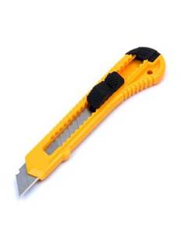
UTILITY KNIFE:
Used to open and slice through the contents of cardboard cartons delivered to your front door. Works particularly well on contents such as seats, vinyl records, liquids in plastic bottles, collector magazines, refund checks, and rubber or plastic parts. Especially useful for slicing work clothes, but only while in use.

Slide 20
SON OF A B*#%@ TOOL:
Any handy tool that you grab and throw across the garage while yelling 'Son of a b*#%@ at the top of your lungs. It is also, most often, the next tool that you will need.

