Slide 1
Annual Formaldehyde Awareness Training
Providence VAMC Environmental, Safety & Health Department

Slide 2
What is Formaldehyde?
Formaldehyde is a colorless, strong-smelling gas commonly used as a preservative.
Although the term “formaldehyde” describes various mixtures of formaldehyde, water and alcohol, the term “formalin” describes aqueous solutions, particularly those containing 37 to 50% formaldehyde and 6 to 15 % alcohol stabilizer.

Slide 3
Who is at Risk For Potential Exposure?
Personnel who work with/utilize formalin products in their workplace:
  Medical lab technicians
  Health care professionals
  Research personnel
Personnel who repair lab equipment
Personnel who transport formalin
Personnel who pickup and transport formalin waste

Slide 4
29 CFR 1910.1048 Formaldehyde
Initial monitoring. The employer shall identify all employees who may be exposed at or above the action level or at or above the STEL and accurately determine the exposure of each employee so identified.
The initial monitoring process shall be repeated each time there is a change in production, equipment, process, personnel, or control measures which may result in new or additional exposure to formaldehyde.

Slide 5
Permissible Exposure Limit (PEL) & Action Level
PEL: The employer shall assure that no employee is exposed to an airborne concentration of formaldehyde which exceeds 0.75 parts formaldehyde per million parts of air (0.75 ppm) as an 8-hour TWA.
"Action level" means a concentration of 0.5 part formaldehyde per million parts of air (0.5 ppm) calculated as an eight (8)-hour time-weighted average (TWA) concentration.

Slide 6
Short Term Exposure Limit (STEL)
Short Term Exposure Limit (STEL): The employer shall assure that no employee is exposed to an airborne concentration of formaldehyde which exceeds two parts formaldehyde per million parts of air (2 ppm) as a 15-minute STEL.

Slide 7
Medical Surveillance
The employer shall institute medical surveillance programs for all employees exposed to formaldehyde at concentrations at or exceeding the action level or exceeding the STEL.
Medical surveillance is also required for employees who develop signs and symptoms of overexposure to formaldehyde and those who respond to an emergency involving formaldehyde

Slide 8
How can formaldehyde harm workers?
It is a sensitizing agent that can cause an immune system response upon initial exposure.
It is also a suspected carcinogen that is linked to nasal cancer and lung cancer.
Ingestion and /or inhalation of high concentrations may be fatal

Slide 9
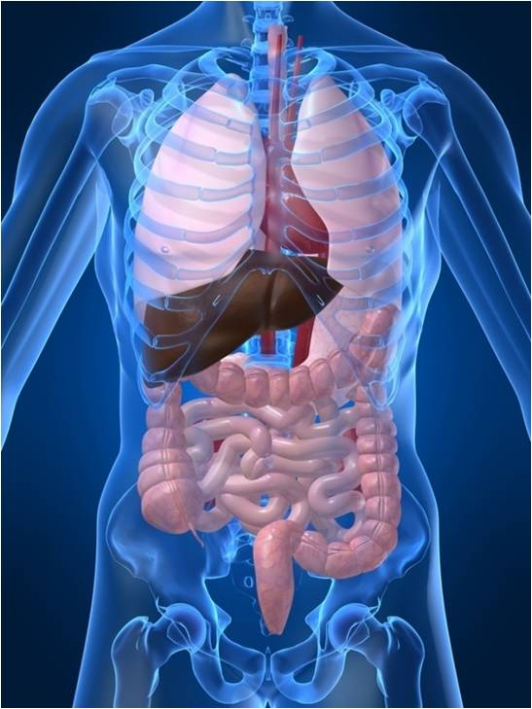
Exposure Routes
Inhalation
Ingestion
Skin contact
Eye contact

Slide 10
Symptoms of Exposure
Irritation to eye, nose, throat & respiratory system
Allergic reactions of the skin, eyes & respiratory tract
Lacrimation (discharge of tears)
Cough, wheezing
Dermatitis
***Immediately report any symptoms of exposure to your supervisor!

Slide 11
Safe Work Practices
Wear appropriate PPE:
  Disposable nitrile gloves for handling containers, pouring operations (change out if torn and wash hands thoroughly after use)
  Chemical goggles and chemical resistant apron for pouring operations (replace if ripped or torn)
Utilize laboratory chemical hood ventilation
Keep formalin containers closed tightly
Keep emergency eyewashes and showers in chemical labs unobstructed

Slide 12
Spills, Emergencies, Clean-up Procedures
For small spills: place leaking container in an air tight secondary container, take up small spill with absorbent material and place in airtight container for disposal
For large spills (beyond ability of equipment to handle): leave the area immediately, call x4999, do not touch spilled materials, shut off ignition sources if able to do so without risk, deny access to area other than emergency personnel

Slide 13
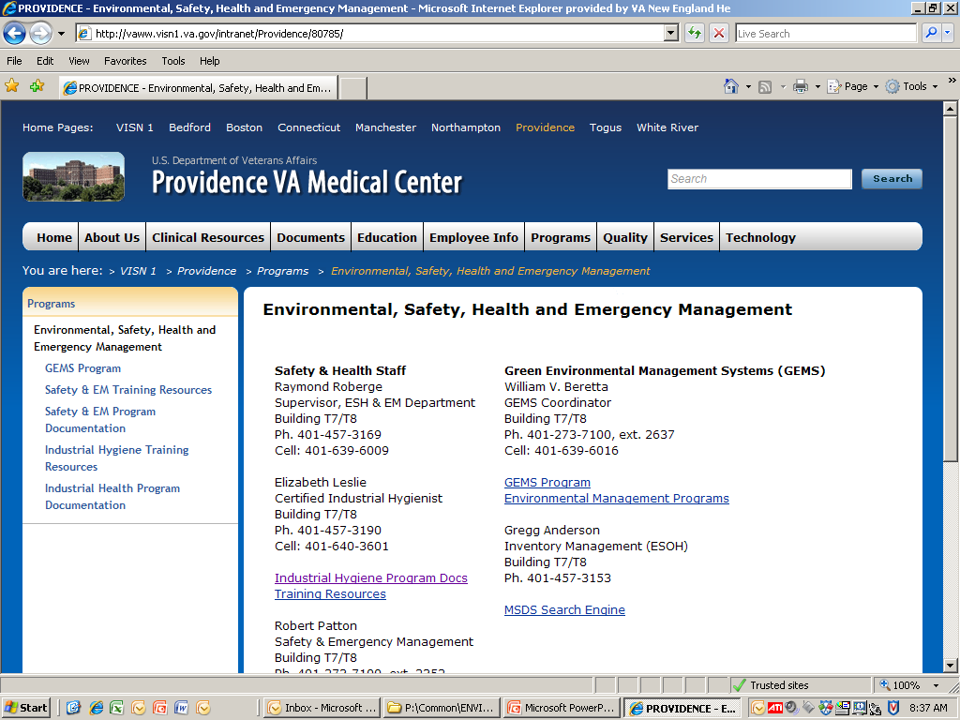
MSDS Search Engine

Slide 14
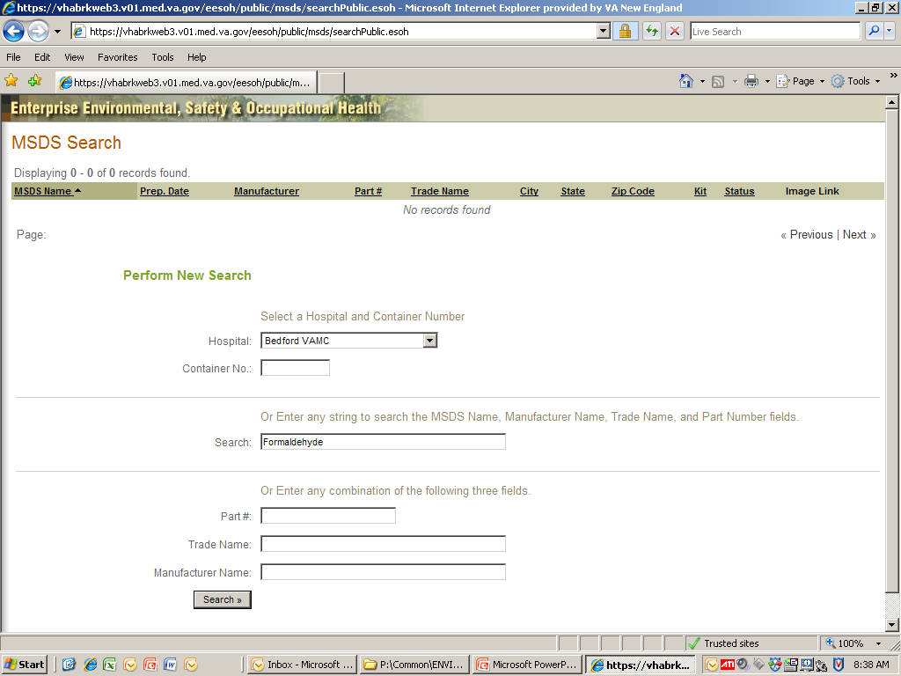
ESOH MSDS Search Page

Slide 15
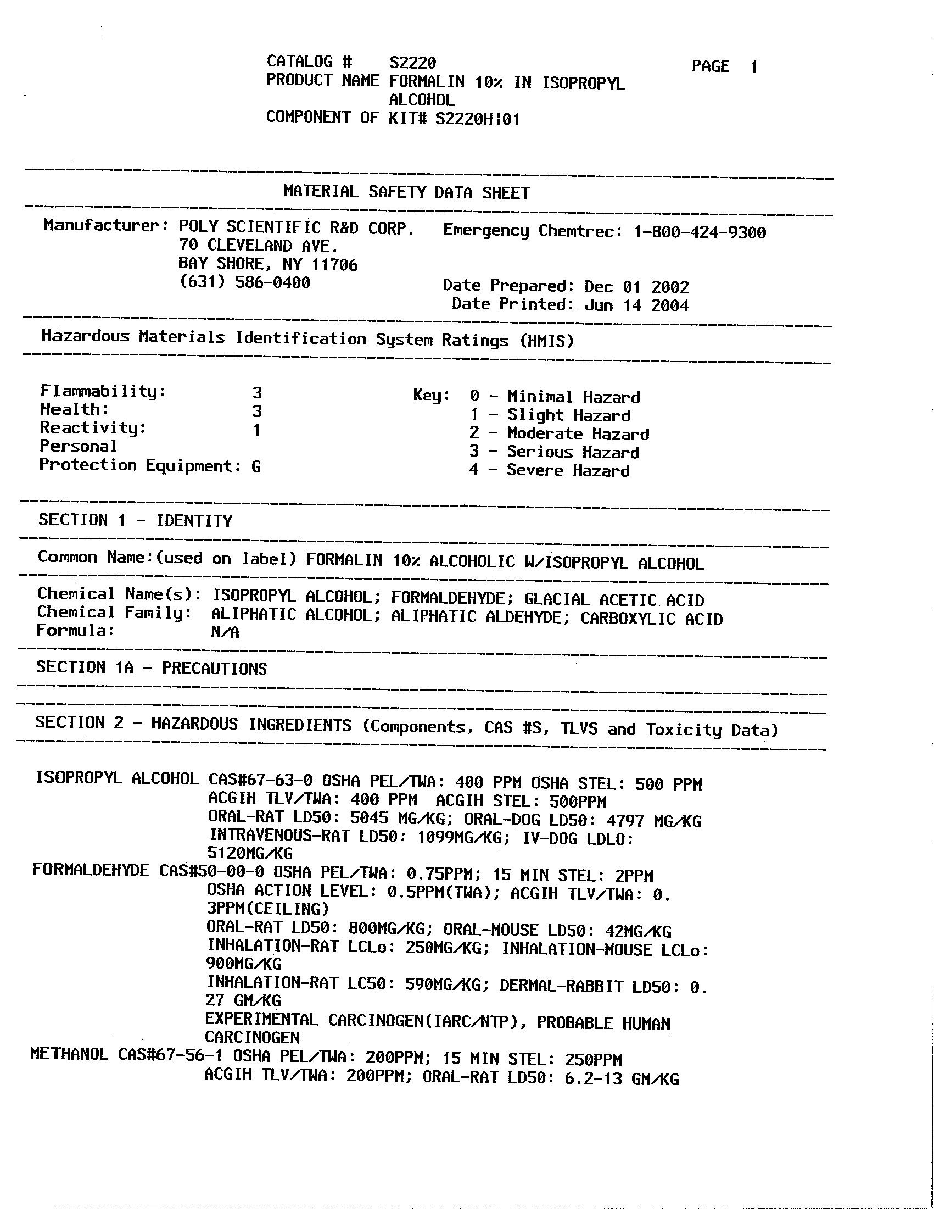
MSDS for Formalin 10%

Slide 16
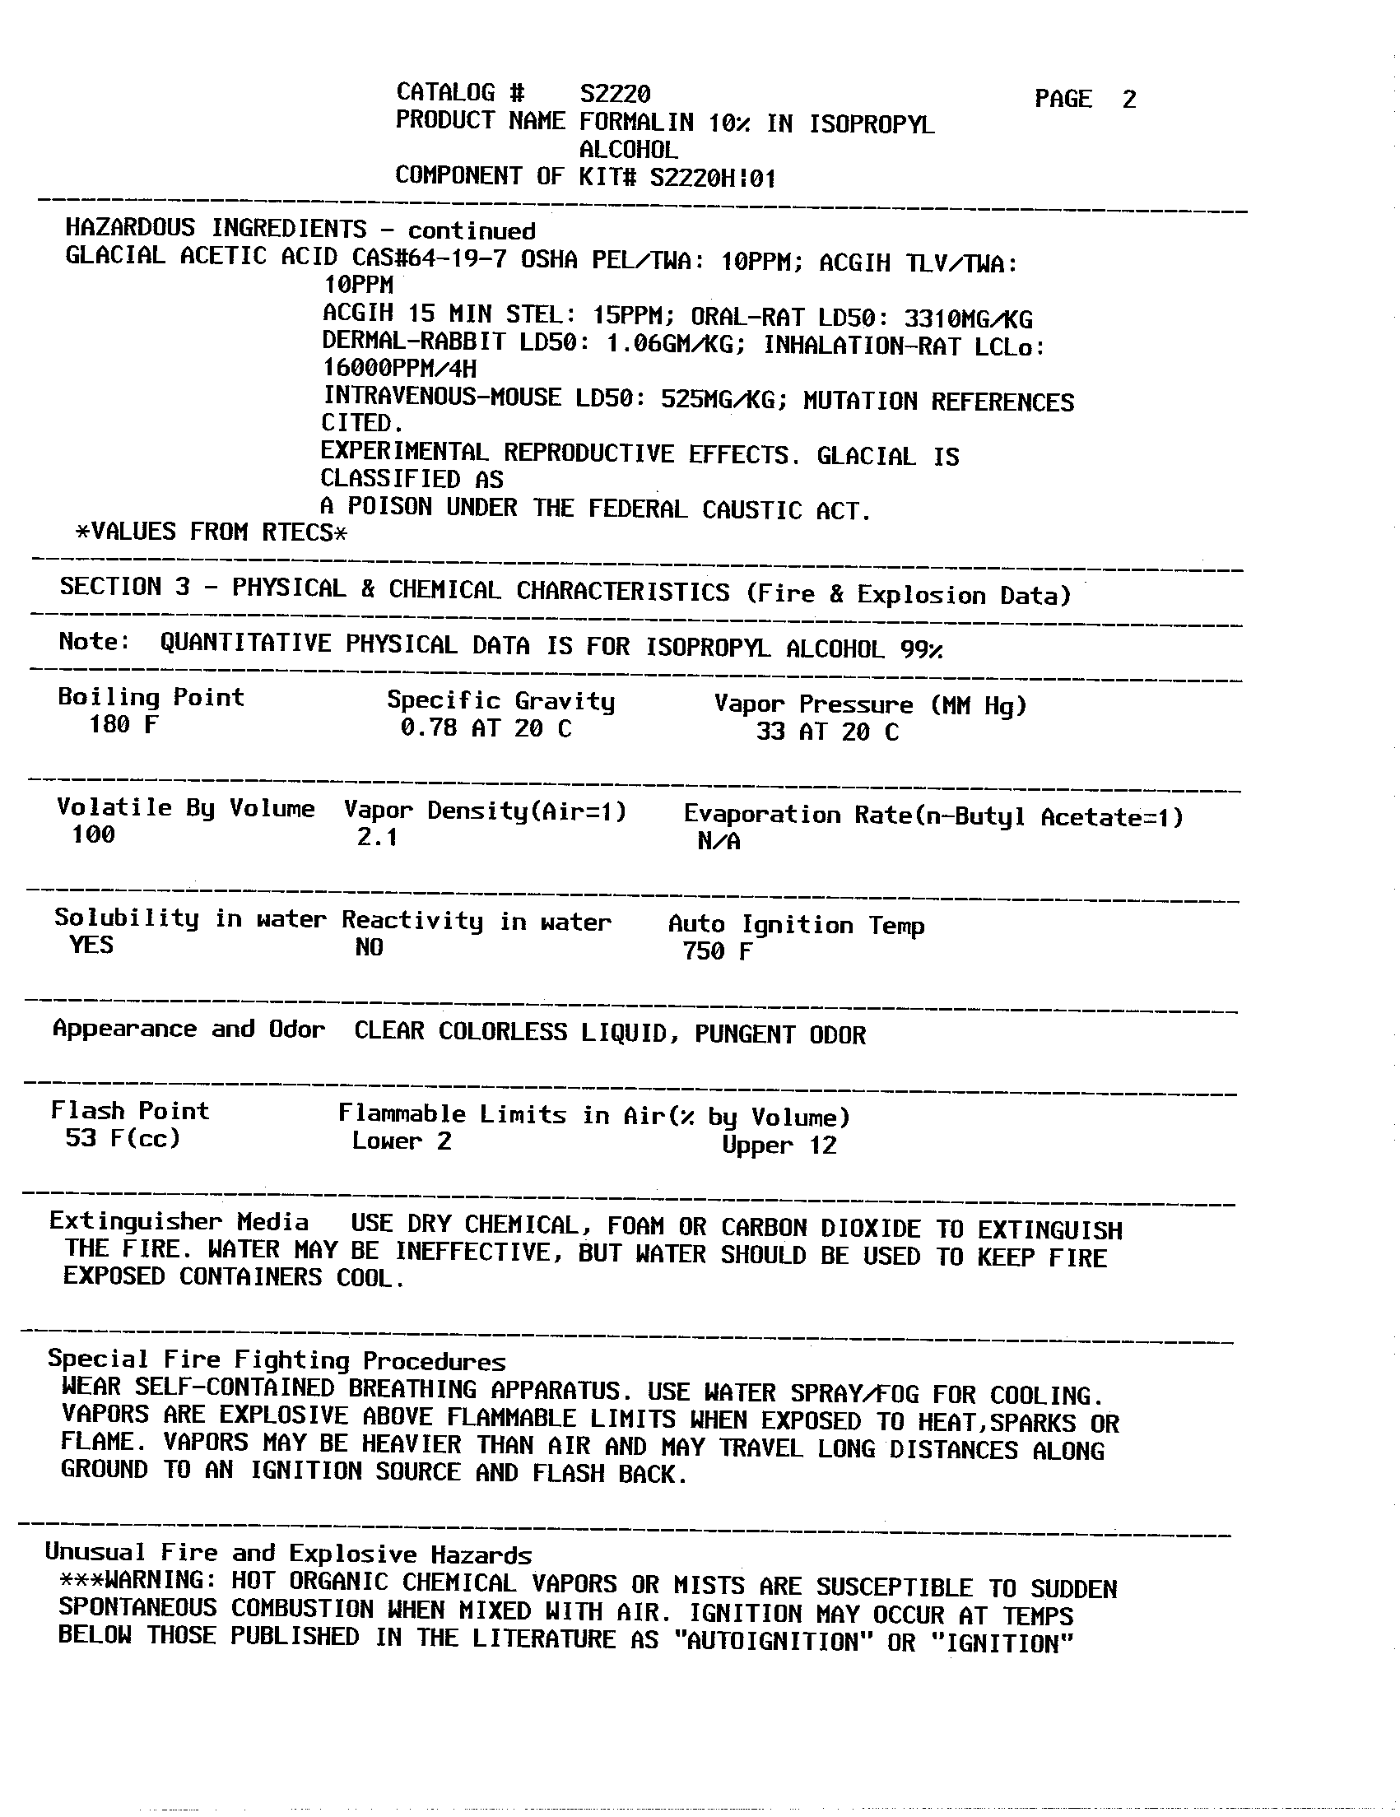
MSDS continued

Slide 17
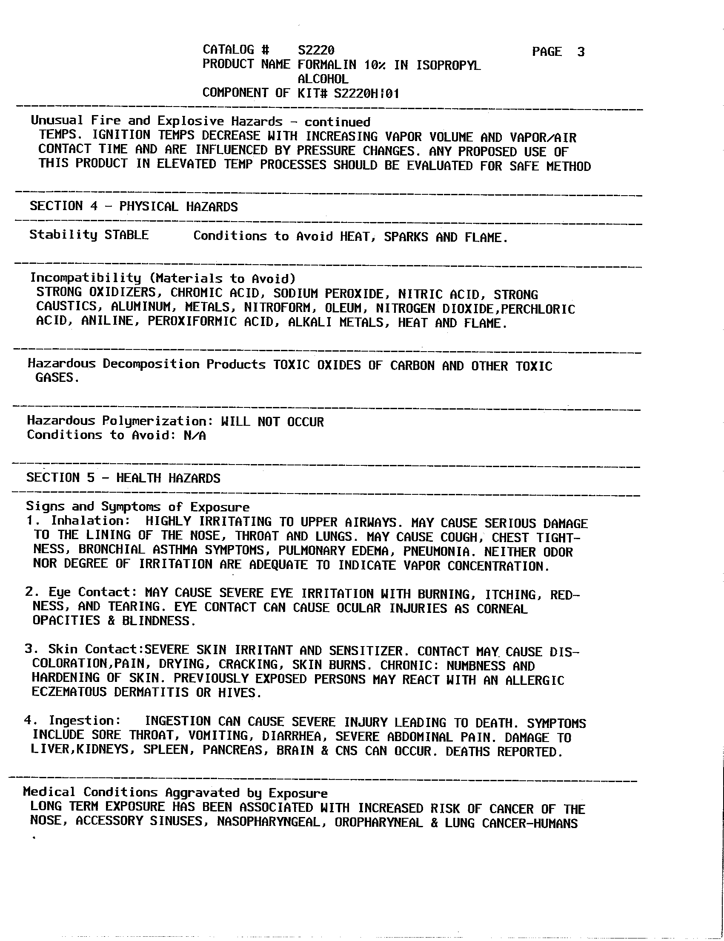
MSDS continued

Slide 18
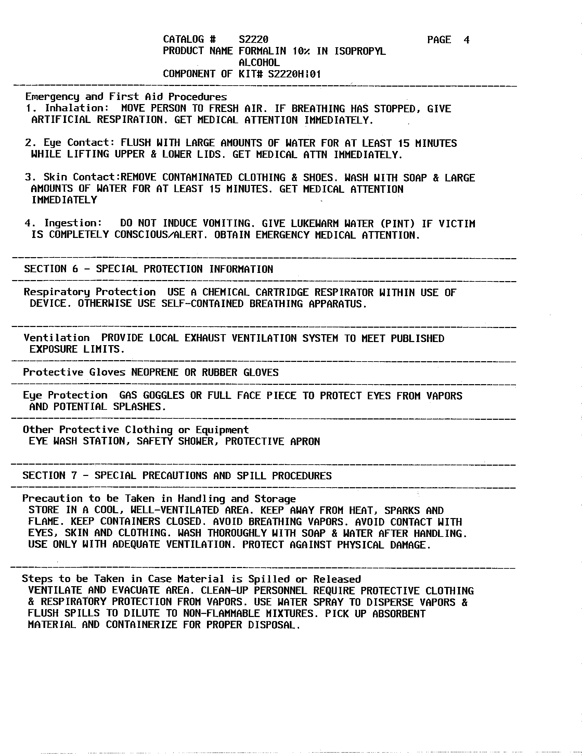
MSDS continued

Slide 19
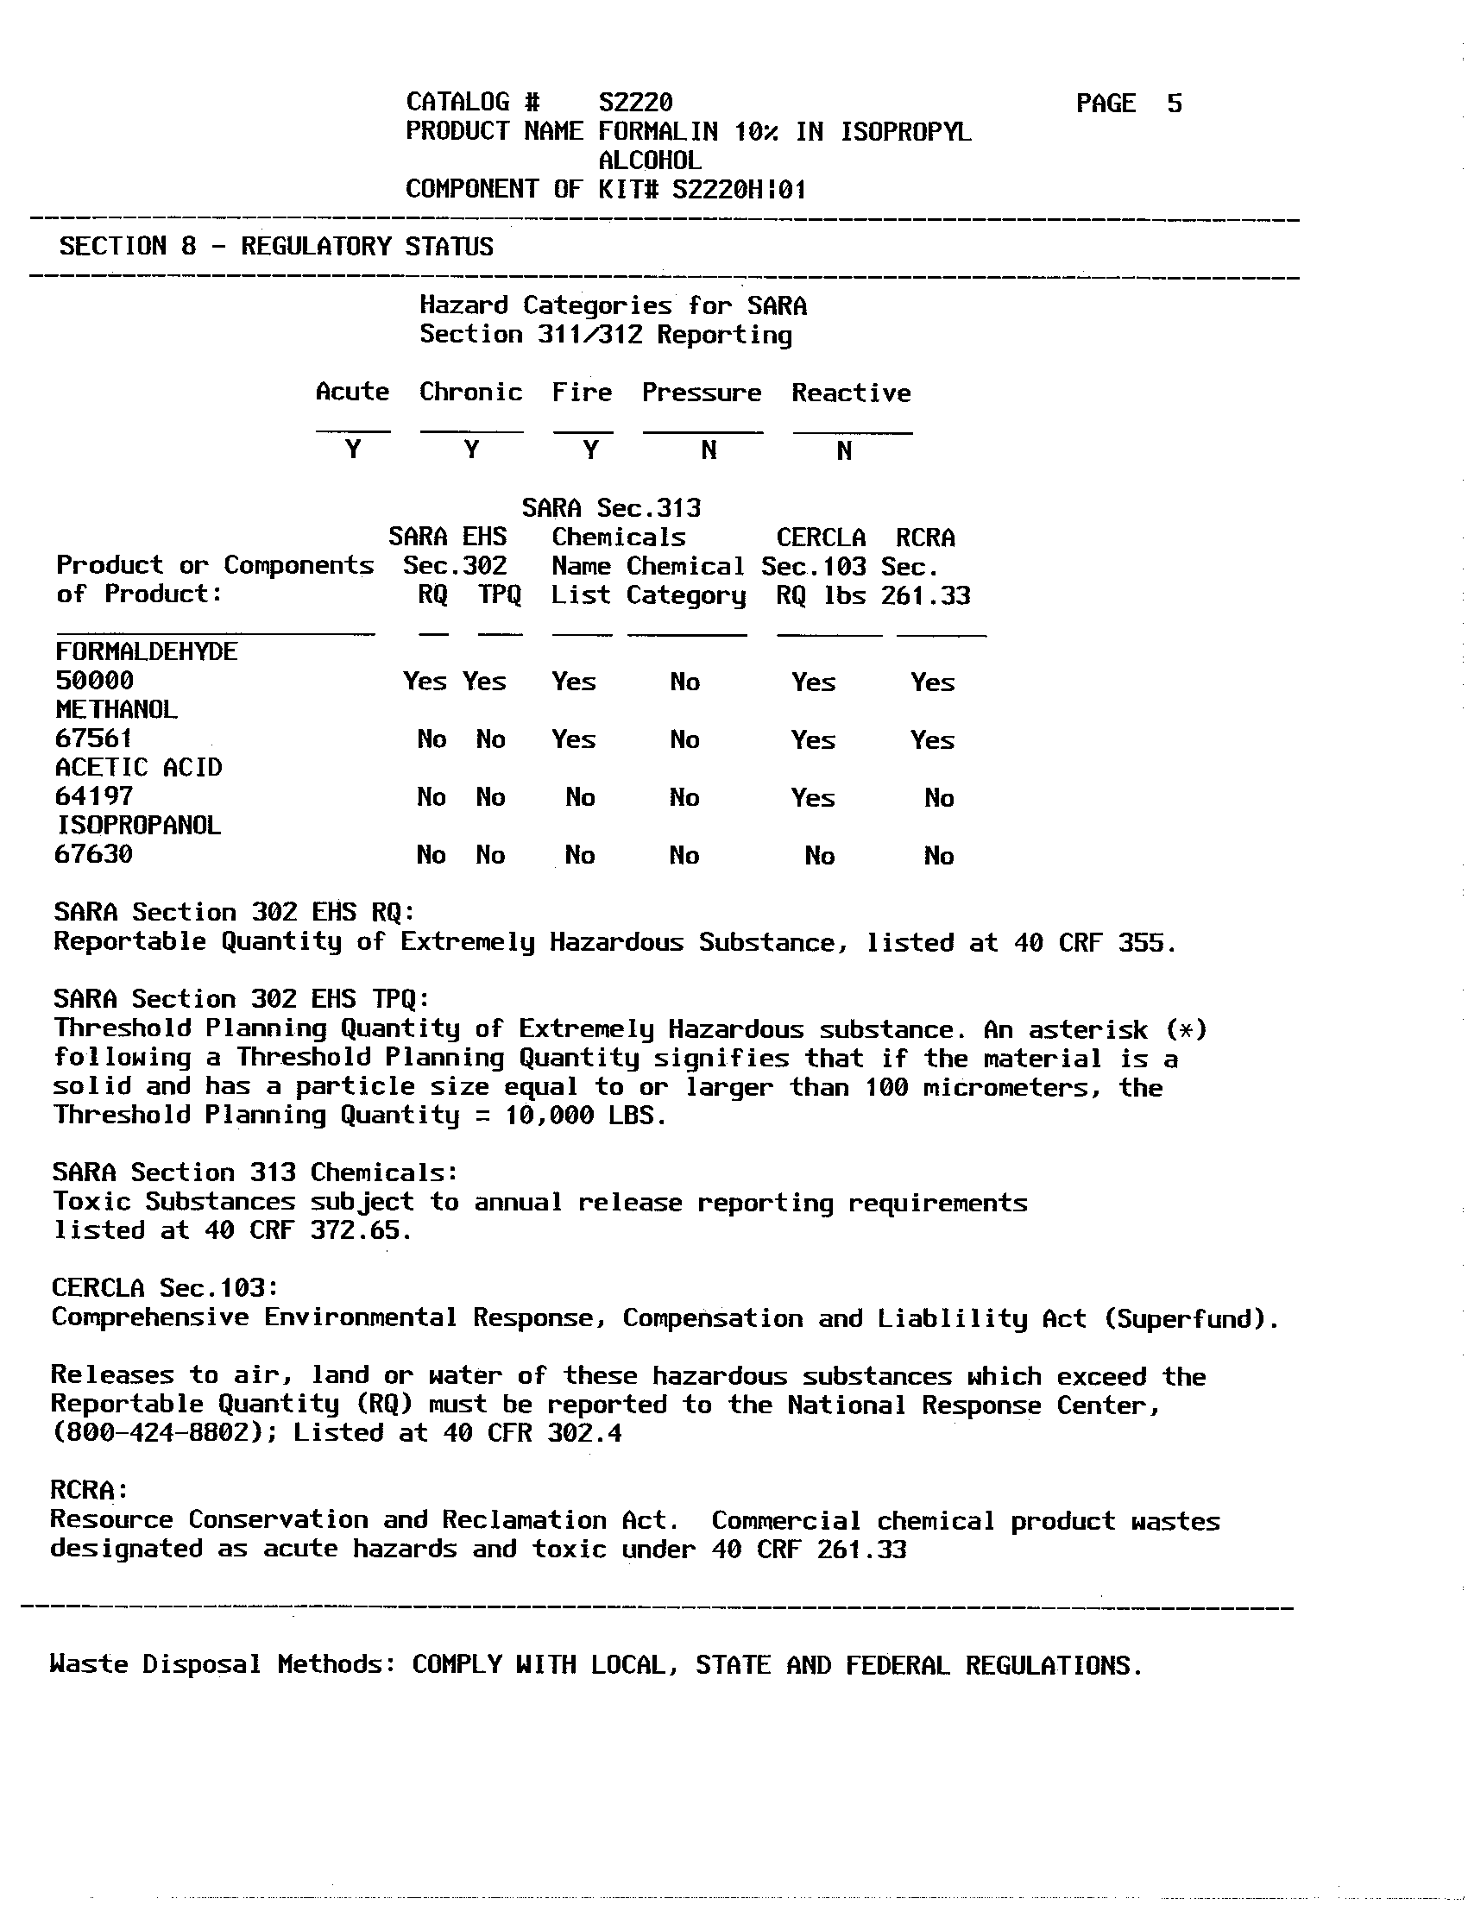
MSDS continued

Slide 20
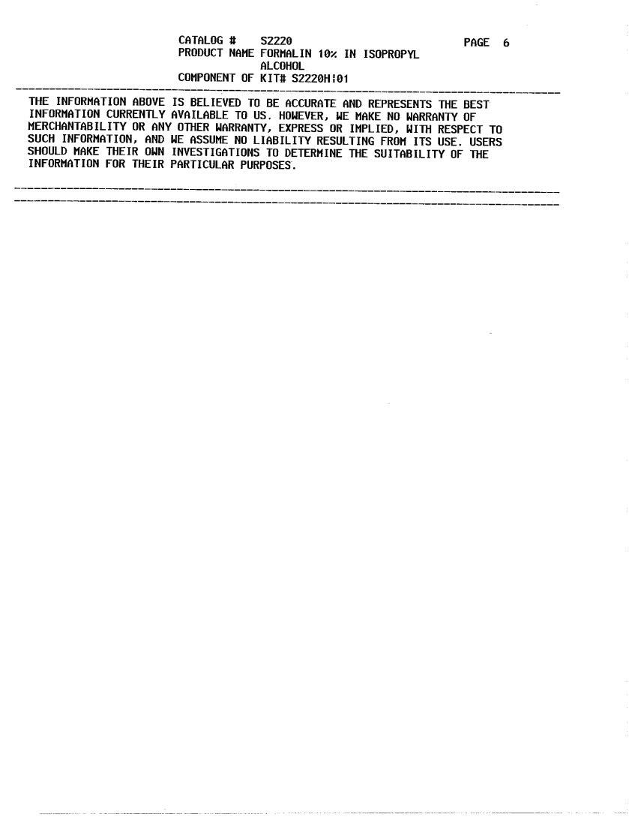
MSDS continued

Slide 21
References
29 CFR 1910.1048 Formaldehyde
29 CFR 1910.1200 Hazard Communication Standard
29 CFR 1910.132 PPE
29 CFR 1910.133 Eye and face protection
OSHA Fact Sheet Formaldehyde, USDOL, 2002
CDC-NIOSH Pocket Guide to Chemical Hazards-Formalin (as formaldehyde)

Slide 22
CERTIFICATE OF COMPLETION
I certify that I have reviewed and understand this training presentation on Formaldehyde.
________________________ ____________
Printed name/Signature Date
(Print for the Training Record)

