Slide 1
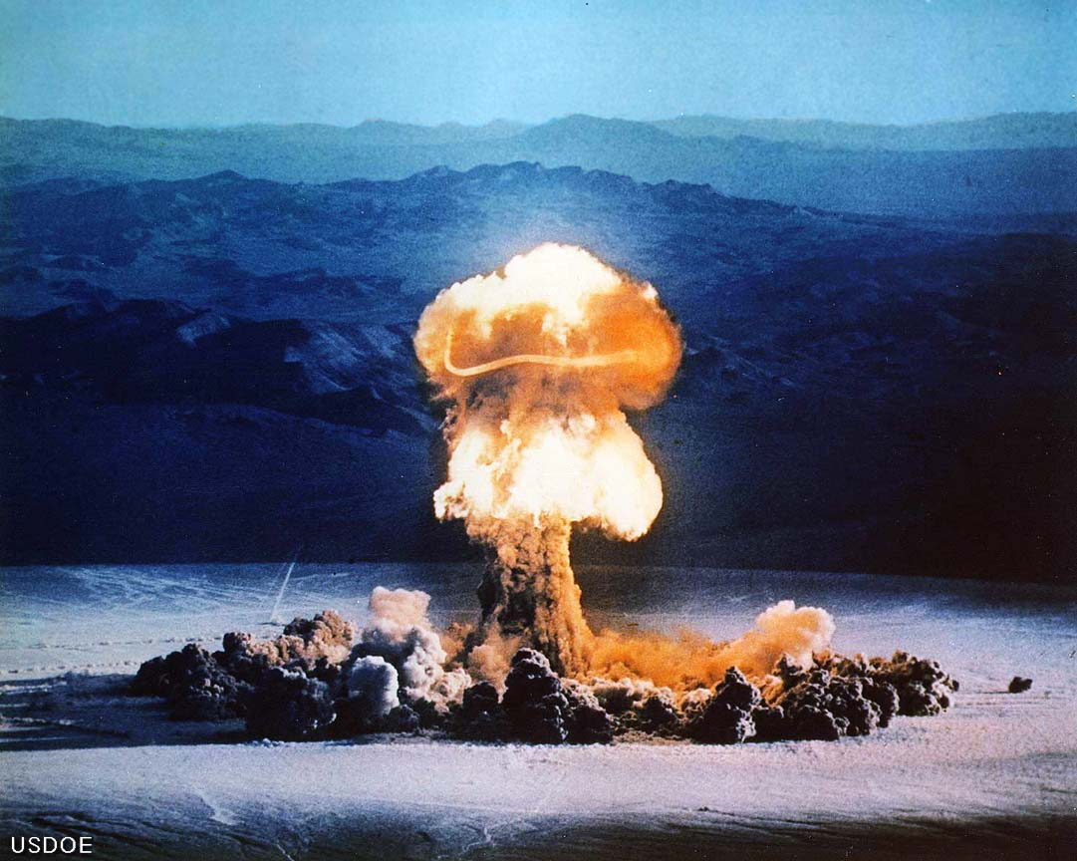
Some of the World’s Biggest Explosions

Slide 2
Russian Tsar Bomb October 30, 1961

Slide 3
PEPCON Disaster Henderson, Nevada May 4, 1988

Slide 4
Appomattox, Virginia Pipeline Explosion

Slide 5
429 Tons of Military Grade High Explosives

Slide 6
The Exploding Whale November 1970

Slide 7
Train Derailment and BLEVE

