Slide 1
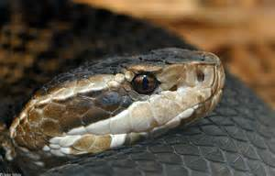
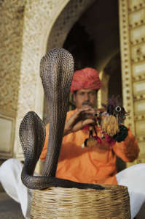
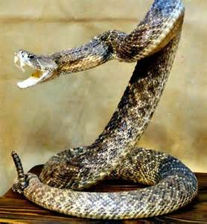
Snake Safety
Notes:
It has been estimated that 7,000–8,000 people per year receive venomous bites in the United States, and about 5 of those people die. The number of deaths would be much higher if people did not seek medical care. It is important for employers to train their workers about their risk of exposure to venomous snakes, how they can prevent and protect themselves from snake bites, and what they should do if they are bitten.
http://www.cdc.gov/niosh/topics/snakes/

Slide 2
Snake Facts
There are over 3,000 species of snakes.
Every year there are nearly 7,000 snake bites.
Snake’s scales are made up of Keratin, which is the same thing that our fingernails are made from.
The Hognose, Grass snake and the Spitting Cobra will fake death when feeling threatened. They flip onto their backs, open their mouths, and let their tongue flop out. And they will let out some smelly stuff from their anal gland.
Notes:
There are over 3,000 species of snakes.
Every year there are nearly 7,000 snake bites.
Snake’s scales are made up of Keratin, which is the same thing that our fingernails are made from.
The Hognose, Grass snake and the Spitting Cobra will fake death when feeling threatened. They flip into their backs, open their mouths, and let their tongue flop out. And they will let out some smelly stuff from their anal gland.

Slide 3
Snake Facts
Most snakes are not aggressive. They will usually retreat from danger. However if they start to feel threatened, they will strike.
Snakes are cold-blooded and rely on their surroundings for warmth.
A reticulated python, named Colossus, was the largest snake that ever lived in a zoo. She lived at the Pittsburgh Zoo in Pennsylvania and was 28 ½ feet long and weighed 320 pounds.
Notes:
Most snakes are not aggressive. They will usually retreat from danger. However if they start to feel threatened, they will strike.
Snakes are cold-blooded and rely on their surroundings for warmth.
A reticulated python, named Colossus, was the largest snake that ever lived in a zoo. She lived at the Pittsburgh Zoo in Pennsylvania and was 28 ½ feet long and weighed 320 pounds.

Slide 4
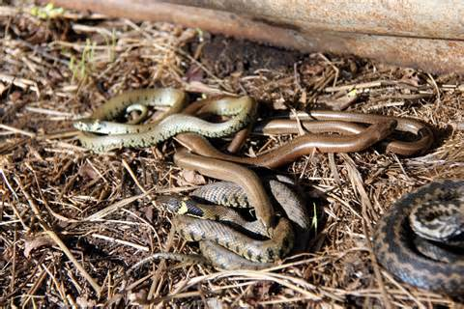
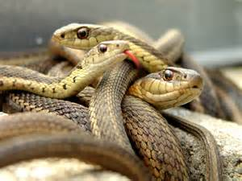
Snakes in Pennsylvania
There are 21 species of snakes in Pennsylvania.
18 are nonvenomous
3 are venomous
Notes:
There are 21 species of snakes in Pennsylvania.
18 are nonvenomous
3 are venomous

Slide 5
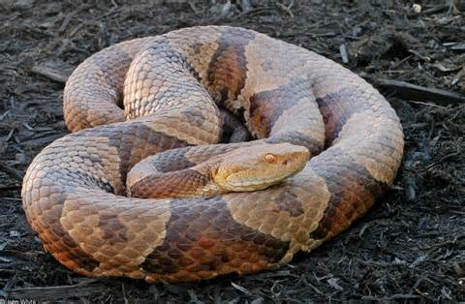
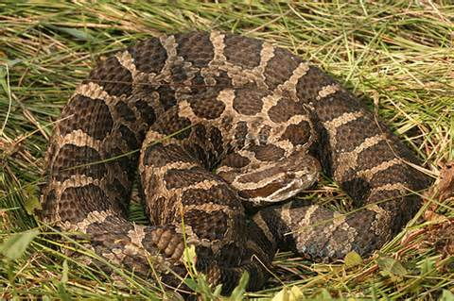
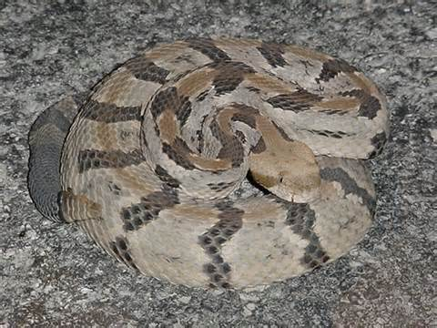
Poisonous Snakes of PA
Northern Copperhead
Eastern Massasauga
Timber Rattle Snake
Yellow phase
Black phase
Notes:
Venomous snakes found in the United States include rattlesnakes, copperheads, cottonmouths/water moccasins, and coral snakes. They can be dangerous to outdoor workers including farmers, foresters, landscapers, groundskeepers, gardeners, painters, roofers, pavers, construction workers, laborers, mechanics, and any other workers who spend time outside. Although rare, some workers with a severe allergy to snake venom may be at risk of death if bitten. http://www.cdc.gov/niosh/topics/snakes/
Northern Copperhead
Eastern Massasauga
Timber Rattle Snake
Yellow phase
Black phase

Slide 6
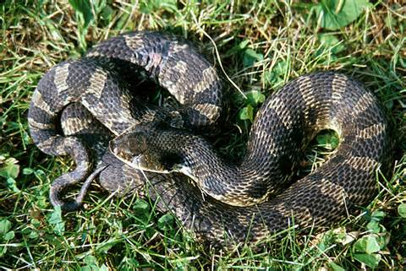
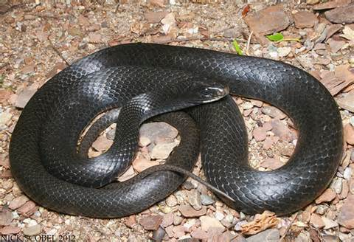
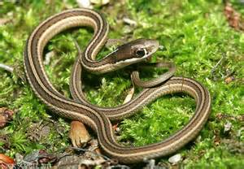
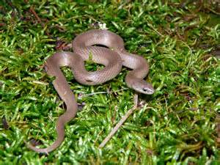
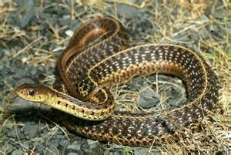
Nonvenomous Snakes of PA
Eastern Hognose
Northern Black Racer
Eastern Ribbon
Eastern Smooth Earth
Eastern Garter
Notes:
Eastern Hognose
Northern Black Racer
Eastern Ribbon
Eastern Smooth Earth
Eastern Garter

Slide 7
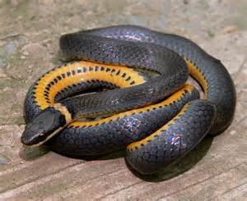
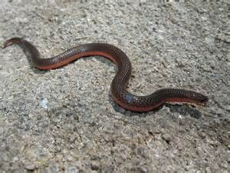
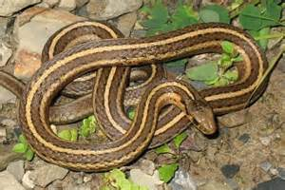
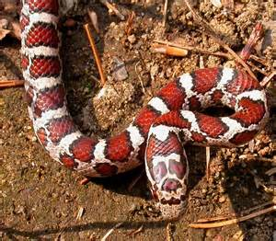
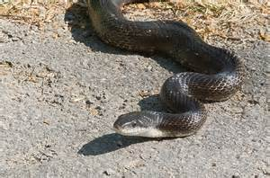
Nonvenomous Snakes of PA
Northern Ringneck
Eastern Worm
Shorthead Garter
Eastern Milk
Eastern Rat
Notes:
Northern Ringneck
Eastern Worm
Shorthead Garter
Eastern Milk
Eastern Rat

Slide 8
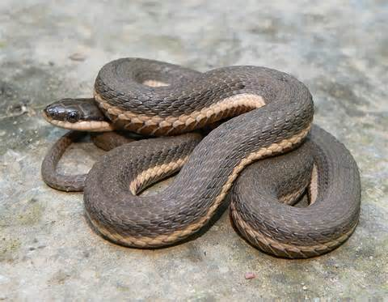
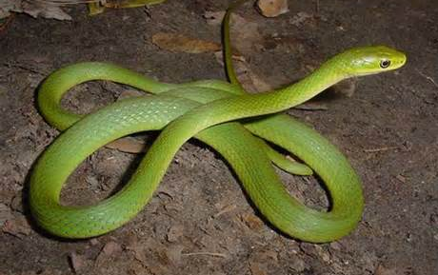
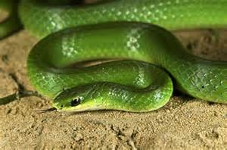
Nonvenomous Snakes of PA
Queen
Rough Green
Smooth Green
Notes:
Queen
Rough Green
Smooth Green

Slide 9
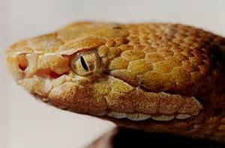
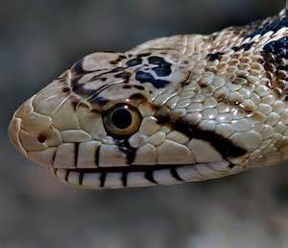
Venomous vs Nonvenomous
In PA all venomous snakes have slit-like pupils, similar to a cat’s eye.
Nonvenomous snakes have round pupils, like humans.
Notes:
In PA all venomous snakes have slit-like pupils, similar to a cat’s eye.
Nonvenomous snakes have round pupils, like humans.

Slide 10
Venomous vs Nonvenomous
All 3 venomous snakes in PA belong to the pit viper family.
A pit viper snake has a deep pit on each side of its head that it uses to detect the warmth of nearby prey.
This helps the snakes to locate food, especially while hunting at night.
These pits are located between the eyes and the nostril.
Nostril
Pit
Notes:
All 3 venomous snakes in PA belong to the pit viper family.
A pit viper snake has a deep pit on each side of its head that it uses to detect the warmth of nearby prey.
This helps the snakes to locate food, especially while hunting at night.
These pits are located between the eyes and the nostril.

Slide 11
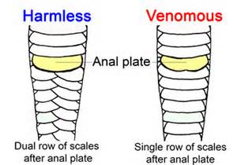
Venomous vs Nonvenomous
If you find a shedded snake skin, look at the scales on the underside.
Single Row – if they are in a single row all the way to the tip of its tail – venomous snake.
Double Row – if the scales split into a double row – nonvenomous snake.
Notes:
If you find a shedded snake skin, look at the scales on the underside.
Single Row – if they are in a single row all the way to the tip of its tail – venomous snake.
Double Row – if the scales split into a double row – nonvenomous snake

Slide 12
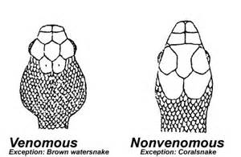
Venomous vs Nonvenomous
Venomous snakes store their venom in a sac on each side of their head (triangular shape).
However, some nonvenomous snakes can also flatten their heads, so do not use head shape alone to identify a venomous snake.
Notes:
Venomous snakes store their venom in a sac on each side of their head (triangular shape).
However, some nonvenomous snakes can also flatten their heads, so do not use head shape alone to identify a venomous snake

Slide 13
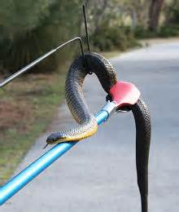
Snake Tips
Leave snakes alone – almost all cases of snake bites occur when people attempt to catch, pick up, or kill snakes.
Use specialty snake handling tools when picking up or transporting any snakes that you cannot identify.
Wear snake boots and/or snake gaiters on your feet and legs when walking through snake country.
Notes:
Snake tips.
Leave snakes alone – almost all cases of snake bites occur when people attempt to catch, pick up, or kill snakes.
Use specialty snake handling tools when picking up or transporting any snakes that you cannot identify.
Wear snake boots and/or snake gaiters on your feet and legs when walking through snake country

Slide 14
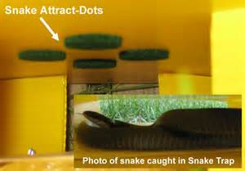
Snake Tips
Buy a snake trap.
Hire a professional snake removal expert.
Learn how to identify venomous and nonvenomous snakes.
Do not try to kill snakes.
Faster than you think
Hard to kill
Wild when injured
Strike after they appear or play dead
Notes:
Buy a snake trap.
Hire a professional snake removal expert.
Learn how to identify venomous and nonvenomous snakes.
Do not try to kill snakes.
Faster than you think
Hard to kill
Wild when injured
Strike after they appear or play dead

Slide 15
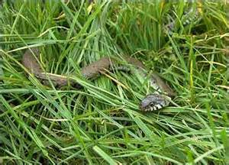
Preventing Snake Bites At Work
Keep grass cut short.
Wear long pants and boots. Tuck your pant legs into your boots
Wear protective gloves when grabbing things off of the ground.
Keep bushes, shrubs and flowers a few feet away from sidewalks or other walkways.
Notes:
Keep grass cut short.
Wear long pants and boots. Tuck your pant legs into your boots
Wear protective gloves when grabbing things off of the ground.
Keep bushes, shrubs and flowers a few feet away from sidewalks or other walkways.

Slide 16
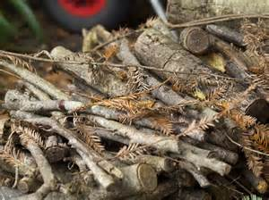
Preventing Snake Bites At Work
Never leave food sitting out.
Do not keep materials piled up outside (wood, brick piles, etc..)
If you see a snake while working back up slowly and call the animal control center.
Notes:
Never leave food sitting out.
Do not keep materials piled up outside (wood, brick piles, etc..)
If you see a snake while working back up slowly and call the animal control center.

Slide 17
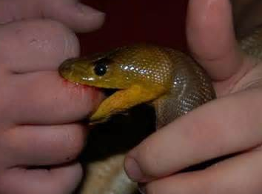
First Aid For Snake Bites
Call for medical attention immediately.
Avoid caffeine or alcohol
Keep the bite below your heart.
Remove any clothing around the bite.
Clean the area gently but do not flush.
Wrap the area but do not restrict blood flow to the site.
Notes:
Call for medical attention immediately.
Avoid caffeine or alcohol
Keep the bite below your heart.
Remove any clothing around the bite.
Clean the area gently but do not flush.
Wrap the area but do not restrict blood flow to the site.

Slide 18
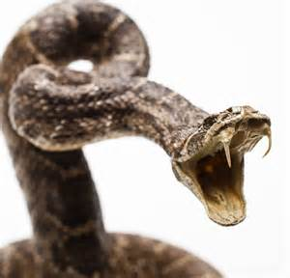
First Aid For Snake Bites
In the movies they cut the area or try to suck out the venom. Doing this in real life could cause an infection in the area.
Never attempt to capture the snake that bit you. It could strike again since it is already agitated.
Try to remember what the snake looks like. This will help the doctors treat the bite.
Notes:
First Aid for snake bites.
In the movies they cut the area or try to suck out the venom. Doing this in real life could cause an infection in the area. Also, if you have a cut on the lips or sores in the mouth, you could end up being the one poisoned!
Never attempt to capture the snake that bit you. It could strike again since it is already agitated.
Try to remember what the snake looks like. This will help the doctors treat the bite.

Slide 19
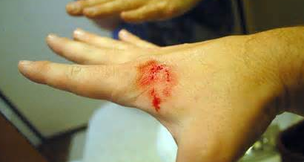
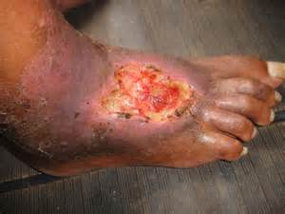
Symptoms of a Snake Bite
Intense pain in the area
Swelling
Bleeding
Shortness of breath
Weakness
Dizziness
Fever
Notes:
Snake bite symptoms include:
Intense pain in the area
Swelling
Bleeding
Shortness of breath
Weakness
Dizziness
Fever

Slide 20
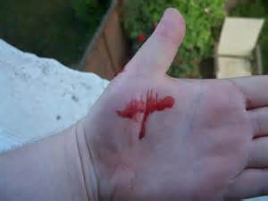
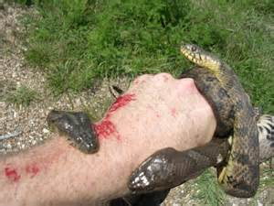
Symptoms of a Snake Bite
Numbness
Nausea
Sweating
Increased heart rate
Blurred vision
Fainting
Notes:
Additional symptoms may be,
Numbness
Nausea
Sweating
Increased heart rate
Blurred vision
Fainting

Slide 21
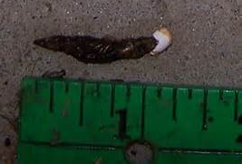
Snake Feces
Smells and often brown
Oblong, liquid excretion with a white cap
Often mistaken for that of a bird – bird feces will appear much whiter
Size will tell you size of the snake
May contain scales, feathers or bones
Contains salmonella bacteria which is linked to severe illness in humans and possibly death.
Notes:
Recognizing the presence of a snake via its feces.
Smells and often brown
Oblong, liquid excretion with a white cap
Often mistaken for that of a bird – bird feces will appear much whiter
Size will tell you size of the snake
May contain scales, feathers or bones
Contains salmonella bacteria which is linked to severe illness in humans and possibly death.

Slide 22
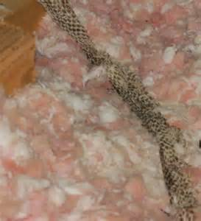
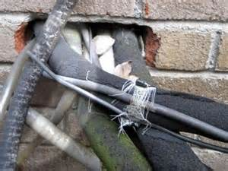
Snakes in the Attic
Rat snakes can live in the attic – can climb and fit in very tiny holes.
Rats leave a distinct odor that snakes follow.
Look for snake skins and droppings.
More active in the warmer months.
Eliminate the rodents and seal shut any gaps or holes.
Notes:
Snakes in the attic, basement or under foundations or porches.
Rat snakes can live in the attic – can climb and fit in very tiny holes.
Rats leave a distinct odor that snakes follow.
Look for snake skins and droppings.
More active in the warmer months.
Eliminate the rodents and seal shut any gaps or holes.

Slide 23
Summary
Know the environment you are entering
Determine the snake hazards which may exist
Know the correct actions to take should you encounter snakes
Ensure you have the ability to render First Aid for bites
If encountering snakes, give them a wide birth and do not antagonize the encounter.

Slide 24
Questions

Slide 25
Contact Information
Health & Safety Training Specialists
1171 South Cameron Street, Room 324
Harrisburg, PA 17104-2501
(717) 772-1635
RA-LI-BWC-PATHS@pa.gov
Like us on Facebook! - https://www.facebook.com/BWCPATHS

Slide 26
Bibliography
http://www.cdc.gov/niosh/topics/snakes/

