Slide 1
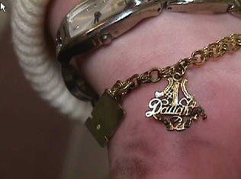
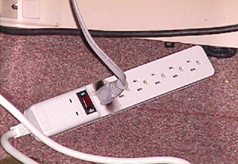
Safe Practices Conductive Apparel
Don’t wear loose conductive apparel, (such as rings, watch bands, bracelets, necklaces, etc.) when plugging in electrical cords
Charm contacted plug
Burn from arc
Charm contacted plug here
Notes:
The charm on this persons arm contacted the prongs of the plug as the person attempted to plug in a cord to power strip, resulting in a electrical short circuit and arc that burned the arm.

