Slide 1
Cell Phone Laws
December 2009

Slide 2
Cell phone laws December 2009
A jurisdiction-wide ban on driving while talking on a hand-held cell phone is in place in 7 states (California, Connecticut, New Jersey, New York, Oregon, Utah, and Washington) and the District of Columbia.
Utah has named the offense careless driving.
Under the Utah law, no one commits an offense when speaking on a cell phone unless they are also committing some other moving violation other than speeding.

Slide 3
Cell phone laws
Local jurisdictions may or may not need specific state statutory authority to ban cell phones.
Localities that have enacted restrictions on cell phone use include: Oahu, HI; Chicago, IL; Brookline, MA; Detroit, MI; Santa Fe, NM; Brooklyn, North Olmstead, and Walton Hills, OH; Conshohocken, Lebanon, and West Conshohocken, PA; Waupaca County, WI; and Cheyenne, WY.
Localities are prohibited from banning cellphone use in 8 states (Florida, Kentucky, Louisiana, Mississippi, Nevada, Oklahoma, Oregon, and Utah).

Slide 4
Cell phone laws
The use of all cell phones while driving a school bus is prohibited in 17 states and the District of Columbia.
The use of all cell phones by novice drivers is restricted in 21 states and the District of Columbia.
Text messaging is banned for all drivers in 19 states and the District of Columbia.
In addition, novice drivers are banned from texting in 9 states (Delaware, Indiana, Kansas, Maine, Mississippi, Missouri, Nebraska, Texas, and West Virginia) and school bus drivers are banned from text messaging in 1 state (Texas).

Slide 5
Cell phone laws
The table below shows the states that have cell phone laws, whether they specifically ban text messaging, and whether they are enforced as primary or secondary laws.
Under secondary laws, an officer must have some other reason to stop a vehicle before citing a driver for using a cell phone. Laws without this restriction are called primary.

Slide 6
Laws restricting cell phone use and texting
State | Hand-held ban | Young drivers all cell phone ban | Bus drivers all cell phone ban | Texting ban | Enforcement
Alabama | no | no | no | no | not applicable
Alaska | no | no | no | all drivers | primary
Arizona | no | no | school bus drivers | no | primary
Arkansas | drivers ages 18 through 20 | drivers younger than 18 | school bus drivers | all drivers | primary: texting by all drivers and cell phone use by school bus drivers; secondary: cell phone use by young drivers¹
California | all drivers | drivers younger than 18 | school and transit bus drivers | all drivers | primary; secondary for hands-free cell phone use by young drivers¹

Slide 7
State | Hand-held ban | Young drivers all cell phone ban | Bus drivers all cell phone ban | Texting ban | Enforcement
Colorado | no | drivers younger than 18 | no | all drivers | primary
Connecticut | all drivers | drivers younger than 18 | school bus drivers | all drivers | primary
Delaware | no | learner's permit and intermediate license holders | school bus drivers | learner's permit and intermediate license holders | primary
District of Columbia | all drivers | learner's permit holders | school bus drivers | all drivers | primary
Florida | no | no | no | no | not applicable

Slide 8
State | Hand-held ban | Young drivers all cell phone ban | Bus drivers all cell phone ban | Texting ban | Enforcement
Georgia | no | no | school bus drivers | no | primary
Hawaii | no | no | no | no | not applicable
Idaho | no | no | no | no | not applicable
Illinois | drivers in construction and school speed zones (effective 01/01/10) | drivers younger than 19 and learner's permit holders younger than 19 | school bus drivers | all drivers (effective 01/01/10) | primary

Slide 9
State | Hand-held ban | Young drivers all cell phone ban | Bus drivers all cell phone ban | Texting ban | Enforcement
Indiana | no | drivers younger than 18 | no | drivers younger than 18 | primary
Iowa | no | no | no | no | not applicable
Kansas | no | learner's permit and intermediate license holders (effective 01/01/10) | no | learner's permit and intermediate license holders (effective 01/01/10) | primary (effective 01/01/10)
Kentucky | no | no | school bus drivers | no | primary
Louisiana | with respect to novice drivers, see footnote² | with respect to novice drivers, see footnote² | school bus drivers | all drivers | secondary; primary for school bus drivers

Slide 10
State | Hand-held ban | Young drivers all cell phone ban | Bus drivers all cell phone ban | Texting ban | Enforcement
Maine | no | learner's permit and intermediate license holders | no | learner's permit and intermediate license holders | primary
Maryland | no | learner's permit and intermediate license holders | no | all drivers | secondary; primary for texting
Massachusetts | local option | no | school bus drivers | no | primary
Missouri | no | no | no | drivers 21 and younger | primary
Montana | no | no | no | no | not applicable

Slide 11
State | Hand-held ban | Young drivers all cell phone ban | Bus drivers all cell phone ban | Texting ban | Enforcement
Nebraska | no | learner's permit and intermediate license holders younger than 18 | no | learner's permit and intermediate license holders younger than 18 | secondary
Nevada | no | no | no | no | not applicable
New Hampshire | no | no | no | all drivers (effective 01/01/10) | primary (effective 01/01/10)
New Jersey | all drivers | learner's permit and intermediate license holders | school bus drivers | all drivers | primary

Slide 12
State | Hand-held ban | Young drivers all cell phone ban | Bus drivers all cell phone ban | Texting ban | Enforcement
New Mexico | local option | no | no | no | not applicable
New York | all drivers | no | no | all drivers | primary; secondary for text messaging
North Carolina | no | drivers younger than 18 | school bus drivers | all drivers | primary
North Dakota | no | no | no | no | not applicable
Ohio | local option | no | no | no | not applicable
Oklahoma | no | no | no | no | not applicable

Slide 13
State | Hand-held ban | Young drivers all cell phone ban | Bus drivers all cell phone ban | Texting ban | Enforcement
Oregon | all drivers (effective 01/01/10) | drivers younger than 18 (effective 01/01/10) | no | all drivers (effective 01/01/10) | primary (effective 01/01/10)
Pennsylvania | local option | no | no | no | not applicable
Rhode Island | no | drivers younger than 18 | school bus drivers | all drivers | primary
South Carolina | no | no | no | no | not applicable
South Dakota | no | no | no | no | not applicable
Tennessee | no | learner's permit and intermediate license holders | school bus drivers | all drivers | primary

Slide 14
State | Hand-held ban | Young drivers all cell phone ban | Bus drivers all cell phone ban | Texting ban | Enforcement
Texas | drivers in school crossing zones | intermediate license holders for the first twelve months | bus drivers when a passenger 17 and younger is present | bus drivers when a passenger 17 and younger is present; intermediate license holders for first twelve months; drivers in school crossing zones | primary
Utah | all drivers | no | no | all drivers | primary for texting; secondary for talking on a hand-held cellphone³

Slide 15
State | Hand-held ban | Young drivers all cell phone ban | Bus drivers all cell phone ban | Texting ban | Enforcement
Vermont | no | no | no | no | not applicable
Virginia | no | drivers younger than 18 | school bus drivers | all drivers | secondary; primary for school bus drivers
Washington | all drivers | no | no | all drivers | secondary
West Virginia | no | drivers younger than 18 who hold either a learner's permit or an intermediate license | no | drivers younger than 18 who hold either a learner's permit or an intermediate license | primary

Slide 16
State | Hand-held ban | Young drivers all cell phone ban | Bus drivers all cell phone ban | Texting ban | Enforcement
Wisconsin | no | no | no | no | not applicable
Wyoming | no | no | no | no | not applicable
¹The laws in Arkansas and California prohibit police from stopping a vehicle to determine if a driver is in compliance with the law.
Clearly, that language prohibits the use of checkpoints to enforce the law, but it has been interpreted as the functional equivalent of secondary provisions that typically state the officer may not stop someone suspected of a violation unless there is other, independent, cause for a stop.

Slide 17
²As of July 1, 2008, all learner's permit holders, irrespective of age, and all intermediate license holders were prohibited from driving while using a hand-held cell phone and all drivers younger than 18 were prohibited from using any cell phone.
Effective April 1, 2010 all drivers, irrespective of age, issued a first driver’s license will be prohibited from using a cell phone for one year.

Slide 18
³Utah's law defines careless driving as committing a moving violation (other than speeding) while distracted by use of a hand-held cell phone or other activities not related to driving.

Slide 19
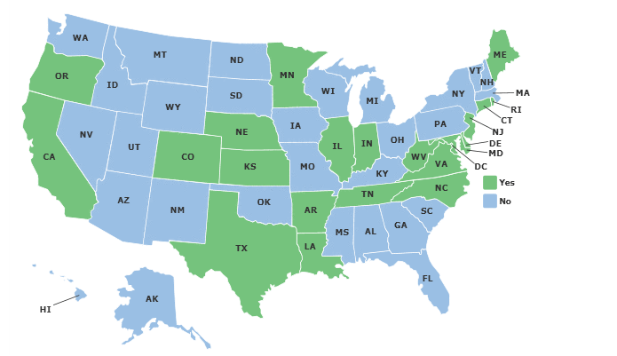
Young Driver Bans

Slide 20
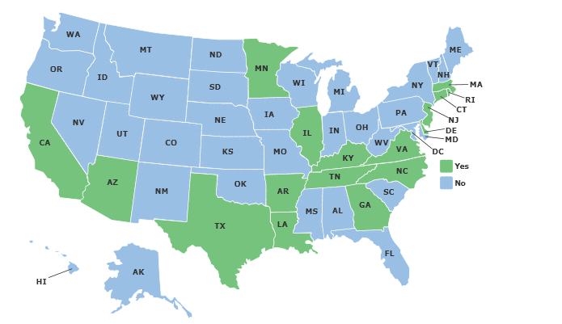
Bus Driver Ban

Slide 21
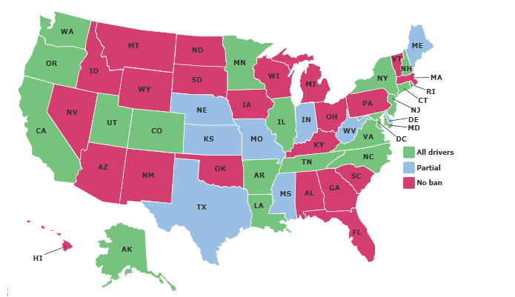
Texting Ban

Slide 22
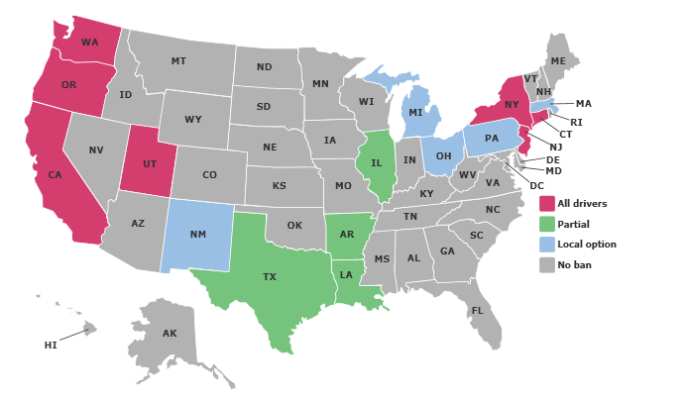
Hand Helds

Slide 23
