Slide 1
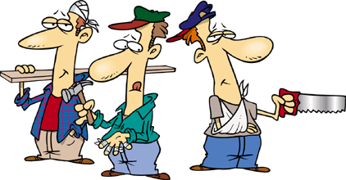
Safety Is Everybody's Business
Oklahoma State University
Environmental Health & Safety Dept. (405) 744-7241

Slide 2
Killer Safety Attitudes
What's really broken?
In many cases what’s broken or
doesn’t work is not our equipment,
training, people or procedures.
Its our attitudes…
Individually and collectively

Slide 3
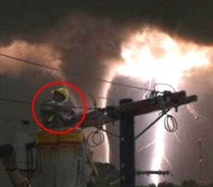
Killer Safety Attitudes
The Right Attitude and
the Right Philosophy!
I can’t teach you how to be safe, no one
can. You have to want to be safe.

Slide 4
Purpose
The purpose of this training is to:
Understand the key elements of an Injury Free Environment (IFE)
Obtain your personal commitment to help create an Injury Free Environment in your workplace
Notes:
Explain purpose as shown on the slide.
A personal commitment by every member of the organization is needed in order for an IFE to be created.

Slide 5
Course Objectives
Participants will:
Understand the key elements of an Injury Free Culture
Understand how our values and choices affect our safe behavior
Understand the human impacts of injuries
Accept responsibility/ownership for safety
Be committed and empowered to create, implement, and maintain an Injury Free Environment in their workplace
Notes:
Read and briefly explain each bullet item. In particular, one of the key objectives of this course is to provide attendees with the tools necessary to go out and make a difference in the work area.
Explain that this slide basically sets the course Agenda
This is intended to be a 3-4 hour course with a 1-hour video – the “Remember Charlie” video
Note that half way through there will be a 10-15 minute break before the video

Slide 6
Why Worry about Safety?
Why do you need to be concerned about safety?
Pain!
WC
EPA
Loss
You
DOL
Lost time
Hurt

Slide 7
Creating Injury-Free Environment
Injuries

Slide 8
What is IFE?
It’s a Culture that believes:
All injuries are preventable
Every individual is responsible for working towards the elimination of all injuries
Injuries are not accepted as a part of doing business
Free and open safety communications are essential
Notes:
The core value in an Injury Free Culture is the belief that every employee and student should remain injury free during their time at OSU.
Every person in the organization must share the vision that all injuries are preventable, and injuries are not accepted as a part of doing business.
Safety communication must be free flowing throughout all levels of the organization, from bottom to top, top to bottom , and between peers/co-workers.

Slide 9
The Goal of IFE
Ensure every employee/student leaves work in the same condition as they came to work!!
Notes:
Ask the question, “What is wrong with a few injuries?”
Example 1%. For an organization with 1,000 employees, that would be 10 individuals getting hurt. For OSU, that means 166 employees would require treatment beyond first aid.
NOTE: Explain that we need to make an IFE our goal because anything less means that we are accepting the fact that individuals WILL be injured.

Slide 10
Creating an Injury-Free Environment
In order to create an Injury Free Environment:
SAFETY MUST BE A VALUE! NOT A PRIORITY
We must choose to be safe for ourselves, our families and our fellow workers, because we believe it is the right thing to do, not because someone told us to do it!!
Notes:
We must choose to be safe because it is a value – a core value that will never be compromised. No priorities can change this.
In order to create an injury free environment, every individual in the organization must share this belief.
The process of creating an injury free culture must be driven by everyone and will require support and specific actions from all levels of the organization.

Slide 11
Creating an Injury-Free Environment
In order to create an Injury Free Environment, it is necessary to
Eliminate unsafe conditions and unsafe acts.
Both require changing the current
Paradigm of the workforce.
Notes:
Until this point, we have discussed how our values and choices affect our overall safe behavior. Now, we need to focus on how to create this Injury Free culture in our workplace.
Define unsafe conditions (physical equipment hazards, e.g. excessive pressure in a gas line, or improper electrical wiring).
Define unsafe acts (employees working at heights without fall protection, or choosing not to wear hearing protection)
Discuss importance of changing behaviors in order to eliminate unsafe conditions and unsafe acts.
Since the inception of OSHA, most employers have done a good job of eliminating unsafe conditions in the workplace. However, unsafe acts have been more common and continue to be the root cause of most injuries.

Slide 12
Paradigms
Paradigm – the way an individual perceives, understands, and interprets the surrounding world.
“If you want small change, work on your behavior, if you want quantum-leap changes, work on your paradigms.”
Steven R. Covey
Notes:
Introduce the concept of paradigms.
Emphasize the point that everyone in the organization has to believe that an IFE is possible, or it will not happen.
The reason we are talking about paradigms is to understand that old safety paradigms can prevent us from achieving our goals.

Slide 13
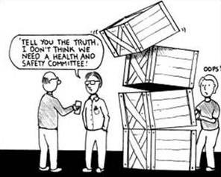
Safety Paradigms from the Past
It won’t happen to me.
Research is more important than safety.
You can’t make everything idiot proof.
When push comes to shove, safety loses.
We are already safe enough.
People are careless.
Notes:
Introduce this slide as a list of example paradigms that will prevent us from reaching our goal of zero injuries.
Were any of these view points expressed during the earlier exercise as reasons why IFE was not possible?
Ask the question, “Who still believes these paradigms?”
Generate some class discussion around paradigms:
Flight – (airplanes, jets, space travel)
Music (78’s, 45’s, 8 tracks, Cassettes, Walkmans, I-Pods.)
Some day. our children/grandchildren will be able to say:
Occupational injuries/fatalities/lost days/ recordables/IFE

Slide 14
New Safety Paradigm
It is possible to work injury-free ???
Notes:
Read the slide.
Note that the key is that we all need to move away from the old paradigms and realize that ALL injuries are preventable, and our IFE goal is possible.
Pick a volunteer from the class and ask the question:
Can you work Injury Free:
For the rest of the day?
For the rest of the week?
For the rest of the month?
For a whole year?
If you can do it, why can’t your co-workers?
Ask another person and generate some discussion.
OSU has previously achieved lower rates than we are experiencing today. There is no reason why we cannot improve to zero injuries.
Reiterate the new safety paradigm – All Incidents/Injuries are Preventable

Slide 15
How Is Injury Free Possible?
The elimination of all incident/injuries must come from a different method of preventing injuries and the involvement and commitment of 110% of the organization.
It must come from a personal commitment to change the way we think of safety.
Notes:
As we have discussed, we cannot expect to eliminate all incidents/injuries by simply writing more safety policies and procedures. In other words, we cannot continue down the same path. Remember:
“If we always do what we’ve always done, we will always get what we always got.”
WE can only eliminate all incident/injuries by utilizing different methods, by focusing on safe behaviors and eliminating all unsafe acts.
Every person must personally commit to ensure safety is their core value.
LIFE IS LIKE A BOX OF DONUTS

Slide 16
Personal Reflection
What are your personal beliefs regarding safety?
Do you hold safety as a value, or a priority?
Is your safety performance dictated by the need for compliance or by choice?
Are you committed to an Injury Free Culture?
Notes:
Ask the class to take a few minutes and think about the questions.
Note that, when the students walk out of the class, our goal is to have safety on the forefront of everyone’s mind at ALL times. For example, as you walk down the hall, as you walk up the stairs, as you enter your work area, and as you go about your day to day activities.

Slide 17
Values vs. Priorities
Understanding how Values &
Priorities affect our behavior
Value:
Doesn’t easily change
Not readily influenced by others or circumstances
Takes a life change to change a value
Priority:
Can and will change frequently
Something that takes precedence over another
Can be easily influenced by others or by circumstances
Notes:
Discuss the concept that our behavior is also strongly influenced by our Values and Priorities
VALUES are defined as a fundamental law, code of conduct, or the basic internal principles by which we live our lives. Values are strongly believed in and rarely, if ever are compromised.
While priorities in life can and will change, and are easily influenced by others, values are constant, stable, and are not readily influenced by others.
We need to value safe behavior just as we value doing a good job.
Ask the group to think of some examples when their priorities changed at work or at home.
Ask the group if Safety is a Value or a Priority. Why?

Slide 18
Compliance vs. Choice
Understanding how Choice & Compliance affect our behavior
Choice:
Individual has the power to choose
Responsible for consequences
“I wanted to do it”
Not easily influenced once made
Driven by our own value set
Compliance:
Comply due to consequences
Blame for consequences may be misdirected
“You made me do it”
Behavior can easily be influenced
Driven by someone else’s priorities
Notes:
Introduce the concept that our personal behavior affects our safety and the safety of others. Two key factors that affect our behavior are compliance and choice.
Discuss the differences between compliance and choice.
Compliance means to follow the rules or to yield to others.
Choice means self-determination, ability to select.
Think of actions based upon the need to comply:
Slowing down when police are around.
Wearing PPE when Supervisor is watching.
Ask the class, “What motivates you to comply?”
Point out that compliance driven safety can only take us so far in achieving an Injury Free Culture.

Slide 19
Cost of Accidents
Direct Costs
Medical Costs (including worker’s comp)
Indemnity Payments
Indirect costs
Time Lost (by worker and supervisor)
Schedule delays
Training new employees
Cleanup time / equipment repairs
Legal fees
Indirect costs usually exceed direct costs by a 4:1 ratio.

Slide 20
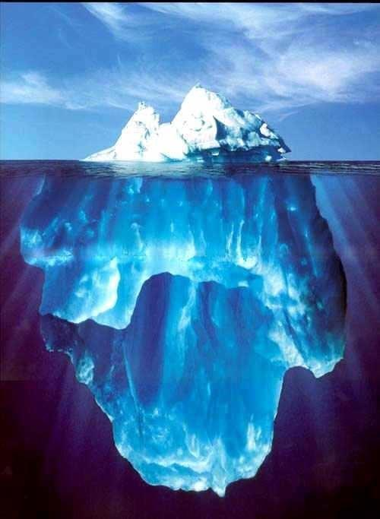
How Good are We Really ?
Fatalities
Injuries
Near Misses
At Risk Behaviors

Slide 21
Next Steps
Promote Safety as a value.
Role Model injury-free concepts and behaviors.
Early Report ALL pain and discomfort.
Move beyond compliance and choose to work safely.
Personally commit to make an impact in your work area.
Notes:
Read over each bullet item and emphasize the importance of carrying this message in your mind as you go through your day-to-day activities.
Remember, actions speak louder than words… do not send a message to your organization that safety is only a priority and loses out to cost, schedule, etc.

Slide 22
Safety Cultures
Establish accountability for safety
Define safety responsibilities

Slide 23
Establishing Accountability: Performance Evaluations
Employees should be evaluated on their safety performance
Doing a job correctly includes doing it safely
OSU job description revisions may include generic job descriptions with:
“Must follow all general and safety policies and procedures as established by the department, college/division, and university.”

Slide 24
Defining Responsibilities
Employee responsibilities include:
Recognizing safety hazards
Reporting safety hazards
Maintaining good housekeeping
Working safely
Using personal protective equipment (PPE)
Making the most of safety training

Slide 25
Defining Responsibilities
Employer responsibilities include:
Providing access to information
Haz Com - MSDSs, written program
Bloodborne Pathogens – written program
Lab Safety – chemical hygiene plan
Quarterly Safety Training

Slide 26
Defining Responsibilities
Employer responsibilities (cont.)
Providing personal protective equipment
From OSHA 1910.132: “Protective equipment, including personal protective equipment for eyes, face, head, and extremities, protective clothing, respiratory devices, and protective shields and barriers, shall be provided, used, and maintained in a sanitary and reliable condition wherever it is necessary by reason of hazards of processes or environment, chemical hazards, radiological hazards, or mechanical irritants encountered in a manner capable of causing injury or impairment in the function of any part of the body through absorption, inhalation or physical contact.”

Slide 27
Defining Responsibilities
Employer responsibilities (cont.)
Providing training
Hazard Communications
Annual and at the time of employment, also when new hazards are introduced
Quarterly safety training (required by state)
Special programs
Laboratory
Bloodborne pathogens
Office Ergonomics
Fire Safety

Slide 28
Defining Responsibilities
Employer responsibilities (cont.)
OSHA General Duty Clause: “Each employer
Has the general duty to furnish each employee with employment and places of employment free from recognized hazards causing or likely to cause death or serious physical harm.
The specific duty of complying with safety and health standards promulgated under the act.”

Slide 29
Legal Issues and Liability
As a result of safety violations:
You can be named in a law suit
Criminal charges may be filed against you
You can be cited by an enforcement agency
You can be fined by an enforcement agency
Your lab/workplace can be shut down by an enforcement agency

Slide 30
Legal Issues and Liability
Because of personal liability, and because you can be named as a defendant in a lawsuit …
Working for the University does not protect you.

Slide 31
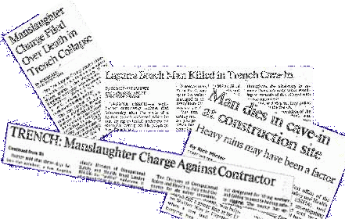
Legal Issues and Liability
Criminal charges can be filed against you.
Negligent supervisors and employers have been charged with manslaughter

Slide 32
Legal Issues and Liability
You can be cited by an enforcement agency
State Department of Labor (DOL)
DOL is currently inspecting departments on campus
EPA
They’ve already been here, and they’re coming back!
Federal OSHA has authority to get involved
GM plant in Oklahoma City

Slide 33
Legal Issues and Liability
You can be fined by an enforcement agency
State DOL will issue citations first
EPA will levy fines…

Slide 34
Legal Issues and Liability
Cease and desist orders: If the violations are serious enough, agencies such as ODOL, OSHA, and the EPA can (and will) shut down the job site until the problems are corrected.
EHS has issued cease and desist orders on OSU projects, as well.

Slide 35
Remembering Charlie
The following video may be disturbing for some because of its graphic nature.

Slide 36
SIGNS OF CULTURE CHANGE
• True management commitment
• Reduced injury rates
• Changes in employees attitudes towards safety
• Heightened participation by employees
• Near-miss reports increase
• More conversations regarding safety
• Employee morale is high

Slide 37
For more information:
Check out the EHS website:
http://ehs.okstate.edu/
Call EHS at (405) 744-7241
Email me at: gregory.hogan@okstate.edu

Slide 38
Thank You! Have
a Safe Day!

