Slide 1
BEHAVIOR-BASED SAFETY
What influences employee behavior and how can you change that behavior to prevent accidents and illness. By the way, everything you learn in this session can be used to influence employee behavior in other ways as well.
Presented by:
Harry Cheff, CSRM
and
Annette Satterly, MS, CIC, CRM, CIC

Slide 2
Session Objectives
Understand how safety behavior is shaped
Analyze employee behavior
Pinpoint, observe, and measure specific behaviors
Provide positive feedback
Use positive reinforcement successfully to improve safety performance

Slide 3
What You Need to Know
ABC Analysis
  Antecedents, Behavior, Consequences
Types of consequences
How to strengthen consequences
Pinpointing, observation and measurement
Feedback and goal setting
Types of positive reinforcement
Reinforcement mistakes

Slide 4
Why Employees Engage in At-Risk Behaviors
Jobs get done faster
Perception that risk is low
“Nothing is going to happen to me” attitude
At-risk behavior is reinforced
Lack of awareness that behavior is risky

Slide 5

ABC Model
Antecedent
Behavior
Consequences

Slide 6

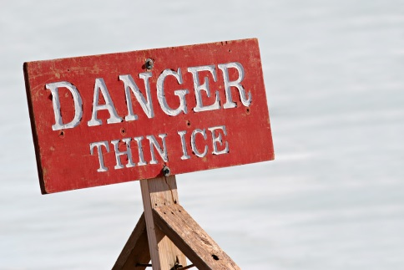
Antecedents
Prompt people to act
Precede the behavior
Communicate information
Work best with consequences
Work only in short term if no consequences

Slide 7
Consequences
Stronger than antecedents
“Consequences” has negative connotation
Positive consequences change behavior
Consequences strengthen or weaken behavior
Four categories of consequences
  Punishment
  Extinction
  Negative Reinforcement
  Positive Reinforcement

Slide 8
Punishment
Getting what you don’t want
Criticism, injury, written warning
Stops unwanted behavior

Slide 9
Extinction
Is not getting what you want
Is no recognition, no acknowledgement
Often decreases wanted or safe behavior
Can cause safe performers to slip

Slide 10


Negative Reinforcement
Not getting what you don’t want
Avoiding criticism, unpleasant tasks, or accidents
Performing desired behavior to avoid punishment
Performing desired behavior only when boss is watching

Slide 11

Positive
Reinforcement
Getting what you want
Acknowledgement, recognition, better work assignments
Maintains or increases desired behavior
Gives discretionary effort (more than asked)
Behavior occurs more frequently

Slide 12
Examine the Behavior
Results of the consequences
How employee receives it
Behavior increasing
Behavior decreasing

Slide 13
Strength of Consequences
Type – positive or negative
When – immediate or future
Probability – certain or uncertain

Slide 14
Powerful Consequences
Most powerful – both immediate and certain
Moderately powerful – either immediate or certain
Least powerful – both future and uncertain

Slide 15
ABC Analysis
Describe the behavior
List all antecedents and consequences and describe strength of consequence
Determine which consequences are motivating behavior
Solution to problem behavior – make weak consequences strong

Slide 16
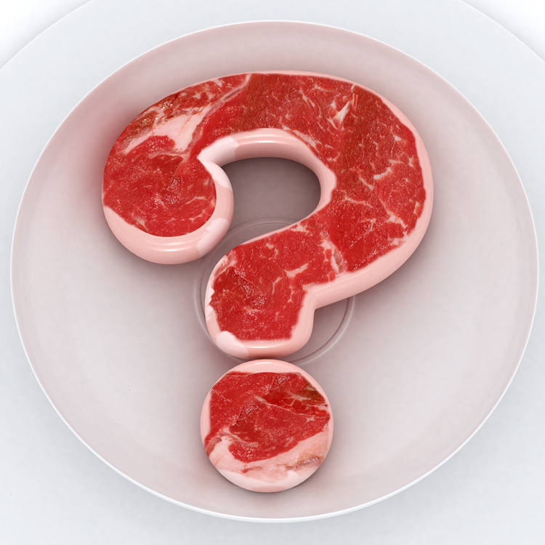
Behavioral Safety Basic
Do you understand the information presented in the previous slides?

Slide 17

Pinpointing Behavior
Measurable
Observable
Reliable
Controllable

Slide 18
Behavior Observation
Observation checklist
Spot check behaviors
If safe behavior, mark “safe”
In unsafe behavior, mark “unsafe”
Turn card in
 | Observations |  | Feedback
 | Safe | Unsafe | Positive | Corrective | Comments
Pinpoint 1 | xxx | xx | xxx | x
Pinpoint 2 | x | xxx | x | xxx
Pinpoint 3 | xxx | x | xxx | x

Slide 19
Measurement
Records observations and analyzes
Uses objective measurement
Measures safety process, not just results
Gives feedback to employees and capture small improvements
Is specific about performance and becomes positive reinforcement

Slide 20
Positive Verbal Feedback
Be specific
Be sincere
Deliver immediately
Be personal
Don’t use “but” or “however”
Way to go!

Slide 21
Corrective Verbal Feedback
Don’t ignore unsafe behavior
Acknowledge small improvements
Be objective
Be specific
Use a questioning approach
Use a 4:1 ration

Slide 22
Graphic Feedback
Past performance or baseline
Current goals
Presented and discussed frequently

Slide 23
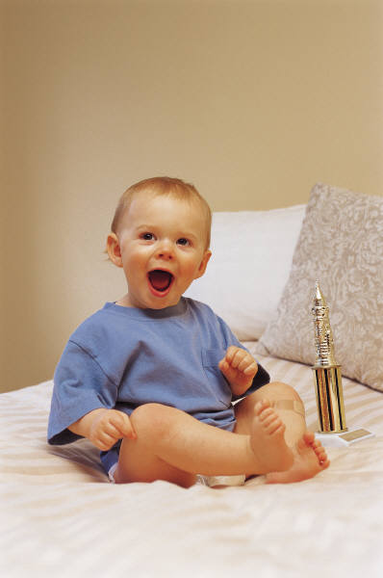
Goal Setting
Short-term and achievable
Employee input
More opportunities for positive reinforcement

Slide 24

Types of Positive Reinforcement
Social reinforcement
Written
Verbal
Physical
Smile
Humor
Time or attention
Just say “Thank you”

Slide 25
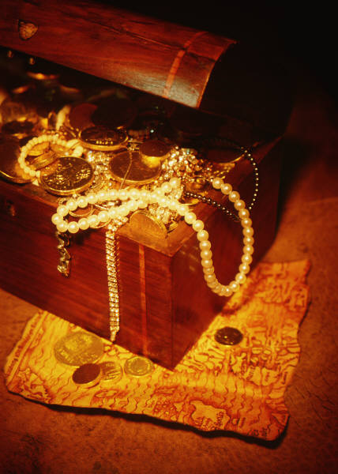
Types of Positive Reinforcement
Tangible reinforcement
Food
Gifts
Certificates
Privileges
Money

Slide 26
Using Tangibles
Anchor the memory
Be spontaneous
Discuss behavior
Different tangibles
Avoid high-value tangibles
Do not overuse tangibles

Slide 27
Reinforcement
Do you understand the information presented in the previous slides?

Slide 28
Reinforcement Mistakes
Too much positive reinforcement
Expecting behavior to change too soon
Reinforcement before behavior
Giving unearned positive reinforcement

Slide 29
Key Points to Remember
Learn how to use consequences effectively
Analyze safety behavior with the ABC model
Pinpoint behaviors and make observations
Study collected data to measure results objectively
Give positive feedback for safe performance and corrective feedback for unsafe behavior

