Slide 1
Mechanism of arsenic poisoning
PHM142 Fall 2015
Instructor: Dr. Jeffrey Henderson
Adrian Bumstead, Xiao Qi Li, Jessica So, Jin (Donna) Yang

Slide 2
Arsenic (As)
Toxic metalloid
Arsenite (As₂O₃; As III)
Arsenate (As₂O₅; As V)
Organic arsenic is non-toxic
Inorganic arsenic is toxic

Slide 3
Arsenic Exposure
Inhalation
Absorption through skin
Ingestion

Slide 4
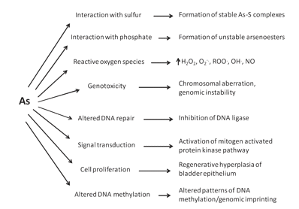

Slide 5
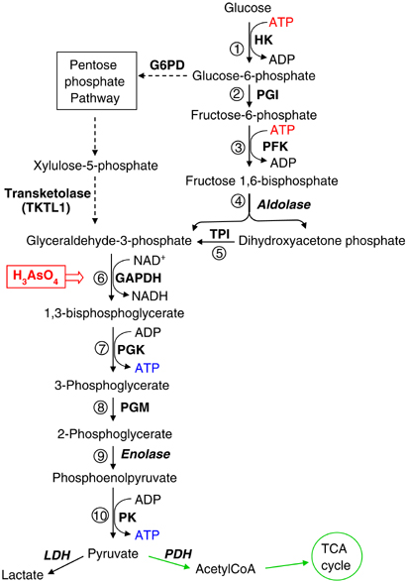
Overview of Glycolysis
Pelicano, H., et al. (2006)
Notes:
Source: Glycolysis inhibition for anticancer treatment (image)

Slide 6
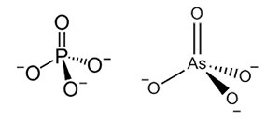
Chemical Structure of Phosphate and Arsenate
Phosphate
Arsenate
Guerinot, M. L. (2014)
Notes:
Source: https://www.niehs.nih.gov/research/supported/dert/programs/peph/podcasts/arsenic/index.cfm (image)
Source 2: Reduction of Arsenate to Arsenite by Human Erythrocyte Lysate and Rat Liver Cytosol – Characterization of a Glutathione- and NADDependent Arsenate Reduction Linked to Glycolysis (information)

Slide 7
Step 6 in Glycolysis
P_{i}
PO₃²⁻
G3P
1, 3 BPG
AsO₄³⁻
AsO₃²⁻
Enzyme: glyceraldehyde-3-phosphate dehydrogenase (G3PD)
Lai, Melisa W., et al (2005)
Notes:
Source: http://dipbsf.uninsubria.it/toxicology/materiale%20tossicologia/arsenico%20caso%20clinico.pdf (image)
Source 2: arsenate replacing phosphate: alternative life chemistries and ion promiscuity (information)

Slide 8
Step 7 in Glycolysis
PO₃²⁻
ADP
ATP
1, 3 BPG
AsO₃²⁻
ATP
Lai, Melisa W., et al (2005)
ADP
Notes:
Source: http://dipbsf.uninsubria.it/toxicology/materiale%20tossicologia/arsenico%20caso%20clinico.pdf (image)

Slide 9
Significance
2, 3 BPG production
Biphosphoglycerate
Mutase
Williams, Melvin H. (2005)
1, 3 Biphosphoglycerate (1,3 BPG)
2, 3 Biphosphoglycerate (2,3 BPG)
Hemolytic anemia
Notes:
Source: MELVIN H. WILLIAM.: 'Dietary Supplements and Sports Performance: Minerals.' JOURNAL OF THE INTERNATIONAL SOCIETY OF SPORTS NUTRITION vol. 2, no. 1, 2005, pages 43 – 49 (image)
Source 2: deficiencies of glycolytic enzymes as a possible cause of hemolytic anemia

Slide 10
Citric Acid Cycle
conversion to acetyl CoA via pyruvate dehydrogenase complex

Slide 11
Citric Acid Cycle
Pyruvate Dehydrogenase Complex (PDC)

Slide 12
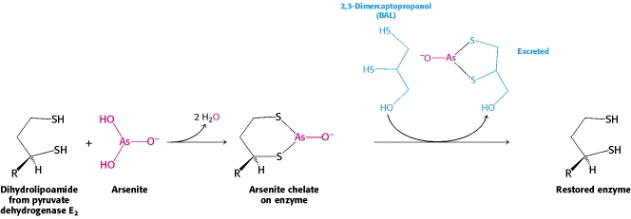
Inactivation of Dihydrolipoamide
formation of arsenite chelate

Slide 13
Acute Symptoms
Vomiting
Dark urine
Hemolysis
Death

Slide 14
Chronic Symptoms
Keratosis
Cancer
Mees’ lines

Slide 15
TREATMENT
Chelating agents
Keratosis treatment
Supporting treatment

Slide 16
Chelating Agents
Chelating agents form a ring around the metal → making it more water soluble for excretion
Examples: Dimercaperol and Succimer (Dimercaptosuccinic acid)
Only form of treatment

Slide 17
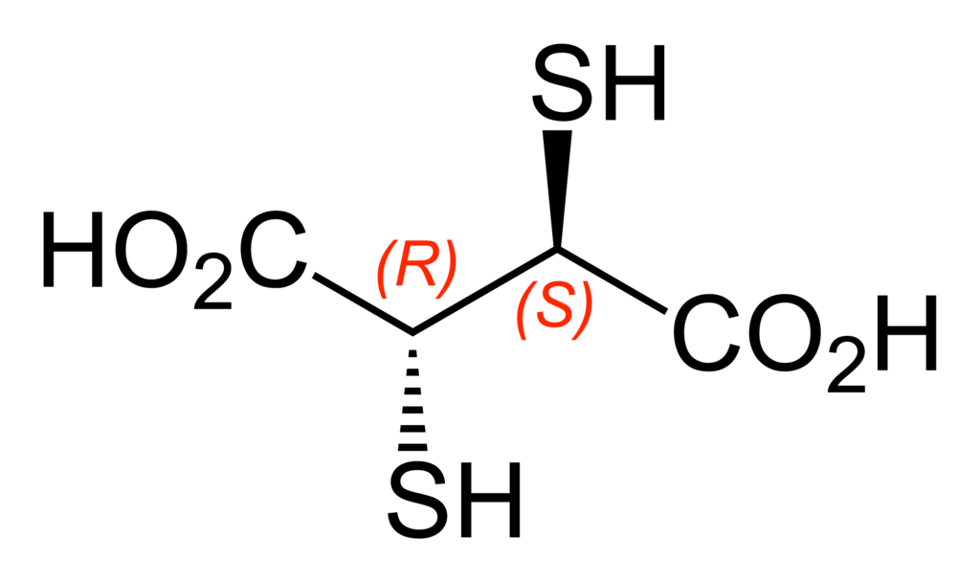
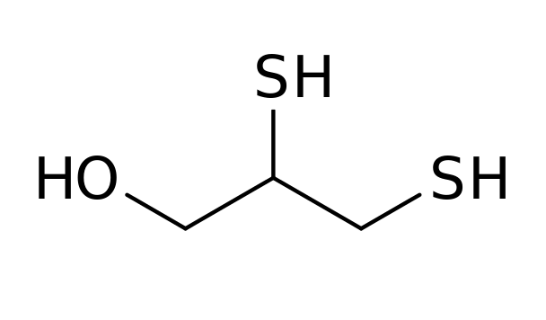
Chelating Agents
Dimercaperol
Succimer

Slide 18
Keratosis Treatment
can treat with chelating agents → not suitable for long term exposure
Retinoid → mechanism of action still unknown

Slide 19
Supportive Therapy
Non-drug related or drugs that help patients indirectly
Remove from source of arsenic
High protein diet

Slide 20
References
Diwan, Joyce. "Pyruvate Dehydrogenase & Krebs Cycle." Pyruvate Dehydrogenase & Krebs Cycle. Web. 5 Oct. 2015. < https://www.rpi.edu/dept/bcbp/molbiochem/MBWeb/mb1/part2/krebs.htm>.
Environmental Health and Medicine Education." Arsenic Toxicity Case Study: Home Page. Agency for Toxic Substances and Disease Registry. Web. 26 Sept. 2015. http://www.atsdr.cdc.gov/csem/csem.asp?csem=1&po=9.
Guerinot, M. L. “Arsenic in Rice and Other Foods” National Institute of Environmental Health Science (2014) Web. Sep 28, 2015 <https:// www.niehs.nih.gov/research/supported/dert/programs/peph/podcasts/arsenic/index.cfm>
Hughes, Michael F., et al. "Arsenic exposure and toxicology: a historical perspective." Toxicological Sciences 123.2 (2011): 305-332.
Lai, Melisa W., et al. "Acute arsenic poisoning in two siblings." Pediatrics 116.1 (2005): 249-257.
Martinov, Michael V., et al. "Deficiencies of glycolytic enzymes as a possible cause of hemolytic anemia." Biochimica et Biophysica Acta (BBA)-General Subjects 1474.1 (2000): 75-87.
Mathieu, D., M. Mathieu-Nolf, M. Germain-Alonso, R. Neviere, D. Furon, and F. Wattel. "Massive Arsenic Poisoning — Effect of Hemodialysis and Dimercaprol on Arsenic Kinetics." Intensive Care Med Intensive Care Medicine 18.1 (1992): 47-50. Web.
Mondal, Srabanti, Sanjit Mukherjee, Keya Chaudhuri, Syed N. Kabir, and Prabir Kumar Mukhopadhyay. "Prevention of Arsenic-mediated Reproductive Toxicity in Adult Female Rats by High Protein Diet." Pharmaceutical Biology 51.11 (2013): 1363-371. Web.
Németi, Balázs, and Zoltán Gregus. "Reduction of arsenate to arsenite by human erythrocyte lysate and rat liver cytosol–characterization of a glutathione-and NAD-dependent arsenate reduction linked to glycolysis." Toxicological Sciences 85.2 (2005): 847-858.
Patel, Mulchand S., and Thomas E. Roche. "Molecular biology and biochemistry of pyruvate dehydrogenase complexes." The FASEB Journal 4.14 (1990): 3224-3233

Slide 21
References
Picture 1: Pyruvate dehydrogenase. (n.d.). Retrieved September 21, 2015, from http://dwb4.unl.edu/Chem/CHEM869P/CHEM869PLinks/ www.chem.umd.edu/biochem/jollie/462-99/pyrdh.htm
Picture 2: Berg JM, Tymoczko JL, Stryer L. Biochemistry. 5th edition. New York: W H Freeman; 2002. Section 17.3, The Citric Acid Cycle Is a Source of Biosynthetic Precursors. Available from: http://www.ncbi.nlm.nih.gov/books/NBK22340/
Pelicano, H., et al. "Glycolysis inhibition for anticancer treatment." Oncogene25.34 (2006): 4633-4646.
Ratnaike, R. "Acute and Chronic Arsenic Toxicity." Postgraduate Medical Journal. BMJ Group, 31 Mar. 2003. Web. 05 Oct. 2015.
Sharma, Anitha K. et al. “Review of arsenic contamination, exposure through water and food and low cost mitigation options for rural areas.” Applied Geochemistry 41 (2014): 11-33.
Tawfik, Dan S., and Ronald E. Viola. "Arsenate replacing phosphate: alternative life chemistries and ion promiscuity." Biochemistry 50.7 (2011): 1128-1134.
Williams, Melvin H. "Dietary supplements and sports performance: minerals." J Int Soc Sports Nutr 2.1 (2005): 43-9.

Slide 22
Summary
Arsenic if a toxic metalloid, which exist in two oxidation states: arsenite (As₂O₃; As III) and arsenate (As₂O₅; As V)
Arsenic exposure can occur from inhalation, absorption through the skin, and ingestion (contaminated ground water and food)
Arsenate are similar in size and charge as phosphate
Product at step 6 in glycolysis becomes 1-arseno-3-phosphoglycerate instead of 1, 3-biosphoglycerate
Conversion of 1-arseno-3-phosphoglycerate to 3-phosphoglycerate does NOT produce ATP, so net ATP production is 0 for glycolysis
Consequence: prevents the conversion of 1, 3-biosphoglycerate to 2, 3-biosphoglycerate, thus affect oxygen delivery by erythrocyte
Arsenite can interfere with the citric acid cycle (and thus aerobic respiration) by inactivating E2 of the pyruvate dehydrogenase complex
Treatment: sulfhydryl reagents (e.g. 2,3-dimercaptopropanol)
Symptoms are more severe in acute arsenic poisoning than chronic
Only chelating agents can treat acute arsenic poisoning
Keratosis is caused by chronic exposure and can be treated with retinoid and supportive therapy

