Slide 1
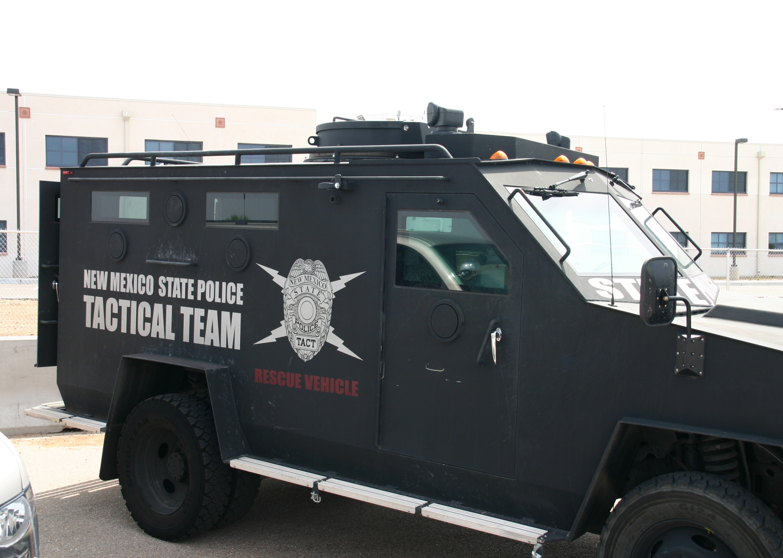
Active Shooter

Slide 2
ACTIVE SHOOTER
PURPOSE
The intent of the following guidelines are:
To provide guidance to those who may be caught in an Active Shooter Situation.
To identify an Active Shooter
To provide guidance as to what to expect from responding Law Enforcement.
These guidelines are not intended to be in-depth, but rather to serve as an initial point of reference for those who find themselves confronted or dealing with a dangerous Active Shooter situation.

Slide 3
ACTIVE SHOOTER
What is an Active Shooter
An active shooter is a person(s) who are actively engaged in killing or attempting to kill people in a confined and populated area.
In Most Cases
An Active Shooter will use a firearm(s) and there is no pattern or method to their selection of victims. These situations are dynamic and evolve rapidly, demanding deployment of Law Enforcement.

Slide 4
ACTIVE SHOOTER
Active shooter situations are unpredictable and evolve quickly. Typically, the immediate deployment of law enforcement is required to stop the shooting and mitigate harm to victims.
Because active shooter situations are often over within 10 to 15 minutes, before law enforcement arrives on the scene, individuals must be prepared both mentally and physically to deal with an active shooter situation

Slide 5
ACTIVE SHOOTER
Good practices for coping with an active shooter situation
Be aware of your environment and any possible dangers
Take note of the two nearest exits in any facility you visit
If you are in an office, stay there and secure the door
If you are in a hallway, get into a room and secure the door
As a last resort, attempt to take the active shooter down. When the shooter is at close range and you cannot flee, your chance of survival is much greater if you try to incapacitate him/her.

Slide 6
ACTIVE SHOOTER
CALL 911 WHEN IT IS SAFE TO DO SO!

Slide 7
HOW TO RESPOND When an Active Shooter is in your vicinity
Quickly determine the most reasonable way to protect your own life.
Customers and Clients are likely to follow the lead of Employees and
Managers during an Active Shooter Situation.
1. Evacuate | 2. Hide Out | 3. Take Actions
Have and escape route and plan in mind Leave your belongings behind. Keep your hands visible. Follow the police officers instructions | Hide in an area out of the active shooter’s view. Hide behind large items Block entry to your hiding place and lock the door if possible. | As a last resort and only when your life is in imminent danger . Attempt to incapacitate the Active Shooter Act with physical aggression and commit to your action.
CALL 911 WHEN IT IS SAFE TO DO SO.

Slide 8
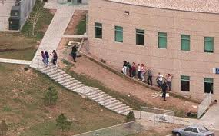
WHAT TO DO
Evacuate:
No matter what the circumstances, if you decide to flee an Active Shooter situation, make sure you have an escape route and plan in mind. Do not attempt to carry anything while fleeing. Move quickly, keep your hands visible, and follow instructions of any Law Enforcement personnel you may encounter. Do not attempt to remove or help injured people. Notify responders of their location. Do not leave and go home you are a potential witness.

Slide 9
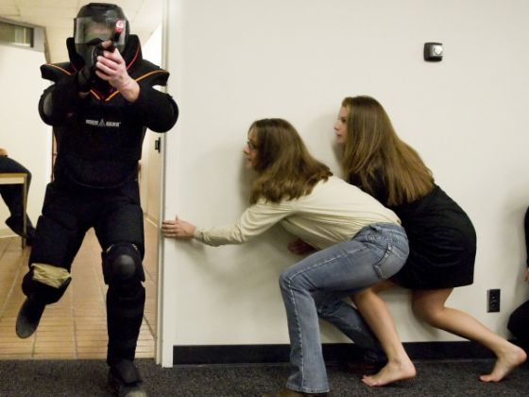
WHAT TO DO
Hide Out
If an Active Shooter is outside the building you should proceed to a room that can be locked. Once you are in such a location you should close and lock all windows, doors and turn off all lights. Make yourself a small target or lay on the ground. One person in the room should call 911 if it is safe to do so. Remain in-place until Law Enforcement gives the “ALL CLEAR” signal. Unfamiliar voices may be the shooter attempting to lure victims from their safe place; do not respond to any voice commands until you can verify with certainty that they are Law Enforcement.

Slide 10
WHAT TO DO
Hide Out
If an Active Shooter is already in the building you should determine if the room you are in can be locked and if so, close and lock all windows, doors and turn off all lights. Make yourself a small target or lay on the ground. One person in the room should call 911 if it is safe to do so. Remain in-place until Law Enforcement gives the “ALL CLEAR” signal. If the room you are in cannot be locked you should determine if there is a nearby location that can be locked and can be reached safely or if there is a safe route to the nearest exit. If you decide to move from your location, be sure that you can do so safely.

Slide 11
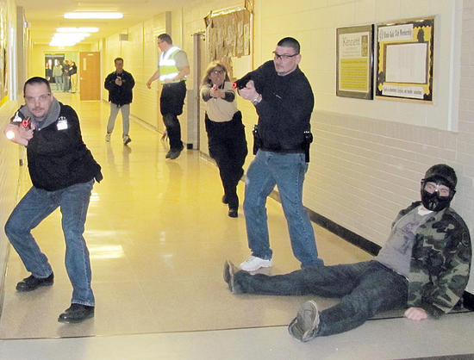
WHAT TO DO
Take Action
If an Active Shooter enters the room you are in, try to remain calm, if possible DIAL 911 and alert Law Enforcement to the shooter’s location. If you cannot speak , leave the line open so that the 911 Operator can listen to what is taking place. Normally the location of a 911 call can be determined without speaking. If there is absolutely no opportunity for escape or hiding, it may be possible to negotiate with the shooter. Attempting to overpower the shooter with physical force or throwing projectiles at the shooter should be considered as a very last resort; after all options have been exhausted.
As a last resort and only when your life is in imminent danger attempt to incapacitate the Active Shooter you must act with physical aggression and commit to your action.

Slide 12
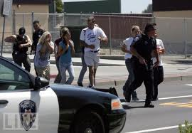
WHAT TO DO
If an Active Shooter leaves
the area you are in:
You should immediately proceed to a safer place, if it is possible to do so safely, or safely exit the building and do not touch anything that was in the vicinity of the shooter.
The purpose of departing the area is avoid the shooter if he decides to return. (The shooter already knows where you are at).
Remember to remain calm and call 911.

Slide 13
HOW TO RESPOND When Law Enforcement arrives on the Scene
HOW YOU SHOULD REACT WHEN LAW ENFORCEMENT ARRIVES:
 | Remain Calm and follow Officer’s Instructions. Immediately raise your hands and spread your fingers. Keep your hands visible at all times. Avoid making quick movements toward Officers such as attempting to hold on to them for safety. | Avoid pointing, screaming and/or yelling. Do not stop to ask Officers for help or direction when evacuating, just proceed in the direction from which Officers are entering.
INFORMATION YOU SHOULD PROVIDE LAW ENFORCEMENT OR 911 OPERATOR:
 | Location of Active Shooter. Number of Shooters, if more than one. Physical description of shooter(s). | Number and type of weapons held by the shooter(s), if possible. Number of potential victims at the location.

Slide 14
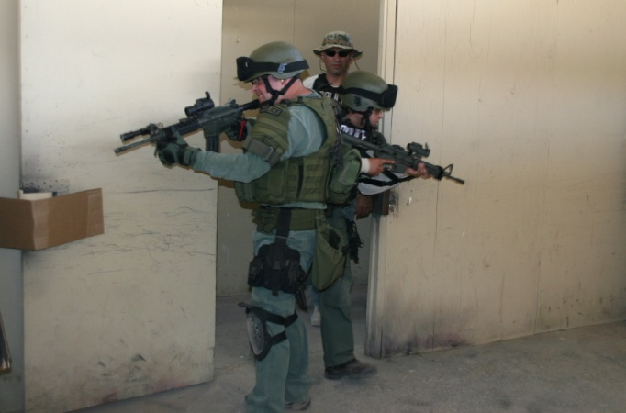
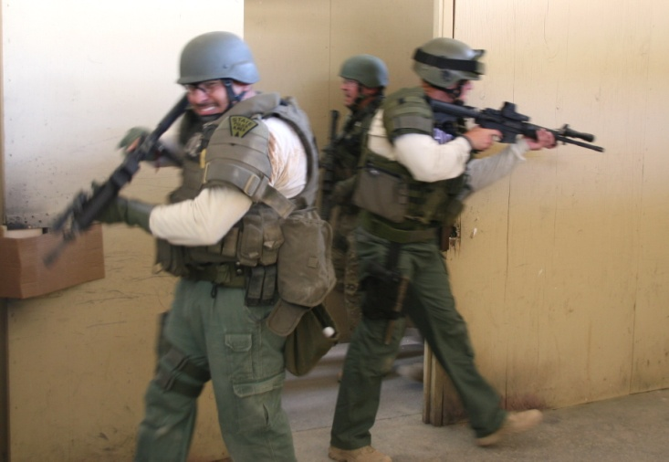
WHAT TO DO When Law Enforcement arrives on the Scene
Law Enforcement personnel who are responding to an Active Shooter situation are trained to proceed to the area in which shots were last heard. Their purpose is to stop the shooting as quickly as possible. The first responding officers will normally be in teams of four in a diamond formation. They may be dressed in regular patrol uniform, or they may be wearing external bulletproof vests, Kevlar helmets and other tactical equipment. The Officers may be armed with rifles, shotguns, or handguns and may be using pepper spray or tear gas to control the situation. Regardless of how they appear, remain calm, do as the Officers tell you and do not be afraid of them.

Slide 15
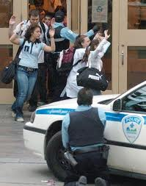
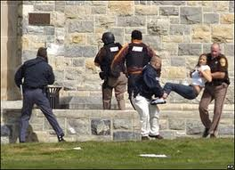
WHAT TO DO When Law Enforcement arrives on the Scene
When Law Enforcement Personnel are on scene you should put down any bags or packages you may be carrying and keep your hands visible at all times. If you know where the shooter is, inform the Officers. The first Officers to arrive will not stop to aid the injured. Their objective is to locate the shooter and stop the shooter without further loss of life or injury. Rescue teams composed of other Officers and Emergency Medical Personnel will follow the first Officers into secure areas to treat and remove the injured.

Slide 16
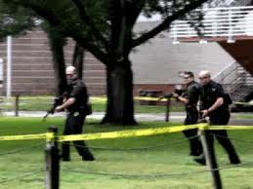
WHAT TO DO When Law Enforcement arrives on the Scene
Keep in mind that the entire area is still a crime scene. Law Enforcement will usually not allow anyone to leave until the situation is fully under control and all witnesses have been identified and questioned. The only exception are those who are injured and/or need immediate medical attention. It is incumbent upon you to stay at an identified assembly point Law Enforcement and/or Authorities have designated.

Slide 17
Recognize Signs Potential work place Violence
AN ACTIVE SHOOTER MAY BE A CURRENT OR FORMER EMPLOYEE.
ALERT YOUR HUMAN RESOURCES DEPARTMENT IF YOU BELIEVE
AN EMPLOYEE EXHIBITS POTENTIAL VIOLENT BEHAVIOR.
INDICATORS OF POTENTIALLY VIOLENT BEHAVIOR MAY
INCLUDE ONE OR MORE OF THE FOLLOWING.
Increased use of alcohol and/or illegal drugs
Unexplained increase in absenteeism; vague physical complaints
Noticeable decrease in attention to appearance and hygiene
Depression / withdrawal
Resistance and overreaction to changes in policy and procedures
Repeated violations of company policies
Increased severe mood swings
Noticeably unstable, emotional responses
Explosive outbursts of anger or rage without provocation
Suicidal; comments about “putting things in order”
Behavior which is suspect of paranoia, (“everybody is against me”)
Increasingly talks of problems at home
Escalation of domestic problems into the workplace; talk of severe financial problems
Talk of previous incidents of violence
Empathy with individuals committing violence
Increase in unsolicited comments about firearms, other dangerous weapons and violent crimes

Slide 18
QUESTIONS??

