Slide 1
Coal Fatalities - 2018

Slide 2
Coal vs MNM

Slide 3
Accident Type
Notes:
Powered Haulage = 5 (3, 4, 5, 6, 10)
Machinery = 3 (8, 11, 12)
Roof / Highwall Fall = 2 (1, 9)
Electrical = 1 (2)
Fire = 1 (7)

Slide 4
Victim’s Age
Notes:
20s = 3 (4, 6, 11)
30s = 5 (2, 3, 8, 9, 10)
40s = 1 (5)
50s = 2 (1, 12)
60+ = 1 (7)

Slide 5
Victim’s Mining Experience
Notes:
Less than a year exp = 2 (6, 11)
1-9 years exp = 4 (4, 7, 9, 10)
10-19 years exp = 4 (1, 3, 5, 8)
20+ years exp = 2 (2, 12)

Slide 6
Victim’s Mine Site Experience
Notes:
Less than 1 year = 5 (2, 5, 6, 8, 11)
1-9 years = 6 (1, 3, 4, 7, 9, 10)
20+ years = 1 (12)

Slide 7
Shift Fatal Occurred
Notes:
1st Shift = 4 (3, 8, 9, 12)
2nd Shift = 3 (2, 6, 11)
3rd Shift = 5 (1, 4, 5, 7, 10)

Slide 8
Coal Fatal #1 – West Virginia
Tuesday, February 6, 2018
UG – Rib Fall
Electrician
52 Years Old
13 Years Mining Experience

Slide 9
Coal Fatal #1 – West Virginia
He was performing routine maintenance on a continuous mining machine.
He was pinned under a large section of rib adjacent to the continuous miner.
Notes:
The victim died as a result of a rib roll. On the day of the accident, he was assigned to perform routine maintenance on a continuous mining machine. He was discovered at 3:45 a.m., pinned under a large section of rib, adjacent to the continuous mining machine where he had been working. There were no witnesses to the accident.
The fatal accident was a result of the coal ribs not being effectively controlled in the work area. The rib support system used at this mine was not adequate for the geologic conditions.

Slide 10
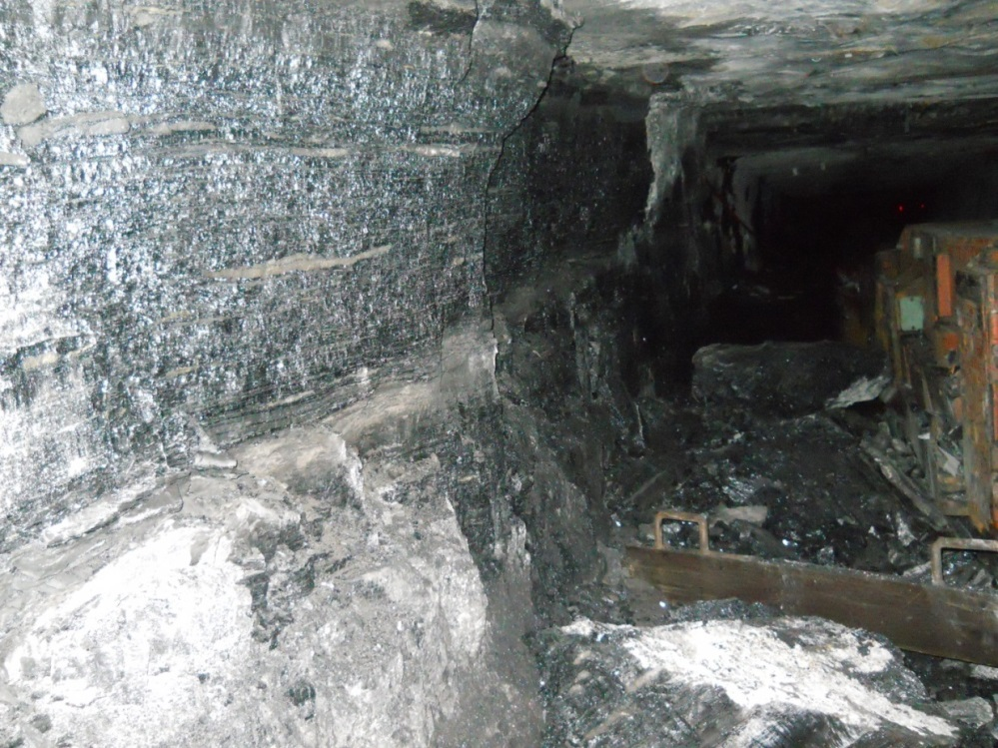
Coal Fatal #1 – West Virginia
Notes:
Root Cause: The rib support system used at the mine was not adequate for the geologic conditions at the location of the accident.
Corrective Action: The mine operator revised the roof control plan to require the installation of rib bolts in all entries on development.

Slide 11
Coal Fatal #1 – Best Practices
Know and follow the approved roof control plan. The roof control plan only contains minimum safety requirements. Additional support may be required when roof or rib fractures, or other abnormalities are detected.
Notes:
Regulation Cited: 75.202(a).

Slide 12
Coal Fatal #1 – Best Practices
Correct hazardous conditions before allowing miners to work and travel in areas. Adequately support or scale any loose roof or rib material from a safe location.
Train all miners to conduct thorough examinations of the roof, face, and ribs in their work areas, including more frequent examinations when conditions change.
Notes:
Other Best Practices:
Be aware of potential hazards when working or traveling near mine ribs, especially when geologic conditions, or an increase in mining height, could cause roof or rib hazards. Take additional safety precautions while working in these conditions.
Install rib bolts with adequate surface area coverage, during the mining cycle, and in a consistent pattern for the best protection against rib falls.

Slide 13
Coal Fatal #2 – West Virginia
Wednesday, February 21, 2018
Surface – Electrical
Highwall Machine Operator
38 Years Old
21 Years Mining Experience

Slide 14
Coal Fatal #2 – West Virginia
The victim was troubleshooting/performing work on the electrical system that supplies power to the mining machine.
He was electrocuted when he contacted an energized connection of a 7,200-volt electric circuit.
Notes:
The victim was electrocuted when he contacted an energized connection of a 7,200 volt electrical circuit. The victim was found inside a transformer station troubleshooting and/or performing electrical work on the electrical system that supplies power to the mining machine
The accident occurred because the operator did not ensure the safe operation, testing, and repair of electrical equipment and circuitry, including use of proper lock out/tag out procedures. Mine management was aware that the electrician certification had expired, and therefore, he was precluded from performing electrical work by State and Federal regulations. However, mine management advised, directed, and assisted him in performing electrical work at the mine.

Slide 15
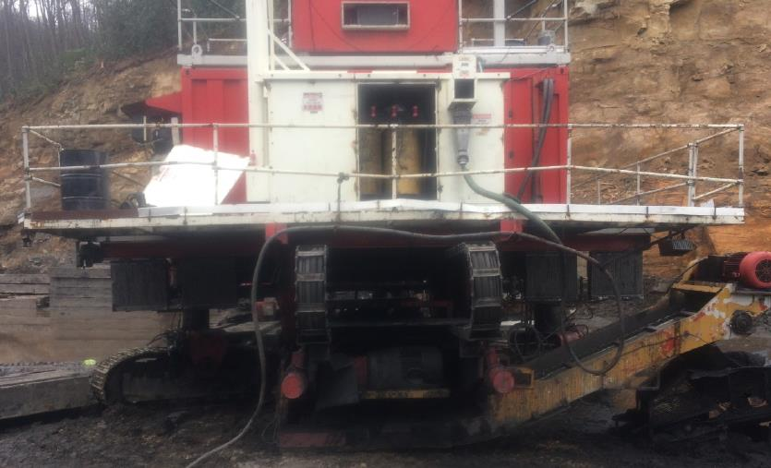
Coal Fatal #2 – West Virginia
Notes:
Root Cause: The mine operator did not perform test and repair work on electrical equipment and circuitry in a safe manner. The mine operator did not use proper lock out/tag out procedures.
Corrective Action: The mine operator developed and implemented an action plan to prevent similar occurrences. This plan includes controls to ensure:
1. Only qualified personnel perform electrical work;
2. Miners receive additional training on electrical testing and repair;
3. The installation of safety features on electrical equipment. The safety features include lid switches wired into the ground monitor circuit, a grounding bar on the load break switch for the three phases of the high voltage transformers, and an additional external visible vacuum disconnect, which will also interrupt the ground monitor circuit causing the substation to remove power on the trailing cable; and
4. Proper lock /tag out procedures.
The mine operator incorporated the provisions of the action plan into the training and ground control plans for this mine. All miners were trained in these new company policies.

Slide 16
Coal Fatal #2 – Best Practices
Lock-Out and Tag-Out the electrical circuit yourself and NEVER rely on others to do this for you.
Electrical work must be performed by a qualified electrician or someone trained to do electrical work under the direct supervision of a qualified electrician.
Notes:
Regulations Cited: 77.501 and 77.103(g)

Slide 17
Coal Fatal #2 – Best Practices
Wear properly rated and well maintained electrical gloves when troubleshooting or testing energized circuits. After the problem has been found, follow the proper steps before performing electrical work.
Use properly rated meters and non-contact voltage testers to ensure electrical circuits have been de-energized.

Slide 18
Coal Fatal #3 – Indiana
Friday, March 16, 2018
UG - Powered Haulage
Mechanic
34 Years Old
16 Years Experience

Slide 19
Coal Fatal #3 – Indiana
The victim was operating a diesel personnel carrier on the mine haulage road.
The vehicle hit the right rib and rolled onto its left side.
The victim was partially ejected from the mantrip, and the canopy came to rest on his chest.
Notes:
The victim died while operating a diesel personnel carrier on the mine haulage road. The vehicle hit the right rib and rolled onto its left side. The victim was partially ejected from the mantrip and the canopy of the mantrip came to rest on his chest.

Slide 20
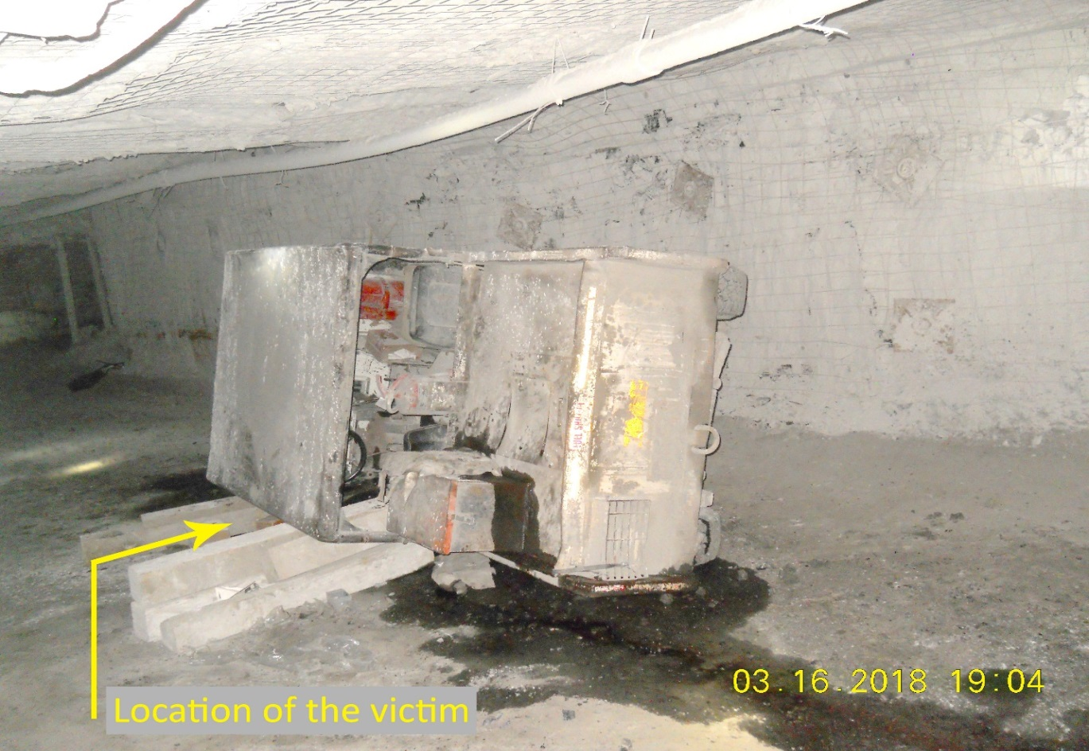
Coal Fatal #3 – Indiana
Notes:
1. Root Cause: The mine operator did not assure that equipment operators maintain full control of the equipment while it was in motion.
Corrective Action: The mine operator retrained all miners on its existing safe operating program for diesel powered equipment. For personnel carriers equipped with three or four gears, the mine operator removed the ability for those transmissions to shift into third or fourth gear, in order to reduce the maximum traveling speed of the carriers. For personnel carriers equipped with only two gears, the mine operator utilized a mechanism to reduce maximum speed
2. Root Cause: The mine operator did not provide safety features to prevent persons in outby personnel carriers from being ejected.
Corrective Actions: The mine operator installed doors on personnel carriers. On personnel carriers where doors were unable to be installed, the mine operator installed netting and/or seatbelts.

Slide 21
Coal Fatal #3 – Best Practices
Operate all mobile equipment at speeds that are consistent with the type of equipment, roadway conditions, grades, clearances, visibility, and other traffic.
Consider installing mechanical devices that limit the top speeds of fast-moving equipment.
Notes:
Regulations Cited: 75.1916(b) and 75.1403

Slide 22
Coal Fatal #3 – Best Practices
Travel at safe speeds, so mobile equipment can be stopped within the visibility limits.
Maintain haulage roadways free from irregularities, debris, and wet or muddy conditions that affect equipment control.
Conduct task training for each type of personnel carrier or equipment being operated.
Notes:
Other Best Practices:
Maintain steering and braking components so that mobile equipment can be controlled at all times.
Properly maintain brakes, lights, and warning devices on mobile equipment. Perform functional tests of the brakes and other safety devices during the pre-operational examination.

Slide 23
Coal Fatal #4 – Kentucky
Wednesday, March 28, 2018
UG – Powered Haulage
Belt Foreman
29 Years Old
8 Years Experience

Slide 24
Coal Fatal #4 – Kentucky
The victim was splicing an underground conveyor belt.
He became entangled with the belt splicing tools as the conveyor belt inadvertently started moving.
Notes:
The victim was fatally injured while he and a co-worker were in the process of splicing an underground conveyor belt when the conveyor belt inadvertently started. The victim became entangled with the belt splicing tools as the conveyor belt moved.

Slide 25
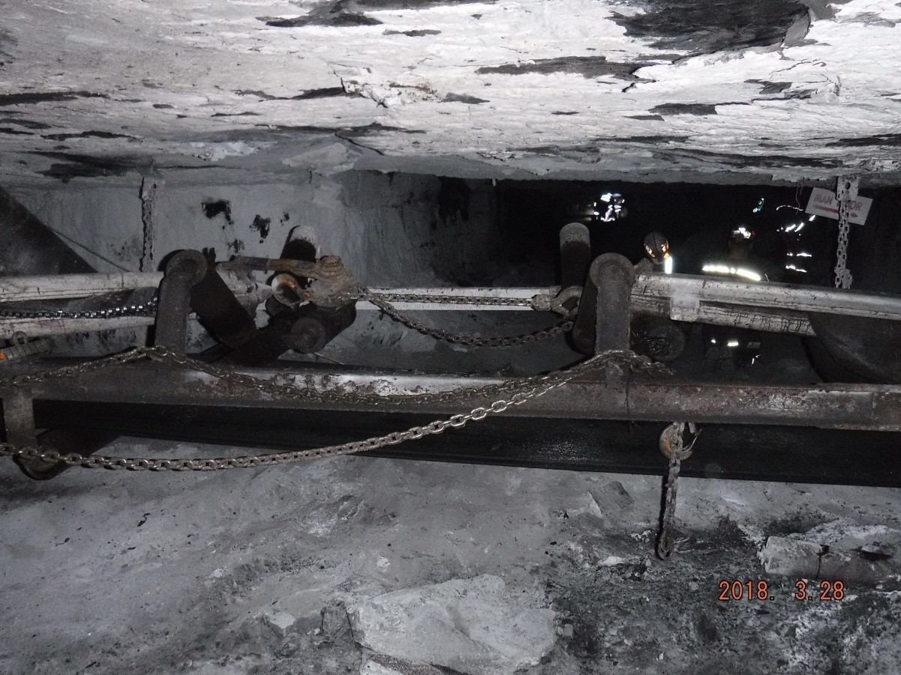
Coal Fatal #4 – Kentucky
Notes:
Root Cause: The mine operator performed repair and maintenance work on a conveyor belt and did not properly lock and tag-out to ensure the electrical power was off while the work was being performed. The operator was splicing the No. 7 conveyor belt using only the belt switch to stop the conveyor belt. The mine operator did not have appropriate lock and tag-out policies and procedures.
Corrective Action: The mine operator submitted a written action plan, which was reviewed and acknowledged by MSHA. On April 4, 2018, the operator adopted the action plan as company policy and put it in the training plan. The policy contains the following provisions:
Electrical or mechanical repairs or maintenance that can result in injuries to miners due to the movement of conveyor belt shall not be performed until the following steps are taken to prevent inadvertent or unexpected motion of the conveyor belt:
1. The person performing the work shall lock and tag the visible disconnect.
2. The tag will state the date and the name of the person performing repairs or maintenance.
3. The key to the lock shall be kept by the person performing repairs or maintenance.
4. Only the person performing the repairs or maintenance shall remove the lock after repairs or maintenance is completed.
5. The mine operator shall insure that no miner is in harm’s way before starting the conveyor belt or belts.
The mine operator trained all employees on the new policy and procedures.
2. Root Cause: The operator performed an improper repair of the remote cable and belt switch wires, which had been damaged during the on-shift examination. The repair caused the belt to start. The mine examiner had not been trained to repair the electrical circuit.
Corrective Action: The electrical circuit was repaired by a miner who was qualified to perform this repair. The mine operator retrained all miners that repairs and maintenance on any electrical circuit must be performed by a qualified electrician.

Slide 26
Coal Fatal #4 – Best Practices
Lock-Out and Tag-Out the visual disconnect yourself and NEVER rely on someone to do this for you.
Release the tension in the conveyor belt take-up/storage unit.
Block the conveyor belt against motion.
Notes:
Regulations Cited: 75.1725(c) and 75.512

Slide 27
Coal Fatal #4 – Best Practices
Ensure that no miner is in harm’s way before starting the conveyor belt(s).
Provide a visible or audible system, with a start-up delay, to warn persons that the conveyor belt will begin moving.
Establish and enforce policies & procedures for performing specific tasks on conveyor belts.
Notes:
Other Best Practices:
Before splicing conveyor belts, perform the following steps:
Open the circuit breaker that supplies electrical power to the conveyor belt drive.
Open the visual disconnect for the cable that supplies electrical power to the conveyor belt drive.
Lock-out and tag-out the visual disconnect yourself and NEVER rely on someone to do this for you.
Release the tension in the conveyor belt take-up/storage unit.
Block the conveyor belt against motion.
Keep the key to the lock at all times while repairs and/or maintenance are performed.
Ensure that you are the only person who removes the lock after repairs and/or maintenance are completed.

Slide 28
Coal Fatal #5 – West Virginia
Monday, June 4, 2018
UG – Powered Haulage
Truck Driver
43 Years Old
10 Years Experience

Slide 29
Coal Fatal #5 – West Virginia
The victim was a passenger in a personnel carrier that traveled over a roof jack which was lying in the roadway.
When hit, the roof jack was propelled into the passenger’s compartment and struck the victim.
Notes:
On Monday, June 4, 2018, a 43-year-old miner with 10 years mining experience, was fatally injured when a roof jack struck him in the head. At the time of the accident, the miner was a passenger in a personnel carrier that traveled over the roof jack, which was lying in the roadway at the time. As a result of being hit, the roof jack was propelled into the passenger’s compartment, striking the victim. The victim was flown to a hospital where he died from his injuries.

Slide 30
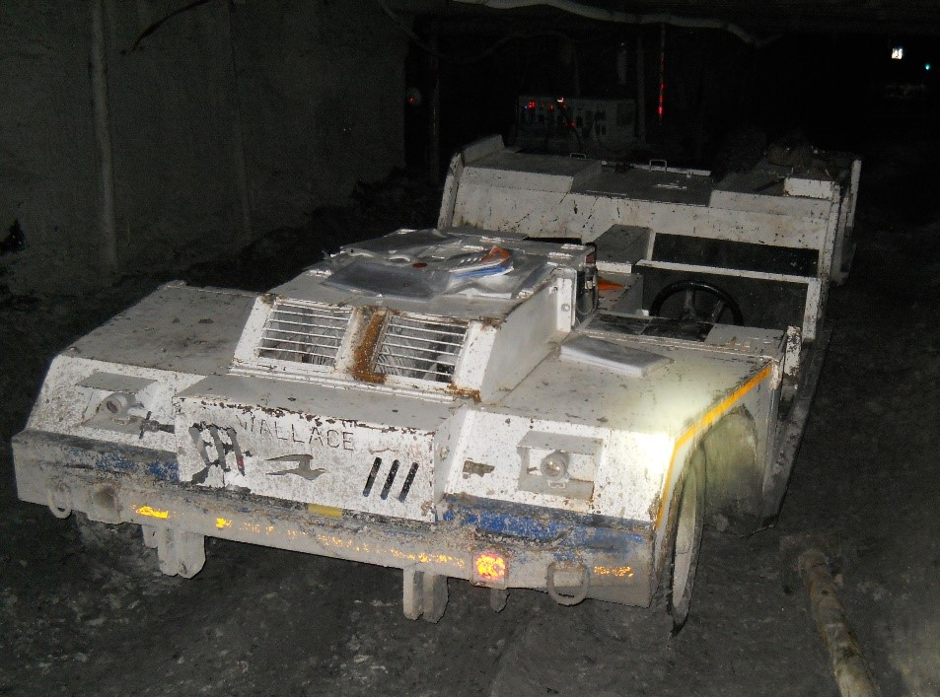
Coal Fatal #5 – West Virginia
Notes:
Root Cause: The mine operator did not maintain the haulage roadway free of extraneous material.
Corrective Actions: All extraneous material was removed from the haulage roadway. The mine operator developed and implemented a policy to secure roof-to-floor supports, located in haulage roadways, to the ribs. This is designed to prevent the supports from becoming dislodged and lying in the haulage roadway (see Appendix F). The miners were trained in this new policy.

Slide 31
Coal Fatal #5 – Best Practices
Conduct thorough examinations of roadways and remove material that may pose a hazard to equipment operators, passengers, or other miners.
Maintain roadways free of excessive water, mud, and other conditions which have an impact on an equipment operator’s ability to control mobile equipment.
Notes:
Regulation Cited: 75.1403

Slide 32
Coal Fatal #5 – Best Practices
Establish and enforce safe operating procedures for mobile equipment and a maintenance schedule for roadways.
Secure loads being hauled to prevent them from falling off haulage vehicles.
If items are lost during transport, immediately search for them and warn other mobile equipment operators.

Slide 33
Coal Fatal #6 – Pennsylvania
Tuesday, September 11, 2018
UG – Powered Haulage
Mobile Bridge Operator
27 Years Old
8 Weeks Experience

Slide 34
Coal Fatal #6 – Pennsylvania
While repositioning the Continuous Mining Machine, the mobile bridge conveyor crushed the victim between it and the rib.
Notes:
The victim was fatally injured during the mining process. The continuous mining machine (CMM) and attached MBCs had been backed out of a completed cut. While the CMM was being repositioned, it moved the attached MBCs and crushed the victim between his MBC and the coal rib.

Slide 35
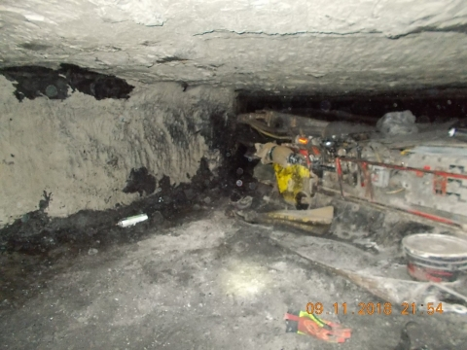
Coal Fatal #6 – Pennsylvania
Notes:
Root Causes:
The mine operator did not provide a means of protection against crushing injuries to the MBC operator.
The mine operator did not provide a means for the MBC operators and the CMM operator to communicate verbally before the CMM is trammed.
There was no electronic means provided to prevent the CMM from tramming and dragging the MBC while the MBC was de-energized.

Slide 36
Coal Fatal #6 – Best Practices
Communicate with other MBC operators before starting or tramming any component of the system. Always be in a location where other MBC operators can readily see or communicate with you.
Stay out of MBC Red Zones if the CMM or any of the MBCs are energized.
Notes:
Regulation Cited: 75.1403

Slide 37
Coal Fatal #6 – Best Practices
Install latching emergency stop switches so MBC operators can actuate them to prevent machine movement when they leave the operator’s cab or position.
Install man-in-position switches on mobile bridge conveyor systems so all MBC operators know everyone is in a safe position before initiating machine movement.
Notes:
Other Best Practices:
Be familiar with how the de-energizing switches on your machine operate and immediately actuate them the moment a hazard is recognized.

Slide 38
Coal Fatal #7 – Indiana
Friday, September 7, 2018
SUR – Fire
Contractor: Haul Truck Driver
60 Years Old
1 Year Experience

Slide 39
Coal Fatal #7 – Indiana
While attempting to escape the burning haul truck, the victim was burned.
He died 5 days later due to complications with his injuries.
Notes:
The haul truck operator received burn injuries while attempting to escape from the cab of the burning haul truck he was operating. Due to complications associated with his injuries, the victim died five days later.

Slide 40
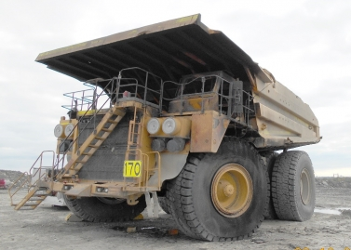
Coal Fatal #7 – Indiana
Notes:
Root Cause:
The mine operator and Cintas did not ensure the fire suppression system on the haul truck was installed and maintained in accordance with manufacturer’s recommendations.
The likely cause of the fire was a steering hose rupture causing hydraulic fluid under high pressure to spray onto hot surfaces of the engine, resulting in a fast-growing fire. The fire suppression system was not properly installed and maintained so that it could mitigate the fire as the haul truck operator escaped. Additionally, the primary egress stairs and the alternate egress ladder were not properly installed and maintained, impeding the ability to escape the fire.

Slide 41
Coal Fatal #7 – Best Practices
Examine all haulage equipment and repair safety defects before placing equipment into service. Follow the original manufacturer’s maintenance recommendations.
Check for accumulations of combustible materials, cracked or blistered hoses, and uninsulated wires.
Notes:
Regulations Cited: 77.404(a) and 77.1606(a)

Slide 42
Coal Fatal #7 – Best Practices
Ensure fire suppression systems are properly maintained and protected from damage. Install automatic fire suppression systems and train miners on their use.
Establish and keep current an Escape and Evacuation Plan for exiting equipment in the event of a fire (§ 77.1101). Train employees on contents of this plan.
Notes:
Other Best Practices:
Be alert to changes in the way the equipment sounds or to a visible plume of exhaust coming from the exhaust system.
Conduct risk assessments on all equipment to determine safe exit locations for required escape and evacuation plans.
Install well designed stairs or ladders to the equipment at both ends for an alternate escape.

Slide 43
Coal Fatal #8 – West Virginia
Wednesday, October 17, 2018
SUR – Machinery
Auger Helper
33 Years Old
3 Days Surface Mining Experience and Performing the Task

Slide 44
Coal Fatal #8 – West Virginia
While attempting to move a section of the auger steel, he was struck in the chest.
Notes:
The victim received fatal injuries during auger mining activities. The victim was attempting to move a section of auger steel by using the onboard crane when he was struck in the chest.

Slide 45
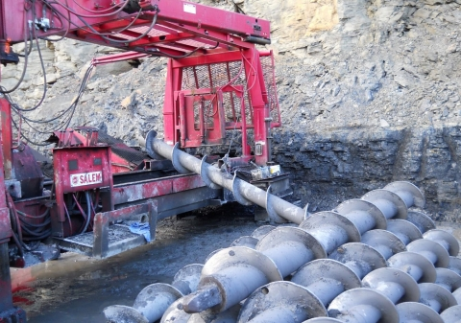
Coal Fatal #8 – West Virginia

Slide 46
Coal Fatal #8 – Best Practices
Do not place yourself in a position that exposes you to hazards. Stand clear of suspended loads having the potential of becoming off-balanced while being moved.
Monitor personnel routinely to ensure safe work procedures are being followed. Unauthorized persons should be kept clear of the work area.

Slide 47
Coal Fatal #8 – Best Practices
Establish, enforce, and discuss policies and procedures for auger mining, including safe work procedures for removing auger steel from the auger tray.
Task train miners to recognize all potential hazards and understand safe job procedures before beginning work.
Notes:
Other Best Practices:
Maintain equipment in safe operating condition. Excessive pressure in a hydraulic circuit can drastically alter the control of booms, etc., creating serious hazards.

Slide 48
Coal Fatal #9 – Alabama
Tuesday, December 11, 2018
SUR – Fall of Highwall
Front-End Loader Operator
38 Years Old
14 Years Experience

Slide 49
Coal Fatal #9 – Alabama
The victim was moving shot rock near the foot of the highwall.
A large portion of the highwall collapsed onto the front-end loader he was operating.
It crushed the cab and killed the front-end loader operator.
Notes:
The victim was operating a front-end loader to move shot rock near the toe of a 63-foot-high highwall. A large portion of the highwall collapsed onto the front-end loader, crushing the operator cab and fatally injuring the miner.

Slide 50
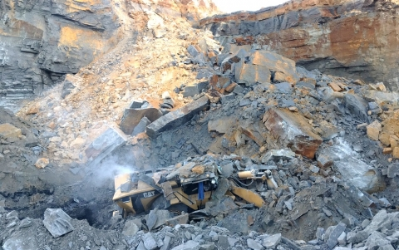
Coal Fatal #9 – Alabama

Slide 51
Coal Fatal #9 – Best Practices
Operate mobile equipment perpendicular to the highwall or with the operator’s cab positioned away from the highwall.
Ensure that miners work, travel, and operate mining equipment at safe distances from the highwall.
Train all miners to recognize hazardous highwall conditions.

Slide 52
Coal Fatal #9 – Best Practices
Safely examine highwalls from as many perspectives as possible (bottom, sides, and top/crest). Look for signs of cracking and other geologic features that could lead to instability, and secure or remove hazardous conditions.
Conduct additional examinations as ground conditions warrant, especially during periods of changing weather conditions.
Notes:
Other Best Practices:
Follow the approved ground control plan at all times to ensure the safe control of highwalls.
Use mining methods that ensure highwall stability and safe working conditions and do not excavate the base of the highwall.
Use proper blasting techniques for forming highwalls and thoroughly examine the highwall after each blasting operation.

Slide 53
Coal Fatal #10 – Pennsylvania
Tuesday, December 20, 2018
UG – Powered Haulage
Mobile Bridge Operator
35 Years Old
5 Years Experience

Slide 54
Coal Fatal #10 – Pennsylvania
The continuous haulage system was preparing to mine in the face.
The victim was crushed between the mobile bridge conveyor and the rib.
Notes:
The victim was crushed between a mobile bridge conveyor and the coal rib resulting in a fatal accident. The accident occurred in the No. 3 Entry of the 5 Right, D Room Section (MMU-002), as the continuous haulage system was preparing to mine in the face of the No. 5 Entry.

Slide 55
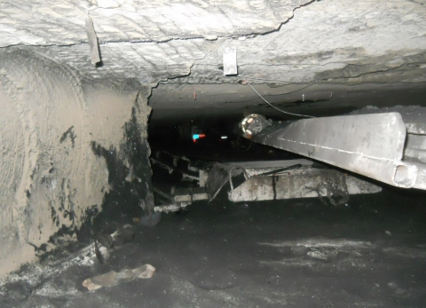
Coal Fatal #10 – Pennsylvania

Slide 56
Coal Fatal #10 – Best Practices
Do not position yourself in pinch-point areas while remotely operating equipment.
Ensure that equipment operators remain in the confines of the equipment cab, if equipped, while the machine is running.
Be familiar with the de-energizing switches on your machine and remote-control unit. “Panic-out” at the first sign of a hazardous situation.
Notes:
Other Best Practices:
•Maintain communications between equipment operators of a continuous haulage system prior to starting or tramming any component of the system.
•Institute and maintain a high level of equipment-specific training for all operators, which includes proper operator positioning during machine operation and also protocols for certain scenarios.
•Always perform thorough pre-operational examinations on mobile equipment to identify any defects that may affect the safe operation of equipment before it is placed into service.

Slide 57
Coal Fatal #11 – Washington
Saturday, December 29, 2018
SUR – Machinery
Contractor: Plant Operator
25 Years Old
21 Weeks Experience

Slide 58
Coal Fatal #11 – Washington
The victim drowned when the dredge he was operating sank.
Notes:
The victim drowned when the dredge he was operating sank.

Slide 59
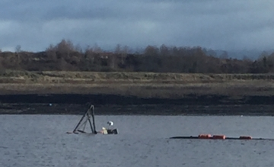
Coal Fatal #11 – Washington
Notes:
As of 1/24/19, the Final Fatal Report was not available.

Slide 60
Coal Fatal #11 – Best Practices
Examine work areas and equipment during the shift for hazards that may be created as a result of the work being performed.
Conduct a risk analysis before starting non-routine tasks to ensure that all hazards are evaluated and eliminated.
Task train persons to recognize potential hazardous conditions and eliminate the hazards before beginning work.
Notes:
Other Best Practices:
Establish procedures requiring persons to alert coworkers when they are in danger.

Slide 61
Coal Fatal #12 – Pennsylvania
Saturday, November 29, 2018
SUR – Machinery
Mechanic
50 Years Old
28 Years Experience

Slide 62
Coal Fatal #12 – Pennsylvania
The victim received a head injury while examining a valve body in the compartment of a company service truck.
While the mechanic was looking at a hydraulic valve for the crane on the back of the truck, a hydraulic fitting blew a piece of 1/8 inch steel or copper line from the valve body penetrating the mechanic's head.
Notes:
The victim received a head injury while examining a valve body in the compartment of a company service truck. While the mechanic was looking at a hydraulic valve for the crane on the back of the truck, a hydraulic fitting blew a piece of 1/8 inch steel or copper line from the valve body penetrating the mechanic's head. The victim died from his injuries on December 30, 2018.

Slide 63
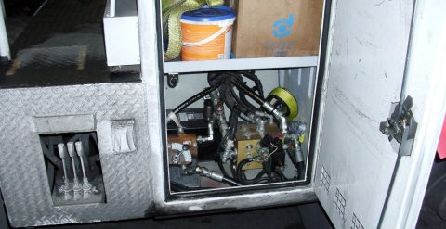
Coal Fatal #12 – Pennsylvania
Notes:
As of 1/24/19, the Final Fatal Report was not available.

Slide 64
Coal Fatal #12 – Best Practices
Remove pressure from the hydraulic system before beginning modifications or repairs.
Position yourself in a safe location, away from any potential sources of failure, while troubleshooting or testing pressurized systems.
When possible, examine and inspect hydraulic components while they are de-pressurized.
Notes:
Other Best Practices:
Train miners to recognize hazards in pressurized systems before troubleshooting or performing work on such systems.
Consult and follow the manufacturer’s recommended safe work procedures.
Make modifications or repairs with proper components and parts that are adequately rated and specifically designed for such purposes.

Slide 65
Summary
Examine each working place for conditions that may affect the safety or health of miners.
Examine the working place at least once each shift and before miners begin work in that area.
If you see a hazardous condition, fix it or report it so it can be fixed.
Do not position yourself in a hazardous position.
Follow and enforce all safety rules and procedures.

Slide 66
SLAM the Risks
Stop – Take a few minutes to think about the task you are about to perform.
Look – Identify hazards that will be encountered while performing the task.
Analyze – Determine what safety procedures are needed; where is the safe place to stand.
Manage – Take action to protect yourself and others from the hazards.

Slide 67
Thank You

