Slide 1
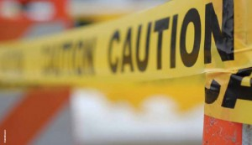
Accident Investigation

Slide 2
Presentation Objectives
• Teach employees the meaning and impact of accidents.
• Teach employees how to identify different types of causes of and accident.
• Ensure that employees know the purpose of an accident investigation.
• Teach employees how to conduct an accident investigation.
• Teach employees how to document accident investigations.

Slide 3
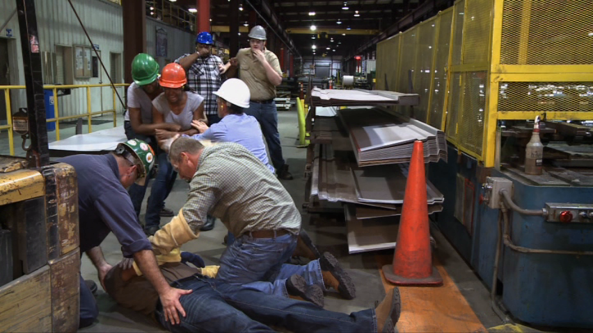
What is an Accident?
An accident is an unplanned event that resulted in a mishap such as personal injury or property/equipment damage.
They are often the result of the failure of people, equipment, materials, or environment to react as typically expected.
Accidents always have unintended consequences, it often depends on the degree of severity of the consequence.

Slide 4
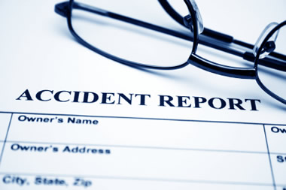
Purpose of Accident Investigation
• To identify the sequences of events leading to the accident.
• To identify the actual cause of the accident.
• To find methods that will prevent the accident from occurring again.

Slide 5
Consequences of Accidents
Direct Consequences
Personal injuries
Loss of property.
Indirect Consequences
Lost income.
Medical expenses.
Retraining another person.
Decreased employee morale.

Slide 6
Types of Causes
Basic Causes:
Poor Management Safety Policy & Decisions
Personal Factors/Environmental Factors
Unsafe Act
Performance
Indirect Causes
Conditions
ACCIDENT
Personal Injury
Property Damage
Unplanned release of energy
(Direct Cause)

Slide 7
Examples of Accident Causes
Direct Causes | Indirect Causes | Basic Causes
Struck by/against | Failure to secure | No oversight
Falls | Guarding | Poor maintenance.
Caught in/between | Improper use | Training
Exertion | Unsafe position | Policies
Contact with…. | Environmental | Stress
Impact (vehicle) | Defect | Engineering

Slide 8
Be Prepared
The best way to be prepared, is to be pro-active and not reactive. This would entail developing a policy for the accident investigation:
Routinely check the policy to:
• Ensure personnel understand their role and are properly trained.
• The operating procedures are driving corrective actions
Assign preventative responsibilities to employees:
• Employees must be trained on how to conduct an accident investigation
• Investigator should be competent, and know the process.

Slide 9
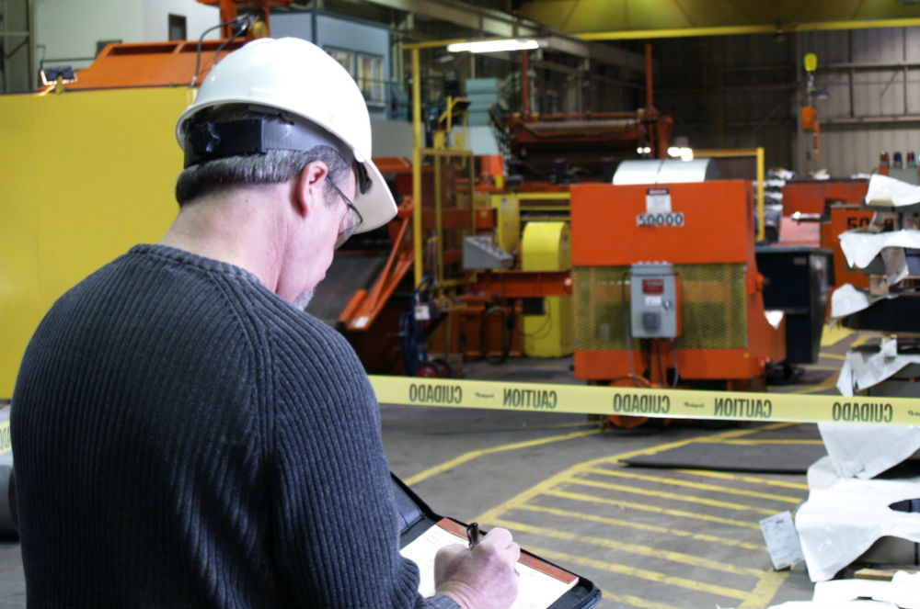
Conducting the Investigation
• It’s imperative to interview the witnesses immediately.
• Document the scene of the accident before any changes are made.
• Review all information such as procedures, equipment manuals, etc.

Slide 10
Conducting the Investigation (ctd.)
Document observations such as:
• Pre-accident conditions of the scene.
• The sequence of events in the accident.
• Condition of the scene after the accident.
Document the facts of the case (i.e.: location, witness remarks, and contributing factors).
Determine specific items related to the sequence of events leading up to the accident.

Slide 11
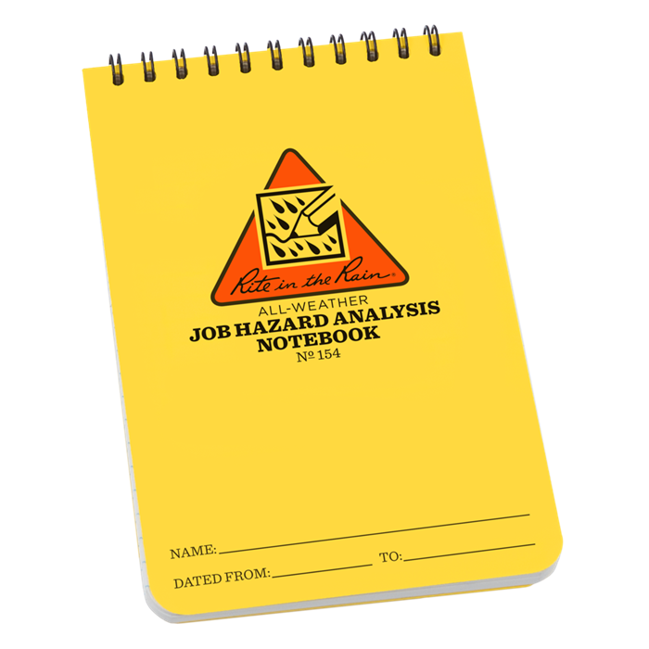
Problem Solving Methods
• “Job Hazard Analysis”
• “Sequence Diagrams”
• “Change Analysis”

Slide 12
Job Hazard Analysis
Steps | Hazards | Causes | Control Measures

Slide 13
“Change Analysis”
The “Change Analysis” includes:
• The definition of the problem.
• Incurring the normal operating procedures.
• Identifying, locating, and describing the change that should take place for preventative measures.
• Identify the causes and effect of the accident.
• Address changes that will be taking place for future prevention.
• Highlight the likely causes of the accident.

Slide 14
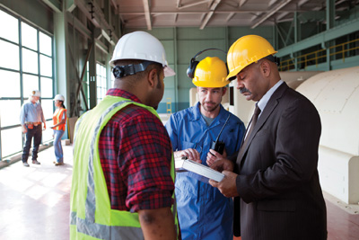
Witness Interviews
• Interview the witnesses promptly so that information is fresh in their minds from the accident.
• Establish good rapport with the witnesses, and be sure to treat them equally without assigning blame.
• Collect as many facts as you can.
• Always record the witness’s statement to refer to later if necessary.

Slide 15
Accident Investigation Recordkeeping
When completing your Accident Investigation form, you should collect:
• Information from personnel involved
• Information about the accident itself such as location, events leading to accident, or machines involved.
• The different types of causes of the accident.
• A thorough recommendation to prevent future accidents or incidents.
• Any necessary follow-up information to prevent future hazards.

Slide 16
Accident Investigation Recordkeeping (ctd.)
Using the accident investigation form, and data collected from witness statements, you can begin to write your accident investigation report.
Included in the report should be:
• Basic background information (where it occurred, who was involved.)
• Summary of the accident (sequence, extent, type, source.)
• An analysis of the investigation (including the different types of causes)
• Recommendations on how to prevent future accidents.

Slide 17
Steps Involved in Accident Investigation
Examine the scene of the accident.
Isolate and secure the scene by initiating interim controls.
Immediately seek help for the victim if necessary.
Gather evidence from the accident scene.
Analyze the data retrieved from the scene.
Determine the causes using the scientific method.
Record and store the documentation, and follow up to ensure the hazards were eliminated.

