Slide 1
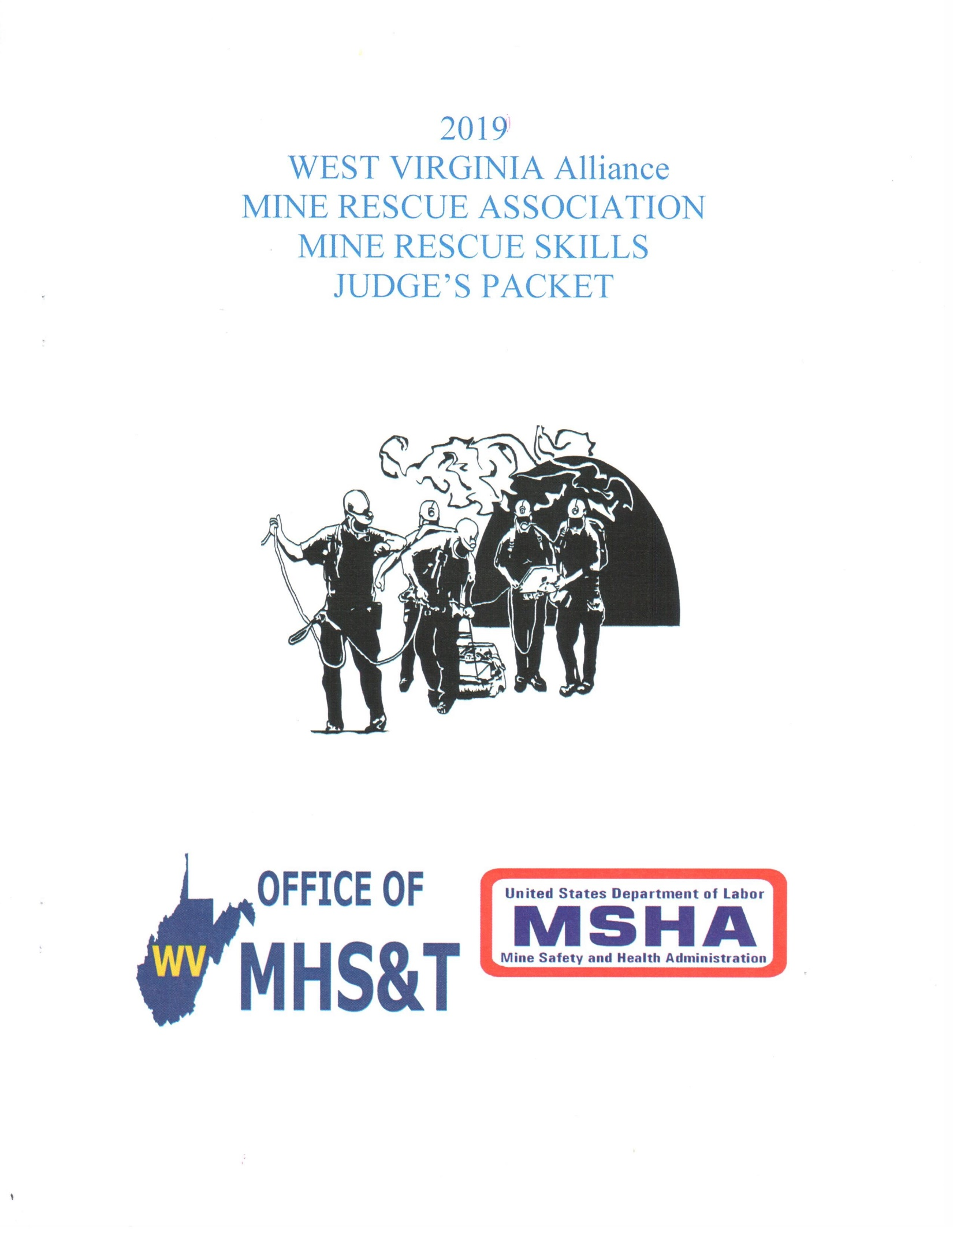

Slide 2
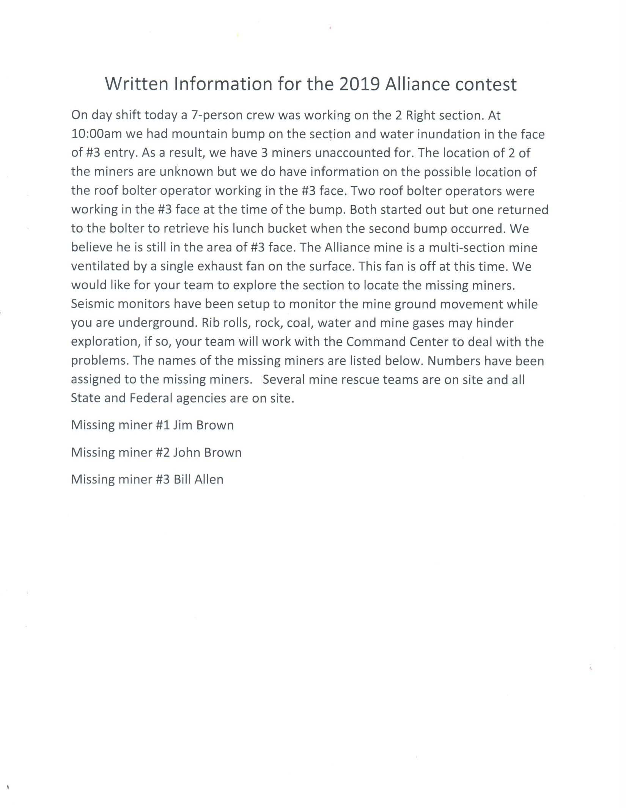

Slide 5
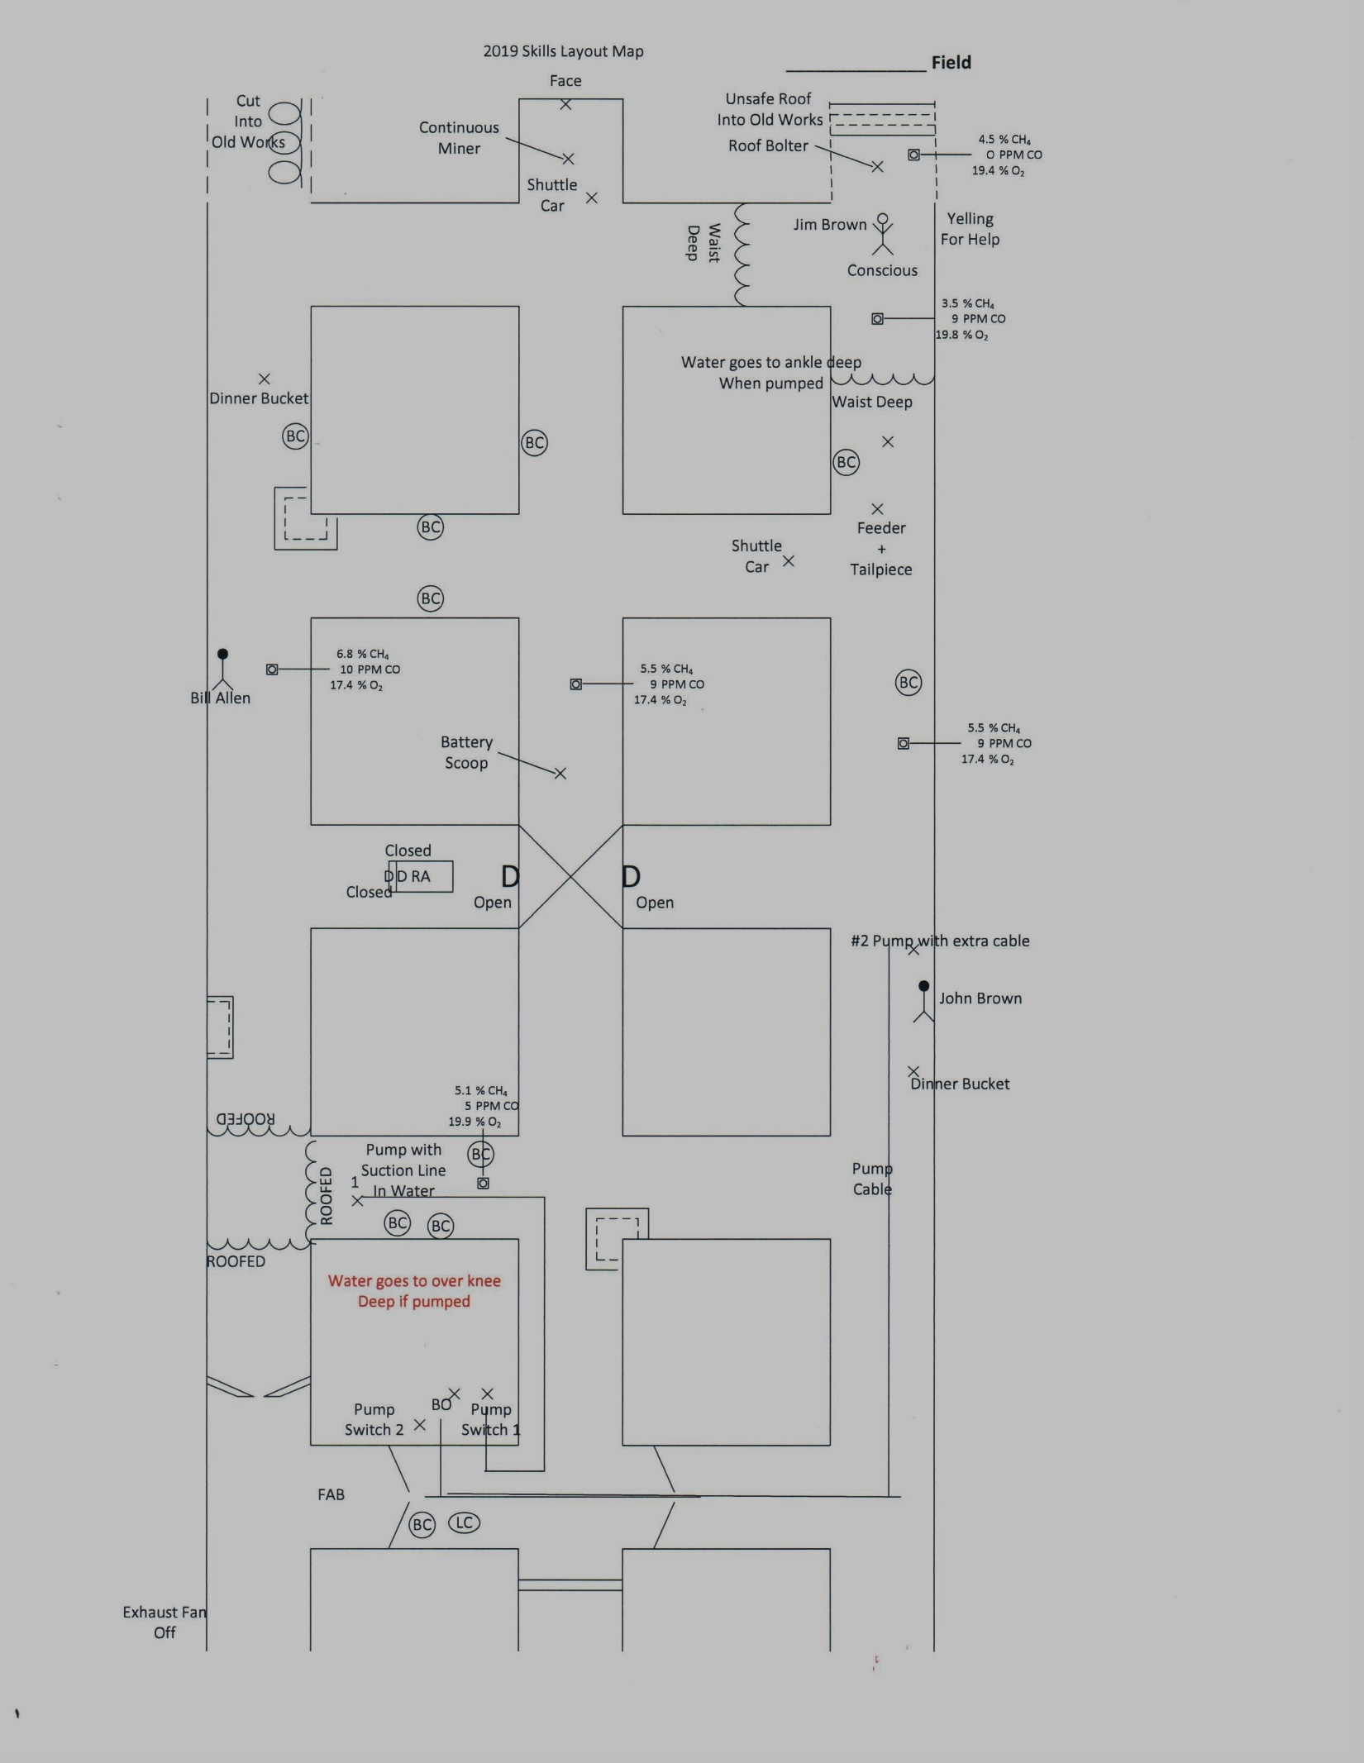

Slide 6
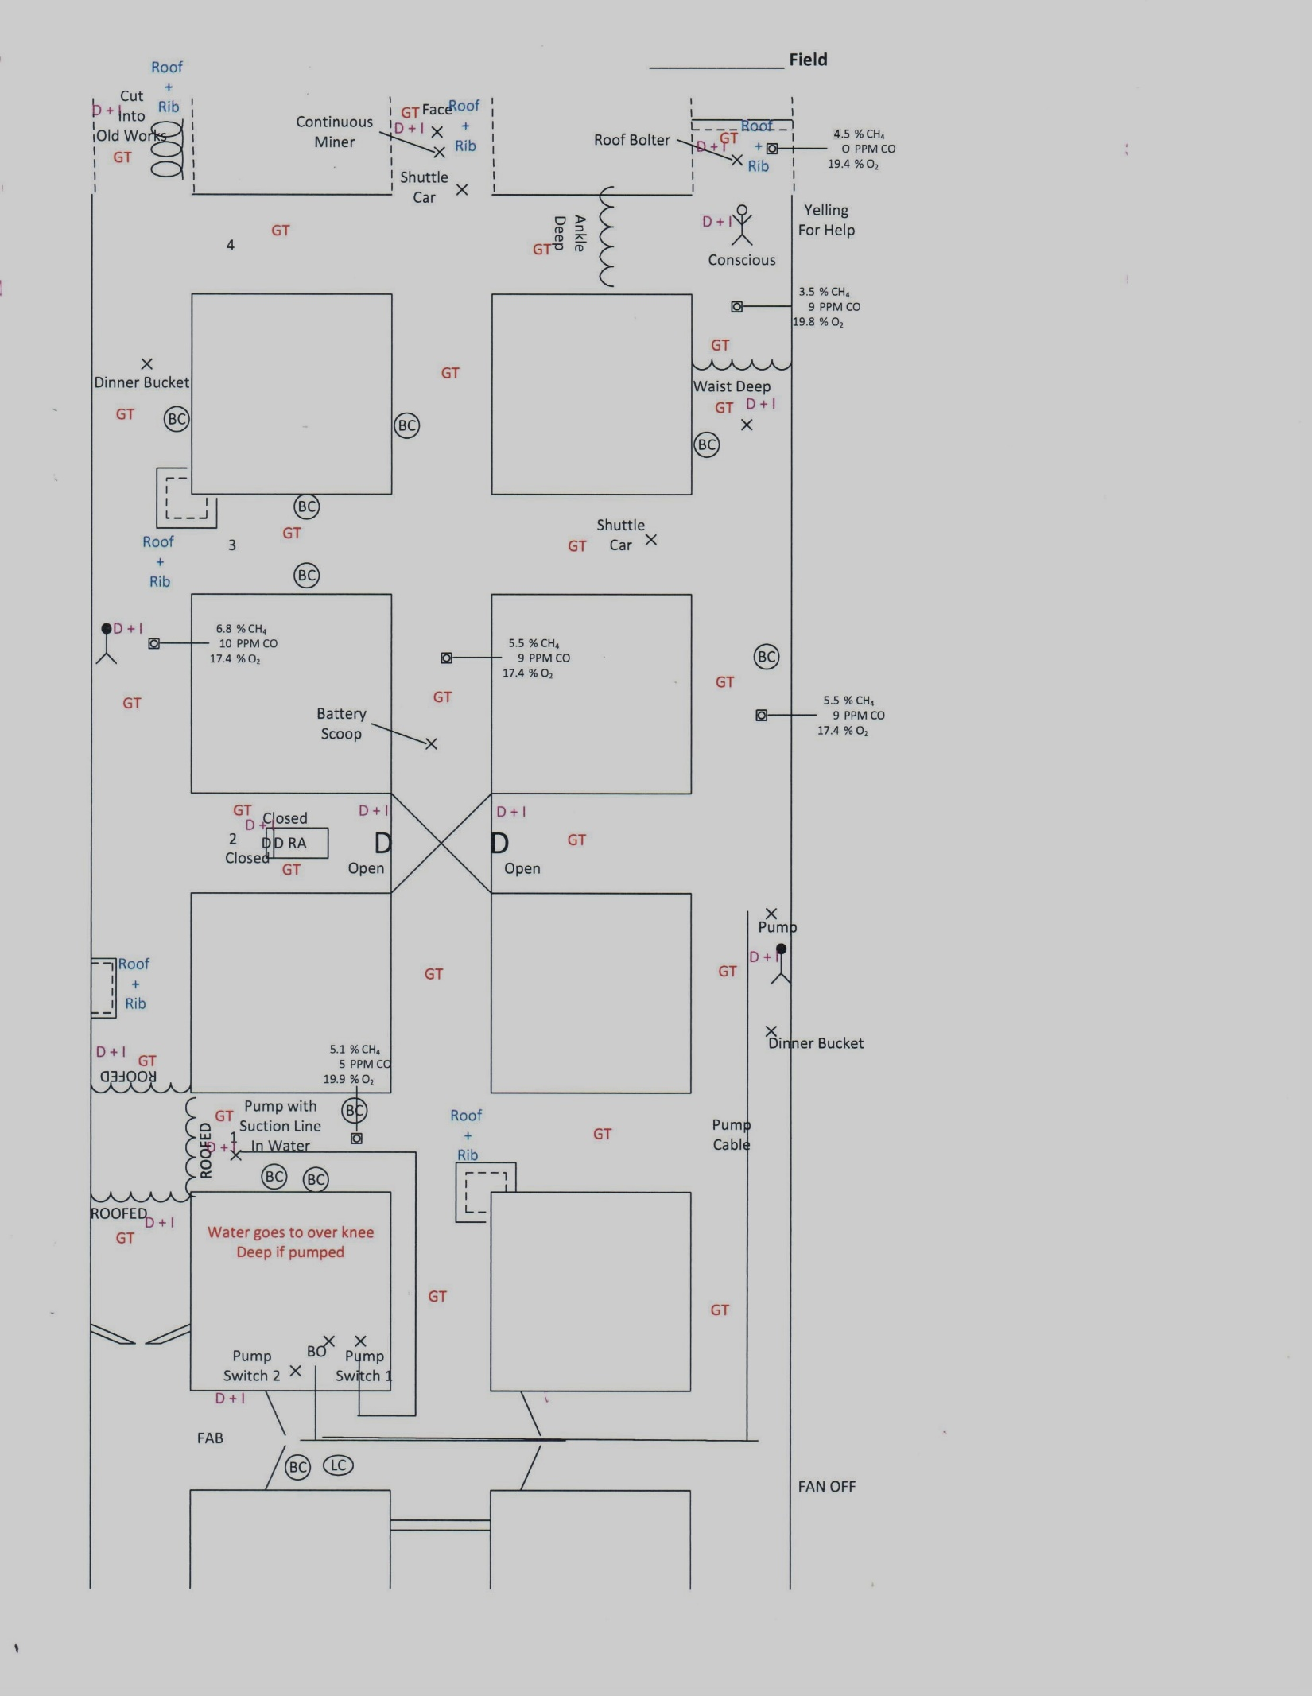

Slide 7
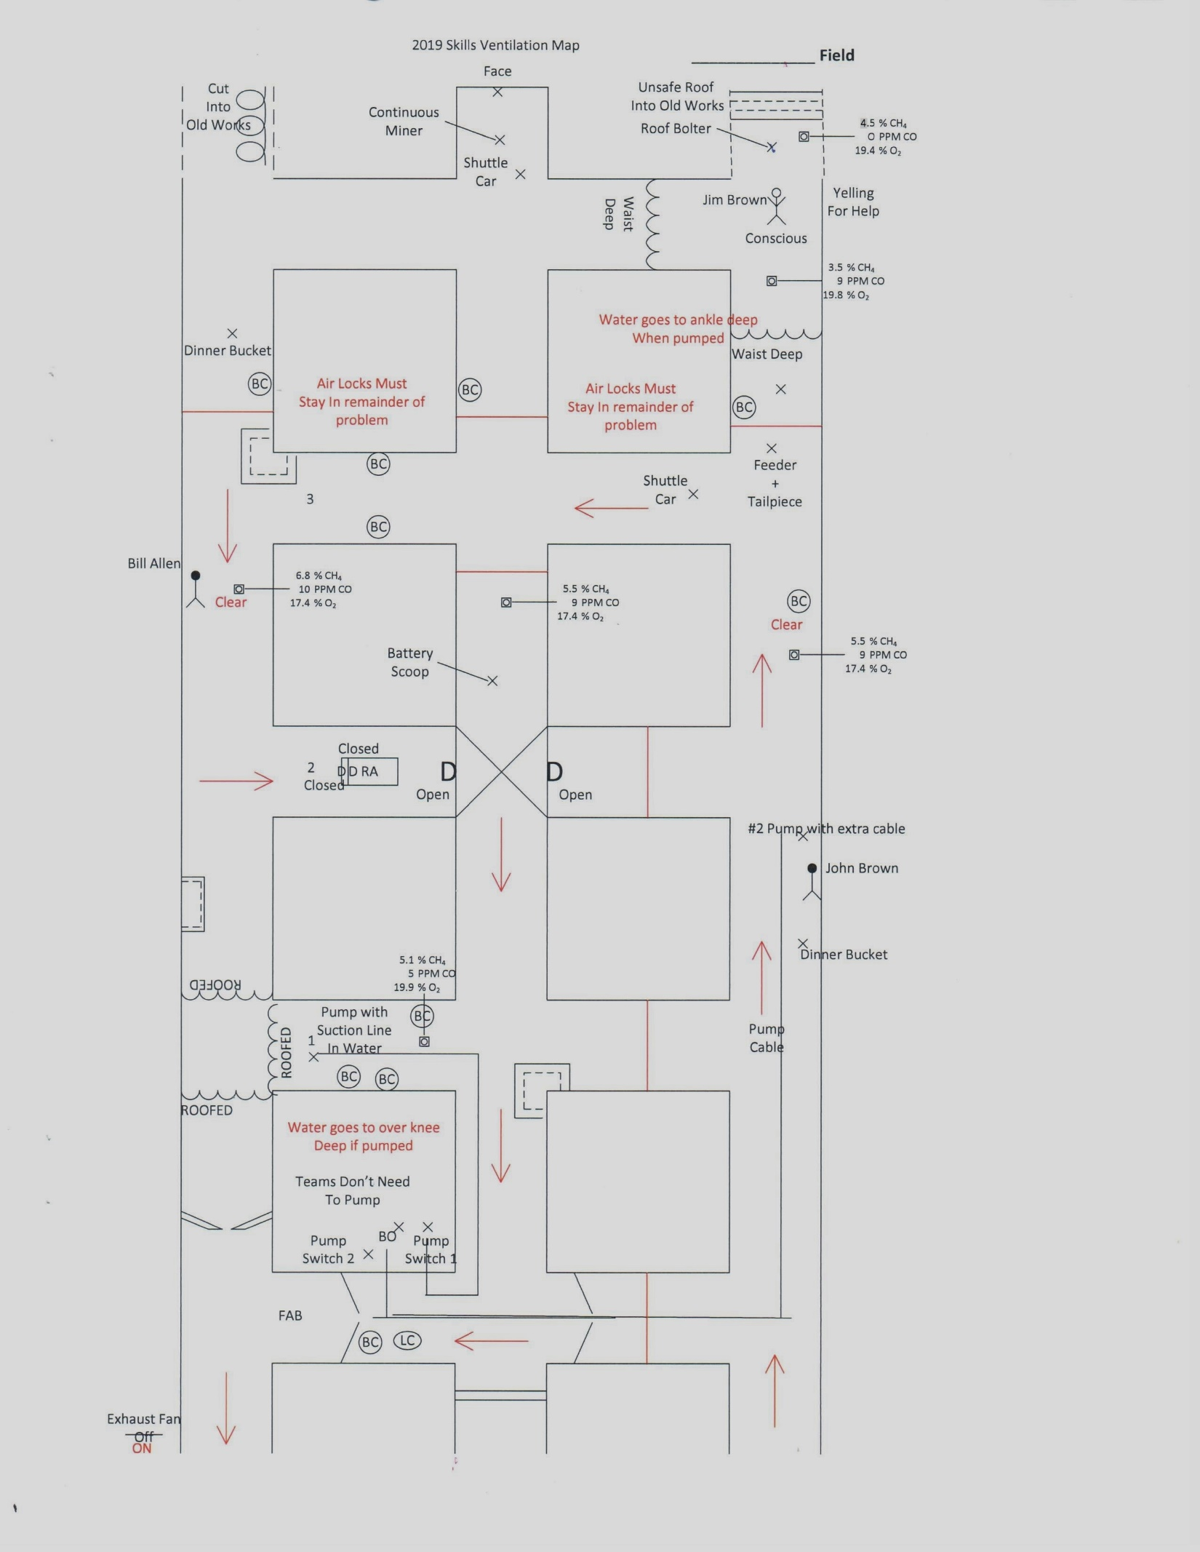

Slide 8
Keys to Problem
Team must follow 2019 Mine Rescue Skills Rules
Exploration is 2+2+1 method
Patient will yell to team from behind waist deep water “Help get me out!”
Discount for delay if any team member goes into last open crosscut before rescuing patient (See vent map)
Average time for this problem was around 45 min……
This problem was meant to be very simple for teams and judges while learning the new procedures for mine rescue skills exploration/judging

