Slide 1
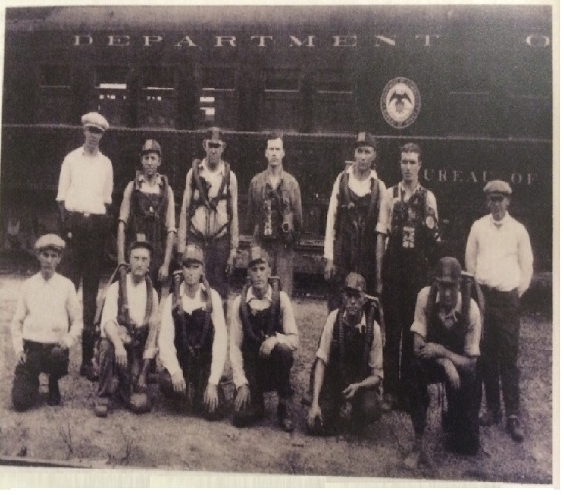
39th Annual
2015 Day 1 Judges Book

Slide 2
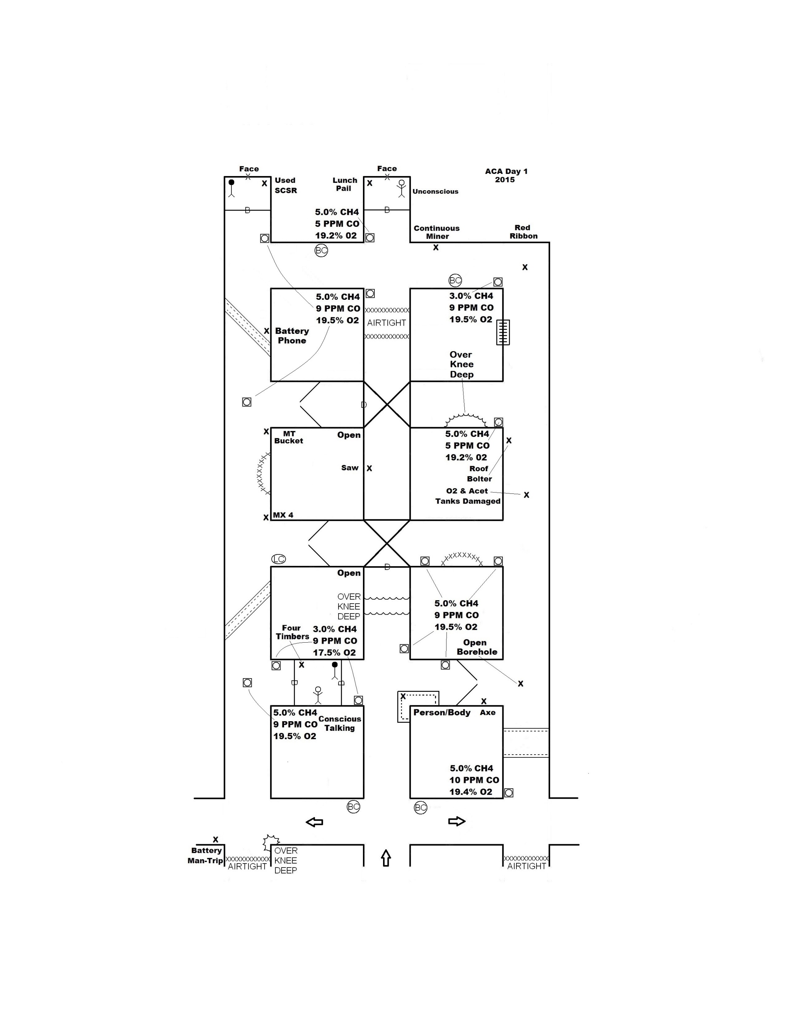

Slide 3
2015 ACA
DAY 1 PROBLEM
GENTLEMEN, WE THANK YOU FOR ANSWERING OUR CALL FOR HELP…….
Five people were working on ventilation controls on the no.1 unit early this morning when the main power knocked outside. The outside dispatcher called underground and could not get anyone by phone or radio. The tracking system shows all five miners were still on the section when the power went off. The RP went underground and found unsafe roof, methane and low O2 at the mouth of the unit and decided not to go any further inby. A fresh air base was established just outby those conditions. We have had major problems with methane over the last few weeks and fear that methane may have built up on the unit while these men were working. Airflow at the fresh air base is coming up the number 2 entry and splitting and going toward the number 1 and number 3 entries.
All authorities have been notified and are here on site. A backup team is present and ready. Your team will be exploring the final area to be explored in search of our missing miners. The mining maps are up to date and will be given to you when you start the clock.
Please be careful during your exploration ………

Slide 5
WRITTEN INSTRUCTIONS
2015 ACA Day 1
ACCOUNT FOR ALL FIVE MISSING MINERS
BRING ALL SURVIVORS TO THE FRESH AIR BASE
THE EXHAUST FAN CANNOT BE STOPPED, STALLED OR REVERSED
BACKUP TEAM CAN ERECT OR TEAR DOWN STOPPINGS THAT HAVE BEEN STARTED OR BUILT BY YOUR TEAM IN THE FRESH AIR BASE ONLY BY ASKING THE SUPERINTENDENT
YOUR TEAM WILL HAVE 90 MIN. TO COMPLETE THE PROBLEM

Slide 7
Conscious Miner Statement
Statement behind both barricades between 1 and 2 entry in first crosscut inby FAB
Help! I have a airtight barricade behind me !

Slide 13
Problem Keys
Move battery phone before first vent to no.3 entry first crosscut inby unsafe roof. (see first vent map) must be careful not to get phone in any explosive mixture
Must not move any irrespirable atmosphere over person in unsafe roof in no. 2 entry (see vent 1 map)
Must breach barricade inby last open in no. 1 entry to have enough brattice cloth to do vent 1 correctly
Must not move irrespirable atmosphere over the water over knee deep in the FAB when winging the barricade in the first crosscut between 1 & 2 entry (see vent 2 map)
Must timber to person in unsafe roof after bringing out patient behind barricade between 1&2 entry (see vent 2 map)
Must not send explosive mixture over battery man-trip in no.1 entry FAB during any vent

