Slide 1
2013 Central Mine Rescue Spectator Information
Idaho Mine Rescue Contest
May 17 and 18, 2013
Kellogg, Idaho

Slide 2
Ladies and gentlemen,
Thank you for coming to the 2013 Central Mine Rescue Contest. The men and women that you will see on the field today dedicate a great deal of time and effort to practicing the skills that they may one day need during an emergency. This time and effort often manifests itself as sacrifices that are apparent to spouses, friends and family. With that in mind, we thank not only you for coming to cheer them on, but the families of the team members. We couldn’t do this without their love and support.
The packet that you have in your hand contains the information normally asked for when a team arrives at a mine site, a brief story of what has transpired and the solution to the problem. I’ve been to more than a few contests and know that what is on paper isn’t always what they do on the field. Please keep an open mind and enjoy the show.

Slide 3
Scenario
The Wildman Mine is a rehabilitation project. The mine was recently acquired by the UMSUTBKIDDINGME Mining Company about a month ago. The crew has been trying to replace the nearly 30 year old timber, particularly in the ventilation raise/secondary escapeway. To help pay the bills, the shifter and nipper have been taking a drift round once or twice a week in the back of the mine.
The ventilation raise is downcast and air exhausts out the portal through the main fan. For some reason we have trouble moving air without using the main fan. There is a rumor of another old borehole, but I haven’t been in the mine yet, so I don’t know.
A little while ago the nipper and shifter came tearing out of the portal wearing their rescuers. Once they caught their breath they told me that smoke was building in the mine from over where the other two were working near the raise. They hollered for Burnt and Reynolds, but didn’t get an answer so they left. The two that made it out are being treated for burns to their mouths.
We’re getting worried. It’s been an hour. The smoke was so bad we shut off the fan, we know there’s a fire. Please explore the mine, seal or extinguish the fire, rescue my guys and ventilate the mine. You have 90 minutes to do all this. Are you ready?
Good Luck!

Slide 4
Mine Information
Wildman Mine, MSHA ID 10-00000
Operated by: UMUSTBKIDDINGME Mining Co.
Nearest town: Lostin, Idaho
Average Employment: 8
Works 2, 10 hour shifts per day, 5 days per week. 07:00 to 15:00, 15:00 to 23:00.
4 man crews (2 miners, 1 nipper, 1 shifter)
Main fan exhausts out portal, axial vane, fixed but reversible (it will take hours)
All authorities have been notified
Back-up team on site, two more teams 10 minutes out.
You are the first team to enter.
Fan controls locked & guarded, fan is off. Power is on and guarded.
Ventilation raise guarded.
Two miners unaccounted for.
One shop, oxygen storage (just moved it in). We hope the miners are in there.
Smoke coming out of portal, carbon monoxide present, low oxygen.
Explosives magazines outside of the mine.
Map was last updated in 1985.

Slide 5
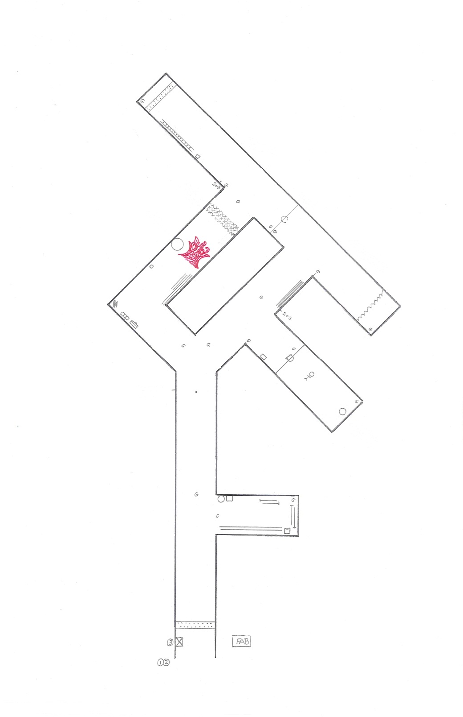
As with any mine rescue problem, there’s always a dozen ways to solve the problem. What you see to the left is the overlay diagram of the problem.
Follow the colored lines as we go through the problem as we expect the team(s) to work it.
In this scenario, the team briefing will call for the team to explore the mine, extinguish or control any fires, find and rescue any survivors and reestablish ventilation.
The team will go to the portal, check for gasses, and in this problem will find low oxygen (O2), high carbon monoxide (CO) and smoke coming out of the portal.
As they enter the team must call out as entering into smoke.
On the left they will find a placard showing the location of the Main Fan, it is off.
The next placard will show that there is loose roof. They must bar down or call out about the loose before proceeding.
At the first intersection the team must perform gas tests to the right and ahead before they proceed.
Since this is the first intersection, most teams will explore the drift to the right. Inside the drift the team will find building materials, some pipe and explosives (caps and stick powder). Some teams may decide to take the explosives out of the mine. If they do not at least separate them it is a discount once they pass it for team endangerment.

Slide 6
The team will retreat back into the intersection and travel further into the mine. The team should perform their 50 foot team check by the time they reach the Y intersection. The small dot shown on your map is as far as they should go before they perform it.
The team will have to make a decision as to which way they chose to travel.
If the team choses to take a left, they will find that they are still in smoke in low O2 and high CO.
Along the left rib they will find a toolbox, boxes of nails and a FEMCO radio.
On the right rib as they travel further inby they will find timber and lagging. On the left rib they will find a box of caps. By this time they should have seen the placard indicating INTENSE HEAT. The team must move the caps out of the area where they will build a temporary stopping with a regulator. If the team leaves it inside 10 minutes after they erect the stopping you should tell them the caps detonated and damaged the stopping(s).
If the team does not indicate that they have a regulator in the temporary stopping you must assume that they have made a ventilation change and assess the appropriate discounts.
Since the timber is in the way it will be easier to build the stopping outby the toolbox. If they chose to build it closer it will take awhile to move the timber. Let the team know it will take 2 minutes to move the timber. If they wish to continue to move it, give them 2 minutes, then flip the placard over.

Slide 7
The other option the team has is to bear right as they travel inby.
The team will need to perform a gas test at the entry to the right and ahead of them.
As they travel into the drift they will find a brattice along the right rib.
They will find a closed door inby. They will test for gas and knock on the door. The #1 judge will answer with the information contained in handout #1.
By rule the teams will retreat from the intersection and travel up the left side of the Y to tie in. The information for travel in this direction is on the preceding page.

Slide 8
Traveling further into the mine, the only available path of travel is on the right side of the Y.
Along the right rib the team will find some heavy posts.
Gas tests will be performed across both sides of the entry.
The team can travel either left or right, If they opt to go to the right, the captain will encounter water about 4 feet from and extending to the face. The water is 10 inches deep and passable.
A gas test will be made at the face.
The team will turn around and move further into the mine.
The captain will check the check curtain and a gas test will be performed.
As the captain goes through the curtain he/she must check conditions, to include testing for gas.
At the next intersection gas tests must be made.
Since the team is looking for a fire, they must turn left.
4 feet into the drift to the left the team will encounter an impassable roof fall. The back is not scalable and any effort to support is ineffective. There will be a placard indicating INTENSE HEAT and another showing a fire out of control (on the other side, but visible).
The team must build a stopping with a regulator (unless they call in for a ventilation change).

Slide 9
The team will have to think about where to build the regulated stopping. Where they do it is up to them. There is room to put the stopping across the entry (Green line).
Placing the stopping here allows the team to continue exploration. Some teams may decide to convert the curtain to a stopping. They can do this, but once they’ve done it they cannot explore the rest of the mine.
If the team has placed the stopping in the right location they will finish exploring the back of the mine.
Along the right rib they will find a lunchbox with the name of a miner (Reynolds Rapp) and a 12 foot long ladder.
Closer to the face they will encounter loose roof that will need to be barred.
At the face a gas test will need to be made.
He team will find a placard showing a loosely capped 24 inch borehole to surface.
By this time the team has explored the mine with the exception of the fire area and behind the door.
Most teams will work to move the smoke and gasses.

Slide 10
Clearing the air <
Before changing ventilation the team must call in to the Mine Manager and receive permission to make the change. This can be done anytime during the problem.
To clear things up, the team will need to convert their regulated stoppings to seals by closing the regulators.
The team must go to the loosely capped borehole and open it.
The main fan must be started. Once the fan is turned on and check curtain opened air can move freely through the mine. Placards along the air course must be flipped to “Clear Air”. Do Not Flip the Placard in front of the door.
To clear the air in front of the door, the team must use the brattice (conveniently located near the door) as a wing to course the air in and sweep the gas out.
Keep in mind, once the air begins to flow, the team must retest for gas everywhere that they travel.

Slide 11
Getting past the door:
There is a miner (Burnt Reynolds) in the room behind the door. Since the captain does not know what’s behind the door an airlock must be erected. Gasses at the door are sufficient to allow the team to build an airlock. Once the airlock is erected, the team may open the door and enter.
The captain must check conditions before/as he enters, including gas.
They will need to check out the miner.
Gas tests must be made at the face.
The team will find a placard showing a huge oxygen cylinder at the face.
If the team has not restored ventilation and cleared gas, they will need to bring the miner out under oxygen. We will simulate putting the mask on the miner.
The miner can be taken out of the mine once he/she is properly secured. When the miner is passed off to the authorities, the team captain will be told that the second missing miner (Reynolds Rapp) climbed up the ladder in the ventilation raise and is safely out of the mine.

